Slide 1
This work is licensed under the Creative Commons Attribution 4.0 International License. To view a copy of this license, visit http://creativecommons.org/licenses/by/4.0/ or send a letter to Creative Commons, PO Box 1866, Mountain View, CA 94042, USA.
Copyright (c) 2022 Cisco Systems, Inc. and its affiliates
All rights reserved.

Slide 2
Full Stack Wellness & Inclusion Series
Creating a team where everyone thrives
Diversity & Inclusion Counsel:
add names here
Notes:
Hi, and thank you very much for having us on the today’s agenda! So today, Joanna and I would like to talk about something that we have been working on as the continuation of the OKR from last quarter. As some of you remember OKR1.1. was all about diversity and inclusion. As some of you may also remember, during the final readout Jeff mentioned something very important - that our Diversity & Inclusion should not just be a time-oriented project. And we all agreed with it. Every member of this OKR team, felt this way. This is why we have decided not to stop with our work.
In our mind diversity and inclusion, should be a part of our fundamental culture. We do however, have some work, that needs to be done before it is our underlaying organisational value - the one that everyone truly believes in. All of this requires a change, and as we all know the first step to any change is building awareness. What Joanna and I are about to present to you today, is about building the awareness. This is what our OKR team - which we now also call our Diversity & Inclusion counsel now(it makes it more real), foucused on over the last couple of months.
After

Slide 3
Vision
Create a community at work where everyone feels heard and included, and where everyone can hear and include their colleagues.
89% of workers at companies that support well-being initiatives are more likely to recommend their company as a good place to work (Forbes, 2019)

Slide 4

Creating a team where everyone thrives
Bi-Weekly Stand Up:
Check-in Activity
February 3rd
Bi-Weekly Stand Up:
Check-in Activity
March 7th
Bi-Weekly Stand Up:
Check-in Activity
April 4th
Bi-Weekly Stand Up:
Check-in Activity
TBD
TBC…
Session 1:
Your Physical Layer: Healthy Body, Healthy Mind
Session 2:
Designing a Team Where Everyone Feels Safe
Session 3:
Developing a Team Where Everyone Belongs
Session 4:
Personal Code Reviews: Owning and Honoring our Achievements
Session 5:
CI/CD Pipeline for Your Best Self
Kick Off Session:
Full Stack Wellness & Inclusion
Today
January
25
February
22
March
22
May
18
June
TBD

Slide 5
It is OUR deal
AWARENESS
VS.
ACTION

Slide 6
What does Diversity & Inclusion mean to me?
[Insert survey QR code survey URL]
OR
[Survey URL]
‘It were not best that we should all think alike; it is the difference of opinion that makes horse races’

Slide 7

Let’s get Active!
“If you win the morning,
you win the day”

Slide 8
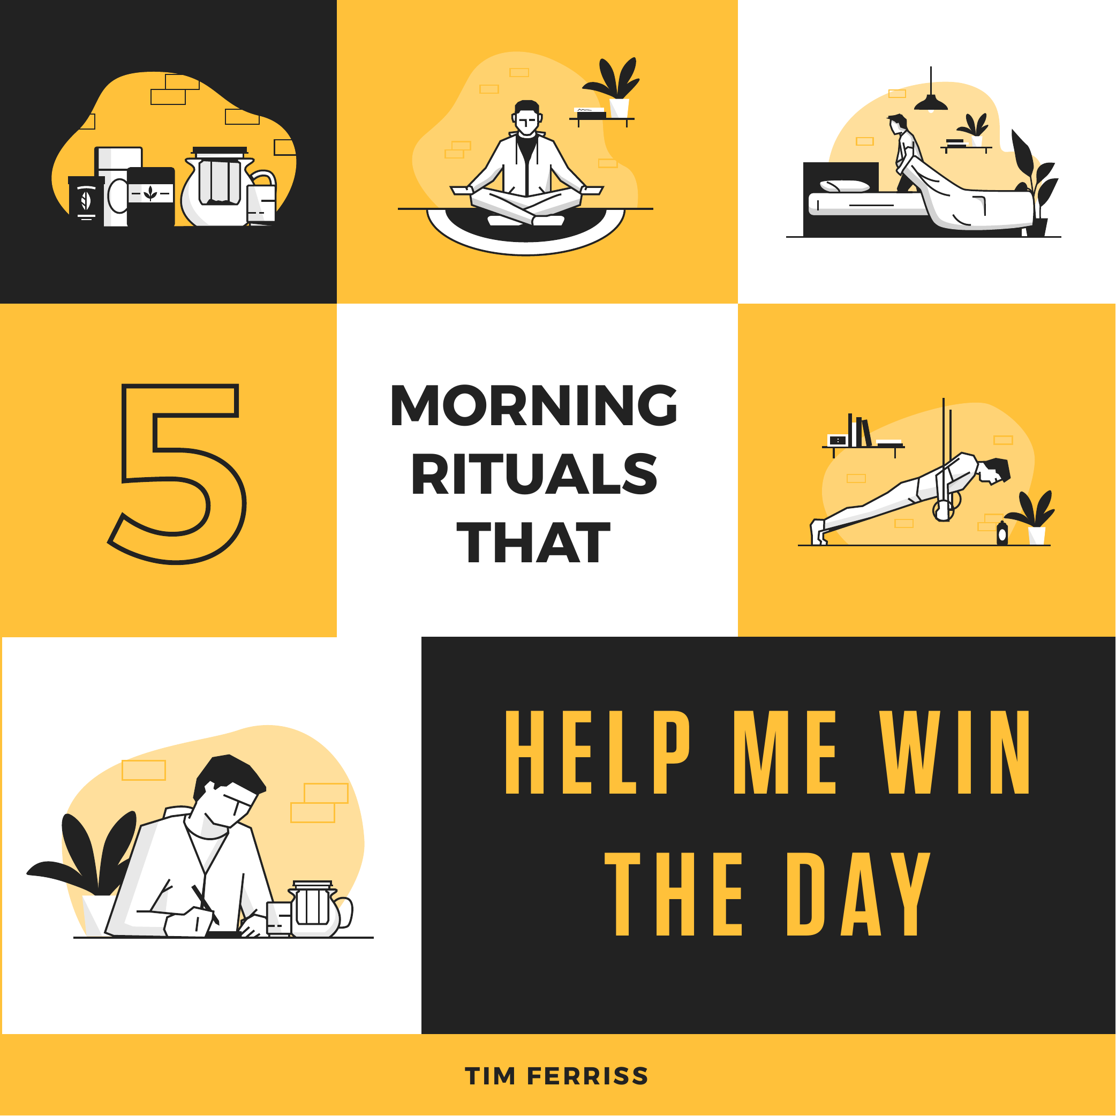

Slide 9
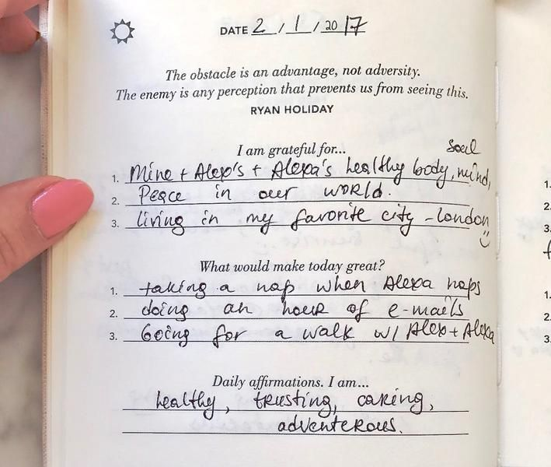
Start your Day with
I am Grateful for …
What would make today Great?
Daily Affirmations. I am …

Slide 10
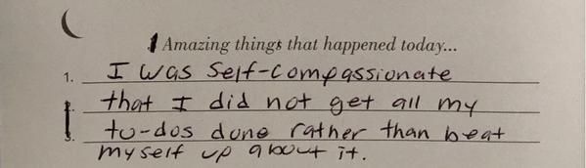
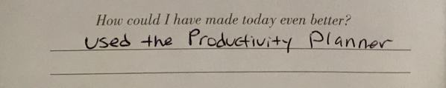
Wind your Day with
Amazing things that happened today
How could I have made today even Better?
Notes:
Review your entries, look for patterns and take actions

Slide 11



It’s been tough couple of years…
Small changes, can make a big difference
Your Physical Layer: Healthy Body, Healthy Mind
Turn 70-hour work week into 40-hour work week…
Let’s get together and have some fun
Self
Actualization Needs
If we are not having fun – what are we doing here?
Esteem Needs
Join us for our First Session – January 25th
Love/Belonging Needs
It will be a great excuse to decline the other three meetings you had booked at this time!
Safety Needs
Physiological Needs
Notes:
Shweta
Small changes can make a big difference: Importance of taking care of mental and physical health and how small change of habits can improve your day-to-day live
Let’s get together and have some fun: We Promise: better well-being, slowing down the pace, broadening horizons, more empathetic environment
If...
You commit to participation in our sessions!
Know – what is it
Feel – How do you want them to feel (excited, useful, energy to be lifted, how attending live will make it better)
Do - Join us VIRTUALLY but BE THERE

Slide 12

An hour for me
.
Notes:
Grace
https://www.ciphr.com/advice/taking-breaks/
How?
Take a walk
Leave your phone at home
Go and get the cup of coffee
Take a nap
There is no prep-work required for this, just leave your laptop and do it now

