Slide 1




[Insert Survey QR code]
OR
[Insert Survey URL code and Passcode]
What does a safe environment mean for you?
Notes:
Jeff Opening Slido Question: Re Safety.. Have you ever had an unsafe environment in you
- What does a safe environment means for you? -Opening Q- Word Cloud- Team to Posts
Welcome Back to the FullStack Wellness and Inclusion Series 2nd session, we're happy to have you here. I hope you all had a wonderful "Day for Me!" Before delve into our session, we'd like to hear from you on our opening question. I'll pass it over to you, Jeff

Slide 2
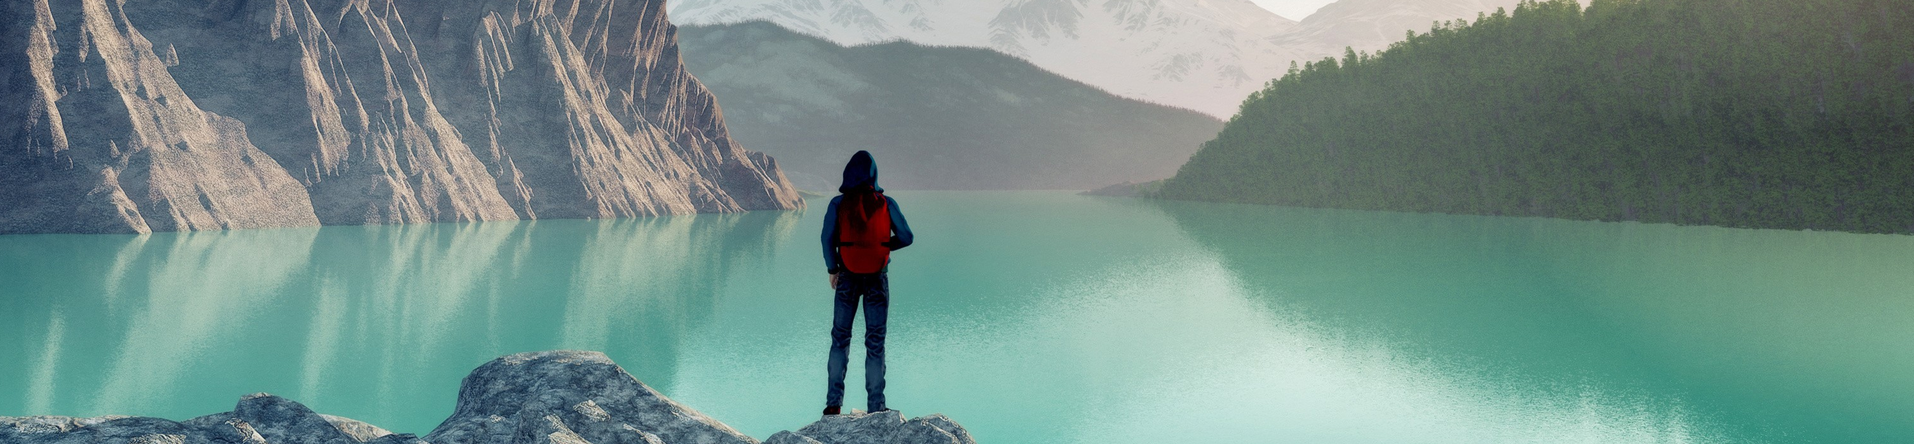
Session 2: Designing a Team Where Everyone Feels Safe
Full Stack Wellness & Inclusion Series
Notes:
Erin – Thank you. Our focus for today's topic will be on Designing a Team Where Everyone Feels Safe. Brene

Slide 3





Session 2: Safety
What (are we going to deliver)?
Designing a team where everyone feels safe
Discuss microaggressions and the impact they have on our work environment. We will also discuss creating safe environments and how they can help to make your teams and collaboration stronger
Why (is this session important)?
To highlight the consequences of an unsafe work environment and benefits of a safe environment where employees can thrive.
Self Actualization Needs
Esteem Needs
Love/Belonging Needs
Physiological Needs
Safety Needs
Story
A member shares a story about experiencing a microaggression (conscious and unconscious) and how they addressed it
Who (are we going to invite)?
<insert appropriate company within your organization>
Post-event Activity
Share stories of microaggression in different workplaces to spread awareness + change something about your own behavior + demo role playing)
Notes:
Erin
- Let's discuss Safey. Our 1st session focused on the Physiological Needs and how our physical and mental well-being is the foundation of our human needs according to the Maslow Hierarchy of Needs. Today, we want to move forward to the next level of the pyramid, to address the safety needs in Designing a team where everyone feels safe.
Continue to cultivate a culture of inclusiveness and why safety matters
Discuss microaggressions and the impact they have on our work environment
This session is important because we need to highlight the consequences of an unsafe work environment and benefits of a safe environment where employees can thrive
A DevRel member will share a story about experiencing microaggressions and how they addressed it with our Speaker, Karen McDonald, Community Lead Director from OneX
Anne Gentle will share a preview on Inclusive Terminology and Jason Davis will share an upcoming event sponsored by the Inter-faith Community ERO.
We invite to join 1 of 2 bi-weekly sessions to share your stories of microaggression in different workplace to spread awareness and acknowledge (conscious or unconscious)
biases
Our vision is to continue to make diversity and inclusion a priority, support all cultures and differences, and uphold safe environments.

Slide 4

Agenda
Intro
Welcome Back
Guest Speaker Story
"Let’s Talk about Well-being & Psychological Safety"
Our DevRel Story
Let’s talk!
Inclusive Language Preview
Our post-event activity
Call to Action- Inter-faith Prayer Walk
Safety & Well-being Resources
Visit the Diversity and Inclusion SharePoint Page
Notes:
Erin – Our agenda for today is as follows
We are in for a wonderful treat and would like to welcome Karen McDonald, Director from OneX to Developer Relations. Karen will present on Well-being and Psychological Safety,
Next, we will move to Our DevRel story from one of our own team members.
Then Let's Talk with Karen on well-being. We invite you submit questions or comments to Karen in Slido. We will then have the exclusive preview on "Inclusive Language."
Last, but certainly not least, we will share information on Our post-event activities. Next slide

Slide 5
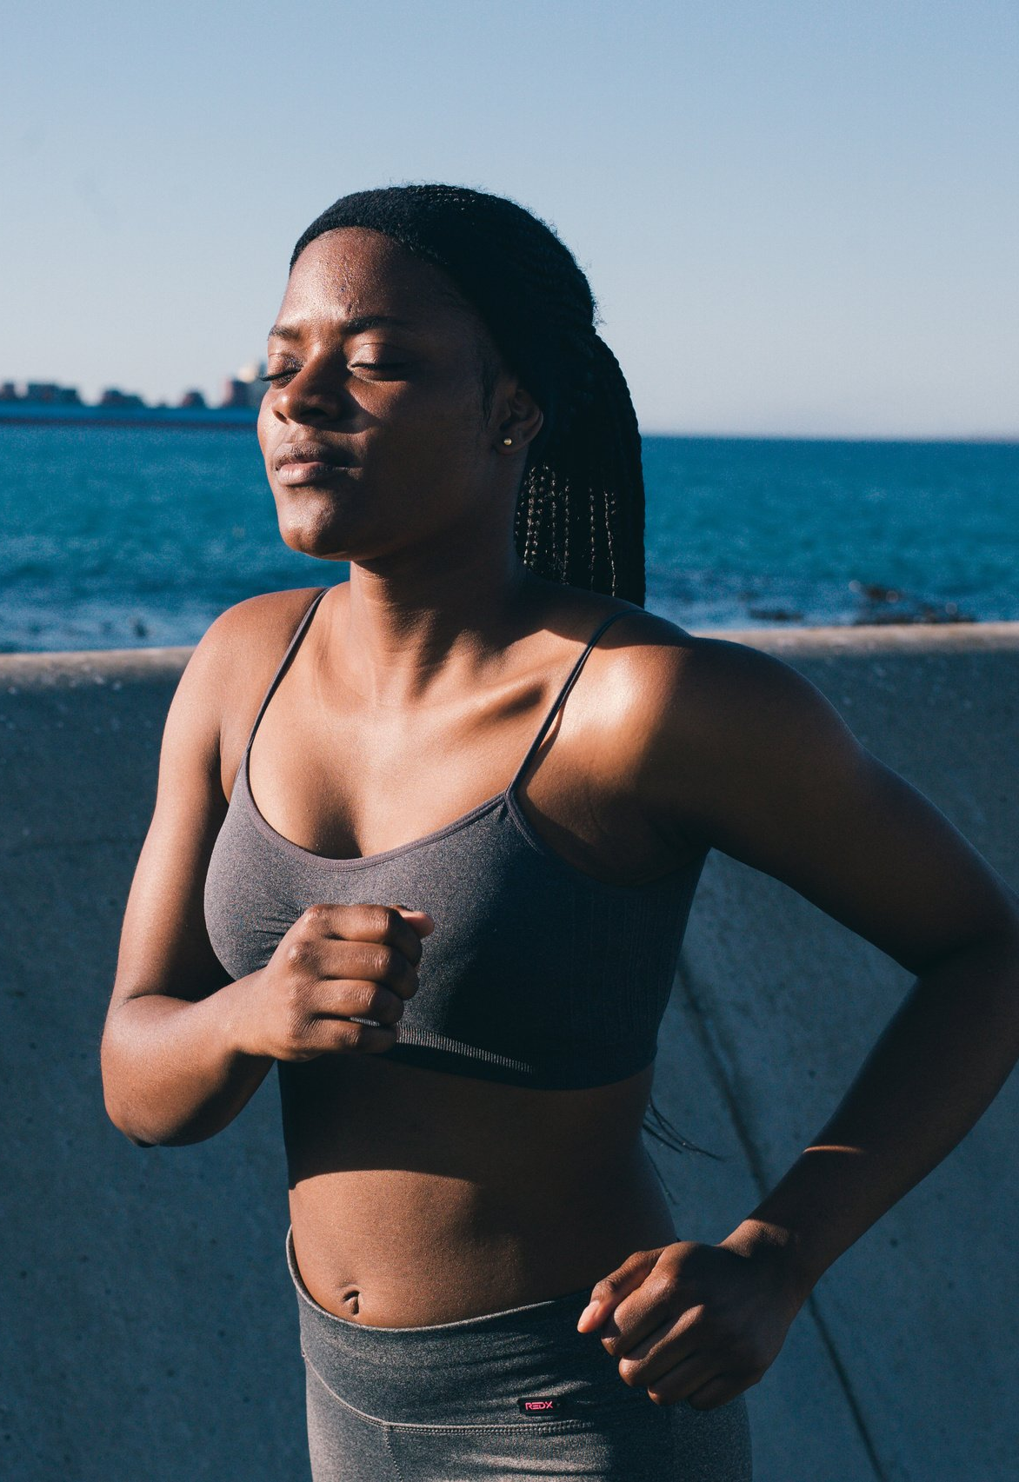

Let's Talk
Well-Being
A Discussion Regarding Psychological Safety
Notes:
Karen

Slide 6
Agenda
What is Psychological Safety
A simple definition we all can understand
What Does It Feel Like
Understanding what it feels like
Understanding what it should not feel like
Characteristics of a Safe Team
Ways to Promote Safety
Ways to address and promote safety
Q&A
Let’s Get Your Questions Answered
Notes:
Karen

Slide 7
Psychological Safety
The belief that your environment is safe for interpersonal risk-taking.
Notes:
Karen

Slide 8
What Psychological Safety Feels Like
What It Feels Like
Freedom to share new ideas or new things, even if they aren’t “perfect”
Energized or motivating
Safe
Constructive feedback is provided on ideas
The benefit of the doubt is default
Freedom to express yourself even if you make a mistake
What it Does Not Feel Like
Feeling the need to make things perfect before sharing
Exhausting or draining
Guarded
Ideas or actions are criticized
Assumptions prevent conversation
Embarrassed or ridiculed for making a mistake or speak up
Notes:
Karen

Slide 9
Characteristics of a Psychological Safe Team
Mutual Respect
Trust and Interest in each other as people
Equality in conversational turn-taking
Shared humility and unconditional professional respect for others
A safe-space for individuals to make mistakes
Team members do not attack each other's knowledge, personality, or character
Notes:
Karen

Slide 10
Ways to Address Psychological Safety
Be vulnerable, while also allowing space for others to be vulnerable
Create an environment of trust
Encourage equal speaking time
Be conscious of your verbal and non-verbal communication
Recognize your shared humanity and show professional respect
Give others space to make mistakes
Notes:
Karen

Slide 11
Ways to Promote Psychological Safety
Promote Self-Awareness
Demonstrate Concerns for Team Members as People
Actively Solicit Questions
Provide Multiple Ways for Employees to Share Their Thoughts
Show Value and Appreciation for Ideas
Promote Positive Dialogue and Discussion
Be Precise with Information, Expectations, and Commitments
Explain Reasons for Change
Own Your Mistakes
Source: https://www.quantumworkplace.com/future-of-work/create-psychological-safety-in-the-workplace
Notes:
Karen

Slide 12
Dialogue & DevRel Story
What are some other things that we can do to support our colleagues as it relates to psychological safety?
Notes:
Karen & Joanna

Slide 13

Conversation with [Speaker]
Question:
Which behaviors make people feel safe and included?

Slide 14
Conversation with [Speaker]
Question:
What's a simple technique to help people get a turn in meetings?

Slide 15
Conversation with [Speaker]
Question:
What methods do you use to actively solicit questions live and offline?

Slide 16
Ensuring and supporting
Notes:
Erin –Next up will be Ryan, who will discuss Safety at Cisco.

Slide 17
Ensuring and supporting safety at [Company]
[Insert available Resources from the benefits page]
Notes:
*Ryan to advise Hannah Wiley P&C Partner, More details to come Erin –Hannah-Ryan room
Reiterate Tools, Trainings, Resources to establish a safe culture. Vision of create safe spaces.

Slide 18
[Topic to focus on Inclusive Language]
Notes:
Erin –Next up will be Anne's Inclusive Terminology Preview.

Slide 19
[Insert Survey QR code]
OR
[Insert Survey URL code and Passcode]
What are one or two words you will carry with you from this session?
Notes:
Jeff Slido Poll Question- Introspection?

