Slide 1
This work is licensed under the Creative Commons Attribution 4.0 International License. To view a copy of this license, visit http://creativecommons.org/licenses/by/4.0/ or send a letter to Creative Commons, PO Box 1866, Mountain View, CA 94042, USA.
Copyright (c) 2022 Cisco Systems, Inc. and its affiliates
All rights reserved.

Slide 2





[Insert survey QR code survey URL]
OR
[Survey URL]
Share one way you would like to be recognized?

Slide 3

Session 4:
Personal Code Reviews: Owning and Honoring our Achievements
Full Stack Wellness & Inclusion Series

Slide 4





Session 4: Esteem
Personal code reviews: Honoring our achievements – ourselves and others
What (are we going to deliver)?
Reflect on personal and team achievements
Self
Actualization Needs
Why (is this session important)?
To highlight the importance of recognizing ourselves and each other, showing appreciation and what resources to utilize
Esteem Needs
Our Story
<Team Manager: Leading a team that have different desires on how they would they like recognize. >
Love/Belonging Needs
Who (are we going to invite)?
-<Guest Speaker: How People work together and recognize effort>
-<HR/Compensation Consultant to review the available recognition programs>
Safety Needs
Post-event Activity
Show yourself some grace and reflect on your own achievements
Prioritize time this to submit a Connected Recognition or High 5
Physiological Needs

Slide 5
Our Full Stack Wellness & Inclusion Series
CI/CD pipeline for your best self
I am in an environment where I can thrive, be creative, and express myself authentically. I want to help others do the same.
Self-
Actualization
Needs
Personal Code Reviews: Owning and Honoring our Achievements
I am in a team where I can support others, and I feel comfortable asking for support when I need it.
Esteem Needs
Developing a team where everyone belongs
I am in an environment where I can express who I am and how I feel.
Love/Belonging
Needs
Designing a team where everyone feels safe
I am not scared to be myself in my workplace. I feel safe here.
Safety Needs
Your Physical Layer: Healthy Body – Healthy Mind:
We can't take care of others if we don't take care of ourselves
Physiological Needs

Slide 6

Employee Recognition & Appreciation
Creating a culture of recognition and feedback is so
important to an organization
<Insert inspiration statement on recognition and feedback>

Slide 7
Our Story
<Team Manager to share story on how direct reports like to be recognized ie. Public or Private settings>

Slide 8
<Guest speaker>
< Invite HR/Compensation Consultant to share resources on available recognition program, if applicable>

Slide 9
[Insert survey QR code survey URL]
OR
[Survey URL]
What are other ways to be recognized and recognize others ?

Slide 10

Self-reflections on Recognitions and Achievements
[Insert Team Activity example:
Share a Shout or Recognition with a team member ]

Slide 11
Calls to Action:
Start changing your routine now – small steps matter
Tell us how we can support you
Learn more about <your organization> recognition programs
Visit our D&I site for all the latest updates

Slide 12

Creating a team where everyone thrives
Bi-Weekly Stand Up:
Check-in Activity
<date>
Bi-Weekly Stand Up:
Check-in Activity
<date>
Bi-Weekly Stand Up:
Check-in Activity
<date>
Bi-Weekly Stand Up:
Check-in Activity
<date>
TBC…
Session 1:
Your Physical Layer: Healthy Body, Healthy Mind
Session 2:
Designing a Team Where Everyone Feels Safe
Session 3:
Developing a Team Where Everyone Belongs
Session 4:
Personal Code Reviews: Owning and Honoring our Achievements
Session 5:
CI/CD Pipeline for Your Best Self
Kick Off Session:
Full Stack Wellness & Inclusion
Today
Today + 1 month
Today + 2 months
Today + 3 months
Today + 4 months

Slide 13
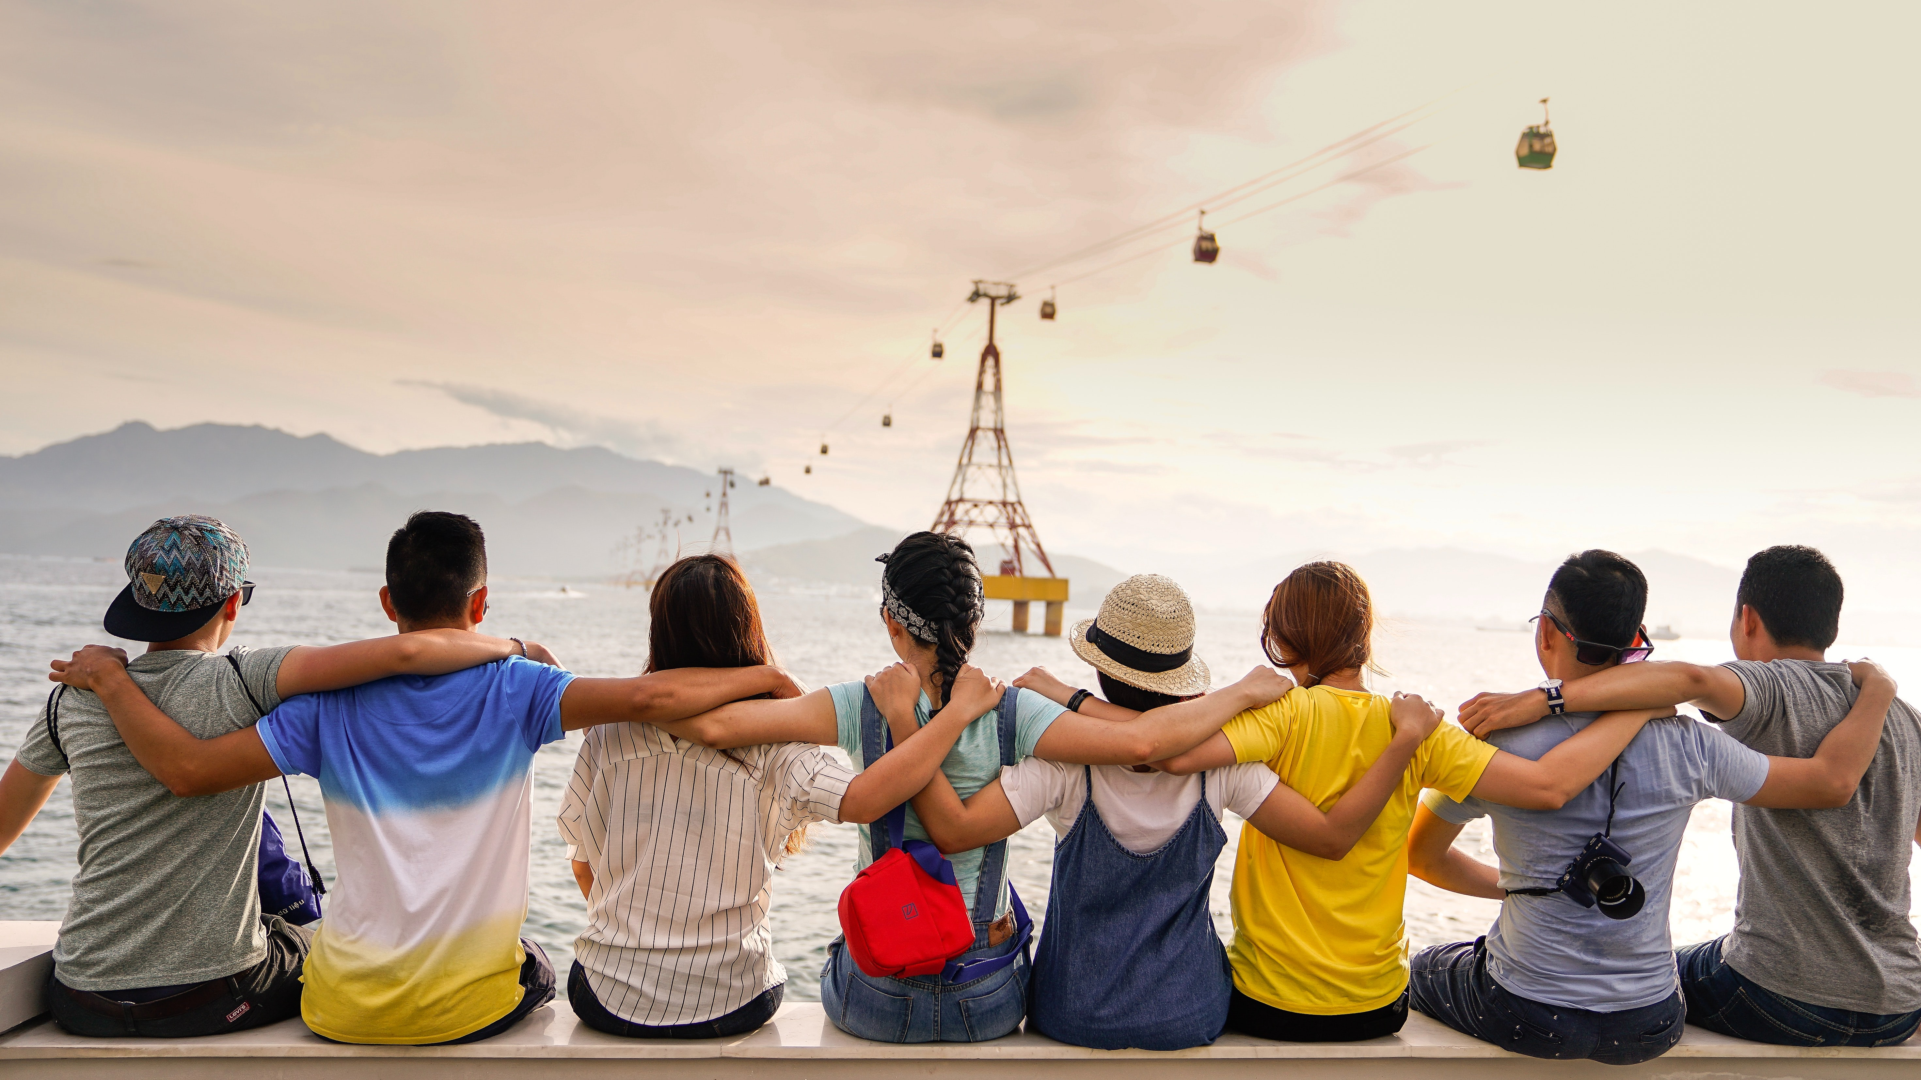
Thank you for all you do and Keep up the Great work!

