Slide 1
DEFINE THE PROBLEM
Ask questions until you can’t think of more questions… then ask more questions
How many phones are experiencing the issue (what percentage)?
Who notices the problem?
Is it only internal calls, only external calls, or both?
Does the issue occur with headset, handset, speakerphone, or all?
Does it happen at certain times of the day or is it constant?
Has the office been re-arranged?
New carpet?
Were there any software/hardware changes?
Do you have a topology?

Slide 2







192.168.7.106
24042
192.168.7.108
23500
Site A
Site B
Phone A
Phone B
INTERNAL
NETWORK
Switch A
Router A
Router B
Switch B

Slide 3
Site A
Site B
Phone A
Phone B
INTERNAL
NETWORK
Switch A
Router A
Router B
Switch B

Slide 4


INTERNAL
NETWORK
SERVICE
PROVIDER

Slide 5
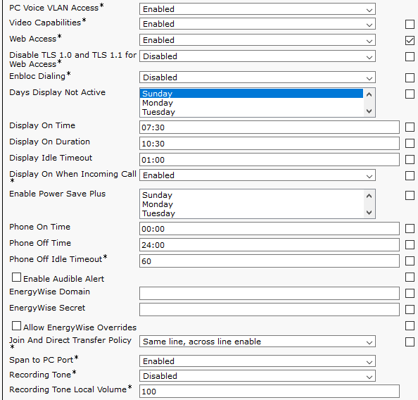

Slide 6
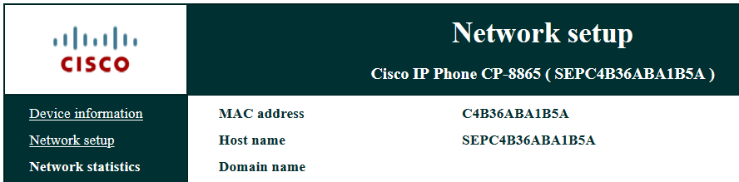


Slide 9
