Slide 1
Pomelo … Untitled
Charlie Crane
@圈圈套圈圈
@xiecc

Slide 2
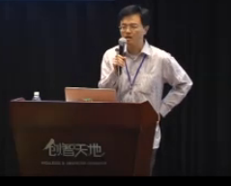
2012-9-15 hujs
My virgin talk
Declare the birth of pomelo framework

Slide 3
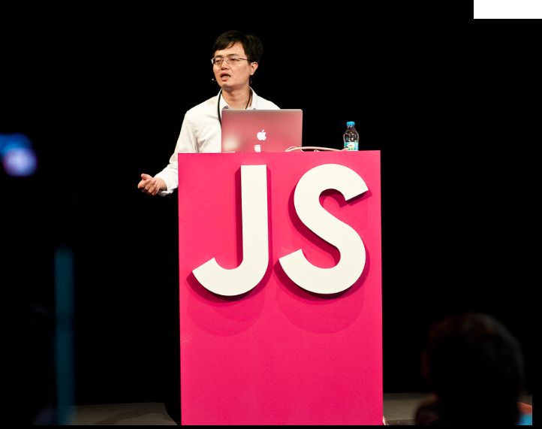
2013-9-15 jsconf eu
Berlin, another virgin talk

Slide 4
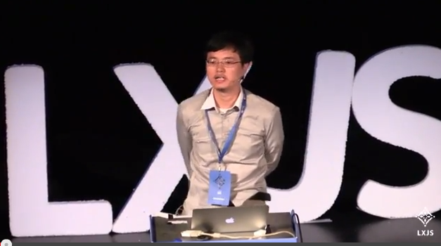
2013-10-2 lxjs
Lisbon

Slide 5
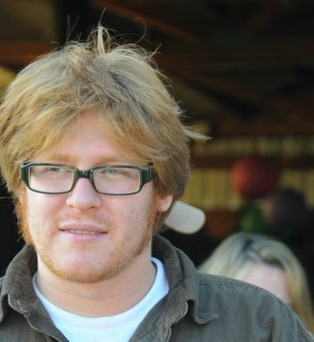
Why?
Go out!!!
Speak even your English is not very good
Participate in open source
Let the world know our open source project

Slide 6
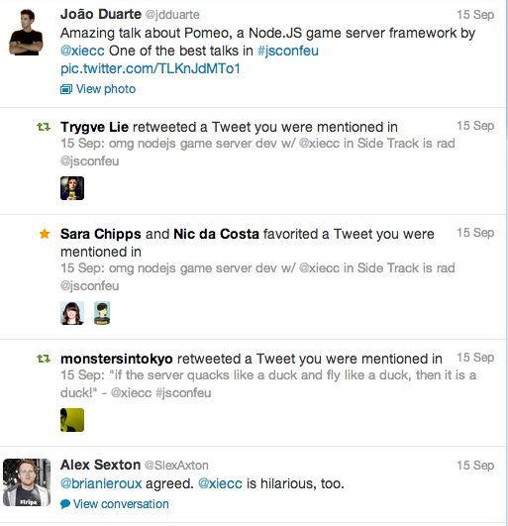
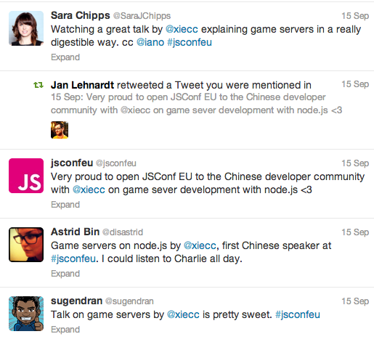
Achievements
Let the world know pomelo framework

Slide 7
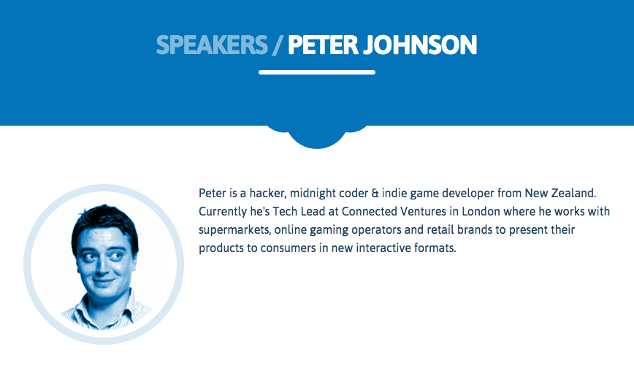
Achievements
New Contributors

Slide 8
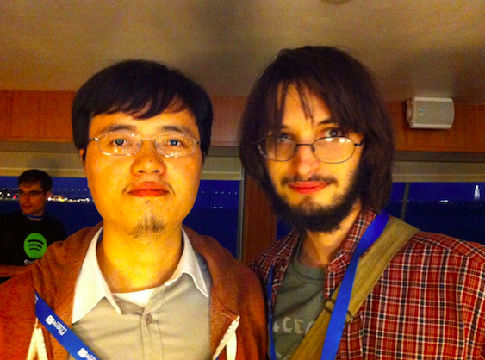
Achievements
To make friends, talk to the people all around the world

Slide 9
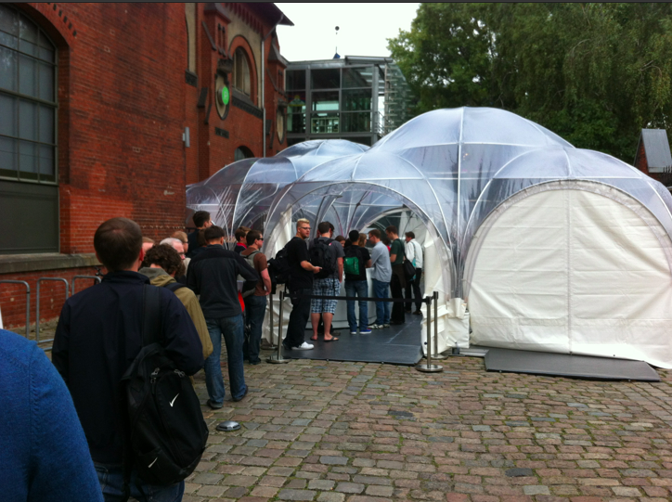
Achievements
Open your eyes, a new experience

Slide 10
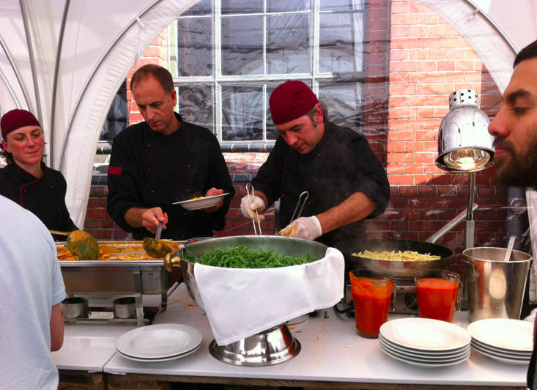
Achievements – open your eyes

Slide 11
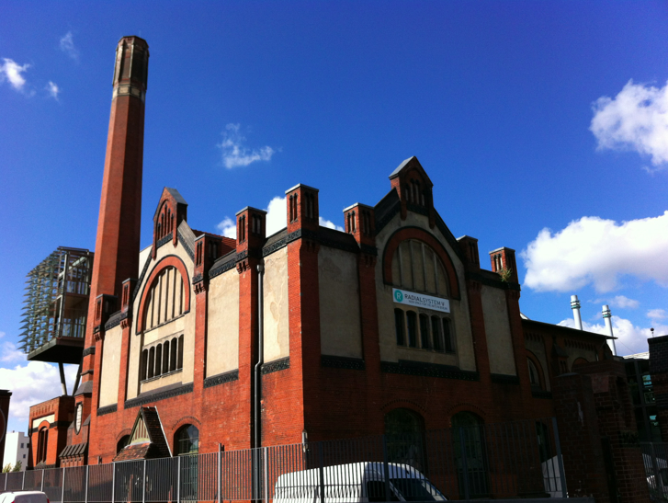
Achievements – open your eyes

Slide 12



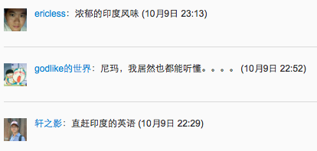
About English

Slide 13
About English
Why do you care about accent?
Baseline: let everybody understand your English!
If you speak in your second language, people will show you extra respect!

Slide 14
You all can speak abroad, be brave!!!

Slide 15
Thank you

