Slide 1
message push based on pomelo
Liu Weijun
@衣兜里的东西
@https://github.com/halfblood369

Slide 2
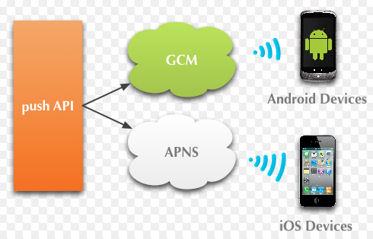
What is message push?
Push message to client by long-connection between push-server and client.

Slide 3
Other pushes
APNS vs GCM
Baidu、SNDA、jpush、getui

Slide 4
Agenda
Products online
Framework
Features
Performance

Slide 5
Products online
Products online
love.163.com
music.163.com
Products on the way (同时在线用户千万级别！)
news.163.com
note.youdao.com
game.163.com
yuehui.163.com
yuedu.163.com
……………………………………

Slide 6
Agenda
Products online
Framework
Features
Performance

Slide 7




Framework
MQTT

Slide 8
Framework
AMQP
publish
APNS publisher
Receiver
Receiver
Receiver
Receiver
APNS publisher
Redis,
Device
Channel push, socket
Connector
Connector
Connector
LVS
socket.io
mqtt
mqtt
Web client
Android client
iOS client

Slide 9
Framework
Pomelo
Cluster management
Dynamic extensions
RPC
Definition of agreement
Statistics of clients

Slide 10
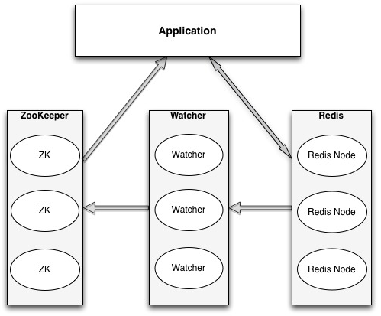
Framework
Redis(https://github.com/numbcoder/node-redis-failover)
master-slave
high availability

Slide 11
Framework
Receiver
Receive message
Schedule message
apnsMaster
Schedule ios message
Apns
Maintain connetion with APNS

Slide 12
Framework
Connector
Maintain long-connection with client
Deliver message to target client
Android/iOS/web
Mqtt/socket.io

Slide 13
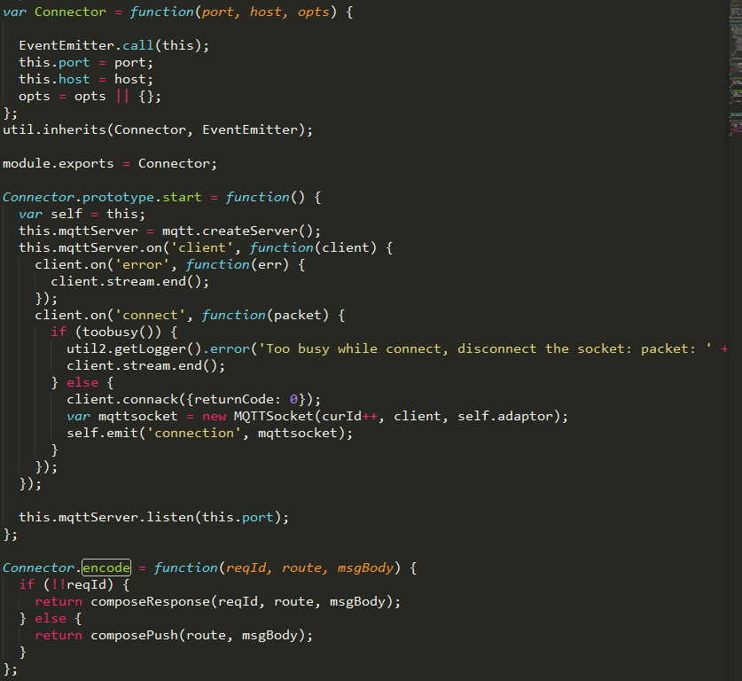

Slide 14
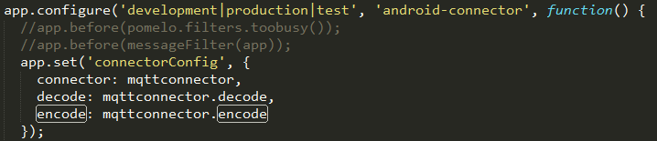

Slide 15
Agenda
Products online
Framework
Features
Performance

Slide 16
Features
Real-time --- long connetion
Reliability --- distributed、multi-node
Dynamic extensions
Broadcast message
Offline message
Dynamic heartbeat
Multiplex link

Slide 17
Real time
Long connection
Android/iOS
Web
MQTT

Slide 18
Reliability
Multi-node
Distributed、Stateless

Slide 19
AMQP
publish
APNS publisher
Receiver
Receiver
Receiver
Receiver
APNS publisher
Redis,
Device
Channel push, socket
Connector
Connector
Connector
LVS
socket.io
mqtt
mqtt
Web client
Android client
iOS client

Slide 20
Dynamic extensions
pomelo add host=[host] port=[port] id=[id] serverType=[serverType]
node app.js env=production host=[host] port=[port] id=[id] serverType=[serverType]

Slide 21

Broadcast message
Slow
High cpu
Single-Threaded

Slide 22
AMQP
publish
APNS publisher
Receiver
Receiver
Receiver
Receiver
APNS publisher
Redis,
Device
Channel push, socket
Connector
Connector
Connector
LVS
socket.io
mqtt
mqtt
Web client
Android client
iOS client

Slide 23
Broadcast message
Create channel
Create channel
Filter clients
Pressure in back-server
Mark session
Cover all sessions
Pressure in front-server

Slide 24
Broadcast message
AMQP
publish
APNS publisher
Receiver
Receiver
APNS publisher
filter
filter
Redis,
Device
Connector
Connector
Connector
LVS
socket.io
mqtt
mqtt
Web client
Android client
iOS client

Slide 25
Offline message
Qos == 1
Expired time
Timestamp
Reconnect

Slide 26
AMQP
publish
APNS publisher
Receiver
Receiver
Receiver
Receiver
APNS publisher
Redis,
Device
Channel push, socket
Connector
Connector
Connector
LVS
socket.io
mqtt
mqtt
Web client
Android client
iOS client

Slide 27
Multiplex link
Share one link with push-server
Dynamic heartbeat
Push-server
APK1
SDK
Long connection
APK2
SDK

Slide 28
Agenda
Products online
Framework
Features
Performance

Slide 29
Performance
High Concurrency
single-process 6w~12w connections(max 30w)
single-server 200w
memory 600M～1.3G (max:3G)
cpu 2～10%
response time < 1 second(AWS clients)

Slide 30
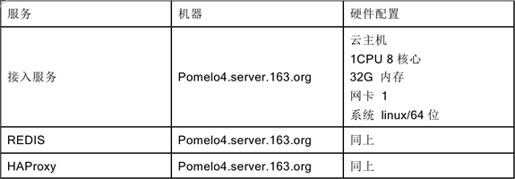
Performance

Slide 31
Performance

Slide 32
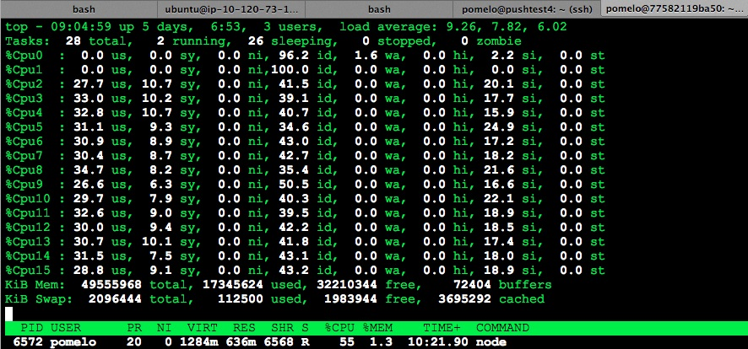
Performance

Slide 33


