Slide 1
stego mission level 6
學號：1051336
姓名：鄭傑鴻

Slide 2
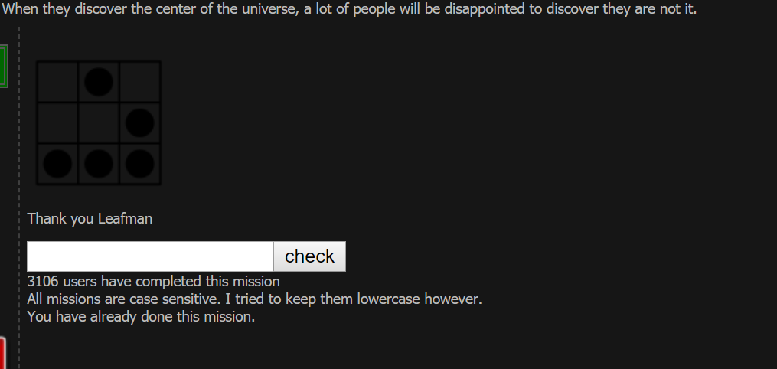

Slide 3
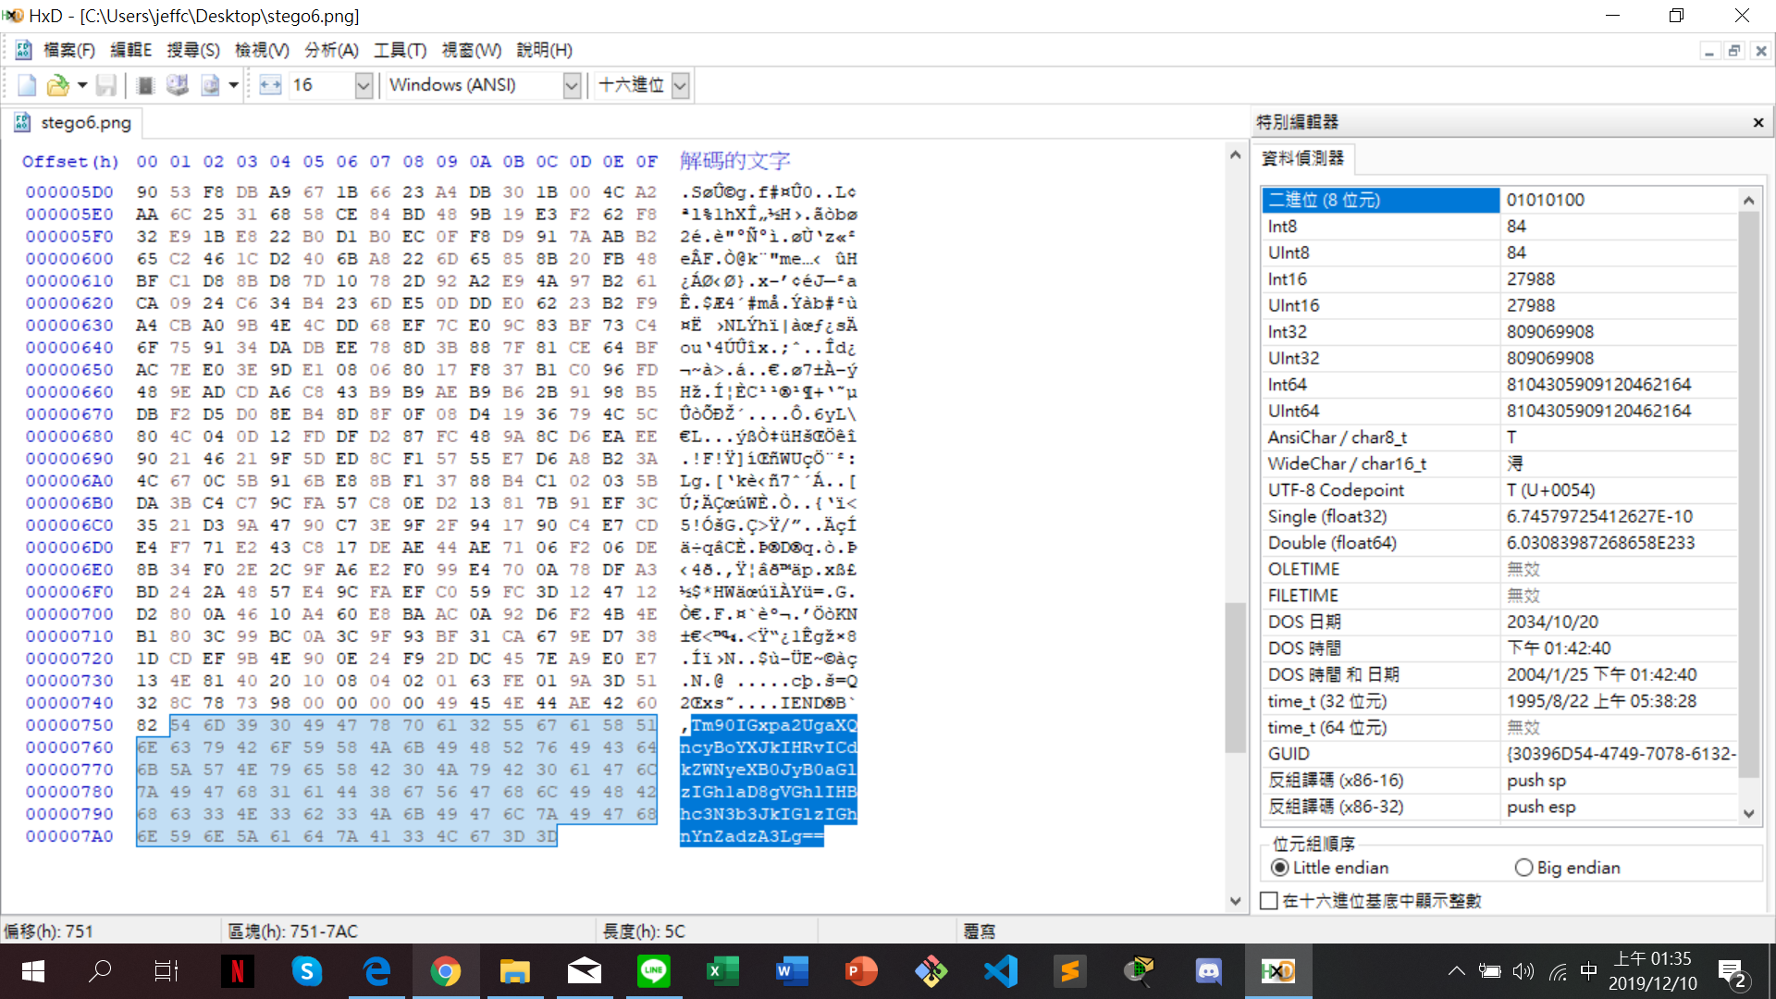
Hex Edit

Slide 4
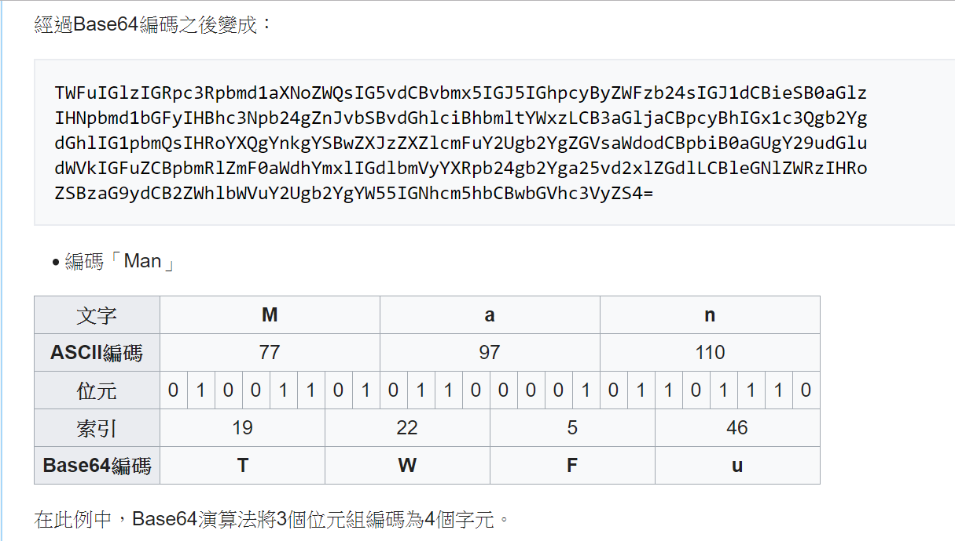
觀察出base64

Slide 5
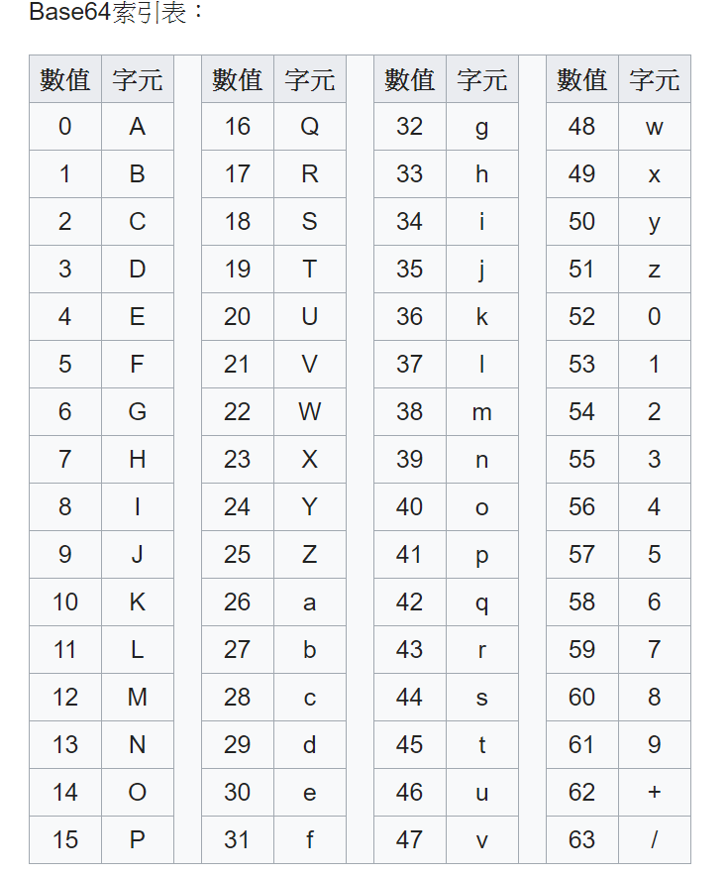
觀察出base64

Slide 6
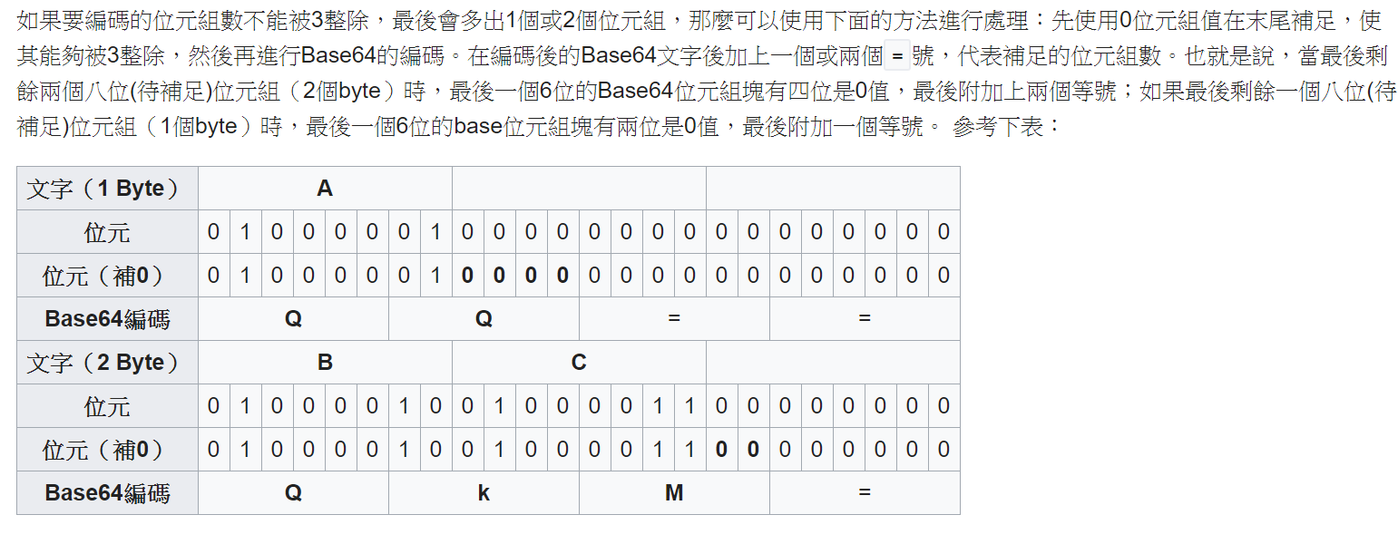
觀察出base64

Slide 7
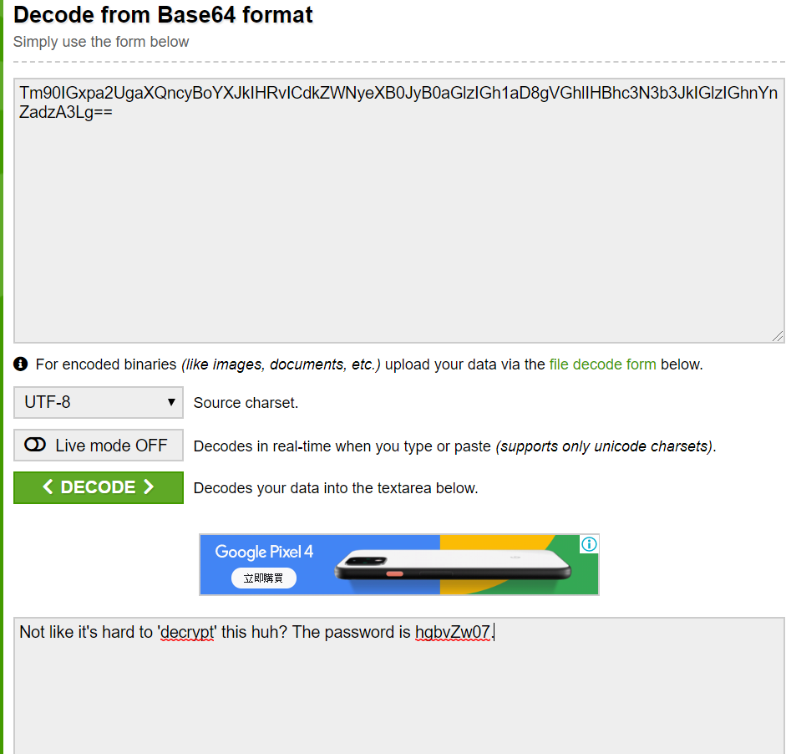
使用base64 decoder
Tm90IGxpa2UgaXQncyBoYXJkIHRvICdkZWNyeXB0JyB0aGlzIGh1aD8gVGhlIHBhc3N3b3JkIGlzIGhnYnZadzA3Lg==
Not like it’s hard to ‘decrypt’ this huh? The password is hgbvZw07.

