Slide 1
Avoiding Redundant Gotos
if x > 200 goto L4
goto L1
L4: ……
Instead, consider the instruction:
ifFalse x > 200 goto L1
L4: ……..
This ifFalse instruction takes advantage of the natural flow from one instruction to the next in sequence, so control simply “falls through" to label L4
if x > 200, thereby avoiding a jump.
Short-circuit code/Jumping Code

Slide 2
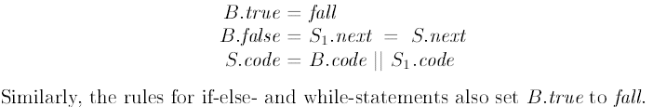
Fall – Through Technique
By using a special label fall (i.e., “don't generate any jump"), we can adapt the semantic rules to allow control to fall through from the code for B to the code for S1.
The new rules for S -> if (B) S1 is set B:true to fall
We now adapt the semantic rules for boolean expressions to allow control to fall through whenever possible. Suppose B:true is fall ; i.e, control falls through B, if B evaluates to true.

Slide 3
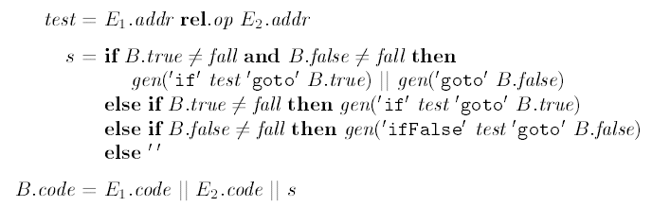
Semantic Rules for B-> E₁ rel E₂
The rules for P -> S create label L1.

Slide 4
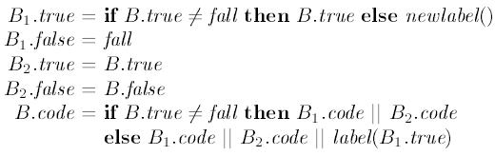
Semantic Rules for B-> B₁ ||B₂

Slide 5
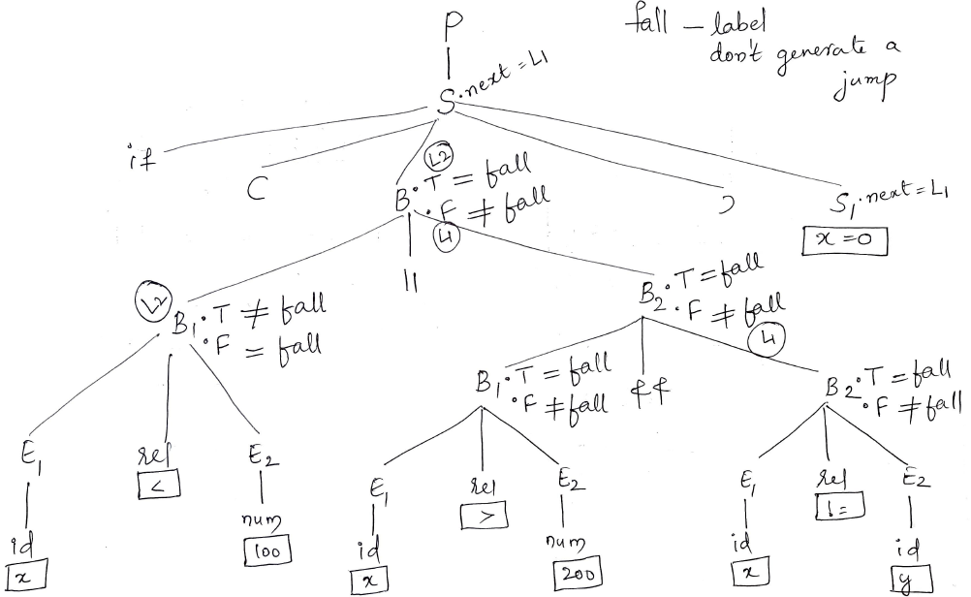

Slide 6
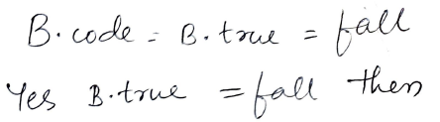

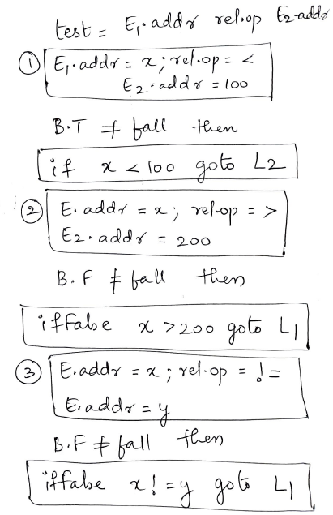
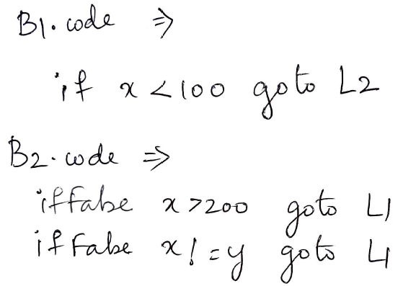
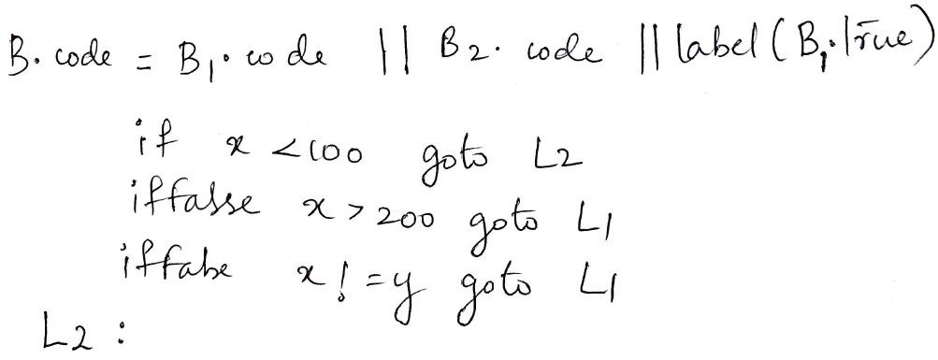

Slide 7
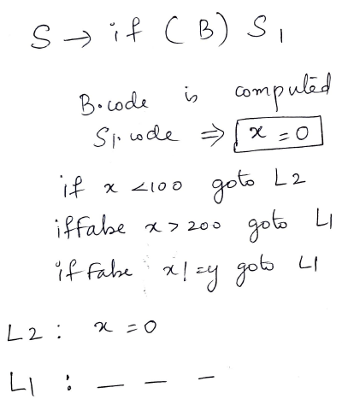

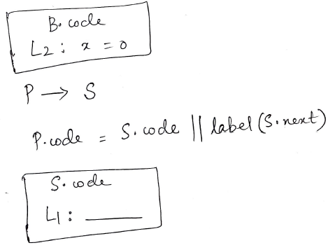
Rewriting using ‘fall’ label: fall through technique/ Short-circuit code

Slide 8
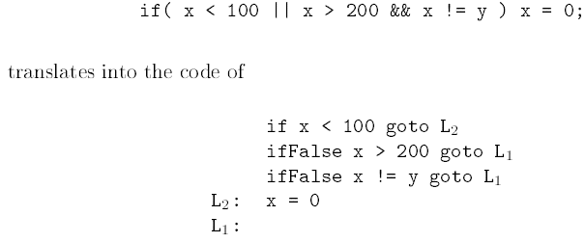
If-statement translated using the fall-through technique

Slide 9
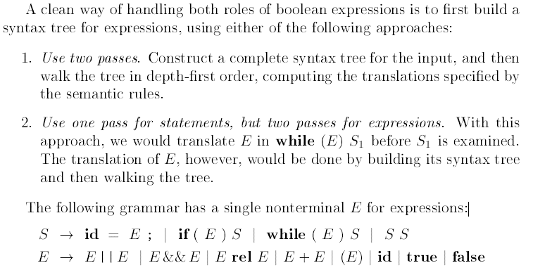
Boolean Values and Jumping Code
A boolean expression may also be evaluated
for its value, as in assignment statements such as x = true; or x = a<b.

Slide 10
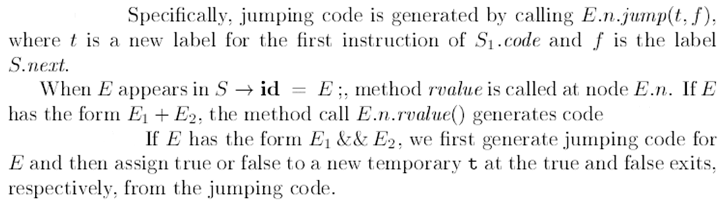
Method jump generate jumping code at an expression node, and let method rvalue generate code to compute the value of the node into a temporary

Slide 11
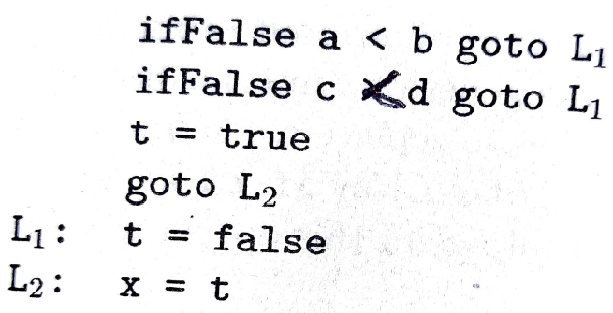
Translating a boolean assignment by computing the value of a temporary
For example, the assignment x = a<b && c<d can be implemented by the code

