Slide 1
EzPark Database project
Developed by Christian Isolda

Slide 2
Table of Contents
Table of Contents 2 Transactions Table 13 Executive Summary 3 Stored Procedure 1 14 E/R Diagram 4 Stored Procedure 2 15 Tables Trigger 16 Towns Table 5 View 1 17 Bank Table 6 View 2 18 Credit Card Table 7 Report 1 19 Area Type Table 8 Report 2 20 Payment Table 9 Report 3 21 Users Table 10 Security 22 Parking Area Table 11 Implementation, Problems, Slots Table 12 Enhancements 23

Slide 3
Executive Summary
Through the whole project I tackled many challenges from technical to mental processes in a business perspective. EzPark is an app that is being developed that takes an annoying task and makes it into a breeze. The app’s fucntionality include paying for parking through our app using a credit card or bank, notification reminders on time remaining, and option to add time to existing parking time. The document contains all information surrounding the database and will also give some insight on what the app revolves around. With the plan to expand nationwide and even worldwide a properly structured and organized database is needed to gold the information. The design of the database makes the app flow and function swiftly. The data input is dummy data, but is meant to resemble what kind of information and processes the database will be handling. This database is a fully functional database made for EzPark based around third normal form.

Slide 4
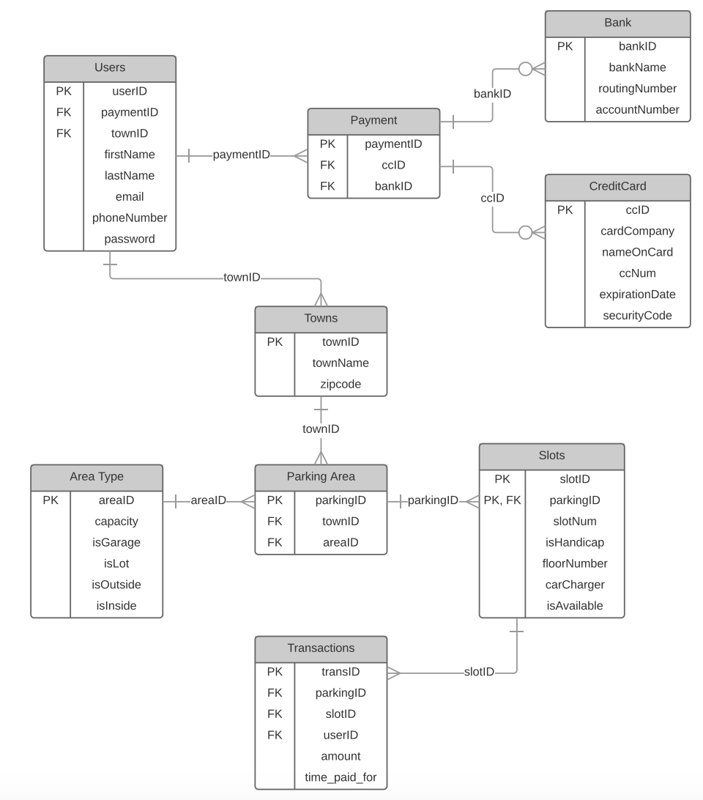
E/R Diagram

Slide 5
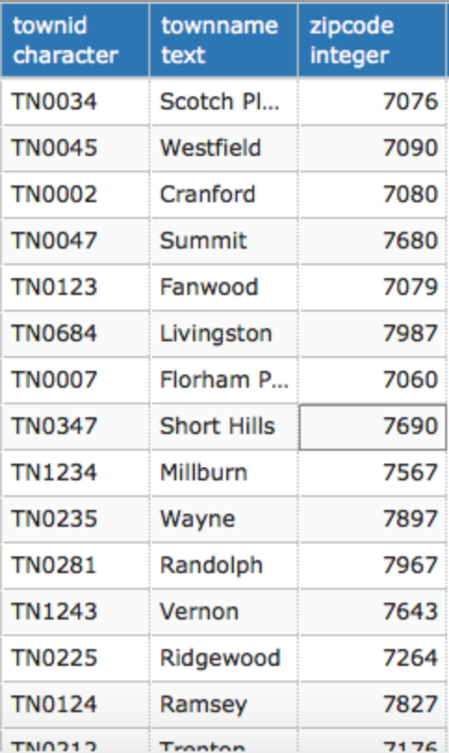
Towns Table
This table represents all the available towns that a user can access with our app.
CREATE TABLE Towns ( townID char(6) not null, townName text not null, zipcode int not null, primary key(townID));
Functional Dependencies: townID→ townName, zipCode
Sample Data

Slide 6
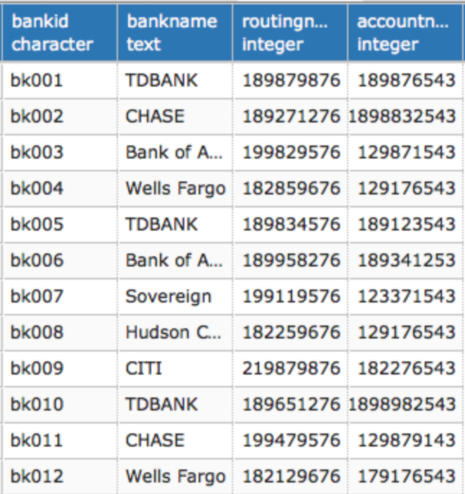
Bank Table
This table represents all the banks entered from the users so it can be referenced in the payment table
CREATE TABLE Bank ( bankID char(6) not null, bankName text not null, routingNumber int not null, accountNumber int not null, primary key(bankID));
Functional Dependencies: bankID→ bankName, routingNumber, accountNumber
Sample Data

Slide 7
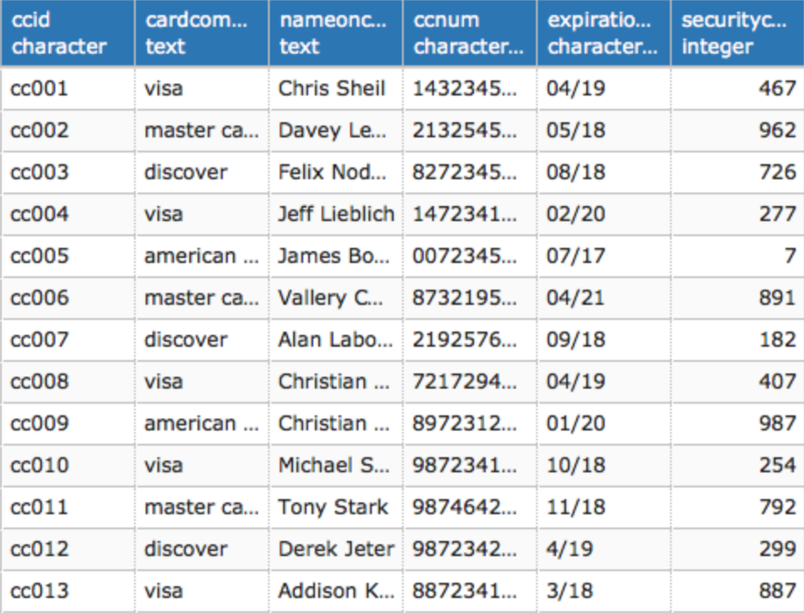
Credit Card Table
This table represents all the credit cards entered from the users so it can be referenced in the payment table
CREATE TABLE CreditCard ( ccID char(6) not null, cardCompany text not null, nameOnCard text not null, ccNum varchar(16) not null, expirationDate varchar(5) not null, securityCode int not null, primary key(ccID));
Functional Dependencies: ccID→ cardCompany, nameOnCard, ccNum, expirationDate, secuirtyCode
Sample Data

Slide 8
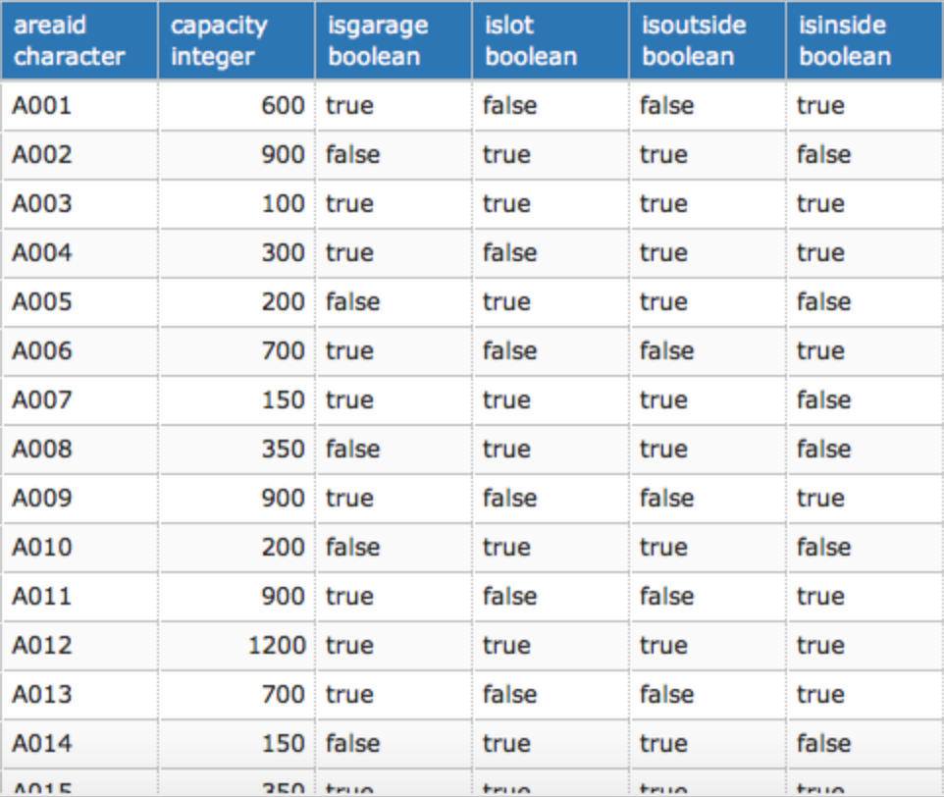
Area Type Table
This table represents all the types of parking garages that the database holds.
CREATE TABLE AreaType ( areaID char(6) not null, capacity int not null, isGarage boolean not null, isLot boolean not null, isOutside boolean not null, isInside boolean not null, primary key(areaID));
Functional Dependencies: ccID→ capacity, isGarage, isLot, isOutside, isInside
Sample Data

Slide 9
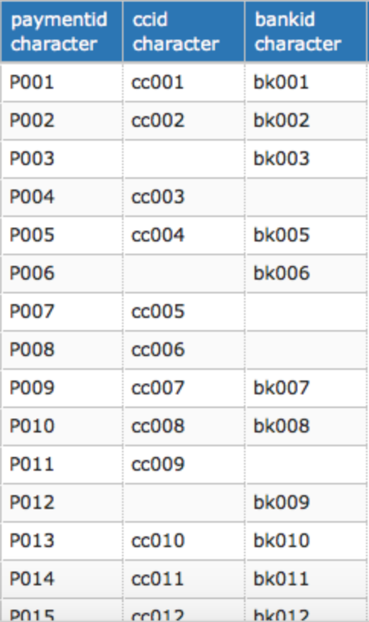
Payment Table
This table represents all the payment options the user has input to make it easy to pay for the user as well having multiple options.
CREATE TABLE Payment ( paymentID char(6) not null, ccID char(6) references CreditCard(ccID), bankID char(6) references Bank(bankID), primary key(areaID));
Functional Dependencies: paymentID→ ccID, bankID
Sample Data

Slide 10
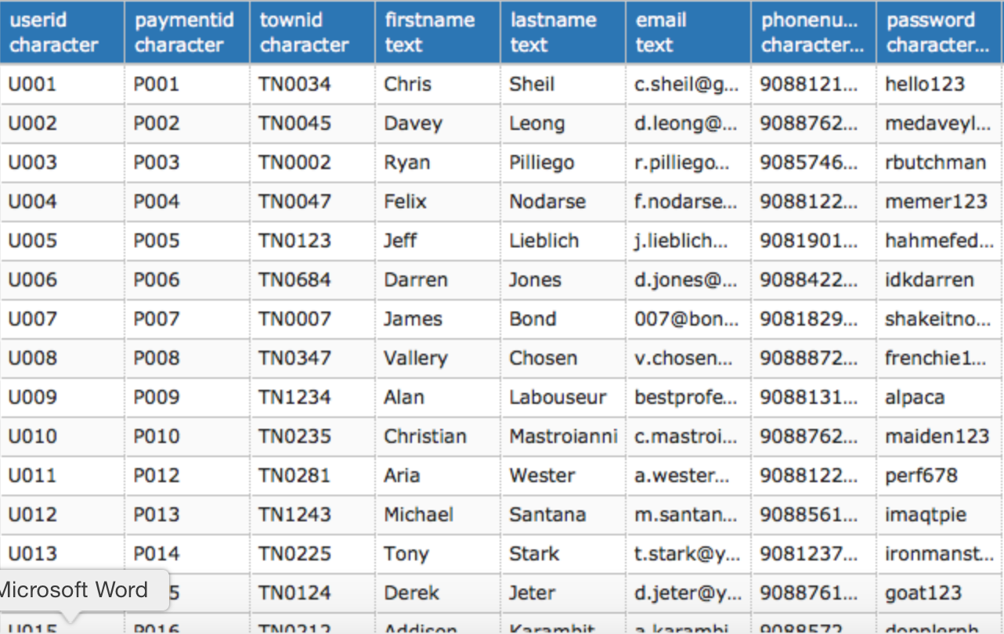
Users Table
This table represents all the users in the database with all their information to be able to utilize the app.
CREATE TABLE Users ( userID char(6) not null, paymentID char(6) not null references Payment(paymentID), townID char(6) not null references Towns(townID), firstName text not null, lastName text not null, email text not null, phoneNumber varchar(10) not null, password varchar(25) not null, primary key(userID));
Functional Dependencies: userID→ paymentID, townID, firstName, lastName, email, phoneNumber, password
Sample Data

Slide 11
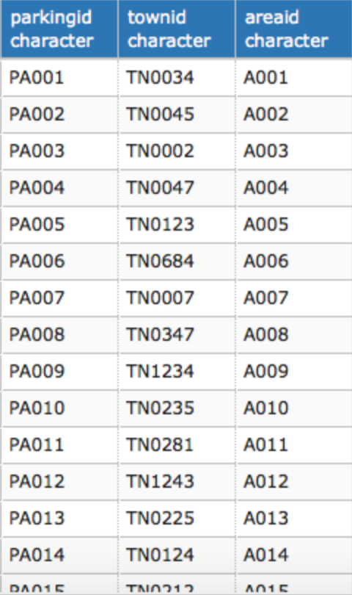
Parking Area Table
This table represents all the areas where the users can actually park.
CREATE TABLE ParkingArea ( parkingID char(6) not null, townID char(6) not null references Towns(townID), areaID char(6) not null references AreaType(areaID), primary key(parkingID));
Functional Dependencies: parkingID→ townID, areaID
Sample Data

Slide 12
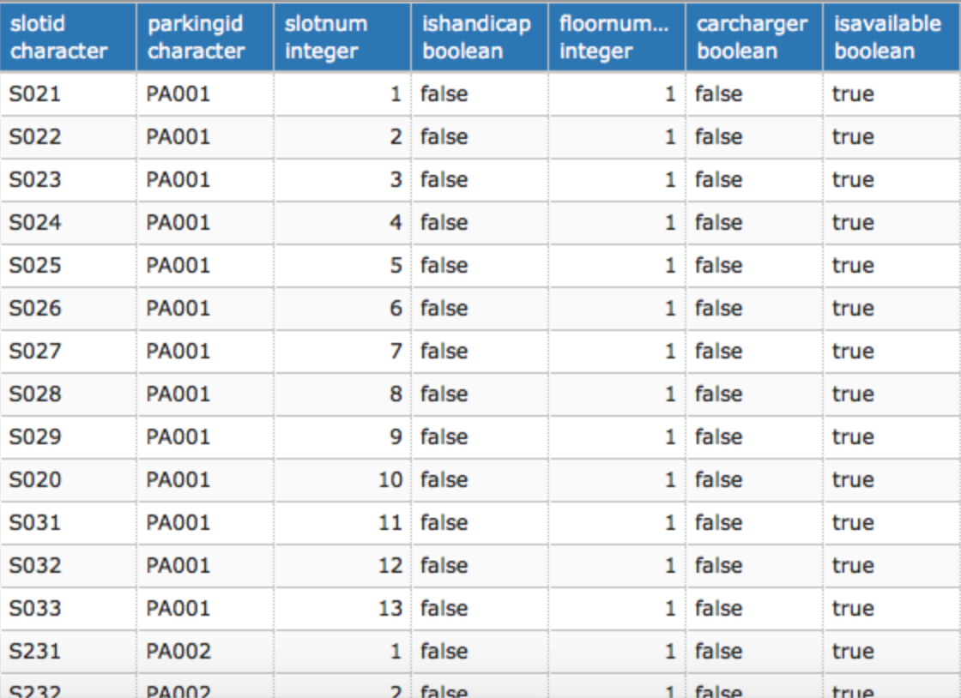
Slots Table
This table represents all the slots or spaces in each parking area that is input.
CREATE TABLE Slots ( slotID char(6) not null, parkingID char(6) not null references ParkingArea(parkingID), slotNum int not null, isHandicap booelan not null, floorNumber int not null, carCharger booelan not null, isAvailable boolean DEFAULT TRUE, primary key(slotID));
Functional Dependencies: slotID→ parkingID, slotNum, isHandicap, floorNumber, carCharger, isAvailable
Sample Data

Slide 13
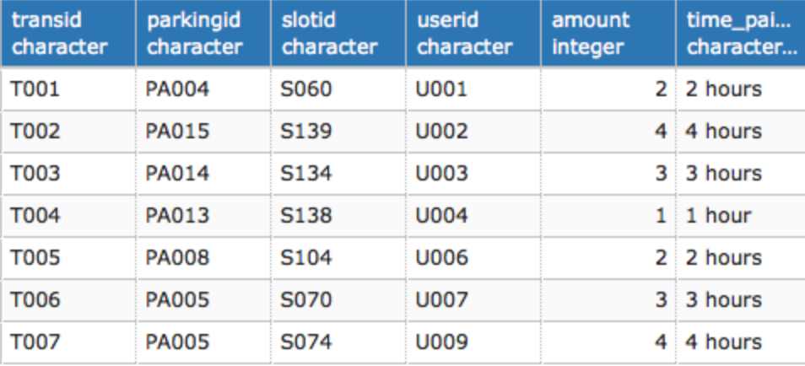
Transactions Table
This table represents all the transactions that are made between users and slots being taken.
CREATE TABLE Transactions ( transID char(6) not null, parkingID char(6) not null references ParkingArea(parkingID), slotID char(6) not null references Slots(slotID), userID char(6) not null references Users(userID), amount int not null, time_paid_for varchar(8) not null, primary key(transID));
Functional Dependencies: transID→ parkingID, slotID, userID, amount, time_paid_for
Sample Data

Slide 14
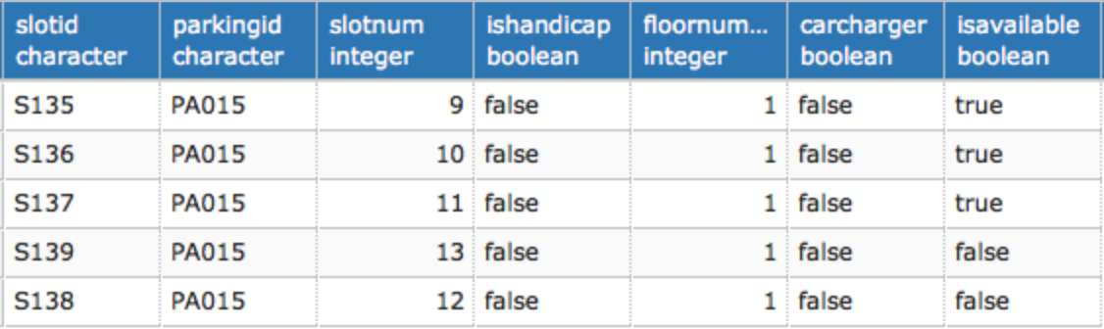
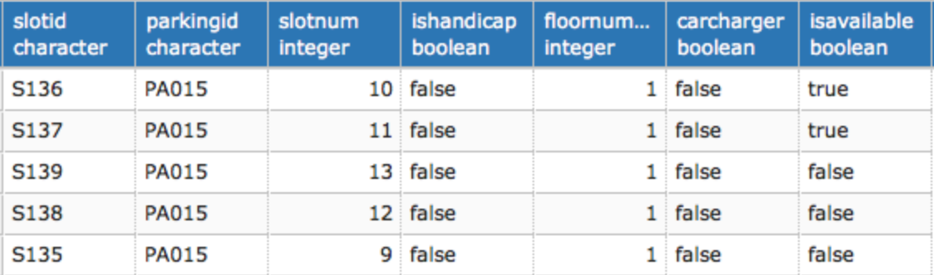
Stored Procedure update_slot_status()
This stored procedure updates slots in a parking when a transaction is made. This allows the system to keep track of timings and notifications a lot easier.
CREATE OR REPLACE FUNCTION update_slot_status () RETURNS TRIGGER AS $$ BEGIN IF NEW.transID is NOT NULL THEN UPDATE Slots SET isAvailable = FALSE WHERE NEW.slotID = Slots.slotID END IF; RETURN NEW; END; $$ LANGUAGE PLPGSQL;
SELECT *
FROM Slots
WHERE parkingID = ‘PA015’
Before Transaction
After Transaction
Transaction Insert Statement
INSERT INTO Transactions(transID, parkingID, slotID, userID, amount, time_paid_for)
VALUES('T010', 'PA015', 'S135', 'U011', 3.00, '3 hours');

Slide 15
Stored Procedure get_users_transaction()
This stored procedure can be used to check the previous transactions.
CREATE OR REPLACE FUNCTION get_users_transaction (char(6), REFCURSOR) returns refcursor as $$ DECLARE userID char(8) :=$1; results REFCURSOR :=$2; BEGIN OPEN results FOR SELECT tr.transID, tr.parkingID, tr.userID, tr.slotID FROM Transactions tr INNER JOIN Users u ON tr.userID = u.userID WHERE userID = u.userID; RETURN results; END; $$ LANGUAGE PLPGSQL;

Slide 16
Trigger update_slot_status_trigger()
This trigger links to the stored procedure in the previous slide, which triggers the stored procedure whenever an INSERT statement is input into Transactions
CREATE TRIGGER update_slot_status_trigger BEFORE INSERT ON Transactions FOR EACH ROW EXECUTE PROCEDURE update_slot_status();

Slide 17
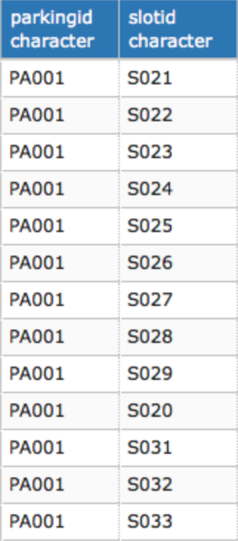
View availableSlots
This view shows a table of available slots that are not being used by users. This can be used for checking the amount of slots open around or even in a parking area
DROP VIEW IF EXISTS availableSLots; CREATE VIEW availableSlots as ( SELECT pa.parkingID, slotID FROM parkingArea pa INNER JOIN Slots s ON pa.parkingID = s.parkingID WHERE s.isAvailable = TRUE );
Sample Data
SELECT * FROM availableSlots
WHERE parkingID = ‘PA001’

Slide 18
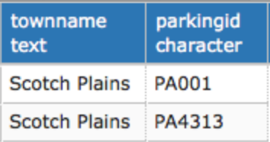
View townParkingAreas
This view shows a table of parking areas that a town has to offer. This can help the company expand into different areas as well as help towns understand their needs.
DROP VIEW IF EXISTS townParkingAreas; CREATE VIEW townParkingAreas as ( SELECT t.townName, pa.parkingID FROM parkingArea pa INNER JOIN Towns t ON pa.townID = t.townID );
Sample Data
SELECT * FROM townParkingAreas
WHERE townName = ‘Scotch Plains’

Slide 19
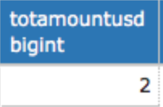
Report / Interesting Query 1
This report searches for the parking ID provided and sums the total amount generated from a specified parking area. This is useful for analytics as well as which types of areas are more used.
SELECT SUM(amount) AS totAmountUSD FROM transactions WHERE parkingID = ‘PA004’
Sample Data

Slide 20
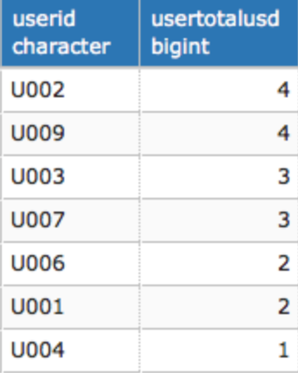
Report / Interesting Query 2
This report queries all the users and shows their total amount spent on parking. This is very useful for analytics as well as pricing and marketing to grow the app.
SELECT u.userID, SUM(amount) AS userTotalUSD FROM Users u INNER JOIN Transactions t ON u.userID = t.userID GROUP BY u.userID ORDER BY userTotalUSD DESC;
Sample Data

Slide 21
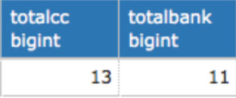
Report / Interesting Query 3
This report counts the amount of bank accounts and credit cards in use. This is very useful for determining which payment method is being used more frequently as well as what more types of options we should offer.
SELECT COUNT(ccID) AS totalCC, COUNT(bankID) as totalBank FROM Payment;
Sample Data

Slide 22
Security
There are two roles in EzPark: Admin and Users Admin: Have control over DB and can monitor and update as needed. Users: Users have privileges to insert and update their user information as well as their payment information.
ADMIN: GRANT ALL ON ALL TABLES IN SCHEMA PUBLIC TO ADMIN;
USERS: REVOKE ALL ON ALL TABLES IN SCHEMA PUBLIC FROM USERS; GRANT INSERT ON Users, Payment, CreditCard, Bank TO USERS; GRANT UPDATE ON Users, Payment, CreditCard, Bank TO USERS;

Slide 23
Implementation – Known Problems – Future Enhancements
Implementation:
If the app was to grow to full scale there would need to be more character values to implement towns into the app.
The app would need to have functionality to communicate with parking station hardware which means software and hardware changes would need to be done to make it communicate.
Known Problems
The second stored procedure is very close to working and can not get it to output correct data.
There will need to be many more options for IDs as well as general information categorizing data in the database, the inputs now are just dummy data and should be fixed before implementation.
Future Enhancements
More payment options such as PayPal would be added to enhance the experience as well provide more options for uses to use the app.
Future development for the app would have a feature that shows a map of the parking area and indicates where there are open slots so it makes parking that much faster.

