Slide 1
Project-1 Architecture
Web Server
Apache Web Server
MOD_JK
Apache Tomcat
JDBC
MariaDB / MySQL DB
App Server
DB Server

Slide 2
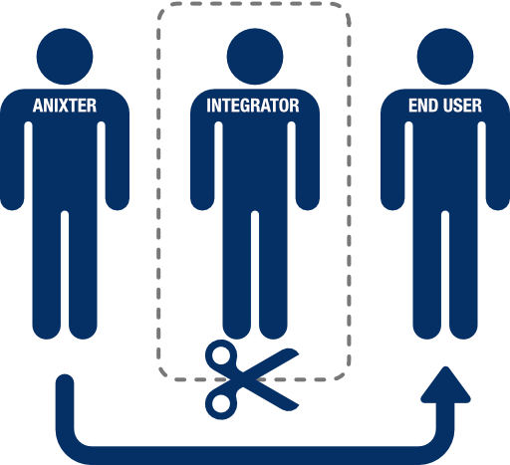
Load Balancer
Web Service
Web Service
App Service
App Service
Node1
Node2
DB Server

Slide 3
Stack 2 Architecture
Angular JS
Web Server
Web
Pages
App Server
DB Server

