Slide 2
Create AWS Account
Raise a SR With Support.
Create Case -> Service Limit Increase
EC2 -> North Virgina -> t2.micro -> 5
Elastic Loadbalancer -> North Virginia -> 2
Elastic Beanstalk -> North Virginia -> Application -> 2

Slide 3
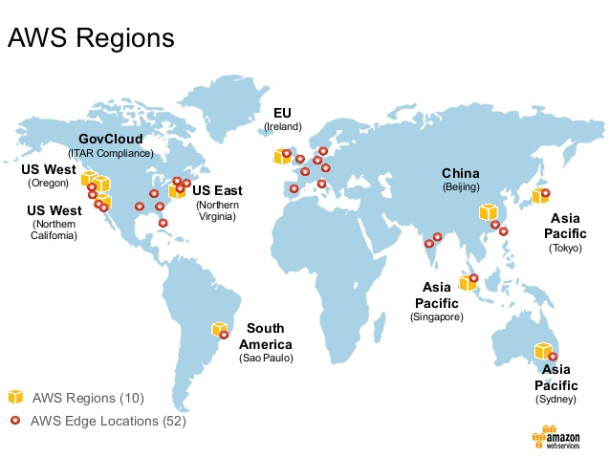
Regions & AZ’s

Slide 4
Upload KeyPair

Slide 5
Create Security Group

Slide 6
Create EC2 Instance

Slide 7
Create AMI

Slide 8
Create ELB

