Slide 1
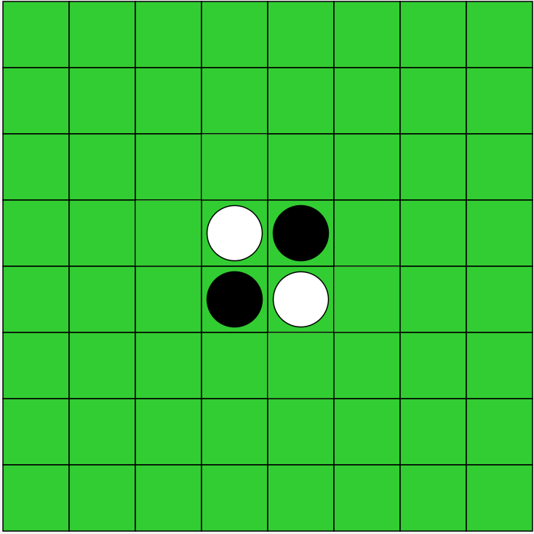
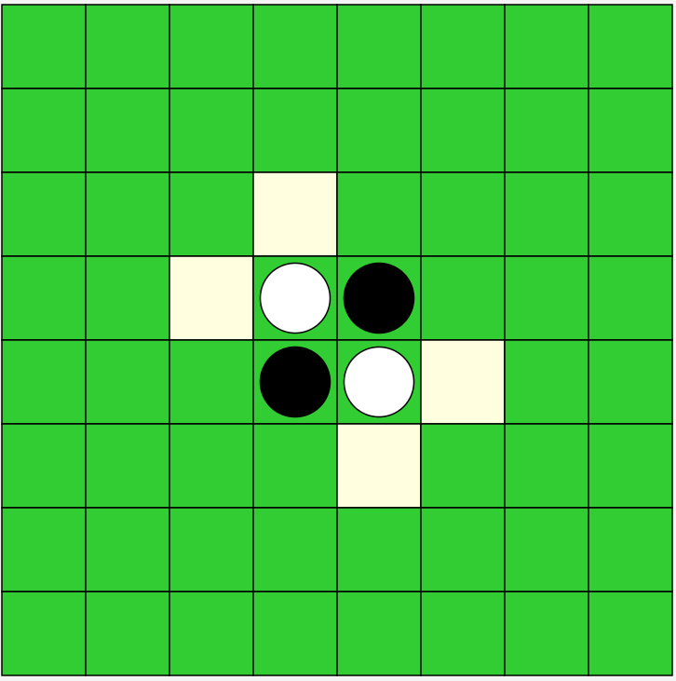
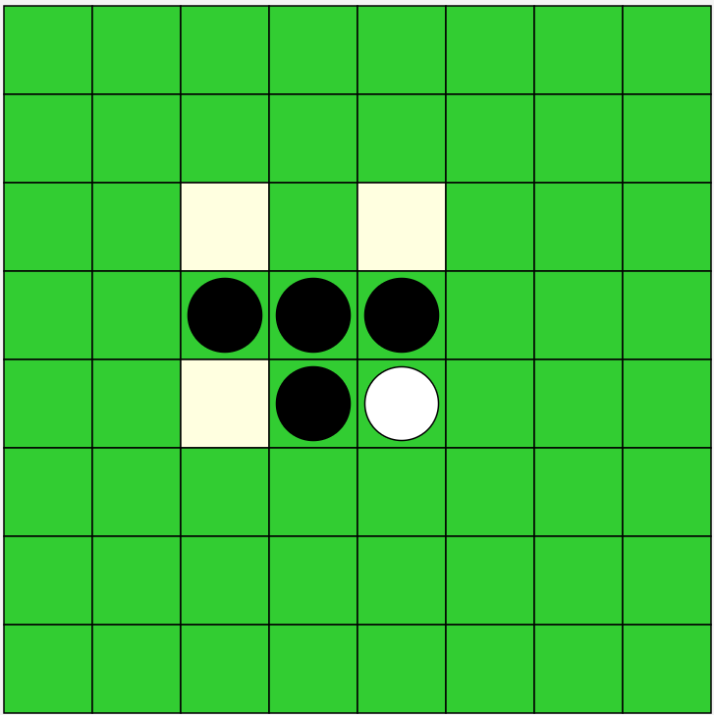
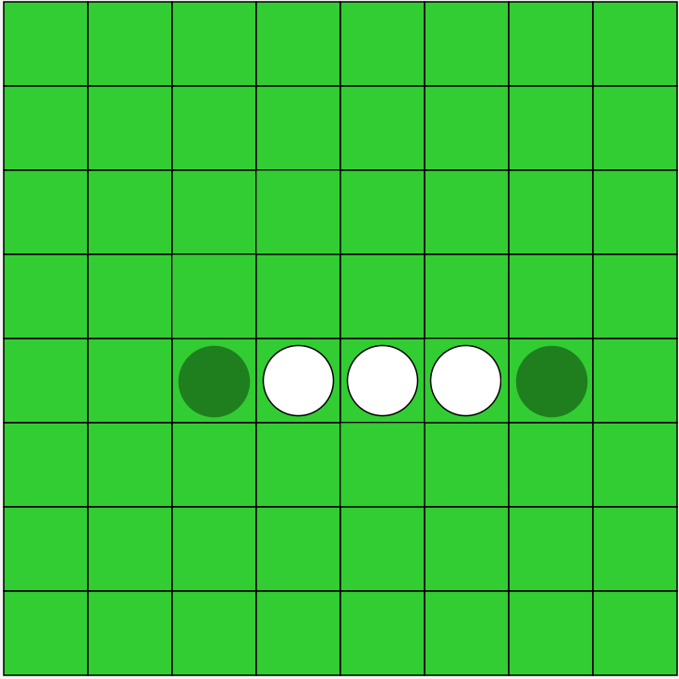
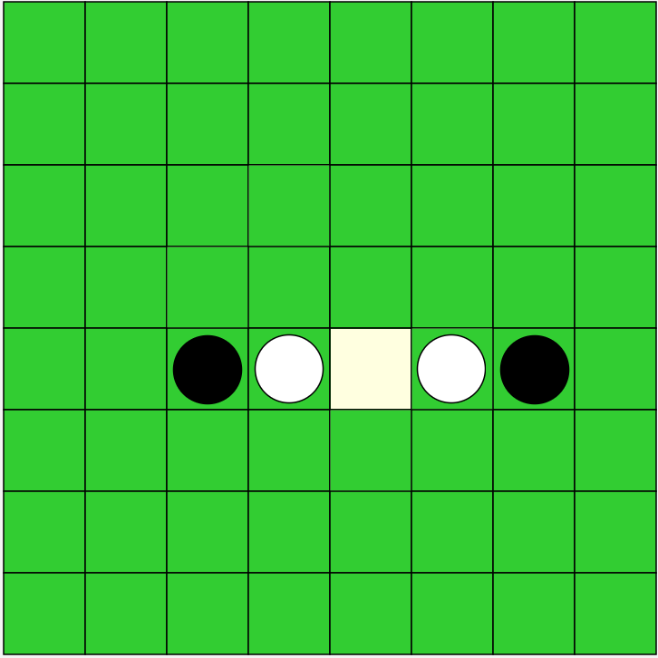
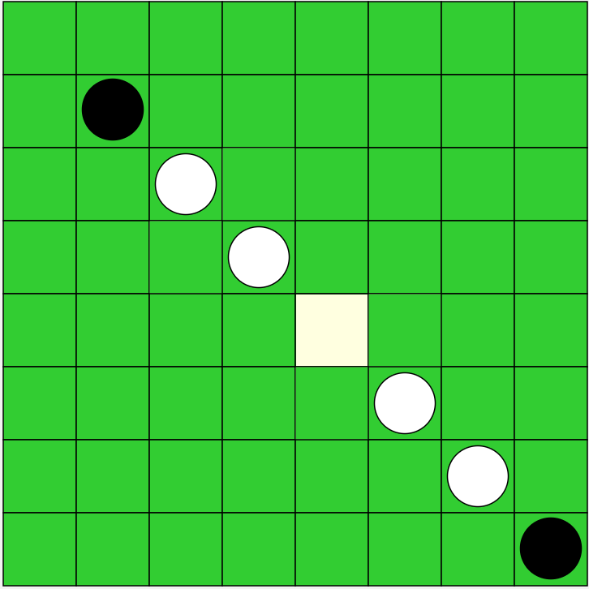
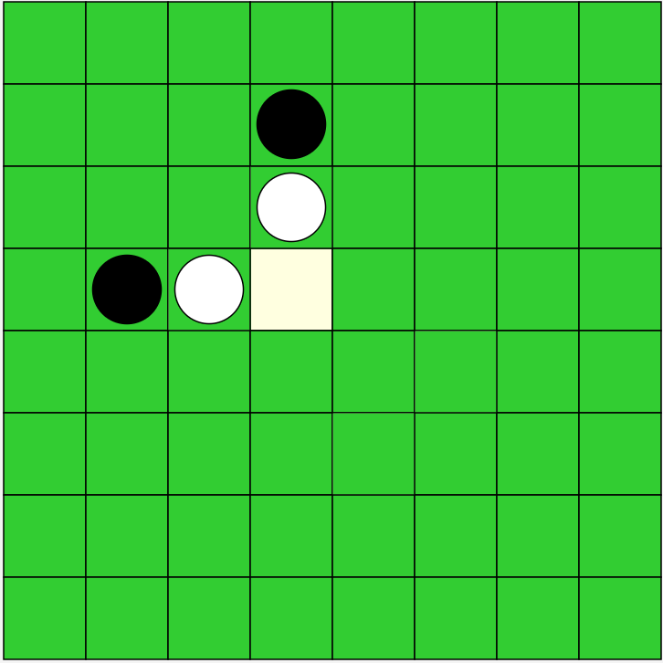
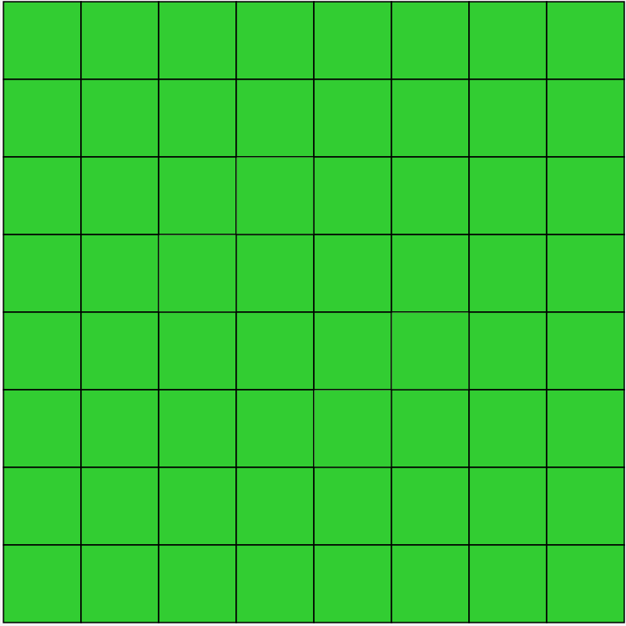
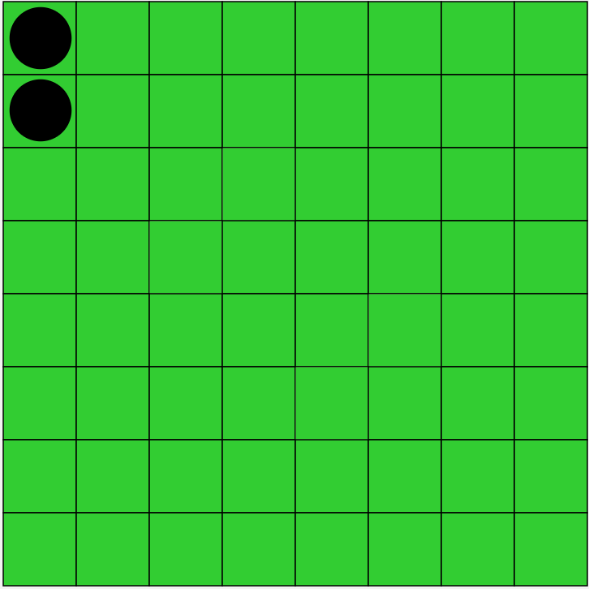
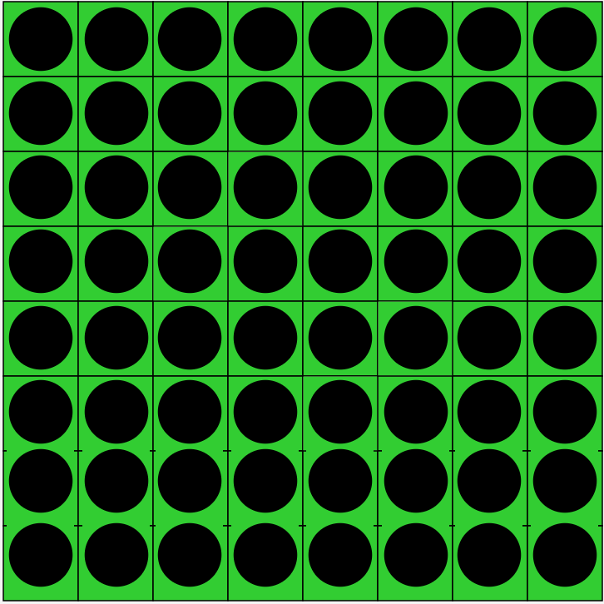
Test
OthelloGameTest
Initialization
Initial-legalmove B
Initial-legalmove W
Check Flip
GameRunning
Initialization
Flip Logic
Game Flow
computerDecision
MinimaxTest
BackFront Flip
LeftRightFlip
Split Flip
Diagonal Split Flip
multiDirection Flip
LearningTrainTest
TDLearningTest
MCTS-relatedTest
Take Space No Op
Take Space Of Null
2-SkipsThenGameOver
fullBoardNoMoves

Slide 2
Test
OthelloGameTest
Initialization
Initial-legalmove B
Initial-legalmove W
Check Flip
GameRunning
Initialization
Flip Logic
Game Flow
computerDecision
MinimaxTest
BackFront Flip
LeftRightFlip
Split Flip
Diagonal Split Flip
multiDirection Flip
LearningTrainTest
TDLearningTest
MCTS-relatedTest
Take Space No Op
Take Space Of Null
2-SkipsThenGameOver
fullBoardNoMoves

Slide 3
Test
Initialization
Initial-legalmove B
Initial-legalmove W
Check Flip
OthelloGameTest
GameRunning
Initialization
Flip Logic
Game Flow
computerDecision
multiDirection Flip
BackFront Flip
LeftRightFlip
Split Flip
Diagonal Split Flip
Take Space No Op
Take Space Of Null
2-SkipsThenGameOver
fullBoardNoMoves

Slide 4
Test
computerDecision
OthelloGameTest
Call Minimax
GameRunning
Call Custom
Initialization
Flip Logic
Call MCTS
Game Flow
computerDecision
Exception UnknownStrategy
DummyComputerPlayer

Slide 5
Test
computerDecision
OthelloGameTest
Call Minimax
Verifies that when the player’s strategy is "minimax", game.computerDecision(...) invokes the minimax branch and returns the stub’s predetermined move.
GameRunning
Call Custom
Initialization
Flip Logic
Call MCTS
Game Flow
computerDecision
Exception UnknownStrategy
DummyComputerPlayer

Slide 6
Test
computerDecision
OthelloGameTest
Call Minimax
Verifies that when the player’s strategy is “custom", game.computerDecision(...) invokes the custom branch and returns the stub’s predetermined move.
GameRunning
Call Custom
Initialization
Flip Logic
Call MCTS
Game Flow
computerDecision
Exception UnknownStrategy
DummyComputerPlayer

Slide 7
Test
computerDecision
OthelloGameTest
Call Minimax
Verifies that when the player’s strategy is “MCTS", game.computerDecision(...) invokes the MCTS branch and returns the stub’s predetermined move.
GameRunning
Call Custom
Initialization
Flip Logic
Call MCTS
Game Flow
computerDecision
Exception UnknownStrategy
DummyComputerPlayer

Slide 8
Test
computerDecision
OthelloGameTest
Call Minimax
GameRunning
Call Custom
Initialization
Flip Logic
Call MCTS
Verifies that when the player’s strategy is unrecognized, game.computerDecision(...) returns null.
Game Flow
computerDecision
Exception UnknownStrategy
DummyComputerPlayer

Slide 9
Test
computerDecision
OthelloGameTest
Call Minimax
GameRunning
Call Custom
Initialization
Flip Logic
Call MCTS
Game Flow
computerDecision
Exception UnknownStrategy
DummyComputerPlayer
Isolate and test computerDecision() branch selection without real AI overhead.

Slide 10
Test
MinimaxTest
Weight Evaluation
Weight Evaluation
Tree Construction
weightEvalTest
adding a piece changes score by its weight
Strategy Selection
emptyWeightTest
empty board scores zero
Board
Alpha-Beta Pruning

Slide 11
Test
MinimaxTest
Tree Construction
Weight Evaluation
Tree Construction
emptyBoardLeafTest
no moves ⇒ leaf node, weight 0
Strategy Selection
noMoveTest
same as above with standard board
Board
depthLeafTest
at maxDepth, children are weight‐bearing leaves
Alpha-Beta Pruning
BuildDepthErrorTest
maxDepth < 2 throws IllegalArgumentException

Slide 12
Test
MinimaxTest
Strategy Selection
Weight Evaluation
Tree Construction
twoLayerChoiceTest
on B-W-W-W chain, depth-2 minimax picks far flip
Strategy Selection
opponentNoMoveTest
if opponent cannot reply, return the only move
Board
oneStepNoMoveTest
no legal moves ⇒ return null
Alpha-Beta Pruning

Slide 13
Test
MinimaxTest
Board
Weight Evaluation
Tree Construction
verticalFlipTest
futureBoard correctly flips a vertical chain
Strategy Selection
futureBoardNullOriginTest
illegal move ⇒ null board
Board
copyPrintTest
copy is independent, toString matches
Alpha-Beta Pruning
copyIsolationTest
mutating copy does not affect original

Slide 14
Test
MinimaxTest
Alpha-Beta Pruning
Weight Evaluation
Tree Construction
BetaPruneTest
max-branch pruning skips worse child
Strategy Selection
Board
Alpha-Beta Pruning

Slide 15
Test
LearningTrainTest
Model Persistence
save/load
Training Loop
repeatGame & trainVsOther
Single-Game Simulation
singleGame
Board
DeepCopyTest

