Slide 1
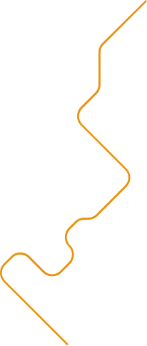





Palo Alto Firewall Deployment in AWS using IAC techniques
By Chidi

Slide 2


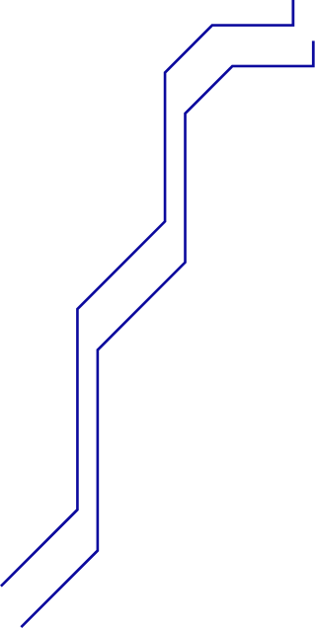

Project Overview
A walkthrough guide for deploying a
Palo Alto Networks VM-Series firewall
in AWS using Terraform.

Slide 3
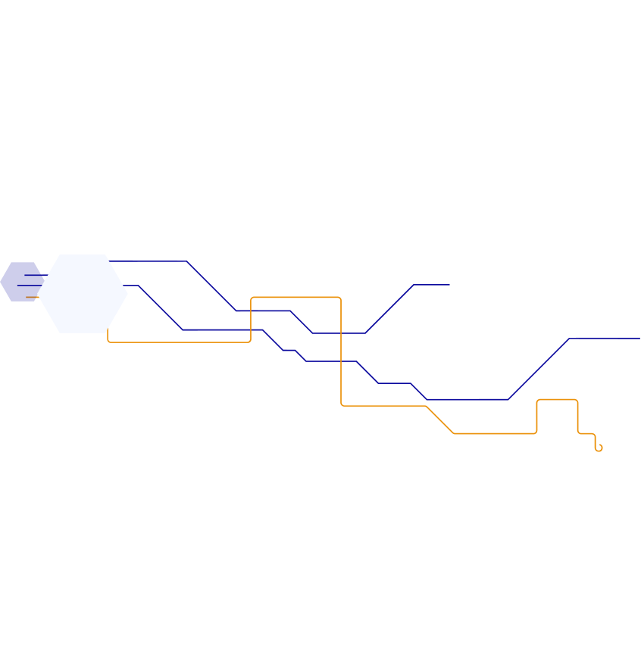
🚀 Prerequisites
01
02
AWS Account
Terraform
Ensure you already have an AWS account with the proper iam user with programatic access
Install terraform into your local Machine
03
04
AWS CLI
SSH Key Pair
You need to install AWS CLI into your local Machine or whatver VM you are working with
Create an SSH keypair and download it

Slide 4
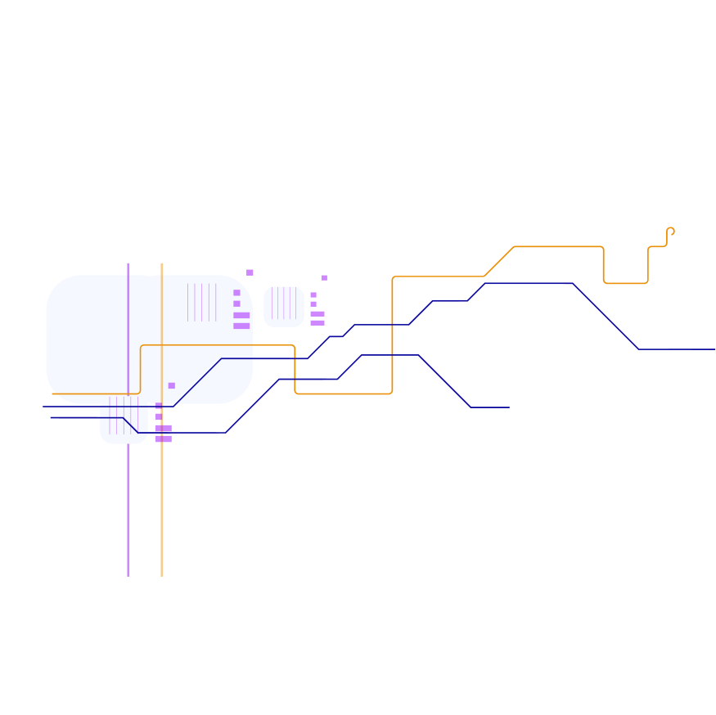



01
Infrastructure
with Terraform

Slide 5






02
🔒 Post-Deployment Access

Slide 6






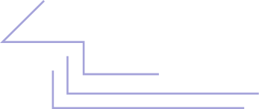
03
📋 Cleanup

