Slide 1


Computer Science Honors Society
September Meeting
9/15/26

Slide 2
CSHS Officers
D
🠺
Mr. Miller
Club Sponsor
🠺
Shlok Joshi
President
Devna Girish
Vice President
Zainab Sayyeda
Secretary/Historian
Evan Rosen
Webmaster
Soham Bhathula
Jr. Webmaster
Advika Mahesh
Member at Large
Heena Parekh
Vice President
Natalie Wooden
Secretary

Slide 3

D
CSHS Point Requirements
🠺
🠺
In order to remain in CSHS, members must earn 10 total points during the school year, with at least 2.5 points coming from meetings. Each meeting, members earn 0.5 meeting points.
Service Awards
BRONZE 25 points
SILVER 50 points
GOLD 100 points
Make sure you attend at least 5 club meetings throughout the school year.

Slide 4
D
CSHS Points
1
🠺
Point Categories
Logging Points
  To log CSHS Service points, visit Point Form
  You cannot log both CSHS and Community Service Hours for the same event (no double dipping!)
  You must meet point requirements to be considered for an officer position.
🠺
Participation | Awarded for participating in CS-related activities or completing verifiable CS course(s) (points vary)
Service | 1 point per hour of volunteering in OR organizing a CS-related activity
Meeting | 0.5 points for Attending and participating in CSHS meetings

Slide 5

VA STAR - Bridge Event
What: Repairing and donating laptops to families then teaching them how to use it
2 Service points
25 volunteers (for the event)
Laptop repairing will happen during lunch.
No experience needed!

Slide 6
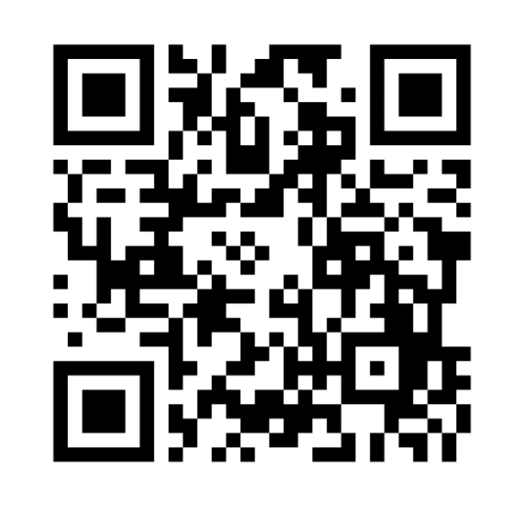
CS Wednesdays
SERVICE OPPORTUNITY
Students may lead a CS discussion for service points and members will receive participation points for attending
Volunteers will receive one service point per hour they worked on it.
CIT Sophomores: you can present your COW presentations
Time: Wednesdays during lunch
Location: Will take place in room SC2
Complete form to be a volunteer:
tinyurl.com/CS-Wednesdays

Slide 7
New Attendance Tracker
UPDATE
Must have Student ID out before entering auditorium
2-3 officers will be scanning your ID as you enter
This DOES NOT mean you can leave right after
Registration

