Slide 1
Office for Civil Rights Investigations, Initiatives, and Updates
Jennifer Mauskapf, Esq.
jmauskapf@bruman.com
Brustein & Manasevit, PLLC
Fall Forum 2015

Slide 2
Overview
Enforcement Agencies
OCR Caseload and Initiatives
Current Areas of Focus
Resources

Slide 3
Enforcement Agencies
US Dept. of Education, Office for Civil Rights (OCR)
US Dept. of Justice, Civil Rights Division (DOJ CRD)

Slide 4

Office for Civil Rights (OCR)
Department of Education, Office for Civil Rights
Mission: “To ensure equal access to education and to promote educational excellence throughout the nation through vigorous enforcement of civil rights.”

Slide 5
OCR & Civil Rights Laws
1964: Title VI of the Civil Rights Act
1972: Title IX of the Education Amendments
1973: Section 504 of the Rehabilitation Act
1975: The Age Discrimination Act
1990: Title II of the Americans with Disabilities Act
2002: Boy Scouts of America Equal Access Act, ESEA § 9525

Slide 6
OCR
Carries out mission through:
Complaint Investigation and Resolution
Proactive Enforcement: Compliance Reviews
Monitoring of Resolution Agreements
Technical Assistance
Affirmative Actions Required
Civil Rights Data Collection (CRDC)
Methods of Administration

Slide 7
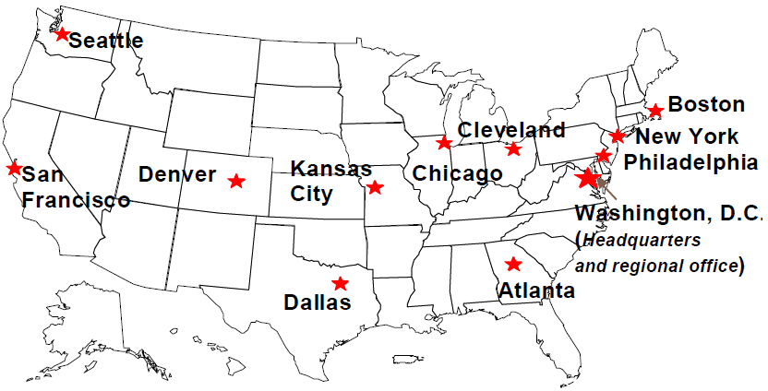
OCR Organization
Washington, DC Headquarters
Assistant Secretary
12 Enforcement Offices

Slide 8

US Department Of Justice (DOJ)
Department of Justice, Civil Rights Division
Mission is to uphold the civil and constitutional rights of all Americans, particularly some of the most vulnerable members of our society

Slide 9
DOJ Civil Rights Division
Enforces a broader range of statutes including:
The Civil Rights Act of 1965
Title III of The Americans with Disabilities Act of 1990
Sections 504 and 508 of the Rehabilitation Act of 1973
May enforce IDEA and Title II of the ADA upon referral from other governmental agencies

Slide 10
DOJ CIVIL RIGHTS DIVISION
Headquarters in Washington, D.C.
Division is made up of 11 sections including the Educational Opportunities and Disability Rights sections
Disability Rights Section Activities:
Enforcement
Certification
Negotiated Rulemaking
Coordination
Technical Assistance

Slide 11
OCR Caseload and Initiatives

Slide 12
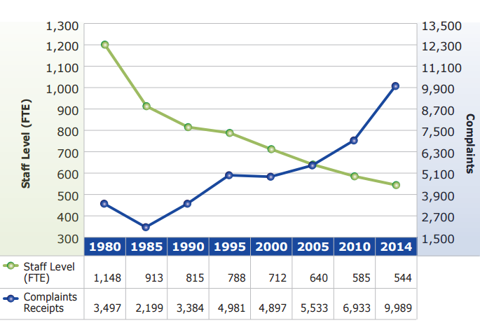
OCR Staff Level and Complaints Received Source: OCR Report to the President

Slide 13
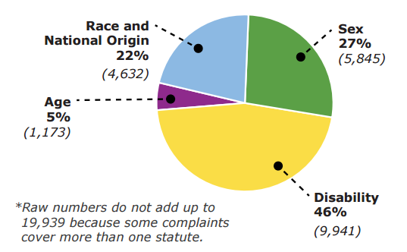
Complaint Caseload FYs 2013-2014 Source: OCR Report to the President

Slide 14
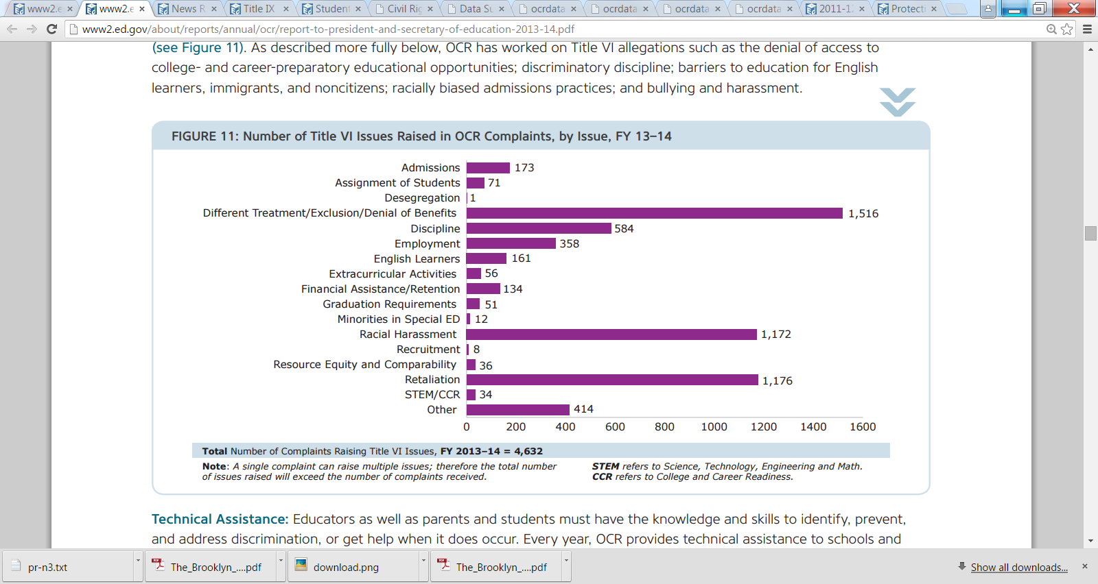
Title VI Complaint Issues, FY 13-14 Source: OCR Report to the President

Slide 15
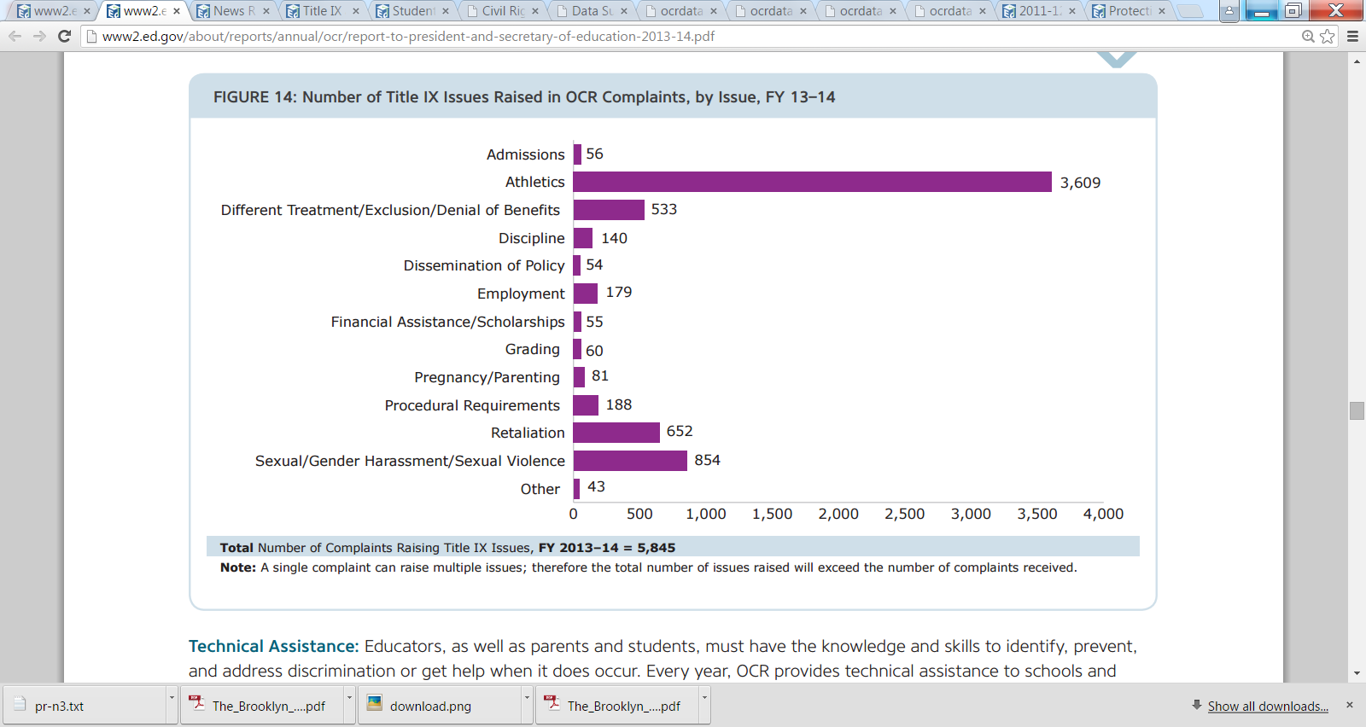
Title IX Complaint Issues, FY 13-14 Source: OCR Report to the President

Slide 16
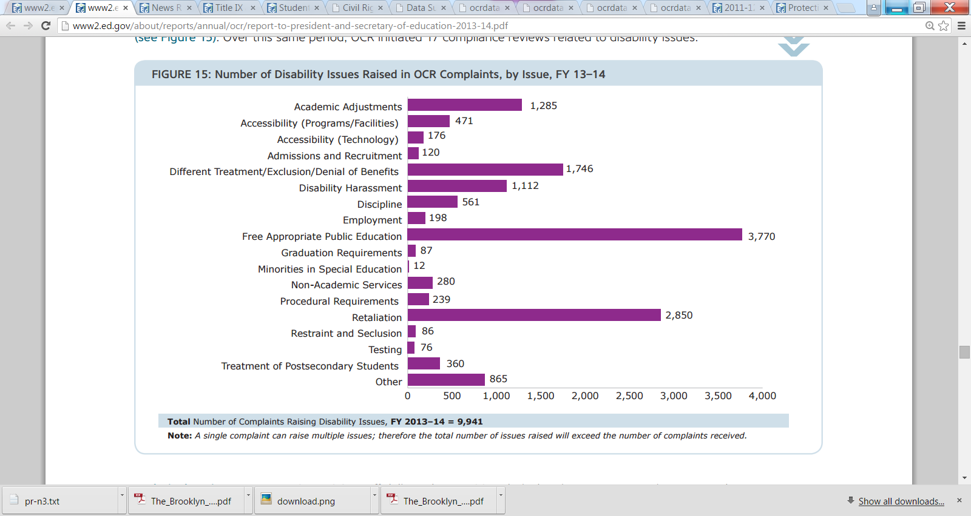
Disability Complaint Issues, FY 13-14 Source: OCR Report to the President

Slide 17
OCR Proactive Enforcement
CRDC
Inter/Intra Agency Initiatives
Guidance / Dear Colleague Letters (DCLs)
Compliance Reviews
Monitoring of Resolution Agreements
Website Update

Slide 18
OCR Investigation and Resolution: What to Expect

Slide 19
Case Processing Manual (CPM) *Revised February & October 2015
Filing the Complaint/Opening of the Case
Rapid Resolution Process (RRP)
Early Complaint Resolution (ECR)
Mediation Process
Timeline
Outcomes:
Success → ECR Agreement
ECR not successful → Return to Investigation
Investigation

Slide 20
Ways to Resolve an OCR Case
ECR Agreement
Section 302 Resolution Agreement
Reached during Investigation
No OCR determination
Investigative Determination
Insufficient Evidence Determination
Non Compliance Determination
304 Resolution Agreement Guidelines
Enforcement Action
Note: Negotiation Timelines

Slide 21
Additional CPM Sections
Complainant Right to Appeal
Monitoring of Resolution Agreements
Compliance Reviews & Directed Investigations
Enforcement Action
Special Intake Procedures
Data Collection and Information Gathering

Slide 22
Select Areas of Focus
Bullying/Harassment
Discriminatory Discipline
National Origin Discrimination and Language Access
Accessibility to Emerging Technologies
Comparable Educ. Opportunities
Sexual Harassment and Assault
Retaliation
Enforcement at Charter Schools

Slide 23
Bullying
Oct. 2010: ED Dear Colleague Letter (DCL) http://www2.ed.gov/about/offices/list/ocr/letters/colleague-201010.html
Relationship between bullying and discriminatory harassment
Obligation to protect students from student-on-student harassment on the basis of sex; race, color, and national origin; and disability
October 21, 2014 DCL on Bullying and SWDs http://www2.ed.gov/about/offices/list/ocr/letters/colleague-bullying-201410.pdf

Slide 24
Addressing Bullying
Anti-bullying Policies
Address all discriminatory harassment incidents when they occur
Training on recognition of and responsibilities to respond to discriminatory harassment
Document reports of discriminatory harassment and investigations
Meaningful consequences to address discriminatory behavior
ED/HHS/DOJ site: www.stopbullying.gov

Slide 25
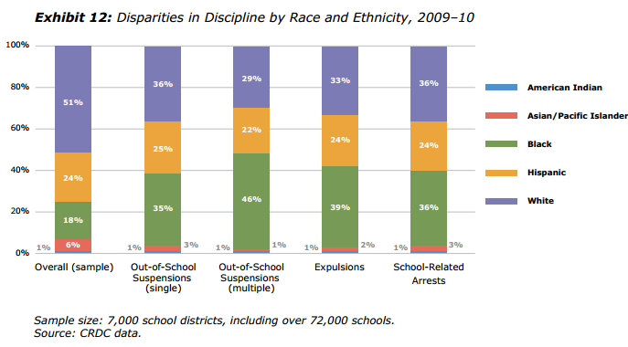
Discipline Disparities – Race Source: OCR Report to the President

Slide 26
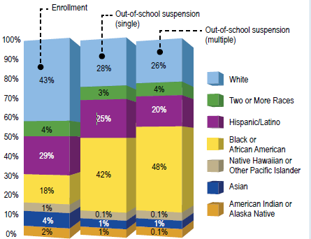
Discipline Disparities – Race, FY 13-14 Source: OCR Report to the President

Slide 27
Combating Discipline Disparities
Guidance Package to Enhance School Climate and Improve School Discipline Policies/Practices, 1/8/14
FY 13-14:
OCR launched 9 proactive investigations related to racial disparities in discipline.
Received 580+ Complaints

Slide 28
Discriminatory Discipline Oakland Compliance Review
Oakland Unified School District
Student population - 32% African American
Suspended students - 63% African American
20% of African American male students suspended at least once a year (6x the rate of white students)
Resolution:
Try not to remove misbehaving student from school
Collaborate with experts on research-based strategies to develop positive school climates that prevent school discipline discrimination
Identify at-risk students and provide them with support services to decrease behavioral difficulties
Provide academic services for students who are removed from school for disciplinary reasons

Slide 29
Discriminatory Discipline School-to-Prison Pipeline
Mississippi Consent Decree, 5/30/13
Kids imprisoned for minor offenses, including school disciplinary infractions
Kids punished disproportionately without due process rights
Most affected students disabled and African American
Broward County (FL) Agreement, 11/5/13
New model for other jurisdictions?

Slide 30
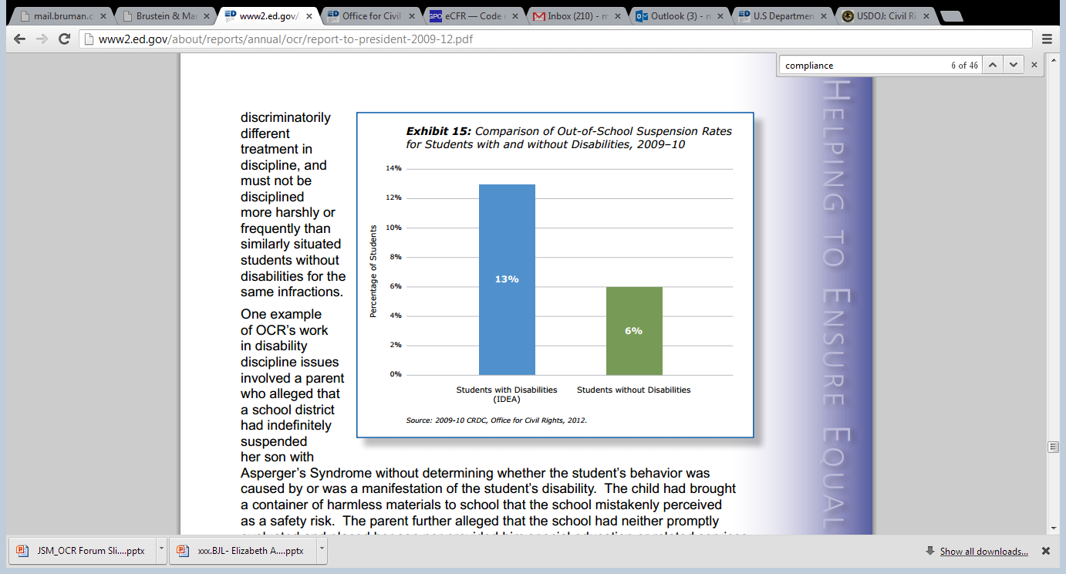
Discipline Disparities– Disability Source: OCR Report to the President

Slide 31
Discipline Disparities– Disability
Resolution agreements have included:
Remedies to ensure manifestation determination reviews (MDR) occur
Training to Staff
Monitoring implementation of MDR protocol
Recent Cases:
Riverview Gardens (MO)
Durham Public Schools (NC)

Slide 32
Recent Key National Origin Based Guidance Documents
OCR/DOJ Joint Guidance to Ensure EL Students Have Equal Access to a High-Quality Education, 1/7/15
http://www.ed.gov/news/press-releases/us-departments-education-and-justice-release-joint-guidance-ensure-english-learn
Title III Toolkit: http://www2.ed.gov/about/offices/list/oela/english-learner-toolkit/index.html
Guidance for School Districts to Ensure Equal Access for All Children to Public Schools Regardless of Immigration Status, 5/8/14 (Update to joint 2011 guidance)
http://www.ed.gov/news/press-releases/secretary-duncan-and-attorney-general-holder-issue-guidance-school-districts-ens

Slide 33
Discriminatory Enrollment Practices May 2014 Dear Colleague Letter
May request proof that student resides within boundaries of school district
May not ask about citizenship or immigration status
May not prevent enrollment because lacks birth certificate or has foreign birth certificate
May request but may not require SSN from student or parent. If SSN requested, must:
Notify that providing such is voluntary and not mandatory for enrollment, and
Explain how SSN will be used

Slide 34
Language Access Parental Communications
Wider Population
Not just parents of EL students
Includes parents who are ELs (regardless of student language proficiency)
Translation and Interpretation Services
Recent Agreements
Tulsa Public Schools (OK), 1/22/13
DeKalb County School District (GA), 6/27/13
Jefferson Parish Public Schools (LA), 7/8/14

Slide 35
Other Recent Language Access Resolution/Settlement Agreements
Dearborn Public Schools (MI), 5/30/12
LEP Parental Communication
Equal Access to Non-Academic Programs/Activities
De Queen School District (AR), 12/6/12
Prince Wm. Co. (VA), 9/5/13
Ganado School District (AZ), 2/18/14
Stamford Public School District (CT), 2/28/14
Hazleton Area School District (PA), April 2014
Clay Co. (AL), 6/19/14
Orleans Parish (LA), July 2014
Crestwood School District (MI), 8/13/14

Slide 36
ADA: Accessible Technology
Univ. of Virginia Darden School of Business, 7/23/10
Use of Kindles denied students equal access to university programs, activities and effective communication
Similar agreements with other postsecondary schools
OCR DCL, 6/29/10
Cannot use inaccessible technology where no reasonable accommodation or modification exists or is unavailable
OCR FAQ, 5/26/11
Discusses equal access requirements of ADA and Section 504 to the use of emerging technology
South Carolina Technical College System, 3/8/13
Website accessibility to persons who are blind, have low vision, or have other print-related disabilities

Slide 37
Comparable Educational Opportunities—Title VI
Topic for more than 20% of OCR’s FY 13-14 Compliance Reviews
South Orange-Maplewood (NJ), 10/28/14
Black students significantly underrepresented in advanced and higher-level learning opportunities
Cleveland Metropolitan (OH), Jan. 2014
Seats in STEM schools went unfilled, yet district was not advertising course availability in Spanish, home language of 80% of the district’s ELs
White Plains (NY), 4/18/13
Disproportionately low number of minority students in GATE programs, Honors and AP courses
Pike Township (IN), 12/5/12
Examined whether African-American students provided equal access to rigorous college preparatory courses, specifically the IB

Slide 38
Guidance re: Equal Access to Rigorous Courses and Curricula (Oct. 2014)
Categories of Educational Resources
Courses, Academic Programs, Extracurricular Activities
Access to Strong Teaching and Instruction
School Facilities
Technology and Instructional Materials
Recommends LEAs proactively assess policies and practices
Highlights Potential Remedies

Slide 39
Additional Initiatives
My Brother’s Keeper
GOAL: To address persistent opportunity gaps faced by boys and young men of color and ensure that all young people can reach their full potential
Excellent Educators for All
Comprehensive Educator Equity Plans
Educator Equity Support Network
Educator Equity Profiles

Slide 40
Sexual Harassment and Assault
Jan. 2014: White House Task Force to Protect Students from Sexual Assault
April 2014
Task Force released first report of recommendations
OCR
DCL on Sexual Violence, 4/4/11
Q&A about Title IX and Sexual Violence, 4/29/14
FY 13-14:
19% of OCR’s Compliance Reviews
9% of OCR’s Complaints

Slide 41
Sexual Harassment and Assault
5/1/14: OCR released list of colleges and universities with open “sexual violence investigations”
List included 55 cases
Over 80 cases pending at that time
Recent Agreements
Univ. of Virginia, 9/21/15
Southern Methodist Univ., 11/16/14
Princeton Univ., 11/5/14
Elem. Sec.: West Contra Costa (CA), 11/6/13

Slide 42
Sexual Harassment and Assault HEA Regulations Revised, 10/20/14
Requires colleges to provide training
Must define ‘consent’
Must outline campus policies on sexual misconduct
Requires collection of wider range of campus crime statistics
Number of cases determined ‘unfounded’
Allows victims and perpetrators to choose an advocate for disciplinary proceedings
Regs do not define standard of evidence to be used, ‘consent’, or how students found responsible for sexual assault should be penalized

Slide 43
Prohibition Against Retaliation
Prohibition Against Retaliation DCL, 4/24/13
FY 13-14 Complaints Received:
Title VI: 1,176
Title IX: 652
Disability: 2,850

Slide 44
Charter Schools
OCR DCL May 1, 2014
Non-Discrimination in Admissions
FAPE for Students with Disabilities
Affirmative Steps for English Language Learners
Nondiscrimination in Discipline
Online Virtual Charter School Investigation
Virtual Community School of Ohio
OCR notification of resolution, 11/6/13

Slide 45
Recent Dear Colleague Letters
Equal Access to Extracurricular Athletics for Students with Disabilities, 1/25/13
Rights of Individuals with Hepatitis B, 6/12/13
Supporting the Academic Success of Pregnant and Parenting Students, 6/25/13
Voluntary Use of Race and Ethnicity to Achieve Diversity in Education, 9/27/13
Communicating with Students with Hearing, Vision, or Speech Disabilities in Public Schools, 11/12/14

Slide 46
Recent Dear Colleague Letters
Guidance on Obligation of Schools to Designate a Title IX Coordinator, 4/24/15
Addressing Risk of Measles while Protecting Civil Rights of Students with Disabilities, 3/18/15
Guidance on Protecting Civil Rights in Juvenile Justice Residential Facilities, 12/8/14
Q&A on Title IX and Single-Sex Elem. and Secondary Classes and Extracurricular Activities, 12/1/14

Slide 47
Resources
ED Office for Civil Rights http://www2.ed.gov/about/offices/list/ocr/index.html
DOJ Civil Rights Division http://www.justice.gov/crt
OCR Report to the President FY 2009-2012 http://www2.ed.gov/about/reports/annual/ocr/report-to-president-2009-12.pdf
OCR Report to the President FY 13-14 http://www2.ed.gov/about/reports/annual/ocr/report-to-president-and-secretary-of-education-2013-14.pdf
Case Processing Manual http://www2.ed.gov/about/offices/list/ocr/docs/ocrcpm.pdf

Slide 48
Questions?

Slide 49
DISCLAIMER
This presentation is intended solely to provide general information and does not constitute legal advice or a legal service. This presentation does not create a client-lawyer relationship with Brustein & Manasevit, PLLC and, therefore, carries none of the protections under the D.C. Rules of Professional Conduct. Attendance at this presentation, a later review of any printed or electronic materials, or any follow-up questions or communications arising out of this presentation with any attorney at Brustein & Manasevit, PLLC does not create an attorney-client relationship with Brustein & Manasevit, PLLC. You should not take any action based upon any information in this presentation without first consulting legal counsel familiar with your particular circumstances.

