Slide 1
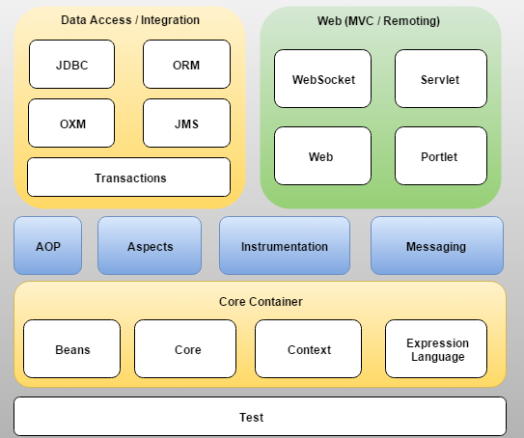
Spring Framework

Slide 2
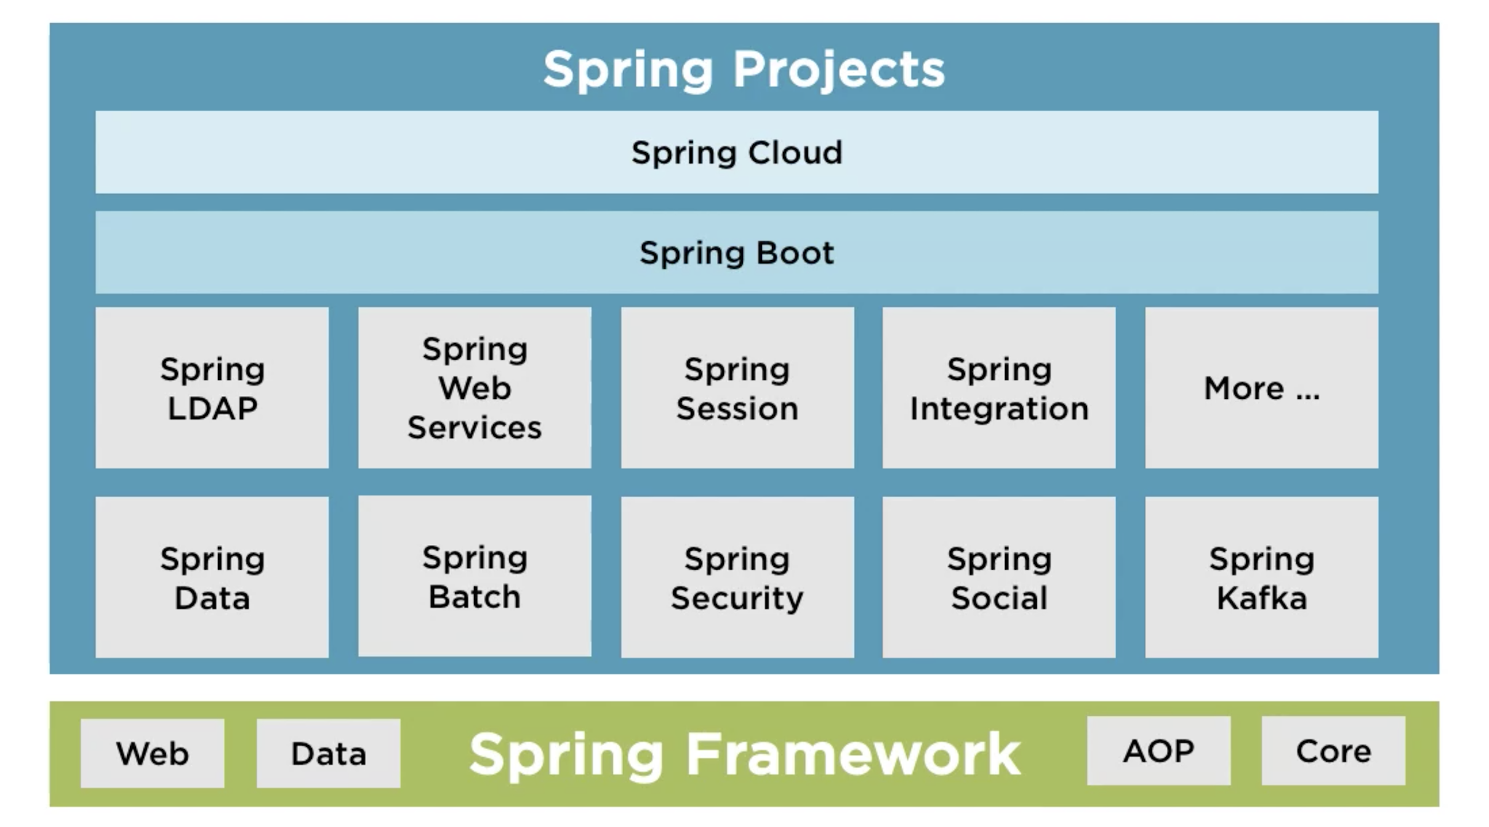
Spring Framework

Slide 3
Dependency Injection
The Inversion-of-Control (IoC) design principle, is about providing any kind of callback, which "implements" and/or controls reaction, instead of acting ourselves directly (in other words, inversion and/or redirecting control to the external handler/controller).
The Dependency-Injection (DI) pattern is a more specific version of IoC pattern, where implementations are passed into an object through constructors/setters/service lookups, which the object will "depend" on in order to behave correctly.

Slide 4
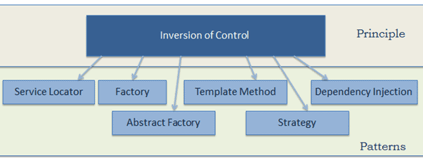
Inversion of control
The Inversion-of-Control (IoC) design principle, is about providing any kind of callback, which "implements" and/or controls reaction, instead of acting ourselves directly (in other words, inversion and/or redirecting control to the external handler/controller).

Slide 5
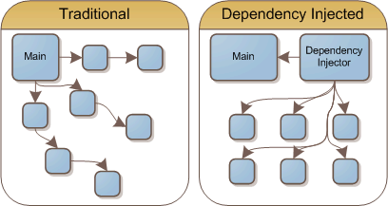
Dependency Injection
The Dependency-Injection (DI) pattern is a more specific version of IoC pattern, where implementations are passed into an object through constructors/setters/service lookups, which the object will "depend" on in order to behave correctly.

Slide 6
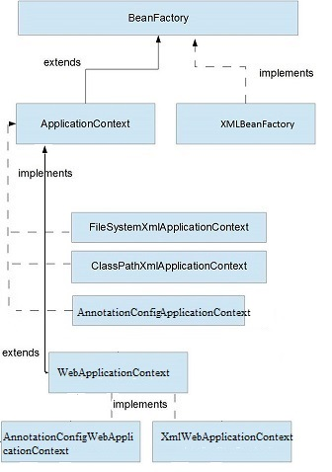
Application Context

Slide 7
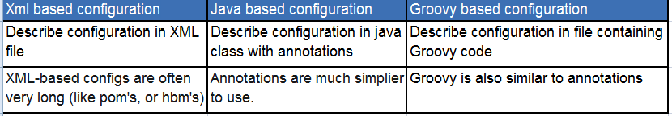
Application Context
Java-based:
Java-based configuration bean definition, when you add beans manually by declaration right in configuration.
Annotation-Based configuration bean definition, when you mark bean classes with specific annotations (like @Component, @Service, @Controller etc).

Slide 8
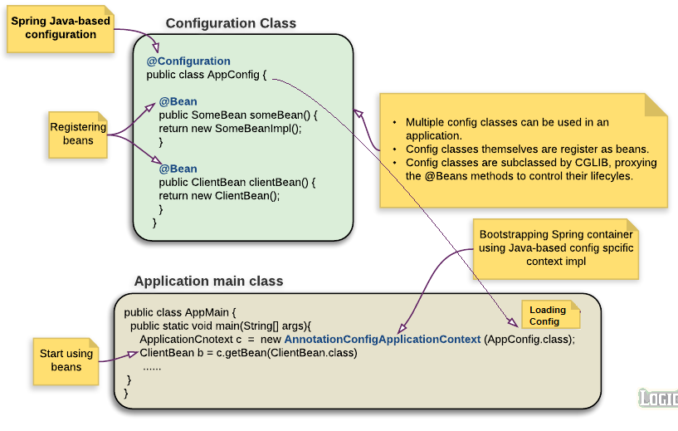
@Bean @Configuration

Slide 9
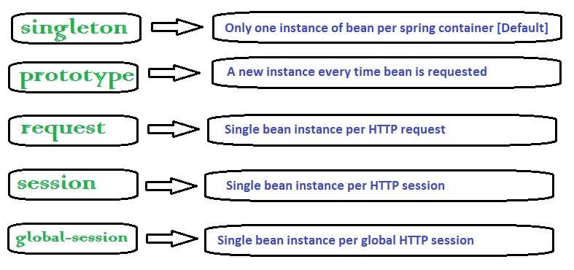
Bean scopes

Slide 10
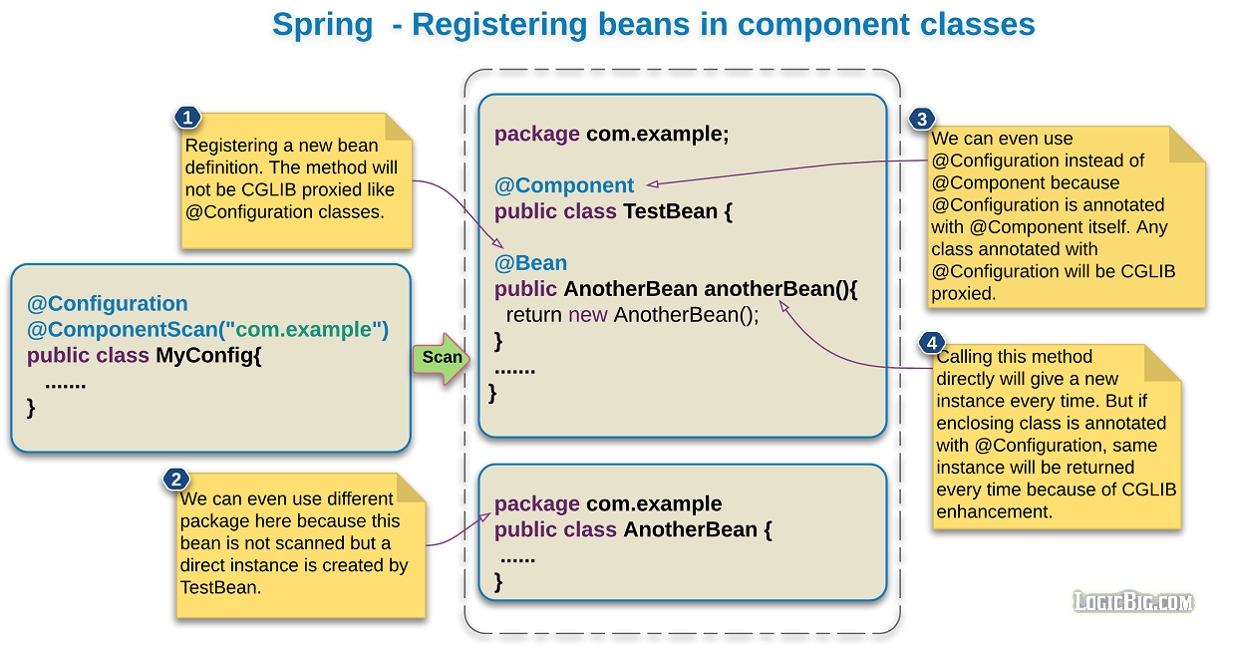
Register beans in components

Slide 11
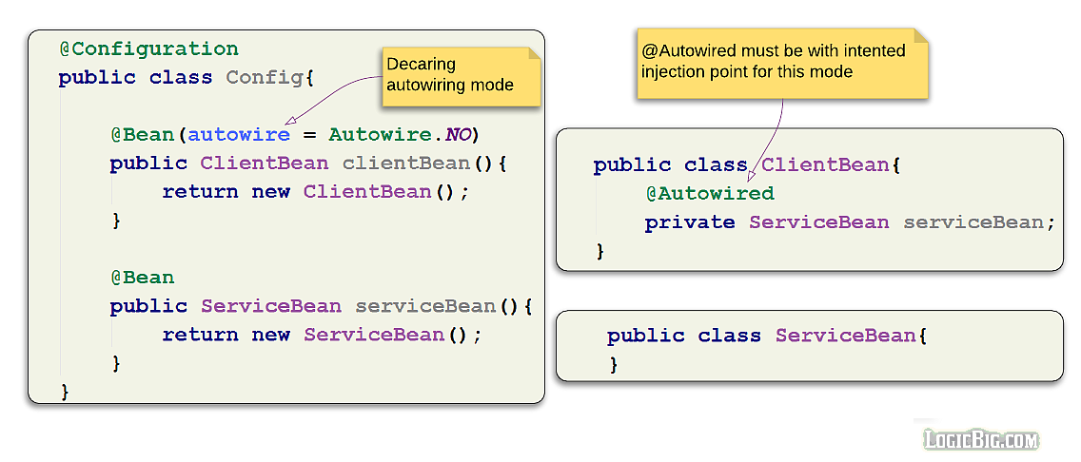
@Autowired

Slide 12
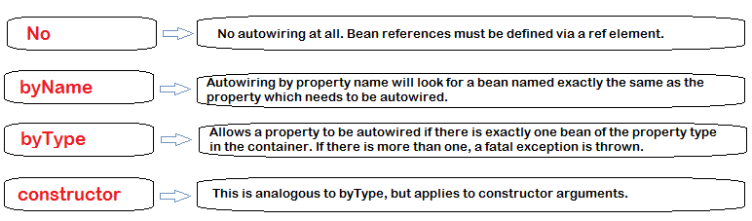
Spring Autowiring modes

Slide 13
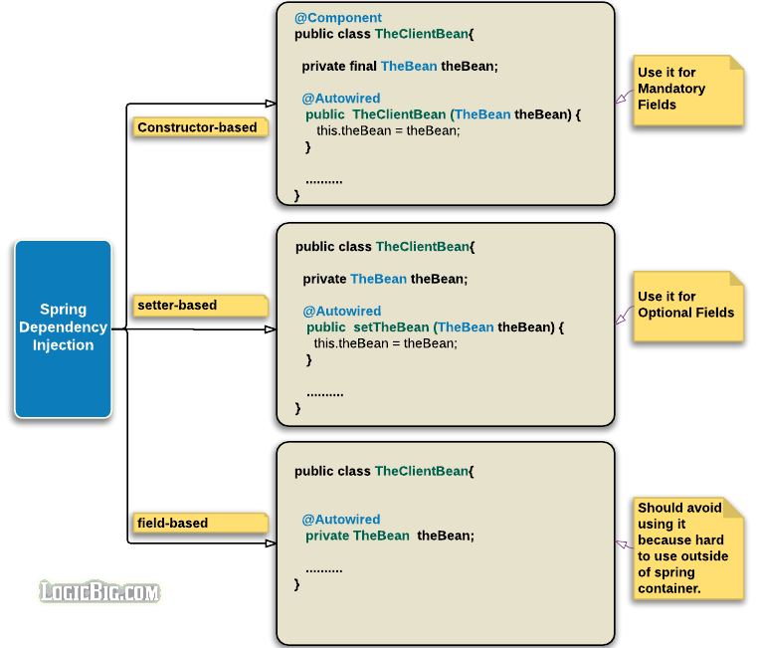
DI in Spring

Slide 14
Spring Bean Lifecycle

