Slide 1
No API? No problem!
API mocking with WireMock
An open source workshop by …
Originally created by Bas Dijkstra – bas@ontestautomation.com – https://www.ontestautomation.com
Notes:
1

Slide 2
What are we going to do?
Stubbing, mocking and service virtualization
WireMock
Exercises, examples, …
Notes:
2

Slide 3
Preparation
Install JDK (Java 17 or newer)
Install IntelliJ IDEA (or any other IDE)
Download or clone project
Import Maven project in IDE
Notes:
3

Slide 4
Section 0: An introduction to service virtualization

Slide 5
Problems in test environments
Systems are constructed out of of many different components
Not all of these components are always available for testing
Parallel development
No control over test data
Fees required for using third party components
…

Slide 6
Problems in test environments
Mobile app
SaaS dependency
Under development
Access fees
System under test
No suitable test data
Limited access
Backend system
Mainframe

Slide 7
Simulation during test execution
Simulate dependency behaviour
Regain control over test environment
Dependencies available on demand
Control over test data (edge cases!)
Eliminate third party component usage fees
…

Slide 8
Problems in test environments
Mobile app
SaaS dependency
Under development
Access fees
System under test
No suitable test data
Limited access
Backend system
Mainframe

Slide 9
Simulation in test environments
Virtualized mobile app
Virtualized SaaS dependency
Unrestricted access
Unrestricted access
System under test
Unrestricted access
Unrestricted access
Virtualized backend system
Virtualized mainframe

Slide 10

Our system under test
ParaBank
The world’s least safe
online bank
Request Loan process
Loan application is processed by 3rd party loan provider component
Notes:
10

Slide 11
ParaBank development team
3rd party development team
Frontend
/
API client
API
ParaBank middleware
API
Loan Processor service

Slide 12
ParaBank development team
WireMock
Frontend
/
API client
API
ParaBank middleware
API
Simulated Loan Processor service

Slide 13
What might we want to simulate?
Early testing against features under development
Easy setup of state for edge cases
Delays, fault status codes, malformatted responses, …
…

Slide 14
Section 1: Getting started with WireMock

Slide 15
WireMock
https://wiremock.org
Java
ports and adapters are available for many other languages
HTTP mock server
only supports HTTP(S)
Open source

Slide 16
WireMock Cloud https://www.wiremock.io

Slide 17
Install WireMock
Maven
<dependency> <groupId>org.wiremock</groupId>
<artifactId>wiremock</artifactId>
<version>3.9.2</version>
<scope>test</test>
</dependency>

Slide 18
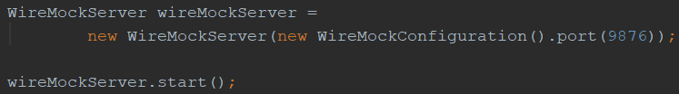
Starting WireMock (JUnit 4)
Via JUnit 4 @Rule
Without using JUnit 4 @Rule

Slide 19

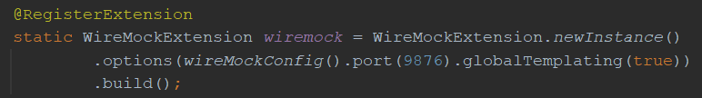
Starting WireMock (JUnit 5)
Uses the JUnit 5 Jupiter extension mechanism
Via @WireMockTest class annotation (basic configuration)
Using @RegisterExtension (full configuration)

Slide 20
Starting WireMock (standalone)
Useful for exploratory testing purposes
Allows you to share WireMock instances between teams
Long-running instances
Download the .jar first
java -jar wiremock-standalone-3.9.2.jar --port 9876

Slide 21
Configure responses
In (Java) code
Using JSON mapping files

Slide 22
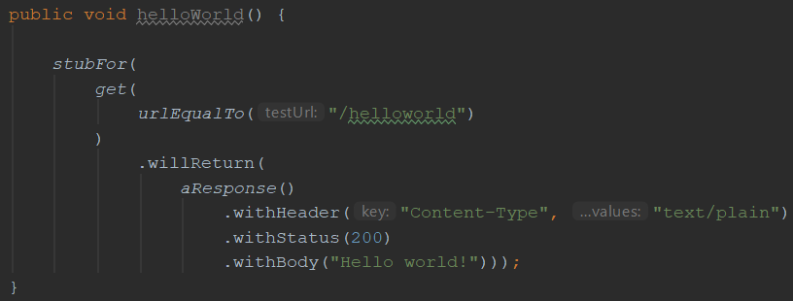
An example mock defined in Java

Slide 23
Some useful WireMock features
Verification
Verify that certain requests are sent by application under test
Record and playback
Generate mocks based on request-response pairs (traffic)
Fault simulation
…
Full documentation at https://wiremock.org/docs/

Slide 24
Now it’s your turn!
exercises > WireMockExercises1Test.java
Create a couple of basic mocks
Implement the responses as described in the comments
Verify your solution by running the tests in the same file
Answers are in answers > WireMockAnswers1Test.java
Examples are in examples > WireMockExamples1Test.java

Slide 25
Section 2: Request matching strategies and fault simulation

Slide 26
Request matching
Send a response only when certain properties in the request are matched
Options for request matching:
URL
HTTP method
Query parameters
Headers
Request body elements
…

Slide 27
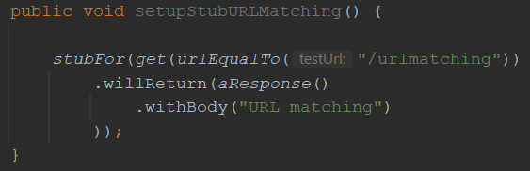
Example: URL matching
Other URL options:
urlPathEqualTo (matches only path, no query parameters)
urlMatching (using regular expressions)
urlPathMatching (using regular expressions)

Slide 28
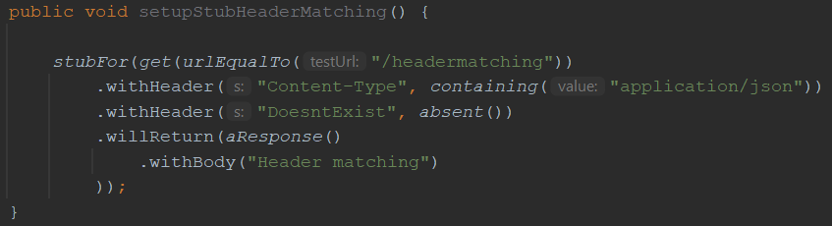
Example: header matching
absent(): check that header is not in request

Slide 29
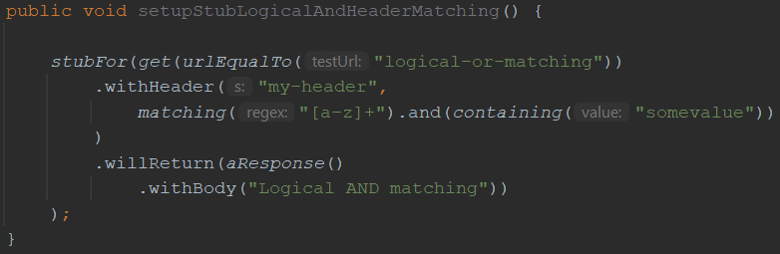
Example: using logical AND and OR
‘somevalue’ is matched
‘bananasomevaluebanana’ is matched
‘banana’ is not matched (does not contain ‘somevalue’)
‘123somevalue’ is not matched (contains numeric characters)

Slide 30
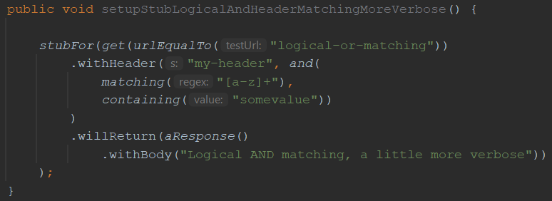
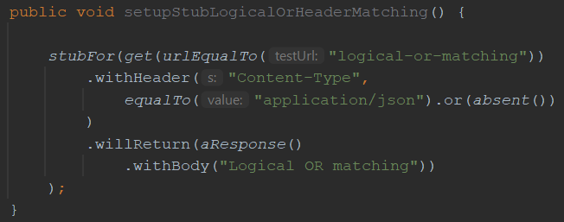
Some more examples…
Same behaviour as the previous example, using a slightly different syntax

Slide 31
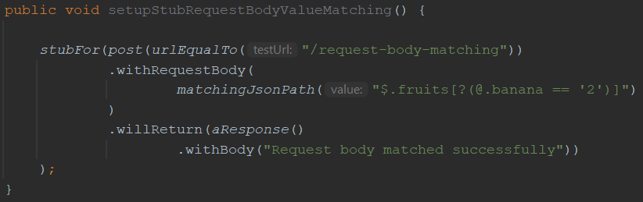
Matching on request body elements
Matching only those request bodies that have a root level element fruits with a child element banana with value 2
{“fruits”: {“banana”: “2”, “apple”: “5”} } ➔ MATCH
{“fruits”: {“apple”: “5”} } ➔ NO MATCH
{“fruits”: {“banana”: “3”, “apple”: “5”} } ➔ NO MATCH

Slide 32
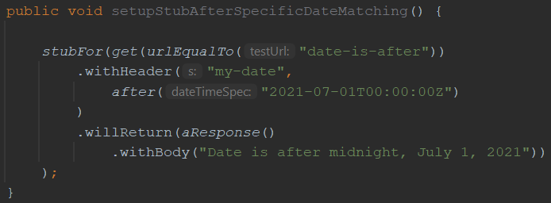
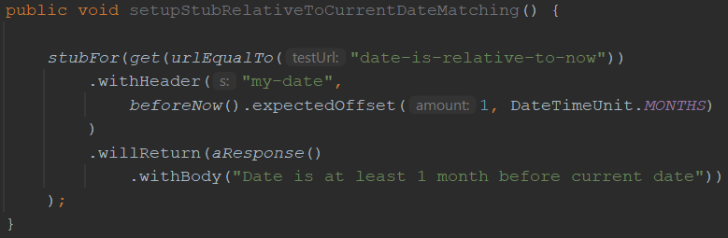
Matching using date/time properties
Matching all dates after midnight of July 1, 2021
Matching all dates at least 1 month before the current date

Slide 33
Other matching strategies
Authentication (Basic, OAuth(2))
Query parameters
Multipart/form-data
You can write your own matching logic, too

Slide 34
Fault simulation
Extend test coverage by simulating faults
Often hard to do in real systems
Easy to do using stubs or mocks
Used to test the exception handling of your application under test

Slide 35
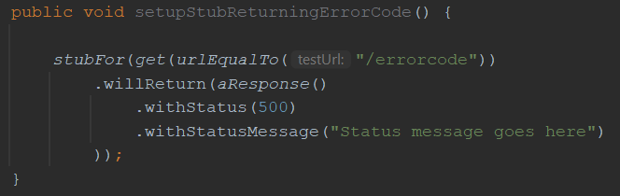
Example: HTTP status code
Some often used HTTP status codes:
Consumer error Provider error
403 (Forbidden) 500 (Internal server error)
404 (Not found) 503 (Service unavailable)

Slide 36
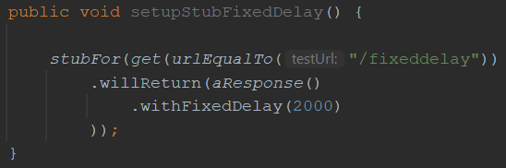
Example: timeout
Random delay can also be used
Uniform, lognormal distribution
Can be configured on a per-stub basis as well as globally

Slide 37
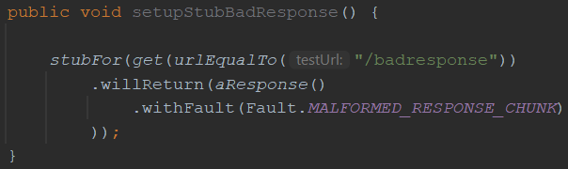
Example: bad response
HTTP status code 200, but garbage in response body
Other options:
RANDOM_DATA_THEN_CLOSE (as above, without HTTP 200)
EMPTY_RESPONSE (does what it says on the tin)
CONNECTION_RESET_BY_PEER (close connection, no response)

Slide 38
Now it’s your turn!
exercises > WireMockExercises2Test.java
Practice fault simulation and different request matching strategies
Implement the responses as described in the comments
Verify your solution by running the tests in the same file
Answers are in answers > WireMockAnswers2Test.java
Examples are in examples > WireMockExamples2Test.java

Slide 39
Section 3: Creating stateful mocks

Slide 40
Statefulness
Sometimes, you want to simulate stateful behaviour
Shopping cart (empty / containing items)
Database (data present / not present)
Order in which requests arrive is significant

Slide 41
Stateful mocks in WireMock
Supported through the concept of a Scenario
Essentially a finite state machine (FSM)
States and state transitions
Combination of current state and incoming request determines the response being sent
Before now, it was only the incoming request

Slide 42
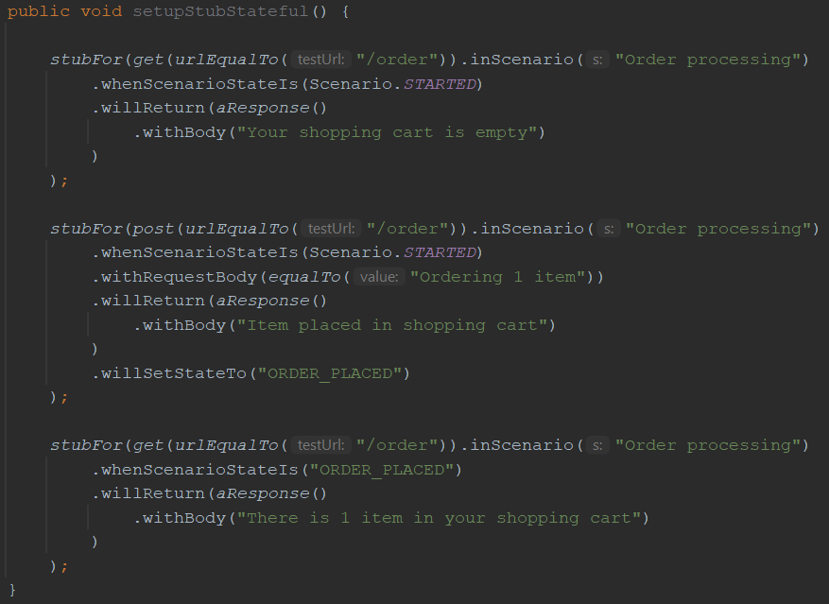
Stateful mocks: an example
Responses are grouped by scenario name
Response depends on both the incoming request as well as the current state
The initial state should always be Scenario.STARTED
Incoming requests can trigger state transitions
State names other than Scenario.STARTED are yours to define

Slide 43
Now it’s your turn!
exercises > WireMockExercises3Test.java
Create a stateful mock that exerts the described behaviour
Implement the responses as described in the comments
Verify your solution by running the tests in the same file
Answers are in answers > WireMockAnswers3Test.java
Examples are in examples > WireMockExamples3Test.java

Slide 44
Section 4: Response templating

Slide 45
Response templating
Often, you want to reuse elements from the request in the response
Request ID header
Unique body elements (client ID, etc.)
Cookie values
WireMock supports this through response templating

Slide 46
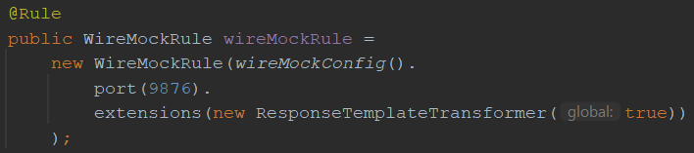
Setup response templating (JUnit 4)
In code: through the JUnit @Rule
Global == false: response templating transformer has to be enabled for individual stubs

Slide 47
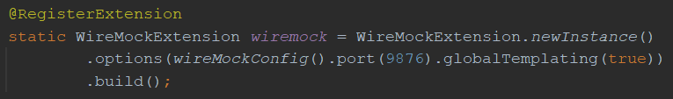
Setup response templating (JUnit 5)
In code: through the JUnit @RegisterExtension
Argument == false: response templating has to be enabled for individual stubs

Slide 48
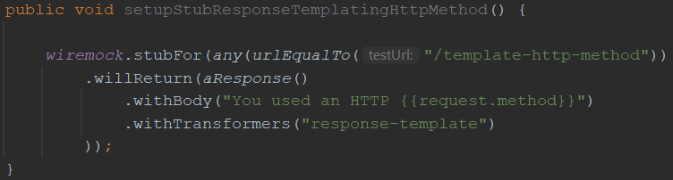
Enable/apply response templating
This template reads the HTTP request method (GET/POST/PUT/…) using {{request.method}} and returns it as the response body
This call to withTransformers() is only necessary when response templating isn’t activated globally

Slide 49
One thing to keep in mind…
Because we’re explicitly initializing a WireMock instance here…
… we need to explicitly assign our stub definition to that instance here, or else the stub definition will not be picked up!

Slide 50
Request attributes
Many different request attributes available for use
request.method : HTTP method (example)
request.pathSegments.[<n>] : n^{th} path segment
request.headers.<key> : header with name key
…
All available attributes listed at
https://wiremock.org/docs/response-templating/

Slide 51
Request attributes (cont’d)
Extracting and reusing body elements
In case of a JSON request body:
{{jsonPath request.body ‘$.path.to.element’}}
In case of an XML request body:
{{xPath request.body ‘/path/to/element/text()’}}

Slide 52
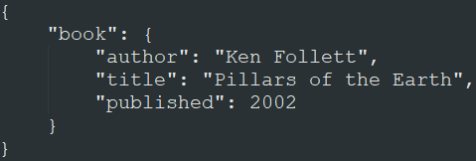
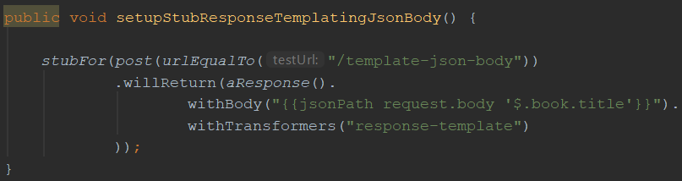
JSON extraction example
When sent this JSON
request body:
This stub returns a response with body “Pillars of the Earth”:
Again, this call to withTransformers() is only necessary when response templating isn’t activated globally

Slide 53
Now it’s your turn!
exercises > WireMockExercises4Test.java
Create mocks that use response templating
Implement the responses as described in the comments
Verify your solution by running the tests in the same file
Answers are in answers > WireMockAnswers4Test.java
Examples are in examples > WireMockExamples4Test.java

Slide 54
Section 5: Verification

Slide 55
Verifying incoming requests
Apart from returning responses, you might also want to verify that incoming requests have certain properties
Fail a test if these verifications aren’t met
You can do this with WireMock in a way very similar to mocking frameworks for unit tests (e.g., Mockito for Java)

Slide 56
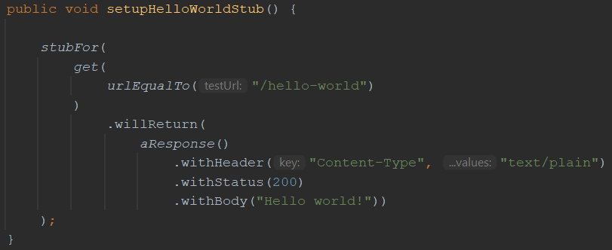
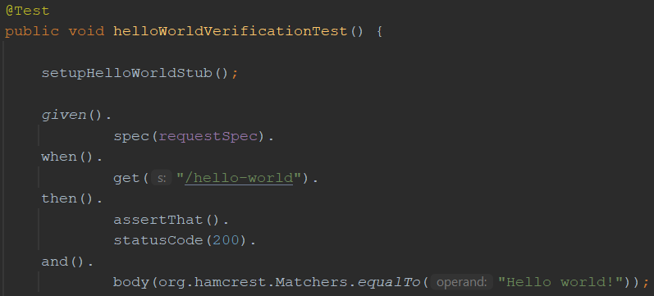
Verifying incoming requests
Given this simple ‘hello world’ stub
When we have this test that should invoke that stub exactly once
Then this verification can be added to the test to ensure that indeed, an HTTP GET to ‘/hello-world’ has been made exactly once

Slide 57
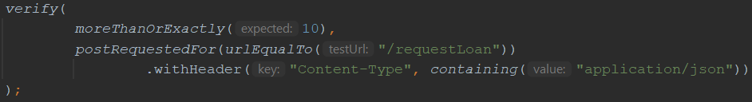
Some more verification examples
The same as the above, but less verbose
Verify that less than 5 HTTP POSTs were made to /requestLoan
Verify that 10 or more HTTP POSTs with a ‘Content-Type’ header value containing ‘application/json’ were made to /requestLoan

Slide 58
Now it’s your turn!
exercises > WireMockExercises5Test.java
Add WireMock verifications to the tests
Verify request properties as described in the comments
Verify your solution by running the tests
Answers are in answers > WireMockAnswers5Test.java
Examples are in examples > WireMockExamples5Test.java

Slide 59
Section 6: Extending WireMock

Slide 60
Extending WireMock
In some cases, the default WireMock feature set might not fit your needs
WireMock is open to extensions
Allows you to create even more powerful stubs
Several options available

Slide 61
Section 6.1: Filtering incoming requests

Slide 62
Request filtering
Modify incoming requests (or halt processing)
This has a variety of use cases:
Checking authentication details
Request header injection
URL rewriting
Created by implementing the StubRequestFilterV2 interface

Slide 63
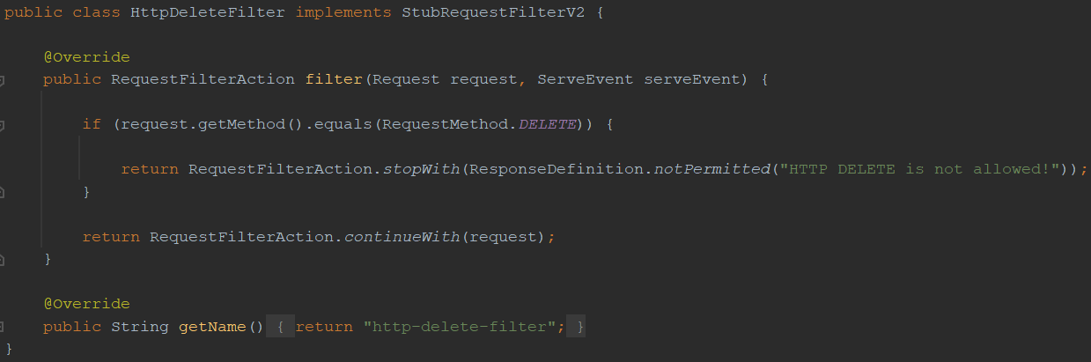
Request filtering – build
If the HTTP verb used equals DELETE…
Return an HTTP 403 and stop processing the request
Else continue processing the request

Slide 64
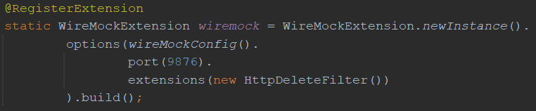
Request filtering – use
An extension can be registered using:
its class name (“com.example.HttpDeleteFilter”)
the class (HttpDeleteFilter.class)
an instance (new HttpDeleteFilter())

Slide 65
Now it’s your turn!
exercises > extensions > BasicAuthFilter.java
Implement a custom request filter that filters out all requests that do not have the proper basic authentication credentials
Verify your solution by running the tests in exercises > WireMockExercises6dot1Test.java
Answers are in answers > extensions > BasicAuthFilter.java
Examples are in examples > extensions > HttpDeleteFilter.java

Slide 66
Section 6.2: Building a custom request matcher

Slide 67
Custom request matchers
Add custom request matching logic to WireMock
Can be combined with existing standard matchers
Done by extending RequestMatcherExtension class

Slide 68
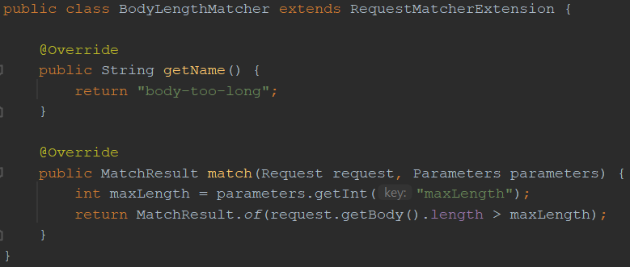
Custom request matcher – build
Get the value of the maxLength matcher parameter
Compare the request body length to the maxLength parameter value and return the result as a MatchResult

Slide 69
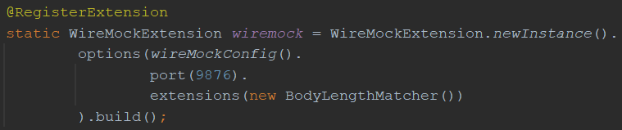
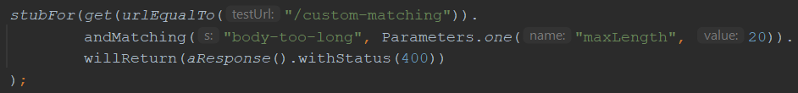
Custom request matcher – use
Register the extension
Use custom matcher in a stub definition using its name (can be combined with existing matchers)
Specify desired parameter value

Slide 70
Now it’s your turn!
exercises > extensions > RejectedHttpVerbsMatcher.java
Implement a custom matcher that reads a list of rejected HTTP verbs and matches the HTTP verb used in the incoming request against it
Verify your solution by running the tests in exercises > WireMockExercises6dot2Test.java
Answers are in answers > extensions > RejectedHttpVerbsMatcher.java
Examples are in examples > extensions > BodyLengthMatcher.java

Slide 71
Section 6.3 is waiting on https://github.com/wiremock /wiremock/issues/2525 to be resolved

Slide 72
Section 6.3: Executing post-serve actions

Slide 73
Post-serve actions
Perform specific actions after serving response
Logging, writing to database, …
Done by extending PostServeAction class

Slide 74
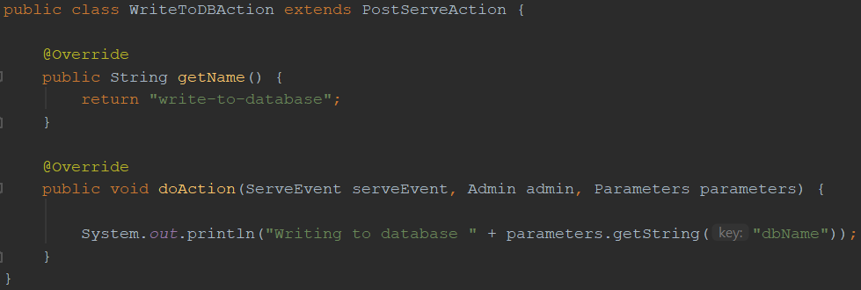
Post-serve action – build
This implements the post-serve action to execute after serving a response
Overriding doGlobalAction() automatically performs the action for all responses served by WireMock (no need to configure this on a per-stub basis anymore)

Slide 75
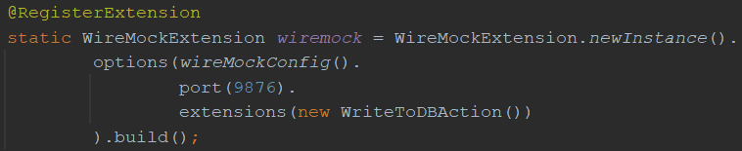
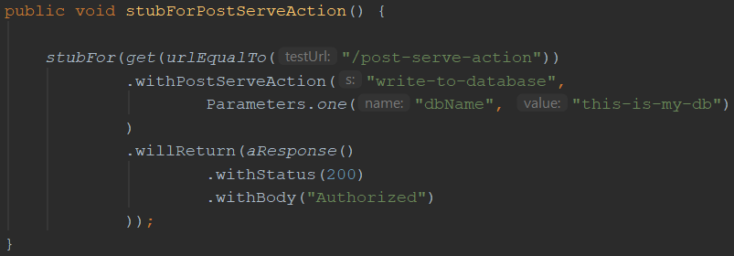
Post-serve action – use
Register the extension
Add the post-serve action to the stub definition and supply the desired parameter value

Slide 76
Now it’s your turn!
exercises > extensions > LogLoanRequestReceptionWithTimestamp.java
Implement a post-serve action that prints a log message containing the current date and time in the requested format to the console
Verify your solution by running the tests in exercises > WireMockExercises6dot3Test.java
Answers are in answers > extensions > LogLoanRequestReceptionWithTimestamp.java
Examples are in examples > extensions > WriteToDBAction.java

Slide 77
https://wiremock.org/docs /extending-wiremock/

Slide 78
Appendix A: JSON equivalents for the Java examples

Slide 79
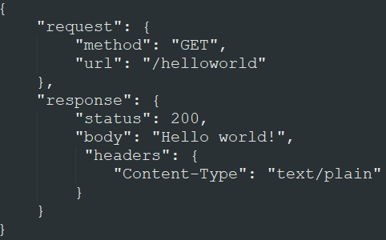
Our Hello world! mock

Slide 80
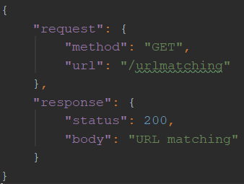
URL matching

Slide 81
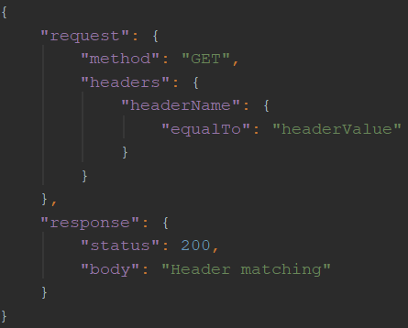
Request header matching

Slide 82
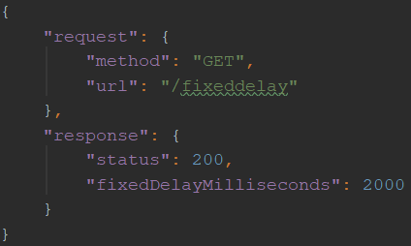
Simulating a delay

Slide 83
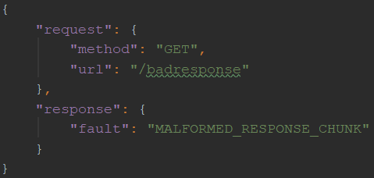
Returning a fault response

Slide 84
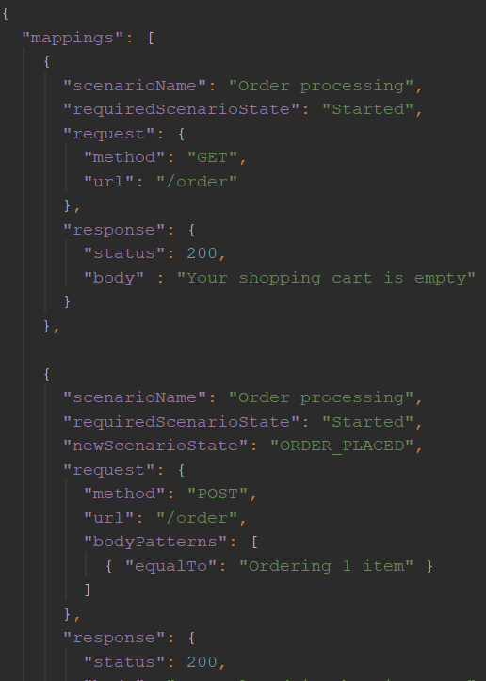
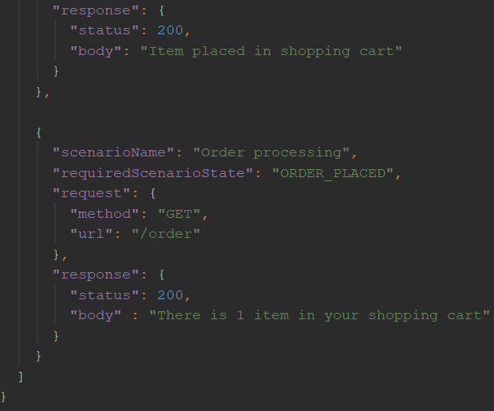
Creating a stateful mock

Slide 85
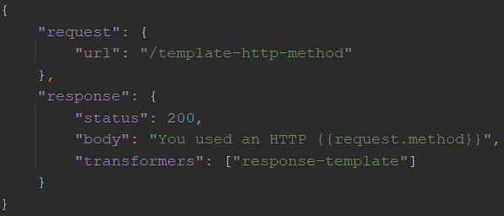
Use response templating

Slide 86
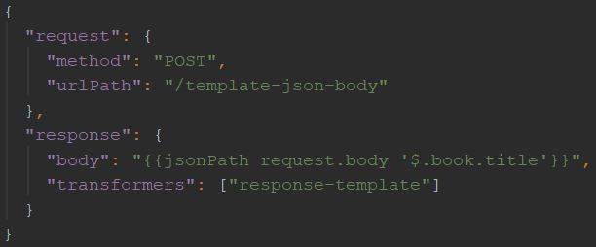
Use response templating
When sent this JSON
request body:
This stub returns a response with body “Pillars of the Earth”:

Slide 87
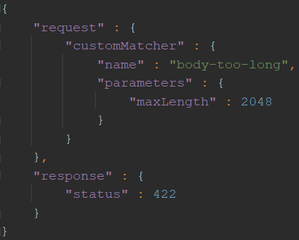
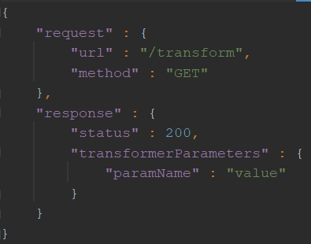
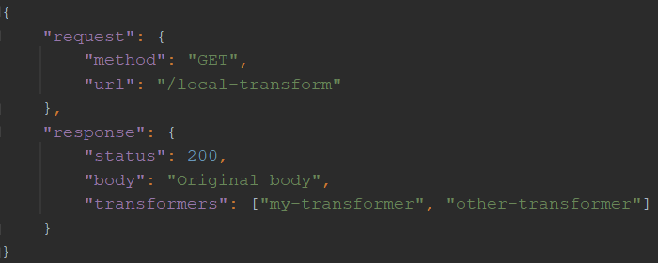
Using WireMock extensions
Using a custom matcher
Specifying transformer parameters
Registering a local transformer

Slide 88
?

