Slide 1

Denied or Certified: Predicting H1B VISA
TEAM Extreme Value Theorem
Citina Liang, Yan Kang, Zheng Wang

Slide 2

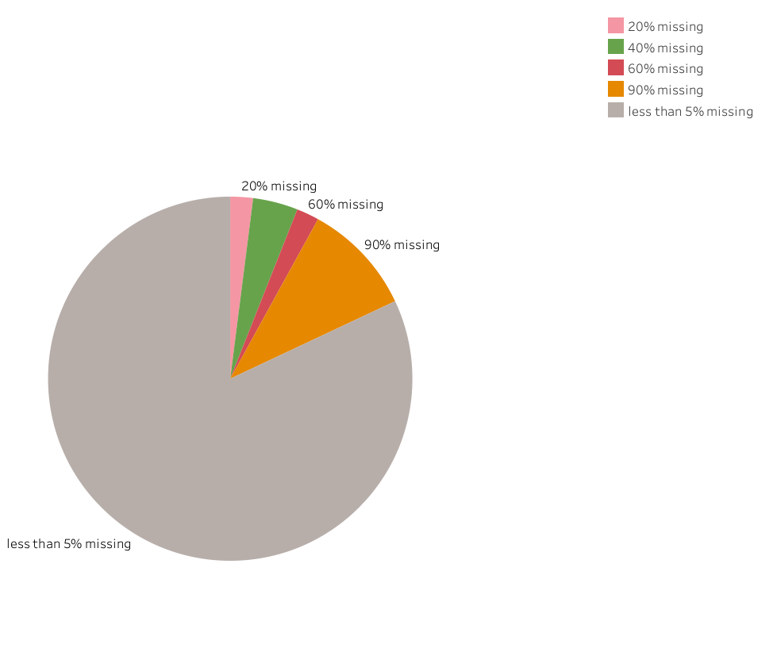
Data Cleaning
Data Description
The h1b data set contains 4918 observations and 52 variables.
There are 4 date-time variables, 3 numerical variables and 45 categorical variable. However, some of the categorical variables contains over 50 levels.
Nearly every observation in this data set contains NA in at least one of the variables.
A few variables contains over 90% of NA values.
Notes:
All wage related variables might include different wage units for each individual observation. Therefore, it is crucial to convert all wages into yearly wage. Hence, we do following:

Slide 3
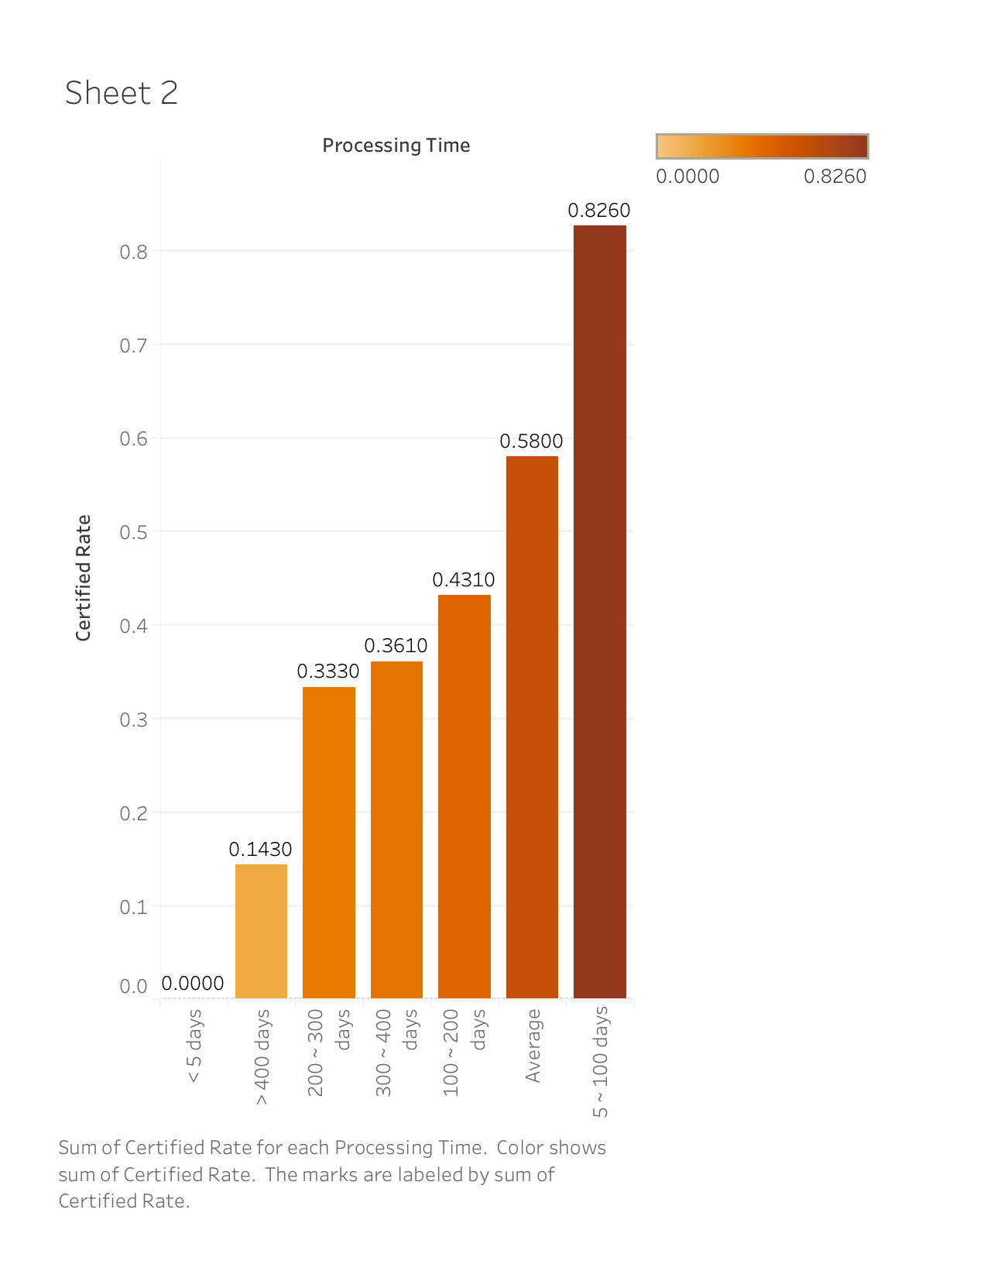
Data Cleaning
Data Transformation
We unify the unit of Wages to year so that they can be compared mutually.
We used fill the missing values to be “N/A” and take it as a new level of factor to indicate that information are not provided.
For factor variables with too many levels, we combine some of the levels to simplify their structures.
For Date-time variables, we take the differences of the starting and ending date or use it to identify which weekday it is.
Exam how the variables after cleaning contribute to the acceptance ratio.
Delete highly correlated variables or uneffective variables.
After cleaning data, we obtained a dataset with 4918 observations and 29 variables
An Example of an effective predictor
Notes:
1. Secondly, as mentioned on the previous slide, there are numerous NA included in this dataset. Especially, there are a few variables contains over 90% of NA values. Whereupon, we transformed some of the potential useful variables into another level of factors. We used NA as a new level of factor to indicate that information are not provided.
2. Also, a few of factor variables contains way too many levels which will cause severe problem while we are trying to fit the model. Therefore, we transformed into simpler form of factor to reduce the task of computer or to avoid model fitting difficulties.

Slide 4

Method Choosing
What methods did we consider?
Logistic Regression
Random Forest
Generalized Boosted Regression
Why Random Forest?
Compared to the other methods, it gives highest accuracy
It gives estimates of what variables are important
Resistant to outliers
Most of our predictors are categorical variables.
Notes:
We have considered logistic regression, random forest, generalized boosted regression and also KNN
we choose rf method as our final model because the rf is to categorize values, since most of our predictors are categorical variables. and the final model will be clear since it is doing binary choosing.
If we did the logistic regression or gbm, the output will be long and hard to interpret, also for the KNN, there are too many dimensions.
And of course, the RF gives highest accuracy.

Slide 5
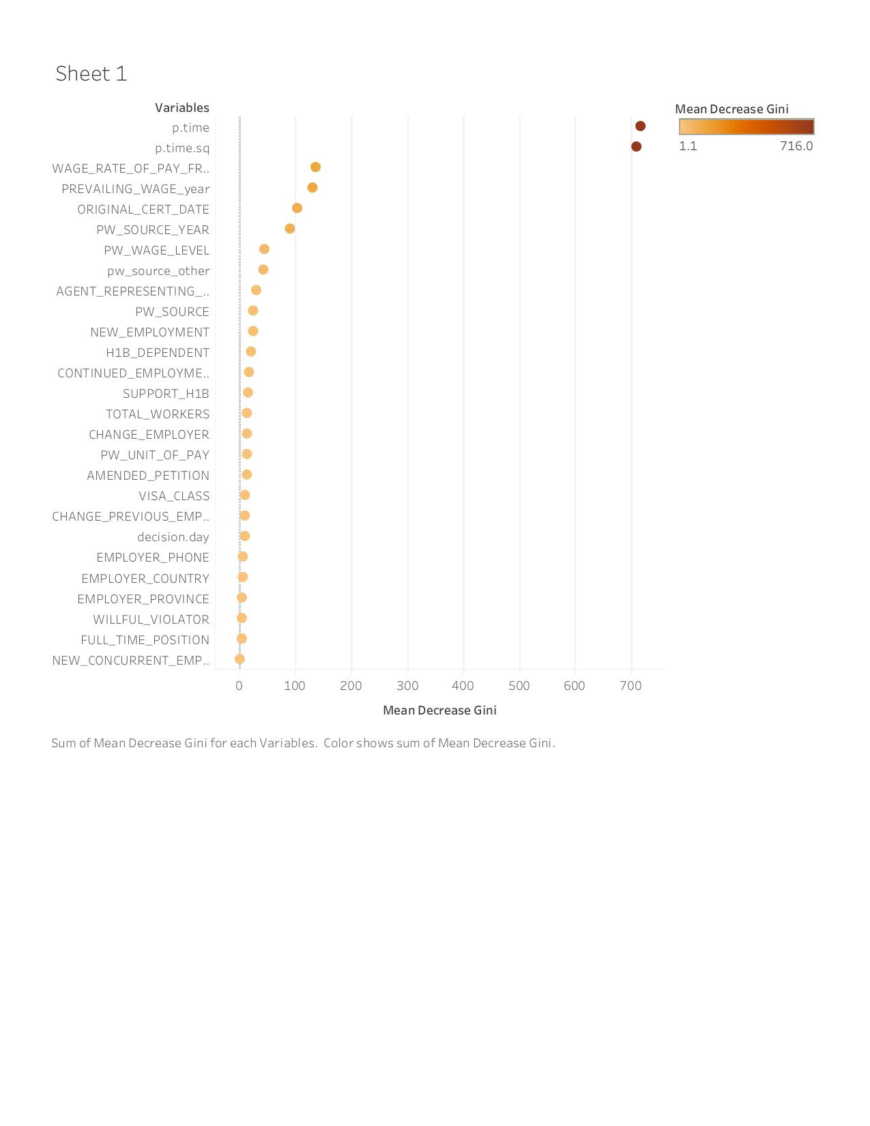
Model Adjustment
What arguments can we change in the function?
number of variables to use
number of trees to grow
How to do it?
Doing Cross Validation to reduce number of unimportant variables
Doing “for” loop to find the best size for tree
Knowing what variables contribute the most
Does the change make an improvement in the accuracy?
We conclude the default values are the best
Notes:
The mean decrease in Gini coefficient measures how each variable contributes to the homogeneity of the nodes and leaves in the resulting random forest.
After doing cross validation, these are the variables contribute to the model most, all others are insignificant
What we can change in the arguments are number of variables to use and number of trees to grow.
We use for loop to try to find the best number for trees
We conclude the default values are the best

Slide 6
Assumptions and Disadvantages
Assumptions
The only assumption that it relies is that sampling is representative. This is a common assumption. In our case, we have nearly 50% CERTIFIED cases and 50% DENIED cases where assumption holds.
Disadvantages
For our dataset, it includes categorical variables with different number of levels. RF are biased in favor of those attributes with more levels.
For minimizing the bias, we have reduced number of levels for categorical variables while we were cleaning data.

Slide 7
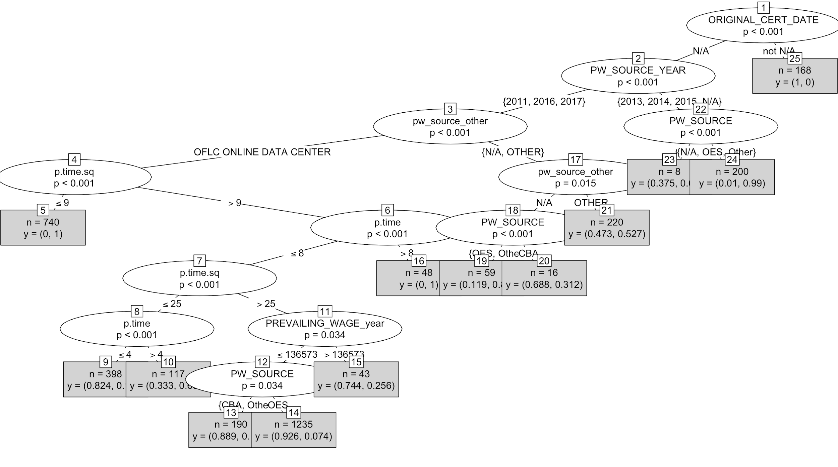
Result and Summary
After performing different models, random forest give the best performance.
Our model produce an approximately 91.5% accuracy.
Final model consists 29 predictors which includes squared processing time as one polynomial predictor.

Slide 8
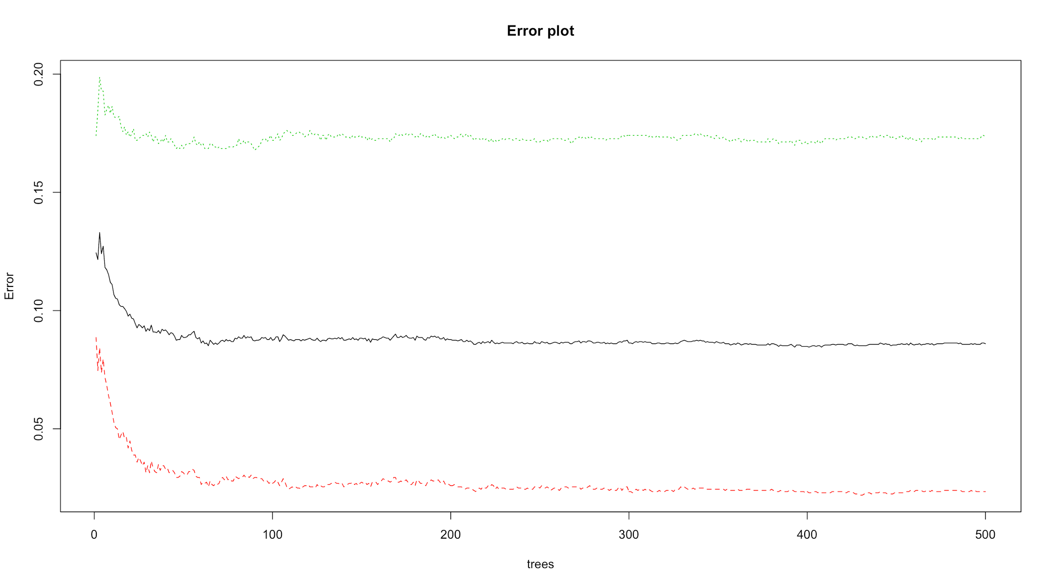
Result and Summary
The graph plots number of trees against error rate for each level of CASE_STATUS.
Red curve - CERTIFIED cases
Green curve - DENIED cases.
Black curve - out-of-bag errors.
The error rate of DENIED cases is always higher than the rate of CERTIFIED cases.

