Slide 1
Meeting C# 6.0
Matt Ellis
JetBrains

Slide 2
Back story
Roslyn
Language features

Slide 3
History

Slide 4
C# 2.0 (2005)
Generics
Nullable types
Iterators
Partial types
Anonymous methods
Getter/setter accessibility
Static classes
New CLR features
Language features
Notes:
C# 1.0 released in 2002
C# 1.2 released for .net 1.1. Called Dispose on IEnumerators which also implemented IDisposable. A few other features
Anonymous methods – code blocks for delegates. NOT lambdas

Slide 5
C# 3.0 (2007)
Anonymous types
Implicit typing (“var”)
Extension methods
Lambda expressions
Query expressions
Expression trees
Auto properties
Object and collection initialisers
Partial methods
LINQ

Slide 6
C# 4.0 (2010)
Dynamic
Named and optional parameters
Embedded interop types
Co- and contra-variance for generics
COM interop
Notes:
I can take *in* a larger type than I was requesting, e.g. IEnumerable<Cat> passed into IEnumerable<Animal>

Slide 7
C# 5.0 (2012)
Async/await
Caller Info attributes
private async static Task<string> DownloadText(string url)
{
using (var webClient = new WebClient())
return await webClient.DownloadStringTaskAsync(url);
}
Notes:
Caller info – CallerFilePathAttribute, CallerLineNumberAttribute, CallerMethodNameAttribute
Couple of minor fixes to scoping of variables in foreach loops, and order of evaluation of named and positional parameters

Slide 8
C# 6.0 (2014 ish)
New compiler!
Roslyn
Auto property initialisers
Index initialisers
Using static members
Null propagation
Expression bodied members
IEnumerable params
nameof operator
Await in catch/finally
Exception filters
Ceremony

Slide 9
Roslyn

Slide 10
Roslyn
“.NET Compiler Platform”
Compiler rewrite
Decade old codebase
C# vs C++
Ease of adding new features
Open Source
Compiler as a service
Notes:
Open Source – taken contributions. Nothing major, but e.g. improvements to error messages

Slide 11
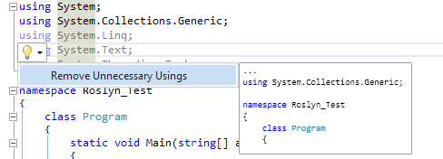
IDE features
Parser and semantic model available across the IDE
Abstract Syntax Tree based analysis, navigation and refactoring
Notes:
In the old world – compiler was one parser, language services was another parser, and expression evaluator was a third. Roslyn unifies all of these, which is a good thing

Slide 12
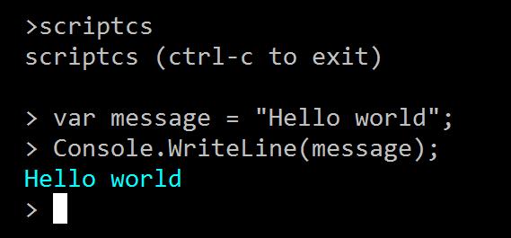
ScriptCS
C# based REPL and scripting
Script packs and NuGet references

Slide 13
ASP vNext
Compiler pipeline based on Roslyn
Compiles to in-memory assemblies
Edit file + refresh browser = compiled
No need to recompile whole project
“Assembly neutral” interfaces (*cough*hack*cough*)
Notes:
Lots of other changes – no msbuild project file, json for configuration, heavily intertwined with NuGet, based on OWIN, etc.

Slide 14
Assembly neutral interfaces?
CLR types defined by assembly qualified name
Requires binary references for shared contracts
E.g.: use same logger across application + 3rd party framework
Must share contract (assembly), or provide adapters
Fakes duck typing/structural equivalence
Common contracts defined in source
Defined in all referrers
How to work around assembly qualified name?

Slide 15
Compile time
// Compiled to CommonLogging.ILogger.dll
namespace CommonLogging
{
[AssemblyNeutral]
public interface ILogger
{
void Log(string value);
}
}
Finds and removes [AssemblyNeutral] types
Compile a new assembly for each type
Predictable assembly qualified name
Original assembly references the types in new assemblies
New assemblies saved as embedded resources in original assembly
Multiple assemblies defining same types generate same assemblies

Slide 16
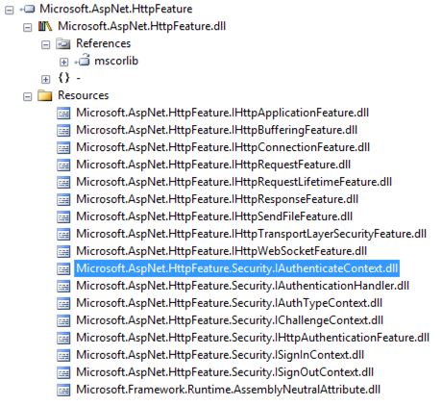
Run time
Application tries to resolve neutral assembly
ASP vNext looks up assembly in resources
Looks at all assemblies
Uses first match it finds
If multiple assemblies define same type, same dll is generated
Types with same namespace and name “Just Work”

Slide 17
Language Features

Slide 18
Using C# 6.0
Disabled by default
Create a new project
Unload the project file
Edit the .csproj
Add the following to the first PropertyGroup:
<LangVersion>experimental</LangVersion>
(case sensitive!)

Slide 19

Primary constructors
Constructor declaration at class level
public class Person(string name)
{
private readonly string _name = name;
}
public class Person2(string name, int age)
{
private readonly string _name = name;
public Person2(string name, DateTime birthday)
: this(name, (DateTime.UtcNow.Year - birthday.Year))
{
}
}
Notes:
Arguments are called class parameters
Why use this?
Inheritance – show deriving and calling a primary constructor
Explicit constructor – no parameters. Requires all other ctors to call the primary ctor
Primary ctor always has same accessibility as class
ReSharper: Basic support
Parses. Resolves. Find usages + navigate to definition works on ctor + parameters. Go to member works with ctor
Control flow (unused parameters)
No QF, CA or inspections

Slide 20
Primary constructor body
Primary constructor doesn’t allow validation
“Anonymous” code block
Executes after member initialisers + base ctors
Why?! Because primary constructor MUST be called
public class Person(string name, int age)
{
{ // Yes, really. Not a mistake!
if (age < 18)
throw new ArgumentException("Invalid age", "age");
}
}
Notes:
Yuck
Weak reason – just create a proper constructor! Primary constructors require all other constructors call them, but just do it…
ReSharper: Basic support
Parsed and understood.
Control flow – unused parameters. Find usages, navigation

Slide 21
Declaration expressions
Declare variables as part of an expression
Easier to use out and ref parameters
Type inference, where possible
Scoped to containing statement
if ((var t = x as DerivedType) != null)
t.DerivedMethod();
if (d.TryGetValue("test", out var v))
Console.WriteLine(v);
Notes:
Also useful where you need a single expression, such as a select – prevents the need for a let statement
Interestingly, CTP3 allows sharing declaration expressions in the initialiser scope!?
Spill out scope in CTP3 has repurcussions when setting up dummy variables for var and ref – can’t reuse names!
ReSharper support: None. Doesn’t parse – spec still in flux – only recently changed the scoping rules

Slide 22
Declaration expressions
No “spill out” passed current statement! *
d.TryGetValue("test", out var v);
Console.WriteLine(v); // INVALID!
Not in scope for else block! *
if (d.TryGetValue("test", out var v))
{
// v is in scope
}
else if (…) // nested if!
{
// v is NOT in scope
}
// v is NOT in scope
* (not implemented in CTP3)
Notes:
So, if (a) X else Y, is now no longer the same as if (!a) Y else X…
Interestingly, CTP3 allows sharing declaration expressions in the initialiser scope!?
Spill out scope in CTP3 has repurcussions when setting up dummy variables for var and ref – can’t reuse names!

Slide 23
Why withdrawn?
Surprising – features were marked “Done”
“Large amounts of downstream work still remaining” – IDE features
Thinking about the future – pattern matching
Primary constructors => record class
Declaration expressions => pattern matching and deconstruction
Notes:
(2) All of the features will need some rudimentary IDE support (colorizing, intellisense). Others might impact more IDE stuff (find-all-references, ...). While the compilers are OSS, the IDE layer isn't. How would we manage this? Would we take in a pull-request with the compiler-features, and then do the rest of the IDE stuff ourselves? How will we make sure that compilers and IDE stay in sync?

Slide 24
Initialisation scope
New scope, helps with primary constructors
Describes scope of class parameters
Primary constructor body
Base parameters
Member initialiser expressions
Same name allowed
public class Person(string name, int age)
{
private readonly string name = name;
}

Slide 25
Auto property initialisation
No need for constructor or backing field
Proper readonly (immutable) auto properties – getter only
public class Person
{
public string Name { get; }
public Address Address { get; } = new Address();
public Person(string name)
{
// Assignment to getter only properties (not in CTP4)
Name = name;
}
}
Notes:
Doesn’t currently work in

Slide 26
Index initialisers
Nicer syntax than previous collection initialisers
Calls indexer rather than Add method
Extends object initialiser
var d = new Dictionary<string, int>
{
["doodad"] = 42,
["widget"] = 64
};
Notes:
Will work with the Aug pattern-matching branch
Also, collection initialisers will now use Add extension methods
ReSharper: No support yet

Slide 27
Using static members
Use static members without qualification
Applies to methods, properties, fields, events, etc.
Does not apply to extension methods
Local declarations resolved first
using System.Math;
public class Sphere(double radius)
{
private readonly double radius = radius;
public double Volume
{
get { return (3/4)*PI*Pow(radius, 3); }
}
}
Notes:
Again, about brevity
Some talk of substituting, e.g. Console.WriteLine for Debug.WriteLine, but don’t approve of that
Useful for e.g. System.Math, Logger.Log
Error if there’s an ambiguity e.g. using Console + Debug, and call WriteLine
ReSharper: Good support – missing QF + CA
Parses, code completion in using list, code completion for symbols, resolves, find usages, navigation
Missing QF + CA, control flow redundant code in qualifier

Slide 28
nameof operator
Returns short name of symbol
Any symbol – class, class member, namespace, type parameters, variables, etc.
Ambiguities are not an error
public void Foo(string value)
{
if (value == null)
throw new ArgumentNullException(nameof(value));
}
Notes:
For getting rid of magic strings. E.g. Reflection, PropertyChanged, ArgumentException
Stems from typeof and mythical infoof
Short name. Drops type parameters.
Last name of namespace
Type parameter is unsubstituted. Aliases are unsubstituted
Nameof(int) vs nameof(int32)
Interesting questions for refactoring, as name can be ambiguous – what if I rename one of the symbols in the set?
ReSharper support: None. Tries to resolve symbol called nameof
namespace A.B.C {
class C { }
}
namespace D.E.F {
class C { } // same generic arity
}
namespace G.H.I {
class C<T, U, V> { }
}
namespace X {
using A.B.C;
using D.E.F;
using G.H.I;
class X {
// here 'C' reference means three different 'C' types
// no 'ambiguous reference' error produced at all
void M(string s) => M(nameof(C));
}
}

Slide 29
Expression bodied members
Replaces single line methods, properties, indexers, operators, etc.
Familiar lambda arrow syntax
Properties are created as getter only
Can only be single expression
public string FullName => FirstName + " " + LastName;
Notes:
Must be a statement for void methods, so return value isn’t even ignored
ReSharper support: Full
Parses, resolves, find usages, control flow
Inspection on property getter return statement
CA on return statement of simple method
CA on expression bodied member

Slide 30
Null propagation
Conditional access operator
Returns null if qualifier is null, else evaluates
Short circuiting
Conditional method invocation, indexer access
Left hand side evaluated only once – thread safe
int? length = customers?.Length;
int length2 = customers?.Length ?? 0;
Notes:
Evaluates left to right
If it’s any step is null, returns null, short circuits *all* following steps
Conditional method invocations can be skipped if null
Lifts type to be a nullable type – use null coalescing to reduce back down to type
Grouping with brackets (customers?[0]?).ToUpper() <- need better example
Grouping with brackets break out of short circuiting uses result as qualifier (because using the access operator, not the conditional access operator)
Cannot do delegate?(args), must do delegate?.Invoke(args)
Thread safe due to LHS only evaluated once + stored in temporary variable, so useful for event handlers

Slide 31
Await in catch/finally
Implementation detail
Previously “impossible”
IL cannot branch into or out of catch/finally
Uses ExceptionDispatchInfo to save exception state and rethrow if necessary
Notes:
Where TryRoslyn is really nice. Can see exactly what the implementation is

Slide 32
Exception filters
Existing CLR feature
Only run catch block if exception handler returns true
Replaces if () throw; pattern
Expected “abuse” – logging
catch (Exception e) if (Log(e))
{
// ...
}
private bool Log(Exception exception)
{
Debug.WriteLine(exception);
return false;
}
Notes:
Order of filters is important

Slide 33
String interpolation (planned)
“My name is \{name} and I’m \{person.Age} years old"
Interesting planning notes:
Wrapper around string.Format? String concatenation?
What culture? Current, invariant, specified?
What about formatting, e.g. hex numbers?
Formatting/encoding for HTML, XML, SQL?
Stored strings, e.g. resx? Library feature?
Arbitrary expressions?
Guarantees about number and order of evaluations?

Slide 34
Field targets on auto properties (maybe)
Target the backing field of an auto property
[field: NonSerialized]
public string Foo { get; set; }
Similar to targeting field of event
(e.g. prevent serialisation of subscribed event handlers)
[field: NonSerialized]
public event EventHandler MyEvent;

Slide 35
IEnumerable params (maybe)
Params methods can take any sequence, not just an array
No need to call ToArray() any more
public void Do(params IEnumerable<string> customers)
{
// ...
}
Do("Smith", "Jones");
Do(new string[] { "Smith", "Jones" });
Do(new List<string> { "Smith", "Jones" });

Slide 36
Conclusion
Roslyn
Language features
Complete rewrite
Easier to maintain
Open Source
Compiler as a service IDE features, scripting, hosting compilers
Auto property initialisers
Getter only auto properties
Index initialisers
Using static members
Null propagation
Expression bodied members
IEnumerable params
nameof operator
Await in catch/finally
Exception filters

