Slide 1
EGM NGSI-LD API GUIDE

Slide 2
Work In Progress: Data Interfacing with ngsi-ld
Defined by the Industry Specification Group for cross-cutting Context Information Management group,
NGSI-LD is the evolution of the OMA/FIWARE NGSI Context Interfaces,
NGSI-LD data model and format:
JSON-LD based
Entity model
Entities can have properties
Entities can have relationships to other entities
NGSI-LD API:
Standard API for Context Information Management
Updates on context
Register context providers
Query context
Subscribe to context information and receive notifications of changes.
Notes:
Data Interfacing with ngsi-ld

Slide 3
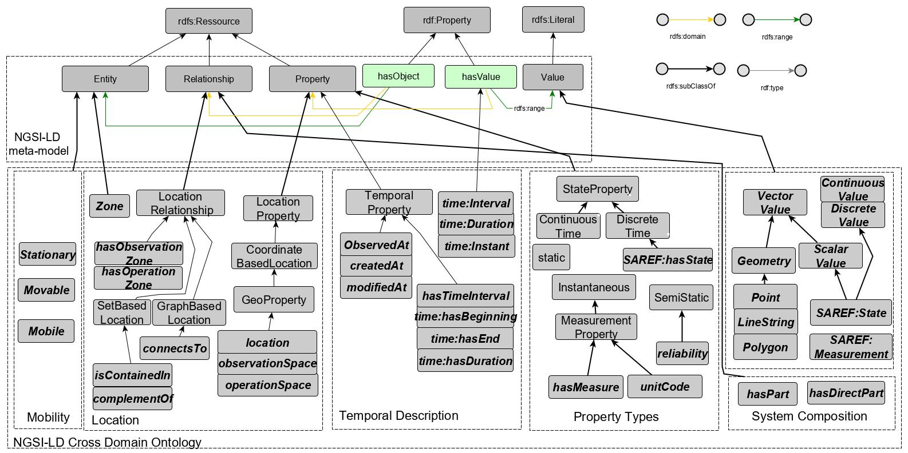
NGSI-LD Data Model
Notes:
Here the NGSI LD data model
The fisr layer is an extension of the rdf model ressources are extended o entities relatioship and property, rdf-properties are extendded to hasobject and has value
Then this layer is alson extended to a cross domain ontology covering multiple contexts such as : mobility, location, temporal description propety types
Now we have to model the aquaculture domain based the NGSI-LD data model in order to exploit then the ngsi-LD api

Slide 4
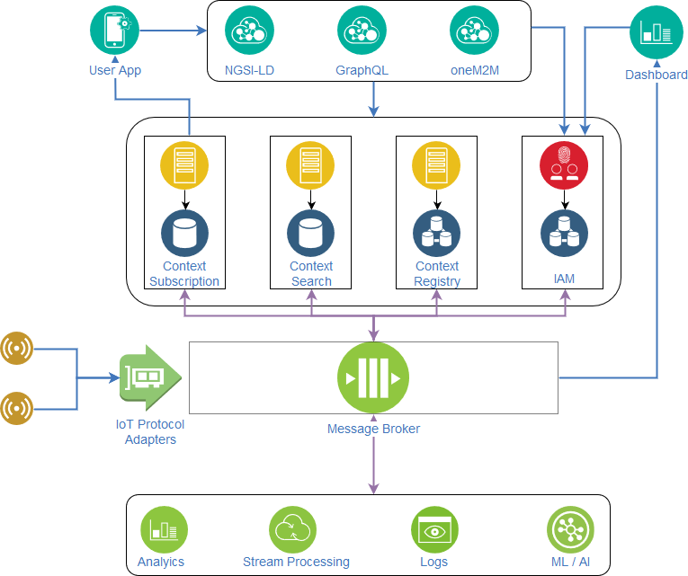
Overview of the EGM API: NGSI-LD Broker

Slide 5

Context Registry
The Context Registry is in charge of storing, updating and retrieving the NGSI-LD entities to/from NEO4J database,
Data Models [@Context]
GET
Storing Data
Queries
POST
Context Registry
PATCH
REST APIs
Updating Data
DELETE
Retrieving Data
NEO4J database

Slide 6
Context Registry API endpoint
Queries | URL
POST | /v2/entities
PATCH | /v2/entities/{entityId}/attrs/
POST | /v2/entities/{entityId}/attrs/ [ONGOING]
PATCH | /v2/entities/{entityId}/attrs/{attrId}
DELETE | /v2/entities/{entityId}/attrs/{attrId} [ONGOING]
DELETE | /v2/entities/{entityId}
GET | /v2/entities
GET | /v2/entities/{entityId}

Slide 7
Data Models @Context
Context files are Json-ld files that define all referenced Entities/Relationships/properties in the Data
{ "id":"urn:ngsi-ld:Sensor:11", "type":"Sensor", "monitors":{ "type":"Relationship", "object":"urn:ngsi-ld:FishContainement:10e2073a01080065" }, "createdAt":"2019-10-18T07:31:39.77Z", "@context":[ "http://uri.etsi.org/ngsi-ld/v1/ngsi-ld-core-context.jsonld",
"URIs to other contexts" ] }
All these properties/ Relationships have to be defined in the context files.

Slide 8
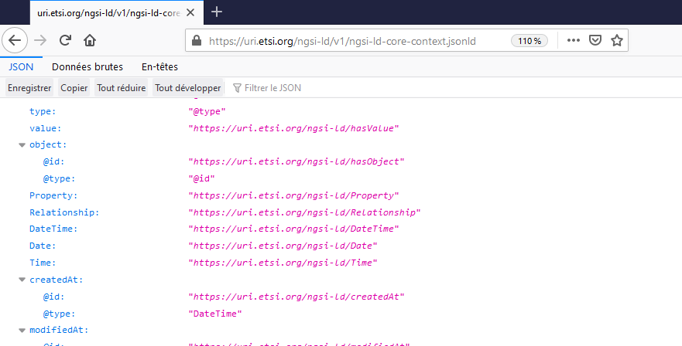
ngsi-ld-core-context.jsonld

Slide 9
New Data Models @Context: 3 Main files
NGSI-LD @Context: The core data model(Entity, Relationship, Properties)
http://uri.etsi.org/ngsi-ld/v1/ngsi-ld-core-context.jsonld
Cross Domain @Context : egm.jsonld
Generic Entities: Sensors,SmartCamera…
Generic Relationships: observedBy, belongs…
Generic Properties: depth,calibrationDate….
Domain specific @Context: aquac.jsonld
Specific Entities : FishContainment, Feeder…
Specific Relationships: RemovedFrom…
Specific Properties: fishNumber….

Slide 10
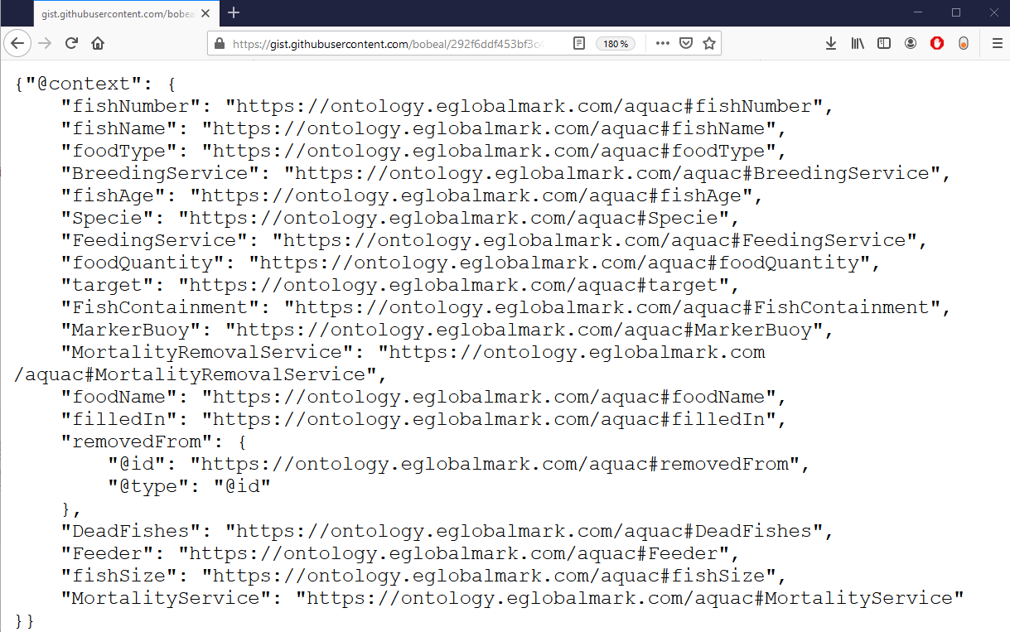
Aquac.jsonld

Slide 11
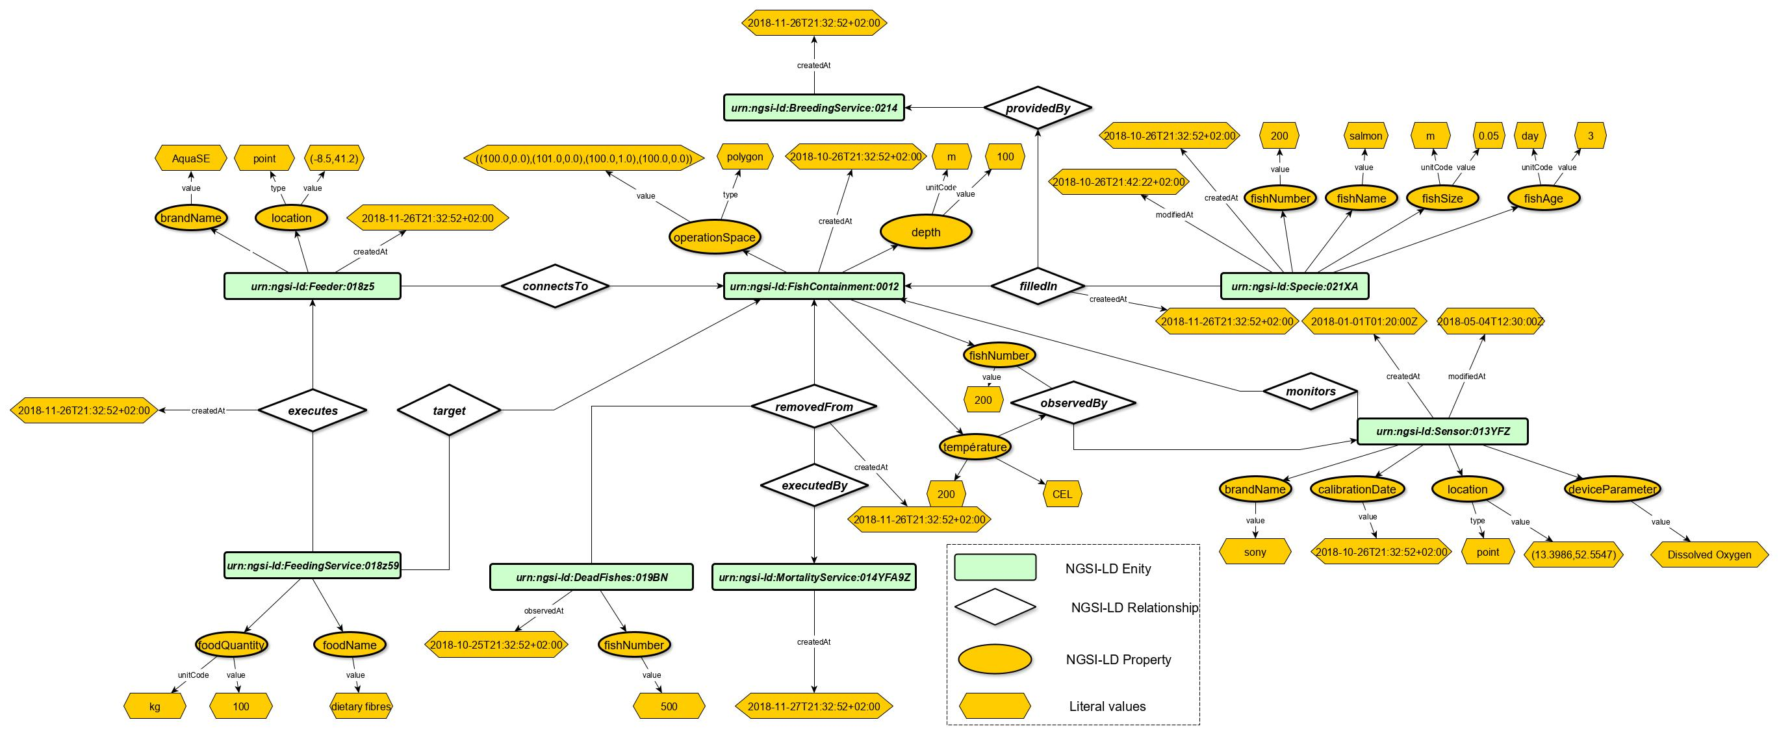
Aquac Data Model

Slide 12
Sensor & Observation Payloads
urn:ngsi-ld:type:id
Fix Part
Entity Type
Entity Identifier
{
"id":"urn:ngsi-ld:FishContainment:0012",
"type":"FishContainment",
"depth":{
"type":"Property",
"value":100,
"unitCode":"m"
},
"createdAt":"2018-10-26T21:32:52+02:00",
"operationSpace":{
"type":"GeoProperty",
"value":{
"type":"Polygon",
"coordinates":[
[100.0,0.0],
[101.0,0.0],
[101.0,1.0],
[100.0,1.0],
[100.0,0.0] ] } },
"@context":[,,,] }
{
"id":"urn:ngsi-ld:Sensor:013YFZ",
"type":"Sensor",
"createdAt":"2018-01-01T01:20:00Z",
"modifiedAt":"2018-05-04T12:30:00Z",
"monitors":{
"type":"Relationship",
"object":"urn:ngsi-ld:FishContainment:0012"},
"brandName":{
"type":"Property",
"value":"sony"},
"calibrationDate":{
"type":"Property",
"value":"2018-10-26T21:32:52+02:00"},
"deviceParameter":{
"type":"Property",
"value":"Ph"},
"@context": [
"https://gist.githubusercontent.com/bobeal/292f6ddf453bf3c427fb7206a2b5638a/raw/ae9b947caa0761b22a7c8a4078741d52a1f8c651/aquac.jsonld",
"https://gist.githubusercontent.com/bobeal/4a836c81b837673b12e9db9916b1cd35/raw/6c7b234b76f86eb66ece385bc93c3f139f8e8cad/egm.jsonld",
"http://uri.etsi.org/ngsi-ld/v1/ngsi-ld-core-context.jsonld"]
}
Relationships and properties have to be instantiated.
Only: value, unitCode, createdAt, observedAt, modifiedAt
Date, time should follow the ISO 8601: observedAt, modifiedAt, createdAt
All Entities types, Relationships and Properties are defined in the @context files

Slide 13
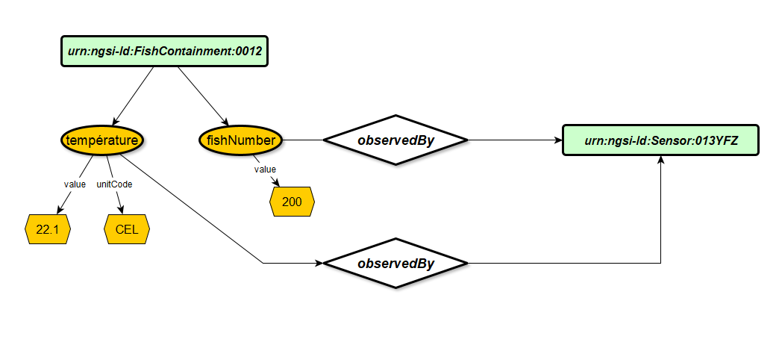
Your Payloads
Verify if the entities, relationship and properties defined in contexts files (NGSI-LD core, aquac.jsonld and egm,jsonld) are enough for your data:
- Please Provide Missing Properties and Relationships(tempereture, ph…)
2. Create your Sensor Payloads and locate them [sensor X is in FishContainement]
3. Create Other Payloads [FishContainement following the example]
4. Add measures/observations….

Slide 14
When First Values are Arriving From Sensor
The solution is to create a UPDATE Queries on the FishContainement Entity
http PATCH http://localhost:8082/ngsi-ld/v1/entities/urn:ngsi-ld:FishContainment:0012/attrs Content-Type:application/json < src/resources/ngsild/FishContainment_ADD_NEW-attribute.json Link:"<contexts uri>; rel=http://www.w3.org/ns/json-ld#context; type=application/ld+json"
"fishNumber":{
"type":"Property",
"value":100,
"observedAt":"2019-10-26T21:32:52+02:00",
"observedBy":{
"type":"Relationship",
"object":"urn:ngsi-ld:Sensor:013YFZ"} },
"temperature#1":{
"type":"Property",
"value":22.2,
"UnitCode" : "UNIT:CEL",
"observedAt":"2019-10-26T21:32:52+02:00",
"observedBy":{
"type":"Relationship",
"object":"urn:ngsi-ld:Sensor:013YFZ"} },

Slide 15
Updating Existing Values
http PATCH http://localhost:8082/ngsi-ld/v1/entities/urn:ngsi-ld:FishContainment:0012/attrs Content-Type:application/json < src/resources/ngsild/sensor_update_attribute.json Link:"<http://easyglobalmarket.com/contexts/sosa.jsonld>; rel=http://www.w3.org/ns/json-ld#context; type=application/ld+json"
"fishNumber":{
"type":"Property",
"value":250,
"observedAt":"2019-10-26T21:32:52+02:00",
},
"temperature":{
"type":"Property",
"value":20.2,
"observedAt":"2019-10-26T21:32:52+02:00",
},

Slide 16
"temperature#1":{
"type":"Property",
"value":22.2,
"UnitCode" : "CEL",
"observedAt":"2019-10-26T21:32:52+02:00",
"observedBy":{
"type":"Relationship",
"object":"urn:ngsi-ld:Sensor:013YFZ"} },
"temperature#2":{
"type":"Property",
"value":23,
"UnitCode" : "CEL",
"observedAt":"2019-10-26T21:32:52+02:00",
"observedBy":{
"type":"Relationship",
"object":"urn:ngsi-ld:Sensor:019"} },

Slide 17
Ahmed Abid
Ph.D, Research Engineer
+33 9 82 33 06 72
Ahmed.abid@eglobalmark.com

