Slide 1
Module 3
Configure Middleware and Services in ASP.NET Core
Notes:
This module will mostly cover topics relating to ASP.NET Core in general, rather than specifically ASP.NET Core MVC. Towards the end of the module, you will show how these topics directly relate with ASP.NET Core MVC, by interacting with a controller. To students familiar with older versions of MVC, this part of the course behaves particularly differently, so be sure to point out differences as you cover the materials.
20486D
03: Configure Middleware and Services in ASP.NET Core

Slide 2
Module Overview
Configuring Middleware Configuring Services
Notes:
The first lesson introduces middleware. After completing the first lesson, students should understand how to use existing middleware, and be able to create their own middleware. Students should be made aware that even adding the support for Model-View-Controller (MVC) is handled by adding middleware.
The second lesson introduces services and Dependency Injection. At the end of this lesson, the students should be able to create new services, assign an appropriate lifetime, and know how to inject them into both startup and MVC controllers.
20486D
03: Configure Middleware and Services in ASP.NET Core

Slide 3
Lesson 1: Configuring Middleware
Application Startup Middleware Fundamentals Demonstration: How to Create Custom Middleware Working with Static Files Demonstration: How to Work with Static Files
Notes:
This lesson will introduce the Startup class. As part of the Startup class, the ConfigureServices method will be introduced. However, services will only be covered in Lesson 2, “Configure Services”.
20486D
03: Configure Middleware and Services in ASP.NET Core

Slide 4
Application Startup
ConfigureServices
Used to set up all custom service in our application
Configure
Used to set up all middleware used in our application
Notes:
In this topic, avoid talking much about services and Dependency Injection because it might confuse the students. These will be covered in Lesson 2, “Configuring Services”.
20486D
03: Configure Middleware and Services in ASP.NET Core

Slide 5
ConfigureServices Method
ConfigureServices is used to set up services for our application
public void ConfigureServices(IServiceCollection services)
{
services.AddSingleton<IService, Service>();
}
Notes:
Avoid explaining services in detail. Mention that services will be covered in Lesson 2, “Configuring Services”
20486D
03: Configure Middleware and Services in ASP.NET Core

Slide 6
Configure Method
Configure is used to set up middleware for our application
public void Configure(IApplicationBuilder app)
{
app.Run(async (context) =>
{
await context.Response.WriteAsync("Hello World!");
});
}
Notes:
The content of the Configure method will be explained in the next topic, “Middleware Fundamentals”.
20486D
03: Configure Middleware and Services in ASP.NET Core

Slide 7
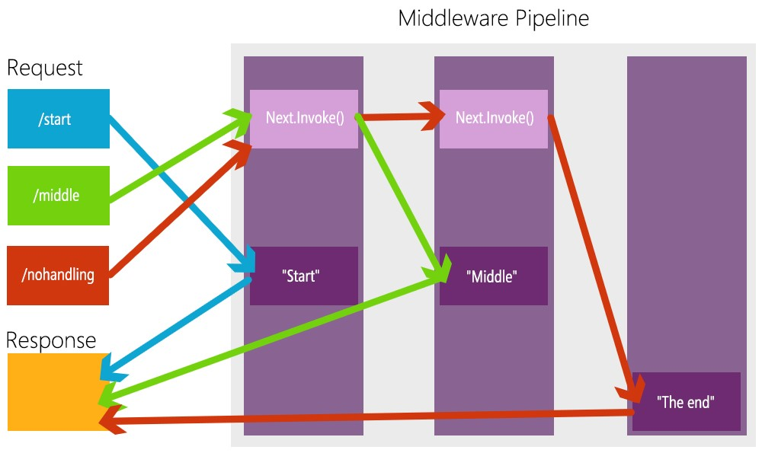
Middleware Fundamentals
Notes:
Emphasize the importance of arranging the middleware in the correct order, particularly in cases where short-circuiting occurs. Point out that the Map shouldn’t be used for routing as there are better ways to handle routes which will be covered in Module 4, “Developing Controllers”.
20486D
03: Configure Middleware and Services in ASP.NET Core

Slide 8
Run Middleware
Always terminates the middleware pipeline
Middleware after it will never be run
Should always provide a response for handling the final case
app.Run(async (context) =>
{
await context.Response.WriteAsync("Inside run middleware");
});
Notes:
Emphasize that the Run middleware should always appear at the bottom of the middleware pipeline. Additionally, while technically a Run middleware does not have to be configured, it is a good convention to use since it allows us to mark a definite end to the pipeline. When Map is used, every single pipeline configured inside Map can have its own separate Run middleware.
20486D
03: Configure Middleware and Services in ASP.NET Core

Slide 9
Use Middleware
Can call the next middleware in the chain by using the next parameter
Can short circuit the pipeline chain by not calling for the next middleware
The middleware most frequently used in the pipeline
app.Use(async (context, next) =>
{
await context.Response.WriteAsync("Inside use middleware");
await next.Invoke();
});
Notes:
Point out that the majority of middleware in the application will be Use.
20486D
03: Configure Middleware and Services in ASP.NET Core

Slide 10
MapUsing the Startup Class to Configure Services Middleware
Allows us to create alternative behavior for specific paths
Does not continue the main path
Can be nested
Does not do anything when used on its own
Not frequently used
app.Map("/Map", (map) =>
{
map.Run(async (context) =>
{
await context.Response.WriteAsync("Run middleware inside of map middleware");
});
});
Notes:
Point out that Map isn’t used as much as the other types of middleware but can be situationally useful. It should be important to point that on its own Map doesn’t do anything, and that the Use and Run middleware will need to be added to the pipeline it creates.
20486D
03: Configure Middleware and Services in ASP.NET Core

Slide 11
Demonstration: How to Create Custom Middleware
In this demonstration, you will learn:
How to add custom middleware to the application
How to use the middleware’s context parameter
How to use the Invoke method on the “next” parameter
How the order of middleware affects their execution
Notes:
In some conditions, middleware may end up not performing any actions and immediately calling next.Invoke. An example for this is the UseStaticFiles middleware, which is covered in Topic 4, “Working with Static Files”. There are no examples for this in this demo.
Demonstration Steps
You will find the steps in the section “Demonstration: How to Create Custom Middleware“ on the following page: https://github.com/MicrosoftLearning/20486D-DevelopingASPNETMVCWebApplications/blob/master/Instructions/20486D_MOD03_DEMO.md#demonstration-how-to-create-custom-middleware.
20486D
03: Configure Middleware and Services in ASP.NET Core

Slide 12
Working with Static Files
Static files are files that do not change at run time
In ASP.NET Core applications static files can be served to clients by using the UseStaticFiles middleware
public void Configure(IApplicationBuilder app)
{
app.UseStaticFiles();
}
Notes:
Point out that static files are files that should be sent to the client as they are. These should not be files that could grant knowledge of the application structure on the server side.
20486D
03: Configure Middleware and Services in ASP.NET Core

Slide 13
Common types of static files
Common types of static files:
HTML files
CSS stylesheets
JavaScript files
Images and other assets
JSON or XML files
Notes:
Note that many other files can be supported by default for serving to the client, and it is possible to toggle a setting allowing non-standard file types. However, that should be handled cautiously.
20486D
03: Configure Middleware and Services in ASP.NET Core

Slide 14
Demonstration: How to Work with Static Files
In this demonstration, you will learn:
How to add HTML and image files as static files in the wwwroot folder
How to serve static files by using the UseStaticFiles middleware
What is the result of attempting to access a file that does not exist
Notes:
Demonstration Steps
You will find the steps in the section “Demonstration: How to Work with Static Files“ on the following page: https://github.com/MicrosoftLearning/20486D-DevelopingASPNETMVCWebApplications/blob/master/Instructions/20486D_MOD03_DEMO.md#demonstration-how-to-work-with-static-files.
20486D
03: Configure Middleware and Services in ASP.NET Core

Slide 15
Lesson 2: Configuring Services
Introduction to Dependency Injection Using the Startup Class to Configure Services Demonstration: How to Use Dependency Injection Inject Services to Controllers Service Lifetime
Notes:
Be sure to explain the benefits of using services over creating new instances manually, in every place where a dependency is needed. Particularly, bring up the case of dependency chains of services with chains of reliance upon other dependencies. Also, mention that unlike middleware, the order of declaring services does not matter as services are instantiated according to requirement.
20486D
03: Configure Middleware and Services in ASP.NET Core

Slide 16
Introduction to Dependency Injection
Service
Registration in ConfigureServices method
Injected into Configure method
Injected into controllers
Injected into services
Injected into views
Notes:
Note that while it won’t be covered in this course, there are additional possibilities for Dependency Injection containers that can be used.
20486D
03: Configure Middleware and Services in ASP.NET Core

Slide 17
Using the Startup Class to Configure Services
Any class can act as a service
By using the ConfigureServices method, you can register any service you would like to use in the application
By using Dependency Injection in the Configure method you can utilize the services inside the middleware
Notes:
Point out that before ASP.NET Core, services had to be instantiated wherever the need to use them arose, and they had to be instantiated manually. This very frequently leads to overly convoluted code, which is hard to manage, and a single change in a service could cause issues with every one of its dependencies.
20486D
03: Configure Middleware and Services in ASP.NET Core

Slide 18
Service Configuration and Injection
public void ConfigureServices(IServiceCollection services)
{
services.AddSingleton<IService, Service>();
}
public void Configure(IApplicationBuilder app, IService service)
{
app.Run(async (context) =>
{
await service.DoSomething();
});
}
Notes:
Remind the students that injecting services aren’t limited only to the Configure method and that it is a powerful tool at our disposal.
20486D
03: Configure Middleware and Services in ASP.NET Core

Slide 19
Demonstration: How to Use Dependency Injection
In this demonstration, you will learn how to:
Create a service in ASP.NET Core
Register a service in the ConfigureServices method
Inject a service into the Configure method by using Dependency Injection
Notes:
Note that the Configure method runs once during the application lifetime. Due to that, all services will always be injected into the Configure method only once. The injection will always occur during startup.
Demonstration Steps
You will find the steps in the section “Demonstration: How to Use Dependency Injection“ on the following page: https://github.com/MicrosoftLearning/20486D-DevelopingASPNETMVCWebApplications/blob/master/Instructions/20486D_MOD03_DEMO.md#demonstration-how-to-use-dependency-injection.
20486D
03: Configure Middleware and Services in ASP.NET Core

Slide 20
Inject Services to Controllers
A controller is used to handle requests from the client
Controllers support constructor dependency injection
If the internal behavior of a service or its dependencies change, you will not need to update the controller
You cannot have more then one constructor in the controller, as the default dependency injection container cannot handle it
Notes:
Mention that by injecting services into the controller it helps make the code more easily testable, removing direct dependencies and opening the way for creating mock data.
20486D
03: Configure Middleware and Services in ASP.NET Core

Slide 21
Injecting a Service to a Controller
public class HomeController : Controller
{
private IMyService _myService;
public HomeController(IMyService myService)
{
_myService = myService;
}
public IActionResult Index()
{
return Content(_myService.DoSomething());
}
}
Notes:
Point out that the service is injected inside of the constructor function for the controller.
20486D
03: Configure Middleware and Services in ASP.NET Core

Slide 22
Service Lifetime
AddSingleton – Instantiates once in the application’s lifetime
AddScoped – Instantiates once per request made to the server
AddTransient – Instantiates every single time the service is injected
public void ConfigureServices(IServiceCollection services)
{
services.AddSingleton<IFirstService, FirstService>();
services.AddScoped<ISecondService, SecondService>();
services.AddTransient<IThirdService, ThirdService>();
}
Notes:
Make sure to emphasize that AddSingleton is entirely intended to be used for when application-wide data integrity is required, while AddScoped services should be used for handling data for a specific request. AddTransient should never be used to store data.
20486D
03: Configure Middleware and Services in ASP.NET Core

Slide 23
Lab: Configuring Middleware and Services in ASP.NET Core
Exercise 1: Working with Static Files Exercise 2: Creating Custom Middleware Exercise 3: Using Dependency Injection Exercise 4: Injecting a Service to a Controller
Estimated Time: 75 Minutes
Notes:
In this lab the students will learn how to send data from an HTML form to a middleware, save the data in a service, and output the data by using a controller and Dependency Injection.
You will find the high-level steps on the following page: https://github.com/MicrosoftLearning/20486D-DevelopingASPNETMVCWebApplications/blob/master/Instructions/20486D_MOD03_LAB_MANUAL.md.
You will find the detailed steps on the following page: https://github.com/MicrosoftLearning/20486D-DevelopingASPNETMVCWebApplications/blob/master/Instructions/20486D_MOD03_LAK.md.
Exercise 1: Working with Static Files
To create the poll, the application needs a styled HTML page. The HTML page must post the poll results to the server. To transfer the results to the server you will use an HTML form.
The main tasks for this exercise are the following:
Create a new project by using the ASP.NET Core Empty project template
Run the application
Add an HTML file to the wwwroot folder
Run the application - the content of the HTML file is not displayed
Enable working with static files
Run the application - the content of the HTML file is displayed
Add an HTML file outside of the wwwroot folder
Run the application - the content of the HTML file outside the wwwroot folder is not displayed
Exercise 2: Creating Custom Middleware
The server needs to handle the client’s request. You have been asked to find which ball game was chosen by the user. To do this, you will create a middleware.
20486D
03: Configure Middleware and Services in ASP.NET Core
(More notes on the next slide)

Slide 24
Notes:
The main tasks for this exercise are the follows:
Create a middleware
Run the application
Change the order of the middleware
Exercise 3: Using Dependency Injection
You will need to aggregate the votes and store them for future use. You will use services to manage and preserve the data.
The main tasks for this exercise are as follows:
Define an interface for a service
Define an implementation for the service
Use dependency injection
Run the application
Exercise 4: Injecting a Service to a Controller
In this exercise, you will create an ASP.NET Core MVC controller to display the poll results.
The main tasks for this exercise are the following:
Enable working with MVC
Add a controller
Run the application
Use dependency injection in a controller
Run the application
(More notes on the next slide)
20486D
03: Configure Middleware and Services in ASP.NET Core

Slide 25
Lab Scenario
The Adventure Works company wants to develop a website about ball games. For this, the company needs to perform a survey to determine the popularity of different ball games. As their employee, you are required to create a survey site.
Notes:
In this lab the students will learn how to send data from an HTML form to a middleware, save the data in a service, and output the data by using a controller and Dependency Injection.
You will find the high-level steps on the following page: https://github.com/MicrosoftLearning/20486D-DevelopingASPNETMVCWebApplications/blob/master/Instructions/20486D_MOD03_LAB_MANUAL.md.
You will find the detailed steps on the following page: https://github.com/MicrosoftLearning/20486D-DevelopingASPNETMVCWebApplications/blob/master/Instructions/20486D_MOD03_LAK.md.
20486D
03: Configure Middleware and Services in ASP.NET Core

Slide 26
Lab Review
What is the difference between app.Use and app.Run in the Configure method in the Startup class? What will change when you update the service configuration in the ConfigureServices method from AddSingleton to AddScoped, or to AddTransient? What happens to the UseStaticFiles middleware when the browser is directed to a path where no static file is found?
Notes:
Question
What is the difference between app.Use and app.Run in the Configure method in the Startup class?
Answer
When you use app.Use, it is possible to run the next middleware in the pipeline, by calling the Invoke method on the next parameter.
When you use app.Run, it is impossible to run any middleware after its usage, and it does not have the next parameter.
Question
What will change when you update the service configuration in the ConfigureServices method from AddSingleton to AddScoped, or to AddTransient?
Answer
If a service is configured to run with AddSingleton, a single instance will be created during the application’s entire lifetime. If AddScoped is used, one copy of the service will be created for each individual request.
If AddTransient is used, a separate instance will be created whenever a service is injected.
Question
What happens to the UseStaticFiles middleware when the browser is directed to a path where no static file is found?
Answer
The UseStaticFiles middleware checks for the existence of the static file in the requested path.
If it finds no match, it invokes the next parameter and continues to the next middleware in the pipeline.
20486D
03: Configure Middleware and Services in ASP.NET Core

Slide 27
Module Review and Takeaways
Review Question Best Practice Common Issues and Troubleshooting Tips
Notes:
Review Question
Question
What are the advantages of using Dependency Injection over instantiating references?
Answer
By using Dependency Injection, you can separate service logic from their dependencies, this can help with the following:
Adding new dependencies does not affect currently existing code.
Changing internal logic has no effect on external code.
By committing to interfaces, the code becomes simpler to mock up during tests, as you can test each service and each component independently.
You do not need to manually manage service lifetime whenever they are injected.
Best Practice
Remember that the order of middleware in the Configure method is crucial to the application’s behavior. While building the middleware pipeline it is important that you think of any potential clashing issues that may occur inside the middleware and design it accordingly.
Common Issues and Troubleshooting Tips
Common Issues
While running an application with UseMvc or UseMvcWithDefaultRoute in the Configure method you get an error: System.InvalidOperationException: 'Unable to find the required services...‘
You navigate to an action in an MVC controller but get an HTTP 500 error page.
20486D
03: Configure Middleware and Services in ASP.NET Core

Slide 28
Notes:
Troubleshooting Tips
Verify that there is a call to AddMvc in the ConfigureServices method.
Ensure that all services are correctly registered in the ConfigureServices method.
Note: Ensure that you cover the common issues and the corresponding troubleshooting tips listed in this section. Encourage students to share tips from their own work environments.
20486D
03: Configure Middleware and Services in ASP.NET Core

