Slide 1
TensorFlow for Social Good
Session 3
Zhixun “Jason” He

Slide 2
Table of Content
Review of TensorFlow model training loop
How to make the training better (regularization to reduce overfitting)
What is Tensor in TensorFlow and its relations to actual training data
How to connect actual numbers to Tensor: Keras backend function
Learning rate scheduling
Add noise and morph on training data
Custom loss and training step
Tips and resources
How to get started
Divide and conquer

Slide 3

Links for code snippets
Find me:
citris.ucmerced.edu/tsg

Slide 4

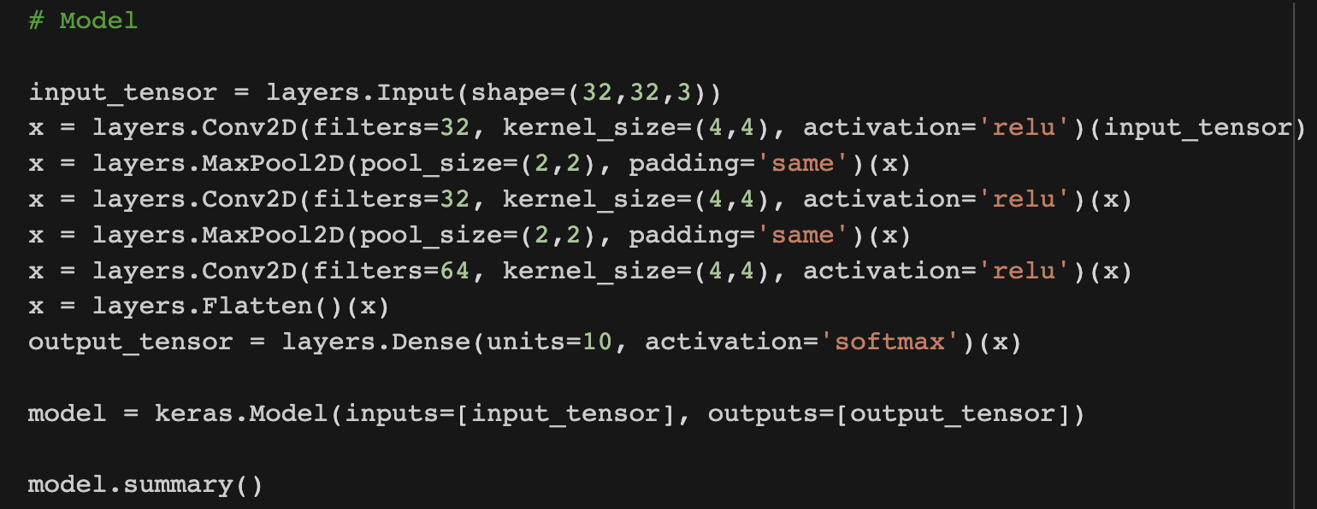
1 Review of TensorFlow model training loop
Training and label data
Neural network structure
Loss function
Start Training and save model

Slide 5
2.1 What is Tensor in TensorFlow and its relations to actual training data
A tensor is a placeholder, an element that is used to construct relations and operations
a + b = c
a, b, d are tensors
‘+’ and ‘=‘ are the operations or relations
‘a + b = c’ is a computation graph, a relation between different tensors

Slide 6
2.1 What is Tensor in TensorFlow and its relations to actual training data
A tensor is a placeholder, an element that is used to construct relations and operations
a + b = c
a, b, d are tensors
‘+’ and ‘=‘ are the operations or relations
‘a + b = c’ is a computation graph, a relation between different tensors
Why we bother to complicate things instead of using the simple concept of variable we learnt from any programming class?

Slide 7
2.1 What is Tensor in TensorFlow and its relations to actual training data
A tensor is a placeholder, an element that is used to construct relations and operations
a + b = c
a, b, d are tensors
‘+’ and ‘=‘ are the operations or relations
‘a + b = c’ is a computation graph, a relation between different tensors
Why we bother to complicate things instead of using the simple concept of variable we learnt from any programming class?
Each tensor is an instance of Tensor class. It includes their unique properties and methods that the TensorFlow framework would like to use during computation.

Slide 8
2.2 How to connect actual numbers to Tensor: Keras backend function
After a computation graph is made, all the tensors/placeholders have their relations to each other defined. To actually use this relations to calculate on actual number, it needs to feed the actual number to the computation graph
For example, computation graph: a + b = c

Slide 9
2.2 How to connect actual numbers to Tensor: Keras backend function
After a computation graph is made, all the tensors/placeholders have their relations to each other defined. To actually use this relations to calculate on actual number, it needs to feed the actual number to the computation graph
For example, computation graph: a + b = c
Question:
How many tensors we have in this computation graph?

Slide 10
2.2 How to connect actual numbers to Tensor: Keras backend function
After a computation graph is made, all the tensors/placeholders have their relations to each other defined. To actually use this relations to calculate on actual number, it needs to feed the actual number to the computation graph
For example, computation graph: a + b = c
Question:
How many tensors we have in this computation graph?
If we feed actual number to this computation graph, among a, b and c, who are those tensors into which should be fed?

Slide 11
2.2 How to connect actual numbers to Tensor: Keras backend function
After a computation graph is made, all the tensors/placeholders have their relations to each other defined. To actually use this relations to calculate on actual number, it needs to feed the actual number to the computation graph
For example, computation graph: a + b = c
Question:
How many tensors we have in this computation graph?
If we feed actual number to this computation graph, among a, b and c, who are those tensors into which should be fed?
Why we call some tensors as placeholder compared to some regular tensor?

Slide 12
2.2 How to connect actual numbers to Tensor: Keras backend function
After a computation graph is made, all the tensors/placeholders have their relations to each other defined. To actually use this relations to calculate on actual number, it needs to feed the actual number to the computation graph
For example, computation graph: a + b = c
Keras function
Thinking about the ‘feeding’ action, this action takes some inputs
After ‘feeding’ the actual number, the computation graph produces some outputs
The ‘inputs’ and ‘outputs’ are the essential components for defining a function

Slide 13
2.2 How to connect actual numbers to Tensor: Keras backend function
After a computation graph is made, all the tensors/placeholders have their relations to each other defined. To actually use this relations to calculate on actual number, it needs to feed the actual number to the computation graph
For example, computation graph: a + b = c
Keras function
Question:
What are the inputs for the ‘feeding’ action?
What are the outputs for the computation graph?

Slide 14
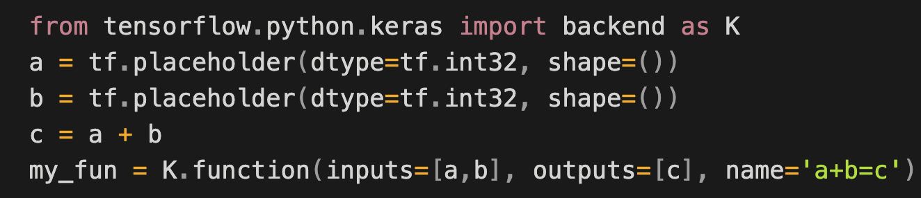
2.2 How to connect actual numbers to Tensor: Keras backend function
After a computation graph is made, all the tensors/placeholders have their relations to each other defined. To actually use this relations to calculate on actual number, it needs to feed the actual number to the computation graph
For example, computation graph: a + b = c
Keras function

Slide 15
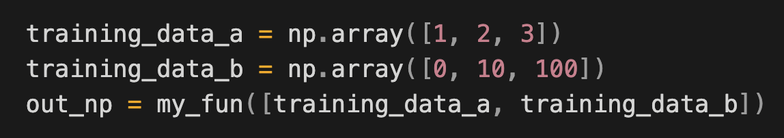
2.2 How to connect actual numbers to Tensor: Keras backend function
Keras function
To use Keras function
my_fun outputs: [array([ 1, 12, 103], dtype=int32)]

Slide 16
2.2 How to connect actual numbers to Tensor: Keras backend function
What TensorFlow has done for us?

Slide 17
2.2 How to connect actual numbers to Tensor: Keras backend function
What TensorFlow has done for us?
Multiple [a,b] pairs are being computed within one call of function, easier for hardware acceleration
Portability, as we have a computation graph, any devices just need the graph to duplicate the same results

Slide 18



2.3 Learning rate scheduling
Learning rate
$$L$$
1st training step
$$\frac{dL}{da^{(i)}}$$
$$a^{(i)}$$
a

Slide 19


2.3 Learning rate scheduling
Learning rate
$$L$$
1st training step
2nd training step
$$\frac{dL}{da^{(i)}}$$
a
$$a^{(i)}$$

Slide 20



2.3 Learning rate scheduling
Learning rate
When the scale of each learning step is too large, at the later stage of training, the parameter’s value will bounce back and forth and never settles at the optimal position
$$L$$
1st training step
2nd training step
$$\frac{dL}{da^{(i)}}$$
a
$$a^{(i)}$$

Slide 21
2.3 Learning rate scheduling
Learning rate
When the scale of each learning step is too large, at the later stage of training, the parameter’s value will bounce back and forth and never settles at the optimal position
So how about we set the learning rate very small from the beginning?
$$L$$
1st training step
2nd training step
$$\frac{dL}{da^{(i)}}$$
a
$$a^{(i)}$$

Slide 22
2.3 Learning rate scheduling
Learning rate
When the scale of each learning step is too large, at the later stage of training, the parameter’s value will bounce back and forth and never settles at the optimal position
So how about we set the learning rate very small from the beginning?
Then the training is going to be very slow
$$L$$
1st training step
2nd training step
$$\frac{dL}{da^{(i)}}$$
a
$$a^{(i)}$$

Slide 23
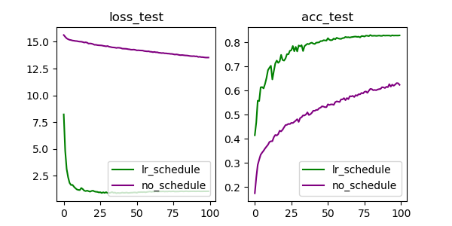
2.3 Learning rate scheduling
Learning rate
When the scale of each learning step is too large, at the later stage of training, the parameter’s value will bounce back and forth and never settles at the optimal position
So how about we set the learning rate very small from the beginning?
Then the training is going to be very slow

Slide 24
2.3 Learning rate scheduling
Learning rate
When the scale of each learning step is too large, at the later stage of training, the parameter’s value will bounce back and forth and never settles at the optimal position
So how about we set the learning rate very small from the beginning?
Then the training is going to be very slow

Slide 25
2.3 Learning rate scheduling
Learning rate
Code snippet

Slide 26
2.4 Add noise and morph on training data
To encourage the model learns the latent feature of the data instead of memorizing the variety in the data set, modifying training data slightly during training can prevent overfitting and add regularization to the learning process.
Many times, the noise and morph applied to the training data will increase the model’s performance after training.

Slide 27
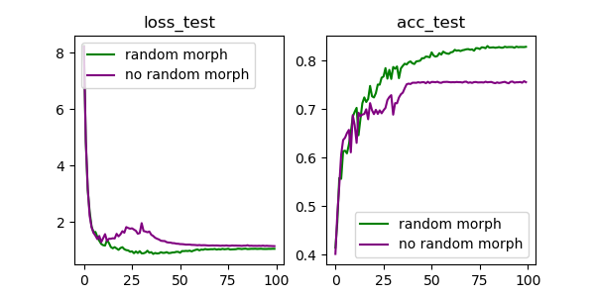
2.4 Add noise and morph on training data
To encourage the model learns the latent feature of the data instead of memorizing the variety in the data set, modifying training data slightly during training can prevent overfitting and add regularization to the learning process.
Many times, the noise and morph applied to the training data will increase the model’s performance after training.

Slide 28
2.4 Add noise and morph on training data
Data augmentation:
e.g., for image data:
horizontal flip
width shift
height shift
self-reflect
add random Gaussian noise

Slide 29
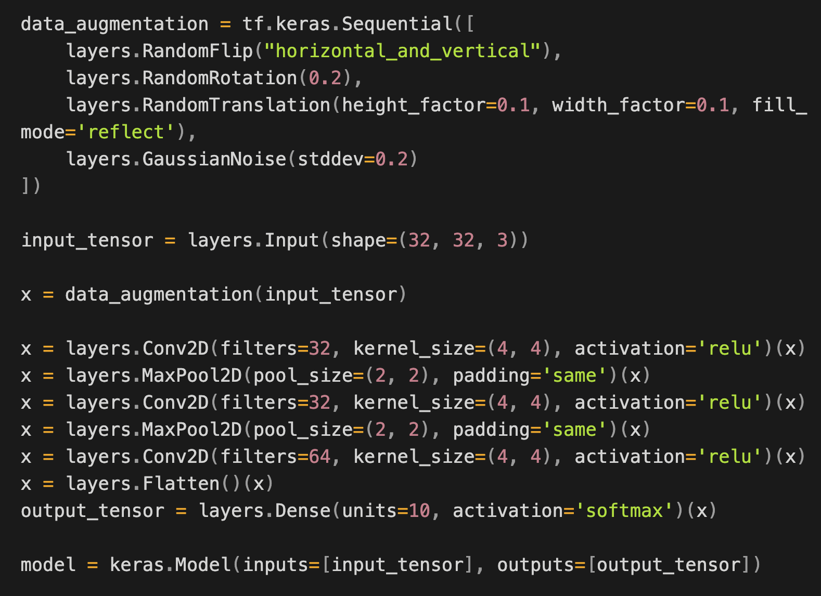
2.4 Add noise and morph on training data
Implementation in Python

Slide 30
2.4 Add noise and morph on training data
Implementation in Python
Note: Data augmentation is inactive at test time so input images will only be augmented during calls to Model.fit (not Model.evaluate or Model.predict)

Slide 31
2.5 Custom loss and training step
Customize training step, define custom model by subclassing the TensorFlow Model class.

Slide 32
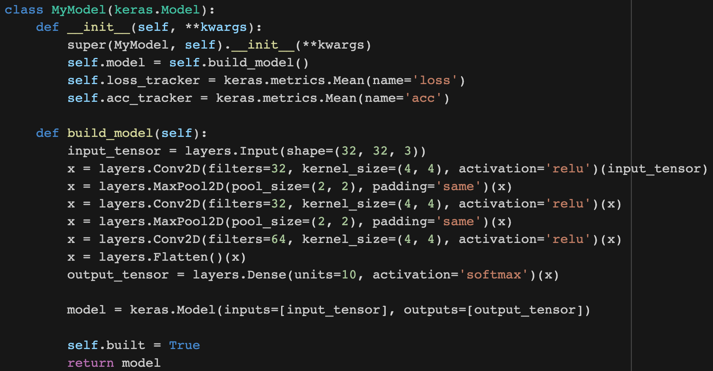
2.5 Custom loss and training step
Customize training step, define custom model by subclassing the TensorFlow Model class.

Slide 33
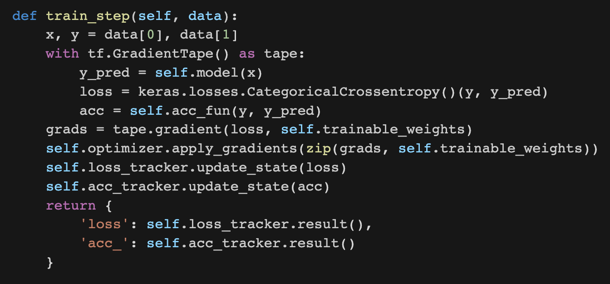
2.5 Custom loss and training step
Define custom training step

Slide 34
2.5 Custom loss and training step
Define custom training step. Note that we have full control on how loss and acc are calculated.

Slide 35
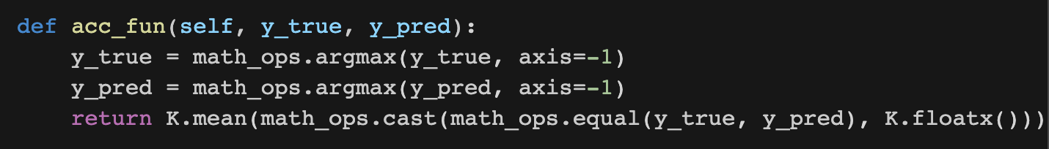
2.5 Custom loss and training step
Define custom training step. Note that we have full control on how loss and acc are calculated, e.g., acc:
y_true and p_pred are one-hot vector, e.g., for 3-way category the vector looks like [0, 0, 1]
argmax will turn [0, 0, 1] into [2] (the index of ‘1’ in the one-hot vector, which has three indices: 0, 1, 2)

Slide 36
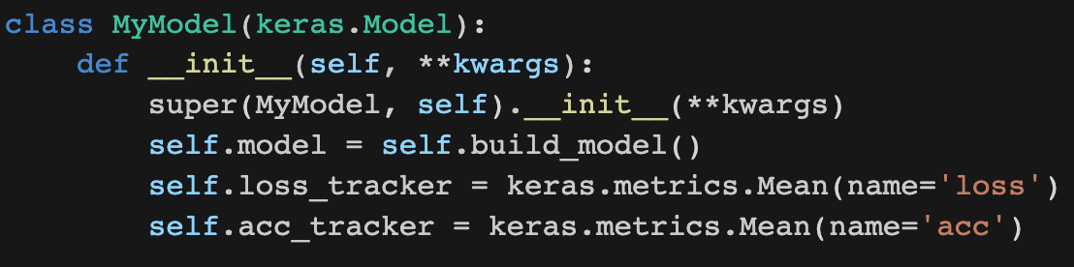
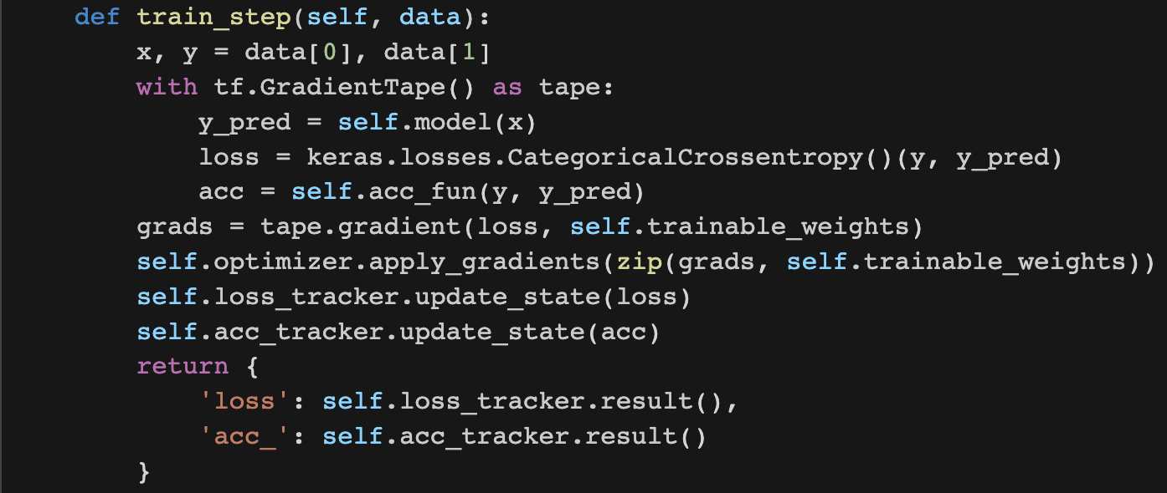
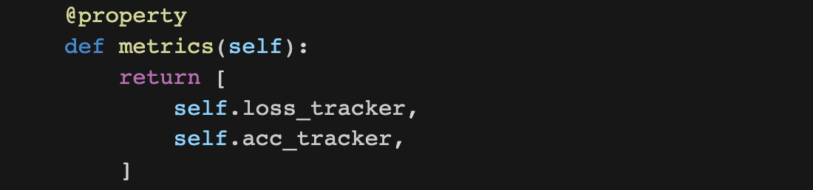
2.5 Custom loss and training step
Monitoring performance through metrics:

Slide 37
3 Tips and resources
3.1 How to get started
Use a handy Integrated Development Environment (IDE), e.g., Pycharm (free for students) to organize your project and individual script
Get ourselves used to searching questions and reading tutorials, such as https://www.tensorflow.org/tutorials, search question on Google, read answers from stack overflow( https://stackoverflow.com/)
Clone a runnable script to your local machine, run it, read it and digest it.
Pay attention to different styles of implementation and see the similarities and differences
3.2 Divide and conquer
Use IDE to track down which line of code gives error
If project is large, comment out big chuck of the project to pinpoint which line starts causing problem
If not sure about certain things, write a separate piece of code with the simplest and leanest possible code to see what exactly happened. The benefit of the leanest code snippet is that you can post it online, ask help from others, and the leanest the code is, the faster you will get a response from other people

