Slide 1
Introduction to Computer Graphics with WebGL
Ed Angel
Professor Emeritus of Computer Science
Founding Director, Arts, Research, Technology and Science Laboratory
University of New Mexico

Slide 2
What is Computer Graphics?
Ed Angel
Professor Emeritus of Computer Science,
University of New Mexico

Slide 3
Computer Graphics
Computer graphics deals with all aspects of creating images with a computer
Hardware
Software
Applications

Slide 4

Example
Where did this image come from?
What hardware/software did we use to produce it?

Slide 5
Preliminary Answer
Application: The object is an artist’s rendition of the sun for an animation to be shown in a domed environment (planetarium)
Software: Maya for modeling and rendering but Maya is built on top of OpenGL
Hardware: PC with graphics card for modeling and rendering

Slide 6
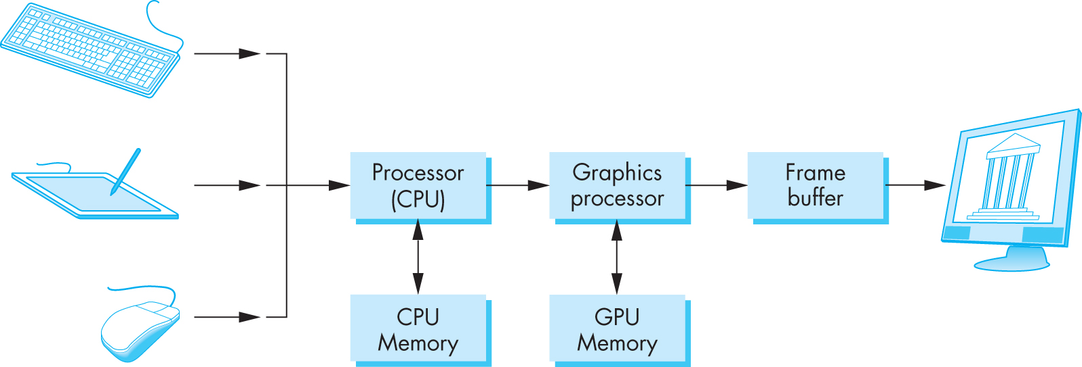
Basic Graphics System
Output device
Input devices
Image formed in frame buffer

Slide 7
Computer Graphics: 1950-1960
Computer graphics goes back to the earliest days of computing
Strip charts
Pen plotters
Simple displays using A/D converters to go from computer to calligraphic CRT
Cost of refresh for CRT too high
Computers slow, expensive, unreliable

Slide 8
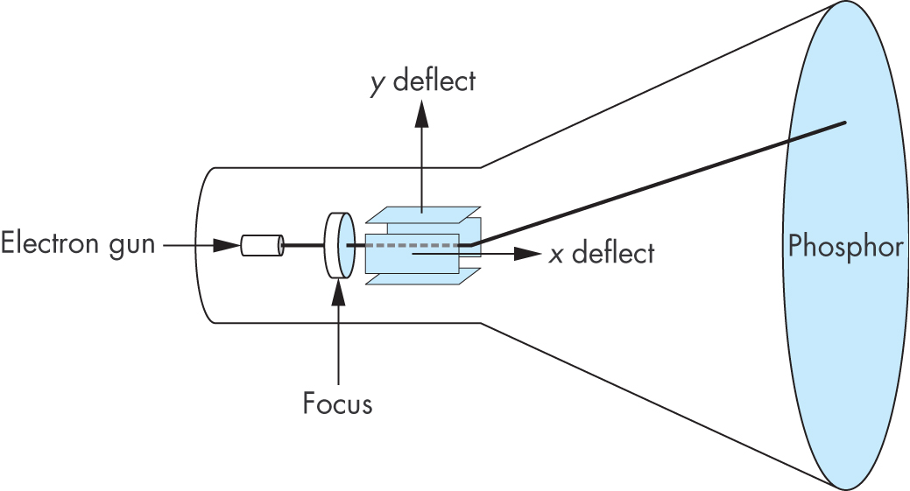
Cathode Ray Tube (CRT)
Can be used either as a line-drawing device (calligraphic) or to display contents of frame buffer (raster mode)

Slide 9
Shadow Mask CRT

Slide 10
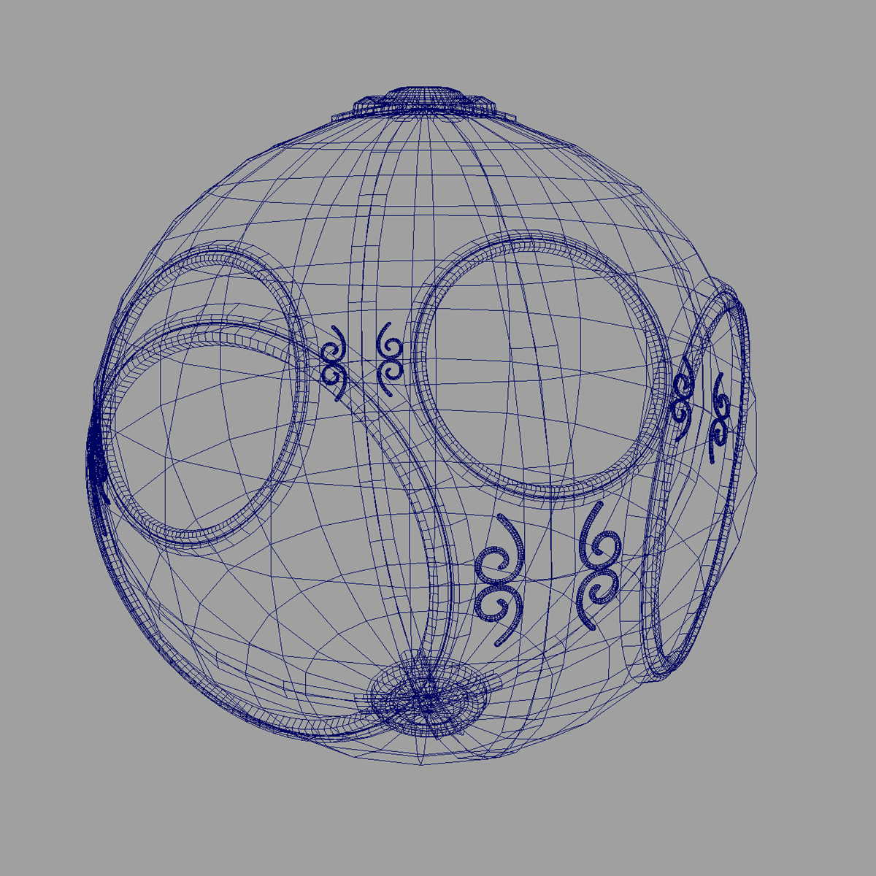
Computer Graphics: 1960-1970
Wireframe graphics
Draw only lines
Sketchpad
Display Processors
Storage tube
wireframe representation
of sun object

Slide 11
Sketchpad
Ivan Sutherland’s PhD thesis at MIT
Recognized the potential of man-machine interaction
Loop
Display something
User moves light pen
Computer generates new display
Sutherland also created many of the now common algorithms for computer graphics

Slide 12
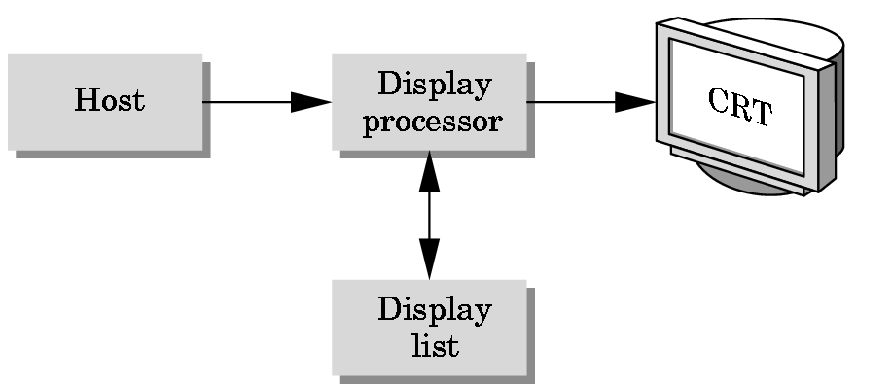
Display Processor
Rather than have the host computer try to refresh display use a special purpose computer called a display processor (DPU)
Graphics stored in display list (display file) on display processor
Host compiles display list and sends to DPU

Slide 13
Computer Graphics: 1970-1980
Raster Graphics
Beginning of graphics standards
IFIPS
GKS: European effort
Becomes ISO 2D standard
Core: North American effort
3D but fails to become ISO standard
Workstations and PCs

Slide 14
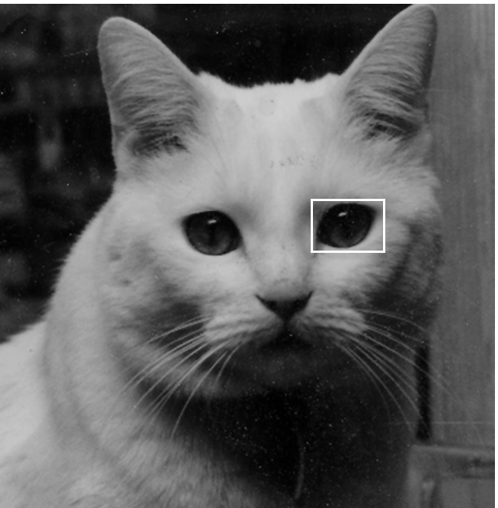
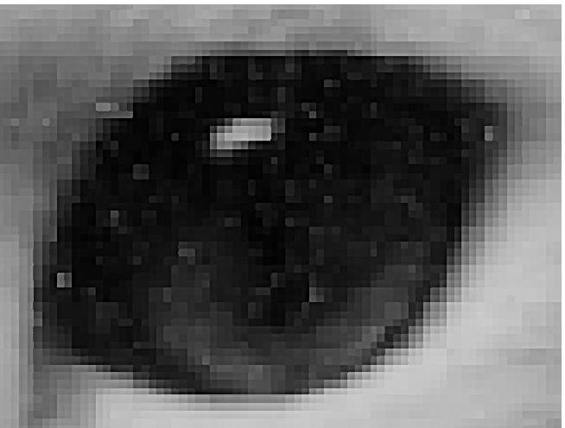
Raster Graphics
Image produced as an array (the raster) of picture elements (pixels) in the frame buffer

Slide 15
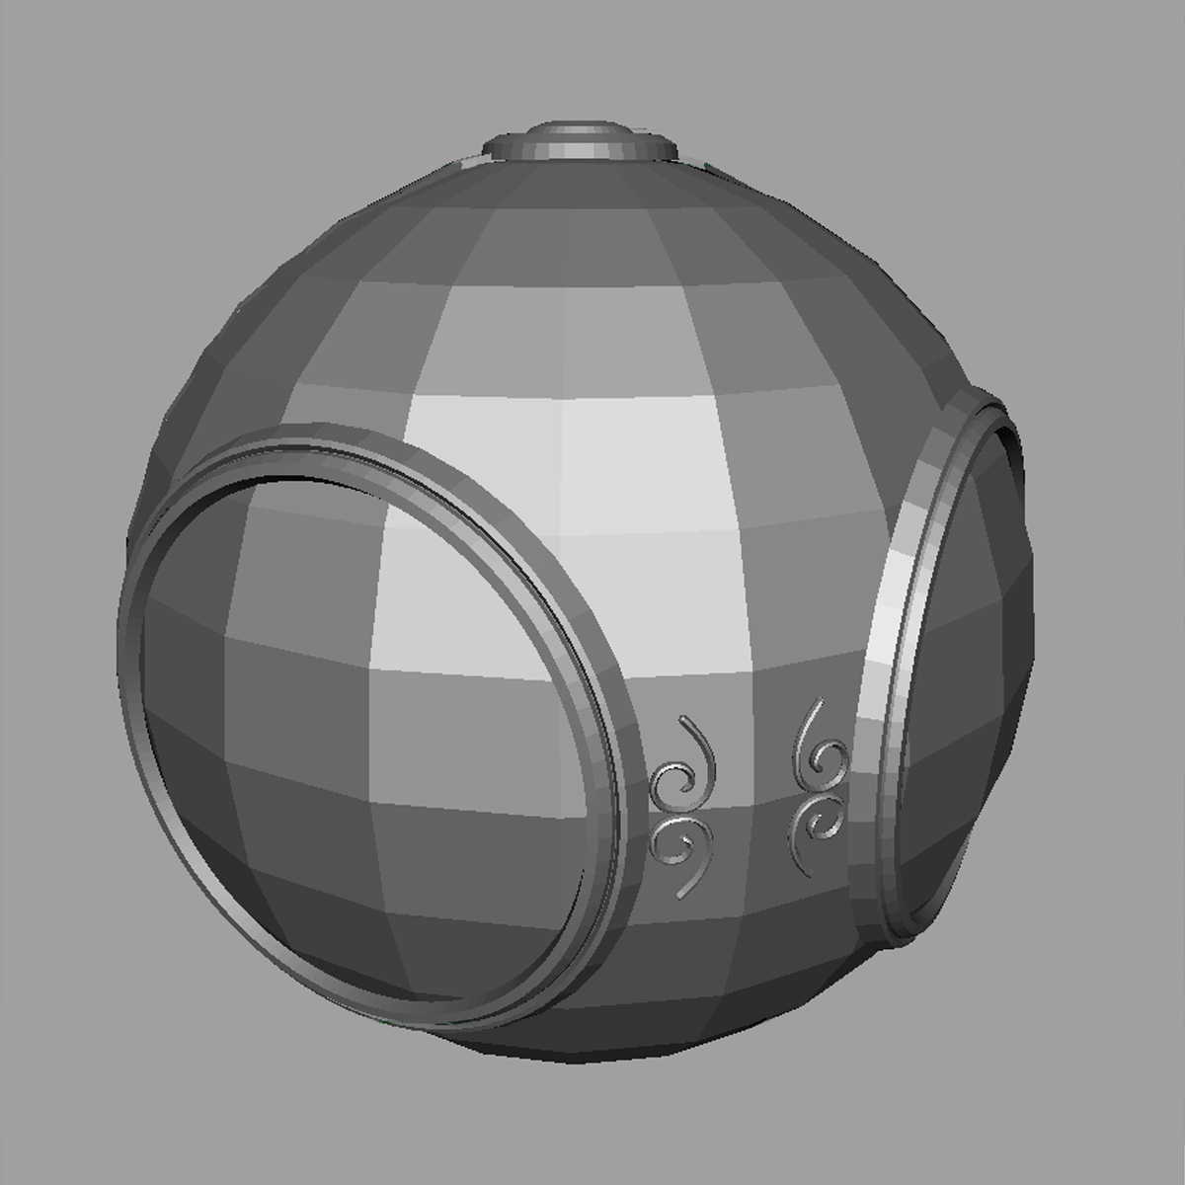
Raster Graphics
Allows us to go from lines and wire frame images to filled polygons

Slide 16
PCs and Workstations
Although we no longer make the distinction between workstations and PCs, historically they evolved from different roots
Early workstations characterized by
Networked connection: client-server model
High-level of interactivity
Early PCs included frame buffer as part of user memory
Easy to change contents and create images

Slide 17
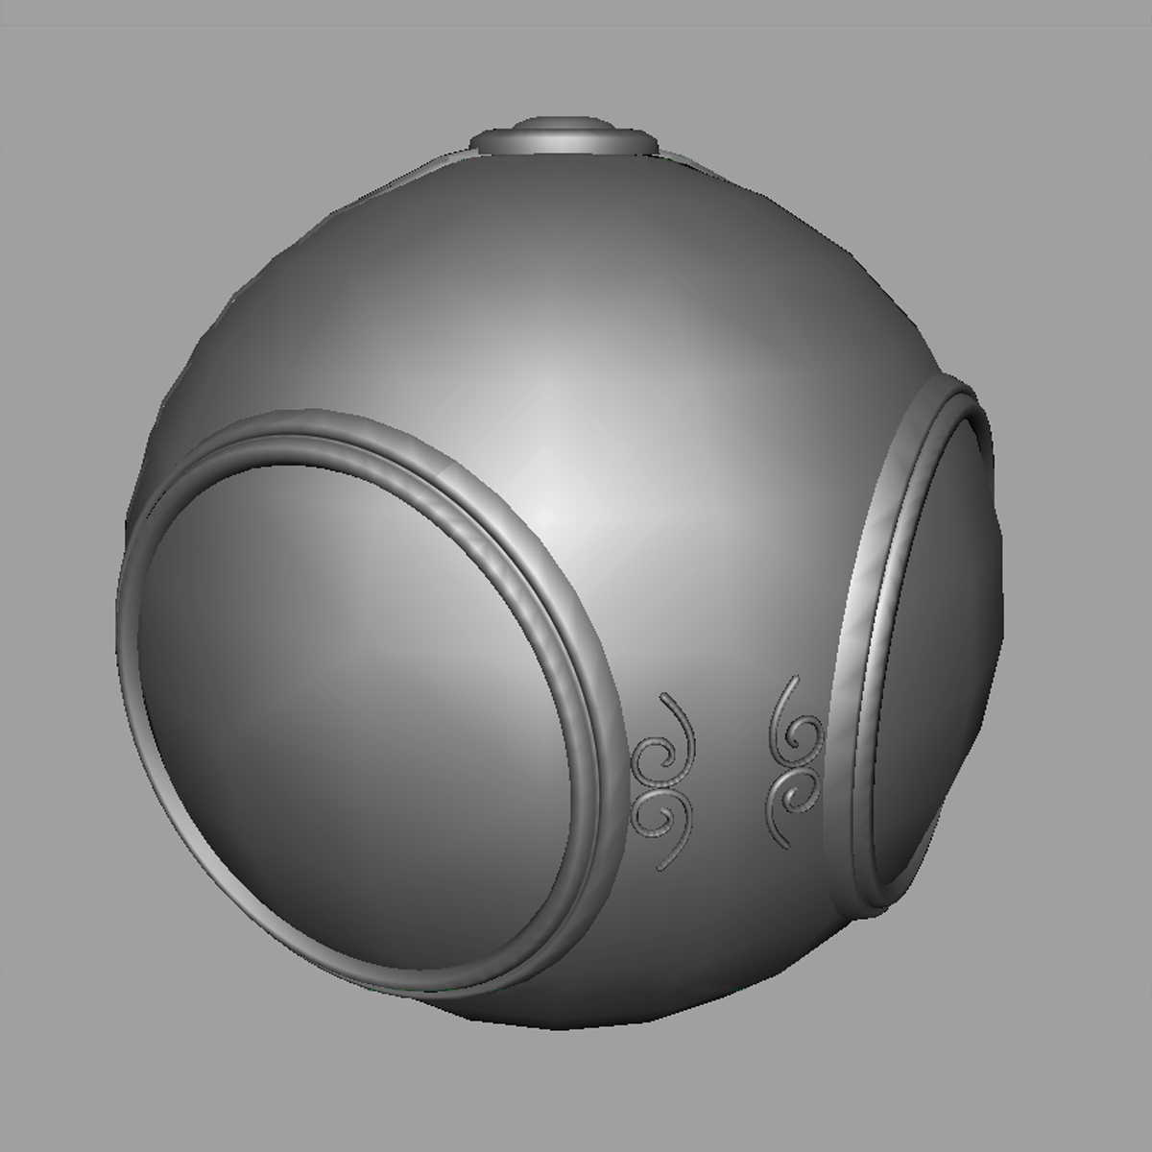
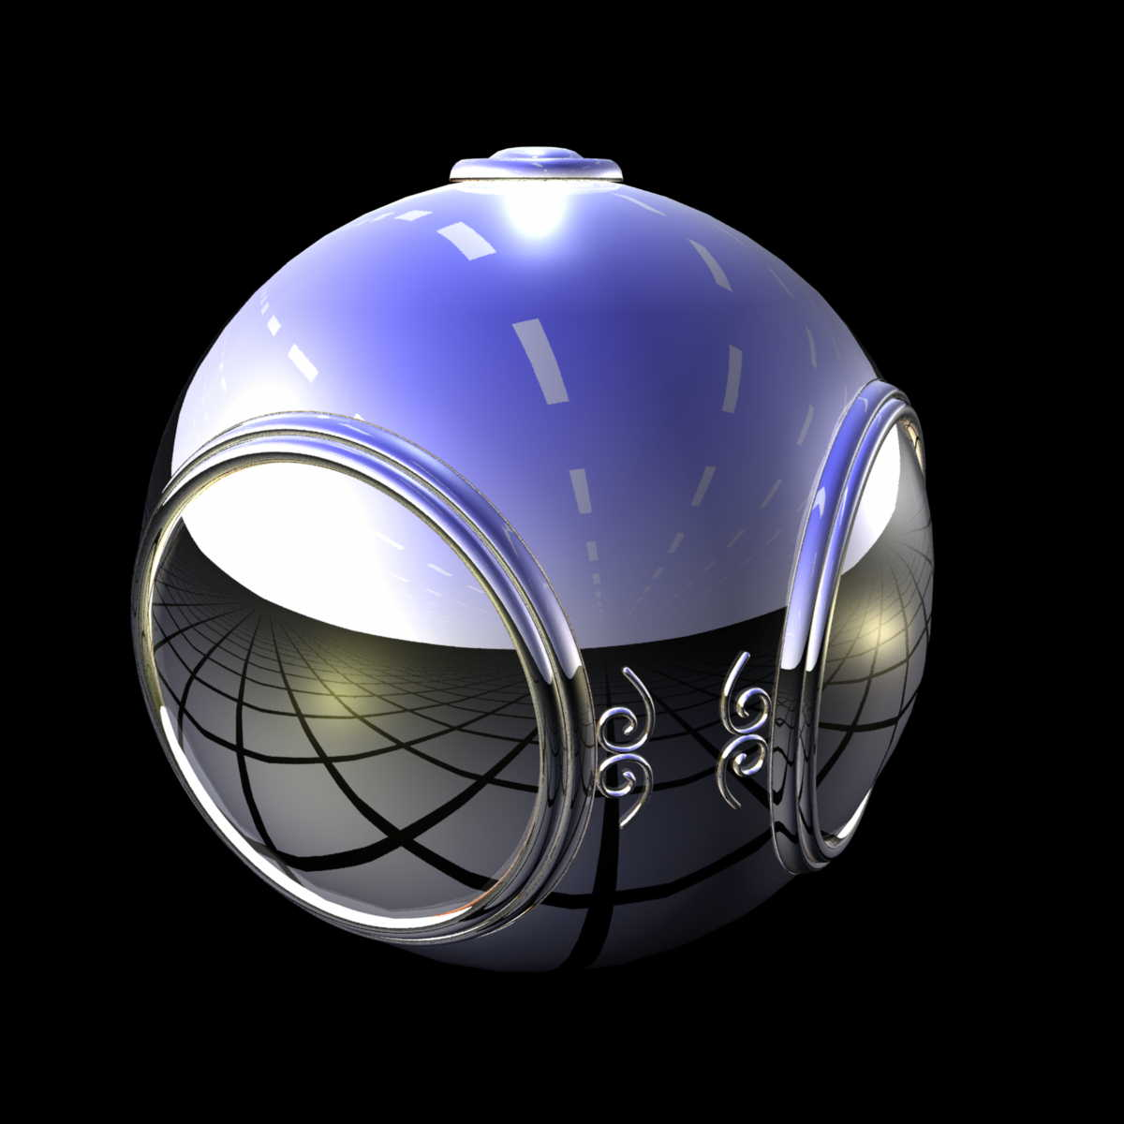
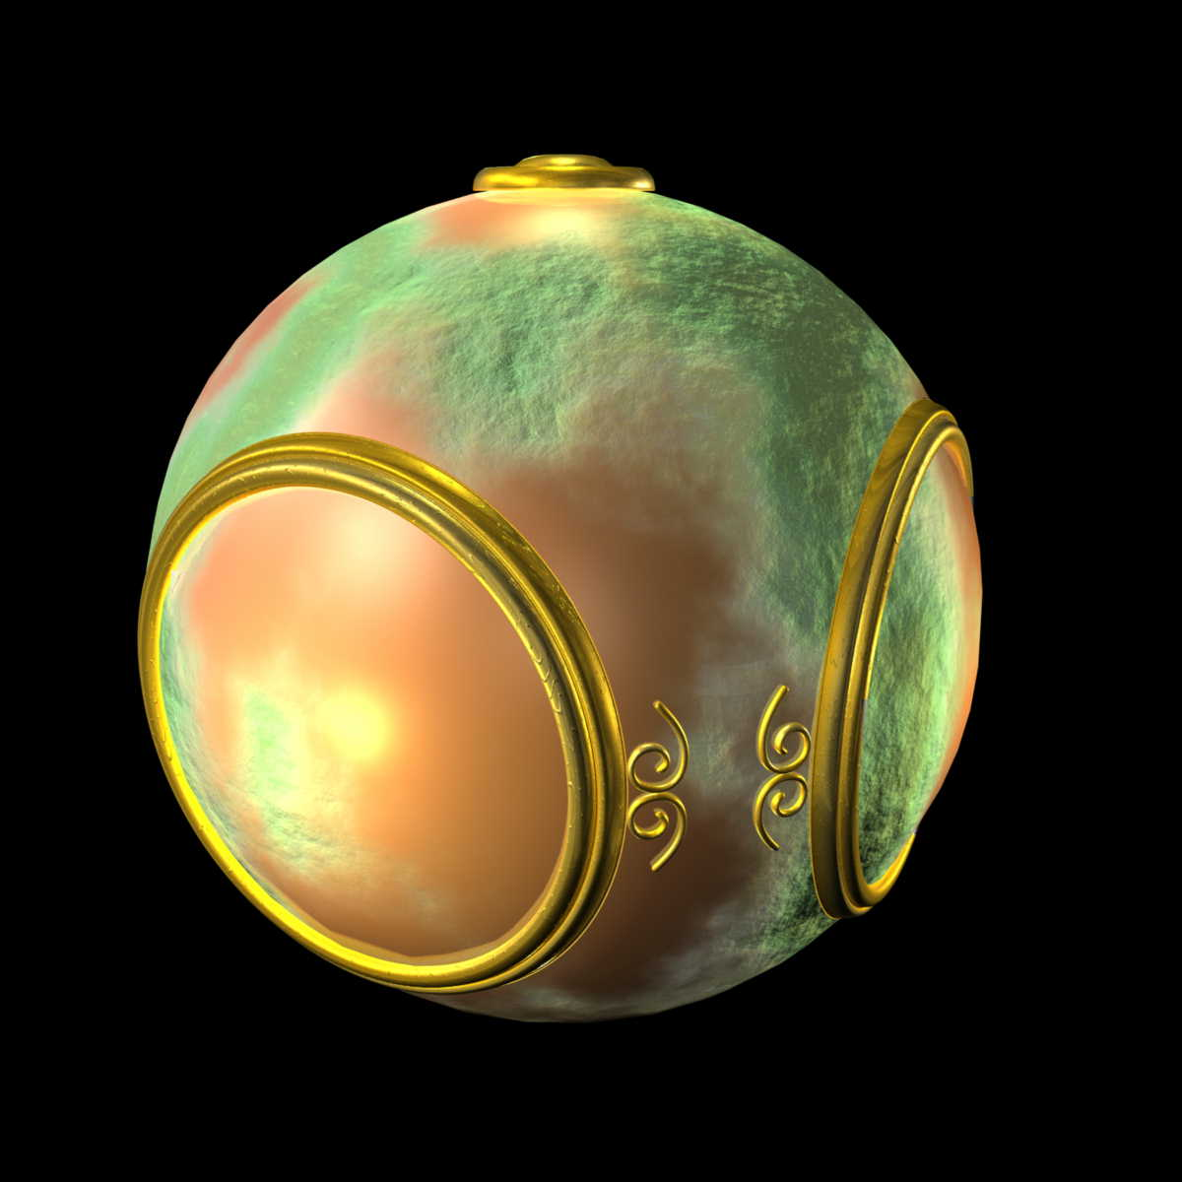
Computer Graphics: 1980-1990
Realism comes to computer graphics
smooth shading
environment
mapping
bump mapping

Slide 18
Computer Graphics: 1980-1990
Special purpose hardware
Silicon Graphics geometry engine
VLSI implementation of graphics pipeline
Industry-based standards
PHIGS
RenderMan
Networked graphics: X Window System
Human-Computer Interface (HCI)

Slide 19
Computer Graphics: 1990-2000
OpenGL API
Completely computer-generated feature-length movies (Toy Story) are successful
New hardware capabilities
Texture mapping
Blending
Accumulation, stencil buffers

Slide 20
Computer Graphics: 2000-2010
Photorealism
Graphics cards for PCs dominate market
Nvidia, ATI
Game boxes and game players determine direction of market
Computer graphics routine in movie industry: Maya, Lightwave
Programmable pipelines
New display technologies

Slide 21
Generic Flat Panel Display

Slide 22
Computer Graphics 2011-
Graphics is now ubiquitous
Cell phones
Embedded
OpenGL ES and WebGL
Alternate and Enhanced Reality
3D Movies and TV

