Slide 1
Introduction to Computer Graphics with WebGL
Ed Angel
Professor Emeritus of Computer Science
Founding Director, Arts, Research, Technology and Science Laboratory
University of New Mexico

Slide 2
Programming with WebGL Part 1: Background
Ed Angel
Professor Emeritus of Computer Science
University of New Mexico

Slide 3
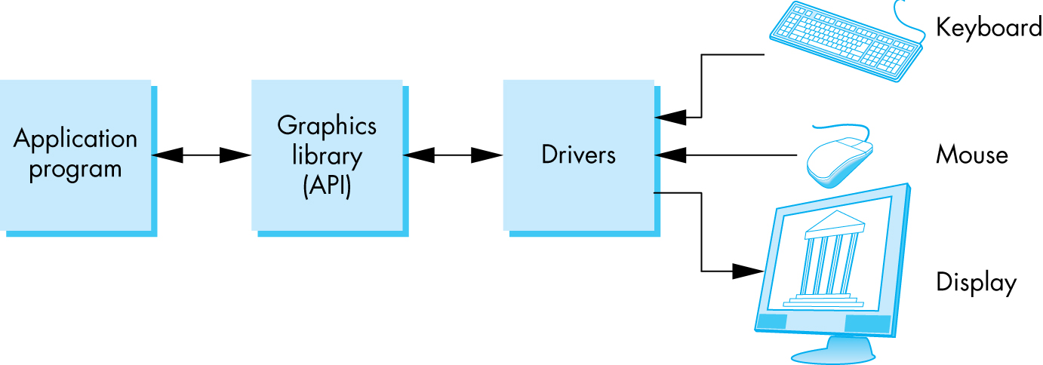
OpenGL Architecture

Slide 4
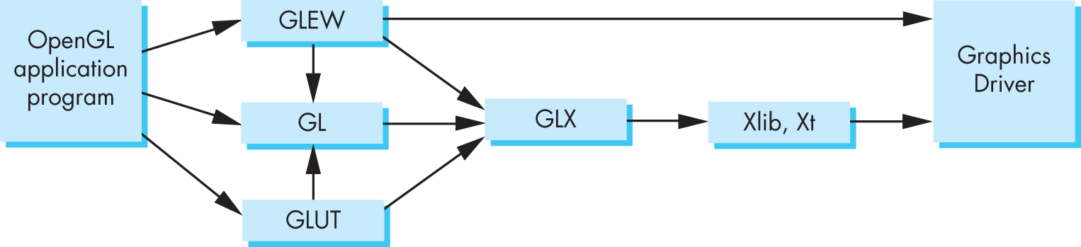
Software Organization

Slide 5
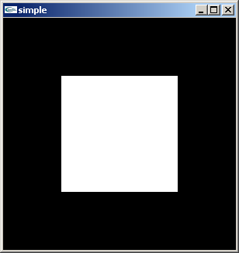
A OpenGL Simple Program
Generate a square on a solid background

Slide 6
It used to be easy
#include <GL/glut.h>
void mydisplay(){
glClear(GL_COLOR_BUFFER_BIT);
glBegin(GL_QUAD;
glVertex2f(-0.5, -0.5);
glVertex2f(-0,5, 0,5);
glVertex2f(0.5, 0.5);
glVertex2f(0.5, -0.5);
glEnd()
}
int main(int argc, char** argv){
glutCreateWindow("simple");
glutDisplayFunc(mydisplay);
glutMainLoop();
}

Slide 7
What happened?
Most OpenGL functions deprecated
immediate vs retained mode
make use of GPU
Makes heavy use of state variable default values that no longer exist
Viewing
Colors
Window parameters
However, processing loop is the same

Slide 8
Execution in Browser

Slide 9
Event Loop
Remember that the sample program specifies a render function which is a event listener or callback function
Every program should have a render callback
For a static application we need only execute the render function once
In a dynamic application, the render function can call itself recursively but each redrawing of the display must be triggered by an event

Slide 10
Lack of Object Orientation
All versions of OpenGL are not object oriented so that there are multiple functions for a given logical function
Example: sending values to shaders
gl.uniform3f
gl.uniform2i
gl.uniform3dv
Underlying storage mode is the same

Slide 11
WebGL function format
function name
dimension
gl.uniform3f(x,y,z)
x,y,z are variables
belongs to WebGL canvas
gl.uniform3fv(p)
p is an array

Slide 12
WebGL constants
Most constants are defined in the canvas object
In desktop OpenGL, they were in #include files such as gl.h
Examples
desktop OpenGL
glEnable(GL_DEPTH_TEST);
WebGL
gl.enable(gl.DEPTH_TEST)
gl.clear(gl.COLOR_BUFFER_BIT)

Slide 13
WebGL and GLSL
WebGL requires shaders and is based less on a state machine model than a data flow model
Most state variables, attributes and related pre 3.1 OpenGL functions have been deprecated
Action happens in shaders
Job of application is to get data to GPU

Slide 14
GLSL
OpenGL Shading Language
C-like with
Matrix and vector types (2, 3, 4 dimensional)
Overloaded operators
C++ like constructors
Similar to Nvidia’s Cg and Microsoft HLSL
Code sent to shaders as source code
WebGL functions compile, link and get information to shaders

