Slide 1
Programming with OpenGL Part 2: Complete Programs
Ed Angel
Professor of Emeritus of Computer Science
University of New Mexico

Slide 2
Objectives
Build a complete first program
Introduce shaders
Introduce a standard program structure
Simple viewing
Two-dimensional viewing as a special case of three-dimensional viewing
Initialization steps and program structure

Slide 3
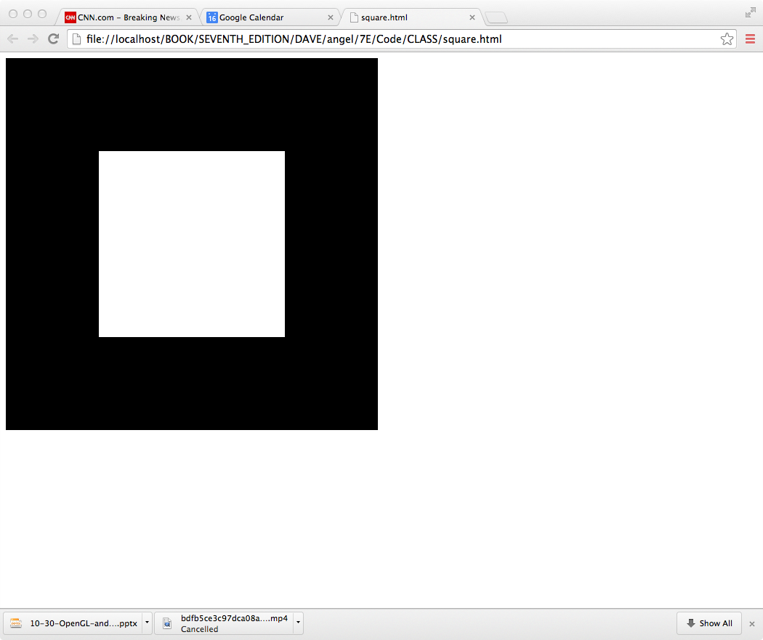
Square Program

Slide 4
WebGL
Five steps
Describe page (HTML file)
request WebGL Canvas
read in necessary files
Define shaders (HTML file)
could be done with a separate file (browser dependent)
Compute or specify data (JS file)
Send data to GPU (JS file)
Render data (JS file)

Slide 5
square.html
<!DOCTYPE html>
<html>
<head>
<script id="vertex-shader" type="x-shader/x-vertex">
attribute vec4 vPosition;
void main()
{
gl_Position = vPosition;
}
</script>
<script id="fragment-shader" type="x-shader/x-fragment">
precision mediump float;
void main()
{
gl_FragColor = vec4( 1.0, 1.0, 1.0, 1.0 );
}
</script>

Slide 6
Shaders
We assign names to the shaders that we can use in the JS file
These are trivial pass-through (do nothing) shaders that which set the two required built-in variables
gl_Position
gl_FragColor
Note both shaders are full programs
Note vector type vec2
Must set precision in fragment shader

Slide 7
square.html (cont)
<script type="text/javascript" src="../Common/webgl-utils.js"></script>
<script type="text/javascript" src="../Common/initShaders.js"></script>
<script type="text/javascript" src="../Common/MV.js"></script>
<script type="text/javascript" src="square.js"></script>
</head>
<body>
<canvas id="gl-canvas" width="512" height="512">
Oops ... your browser doesn't support the HTML5 canvas element
</canvas>
</body>
</html>

Slide 8
Files
../Common/webgl-utils.js: Standard utilities for setting up WebGL context in Common directory on website
../Common/initShaders.js: contains JS and WebGL code for reading, compiling and linking the shaders
../Common/MV.js: our matrix-vector package
square.js: the application file

Slide 9
square.js
var gl;
var points;
window.onload = function init(){
var canvas = document.getElementById( "gl-canvas" );
gl = WebGLUtils.setupWebGL( canvas );
if ( !gl ) { alert( "WebGL isn't available" );
}
// Four Vertices
var vertices = [
vec2( -0.5, -0.5 ),
vec2( -0.5, 0.5 ),
vec2( 0.5, 0.5 ),
vec2( 0.5, -0.5)
];

Slide 10
Notes
onload: determines where to start execution when all code is loaded
canvas gets WebGL context from HTML file
vertices use vec2 type in MV.js
JS array is not the same as a C or Java array
object with methods
vertices.length // 4
Values in clip coordinates

Slide 11
square.js (cont)
// Configure WebGL
gl.viewport( 0, 0, canvas.width, canvas.height );
gl.clearColor( 0.0, 0.0, 0.0, 1.0 );
// Load shaders and initialize attribute buffers
var program = initShaders( gl, "vertex-shader", "fragment-shader" );
gl.useProgram( program );
// Load the data into the GPU
var bufferId = gl.createBuffer();
gl.bindBuffer( gl.ARRAY_BUFFER, bufferId );
gl.bufferData( gl.ARRAY_BUFFER, flatten(vertices), gl.STATIC_DRAW );
// Associate out shader variables with our data buffer
var vPosition = gl.getAttribLocation( program, "vPosition" );
gl.vertexAttribPointer( vPosition, 2, gl.FLOAT, false, 0, 0 );
gl.enableVertexAttribArray( vPosition );

Slide 12
Notes
initShaders used to load, compile and link shaders to form a program object
Load data onto GPU by creating a vertex buffer object on the GPU
Note use of flatten() to convert JS array to an array of float32’s
Finally we must connect variable in program with variable in shader
need name, type, location in buffer

Slide 13
square.js (cont)
render();
};
function render() {
gl.clear( gl.COLOR_BUFFER_BIT );
gl.drawArrays( gl.TRIANGLE_FAN, 0, 4 );
}
1
2
3
0

Slide 14
Triangles, Fans or Strips
gl.drawArrays( gl.TRIANGLES, 0, 6 ); // 0, 1, 2, 0, 2, 3
gl.drawArrays( gl.TRIANGLE_FAN, 0, 4 ); // 0, 1 , 2, 3
1
2
1
2
0
3
0
3
gl.drawArrays( gl.TRIANGLE_STRIP, 0, 4 ); // 0, 1, 3, 2

