Slide 1
Programming with OpenGL Part 2: Complete Programs
Ed Angel
Professor of Emeritus of Computer Science
University of New Mexico

Slide 2
Objectives
Build a complete first program
Introduce shaders
Introduce a standard program structure
Simple viewing
Two-dimensional viewing as a special case of three-dimensional viewing
Initialization steps and program structure

Slide 3
Program Execution
WebGL runs within the browser
complex interaction among the operating system, the window system, the browser and your code (HTML and JS)
Simple model
Start with HTML file
files read in asynchronously
start with onload function
event driven input

Slide 4
Coordinate Systems
The units in points are determined by the application and are called object, world, model or problem coordinates
Viewing specifications usually are also in object coordinates
Eventually pixels will be produced in window coordinates
WebGL also uses some internal representations that usually are not visible to the application but are important in the shaders
Most important is clip coordinates

Slide 5
Coordinate Systems and Shaders
Vertex shader must output in clip coordinates
Input to fragment shader from rasterizer is in window coordinates
Application can provide vertex data in any coordinate system but shader must eventually produce gl_Position in clip coordinates
Simple example uses clip coordinates

Slide 6
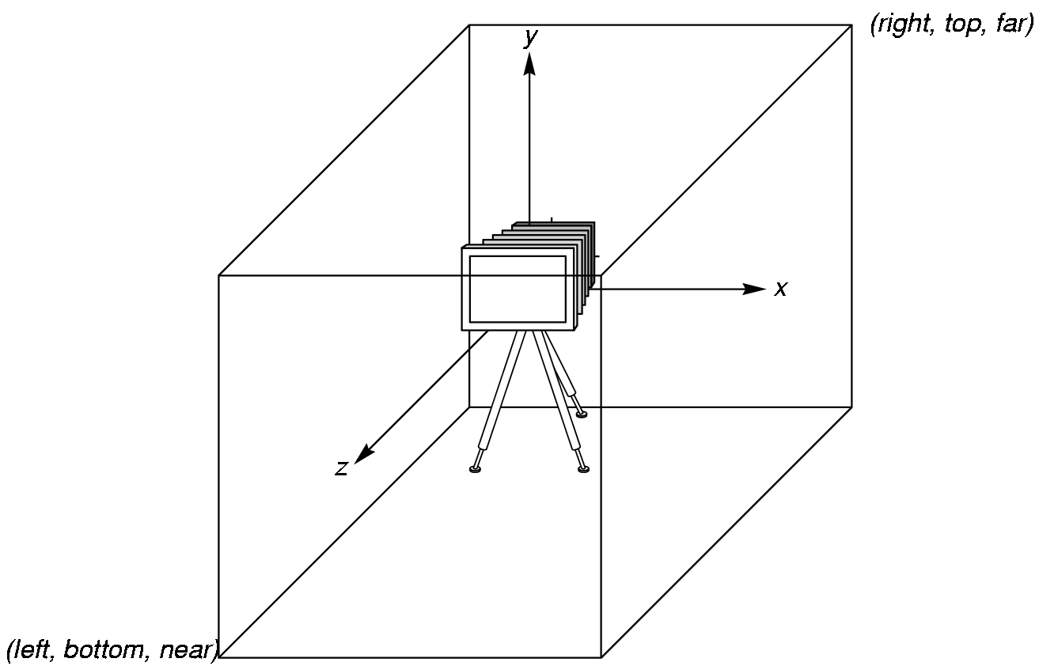
WebGL Camera
WebGL places a camera at the origin in object space pointing in the negative z direction
The default viewing volume
is a box centered at the
origin with sides of
length 2

Slide 7
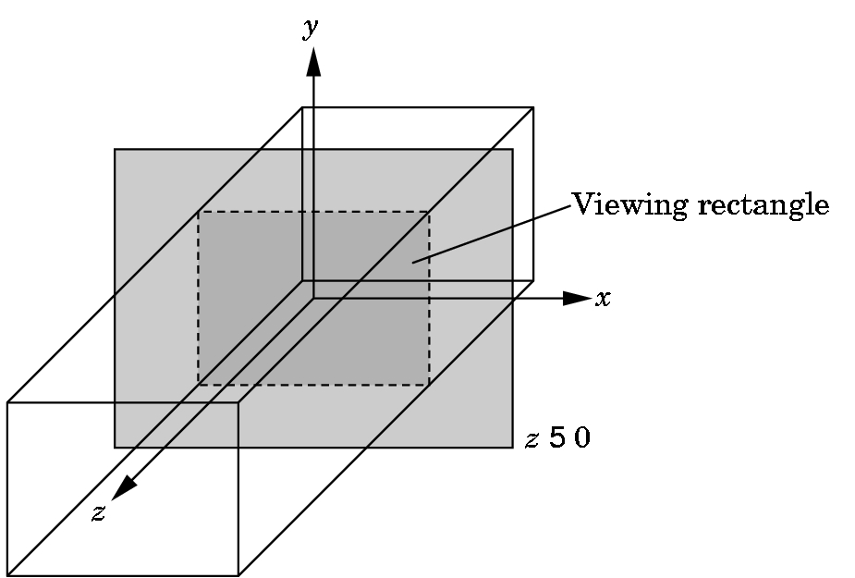
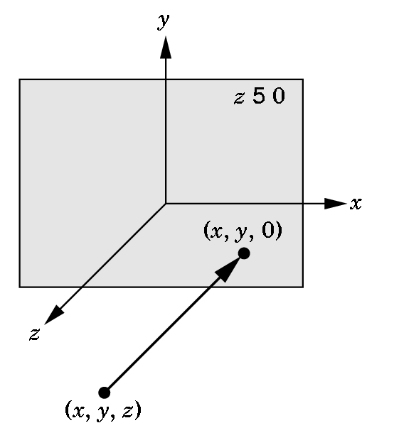
Orthographic Viewing
In the default orthographic view, points are
projected forward along the z axis onto the
plane z=0
z=0
z=0

Slide 8
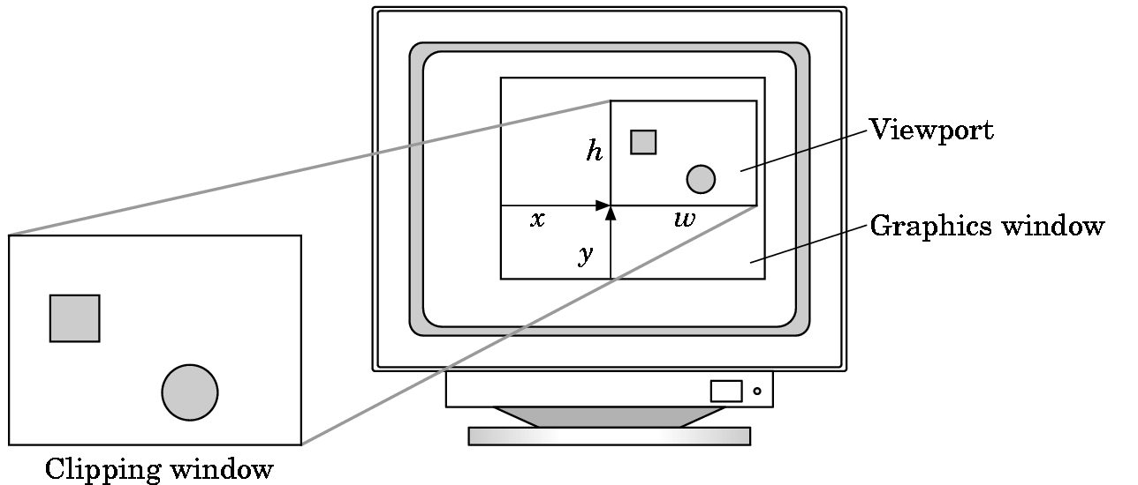
Viewports
Do not have use the entire window for the image: gl.viewport(x,y,w,h)
Values in pixels (window coordinates)

Slide 9
Transformations and Viewing
In WebGL, we usually carry out projection using a projection matrix (transformation) before rasterization
Transformation functions are also used for changes in coordinate systems
Pre 3.1 OpenGL had a set of transformation functions which have been deprecated
Three choices in WebGL
Application code
GLSL functions
MV.js

Slide 10
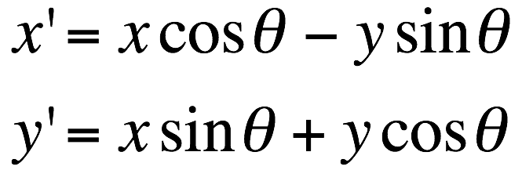
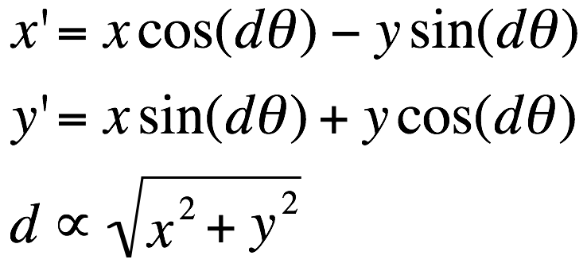
First Assignment: Tessellation and Twist
Consider rotating a 2D point about the origin
Now let amount of rotation depend on distance from origin giving us twist

Slide 11
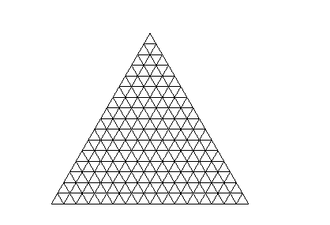
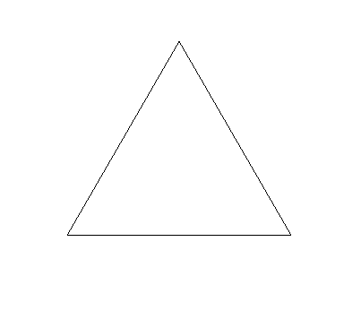


Example
triangle
tessellated triangle
twist without tessellation
twist after tessellation

