Slide 1
Introduction to Computer Graphics with WebGL
Ed Angel
Professor Emeritus of Computer Science
Founding Director, Arts, Research, Technology and Science Laboratory
University of New Mexico

Slide 2
Programming with WebGL Part 3: Shaders
Ed Angel
Professor of Emeritus of Computer Science
University of New Mexico

Slide 3
Objectives
Simple Shaders
Vertex shader
Fragment shaders
Programming shaders with GLSL
Finish first program

Slide 4
Vertex Shader Applications
Moving vertices
Morphing
Wave motion
Fractals
Lighting
More realistic models
Cartoon shaders

Slide 5
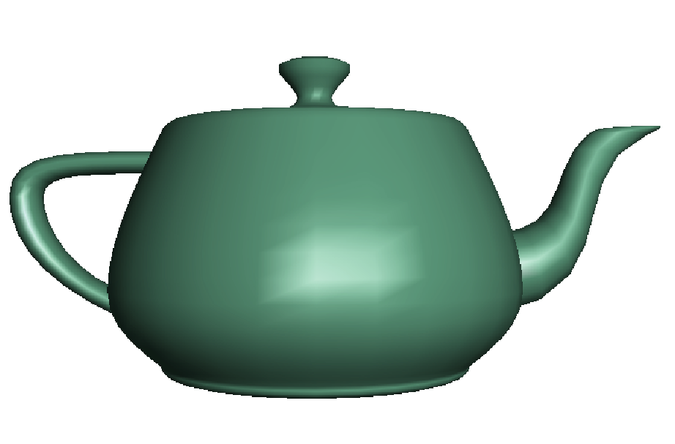
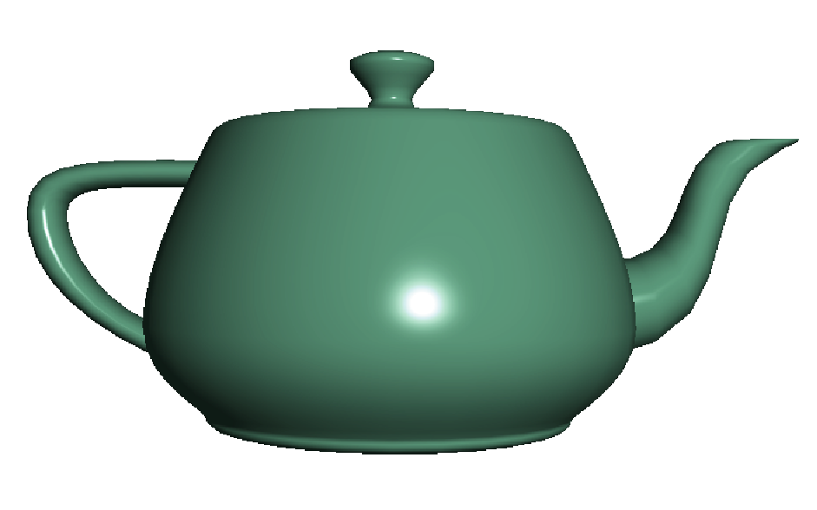
Fragment Shader Applications
Per fragment lighting calculations
per vertex lighting
per fragment lighting

Slide 6
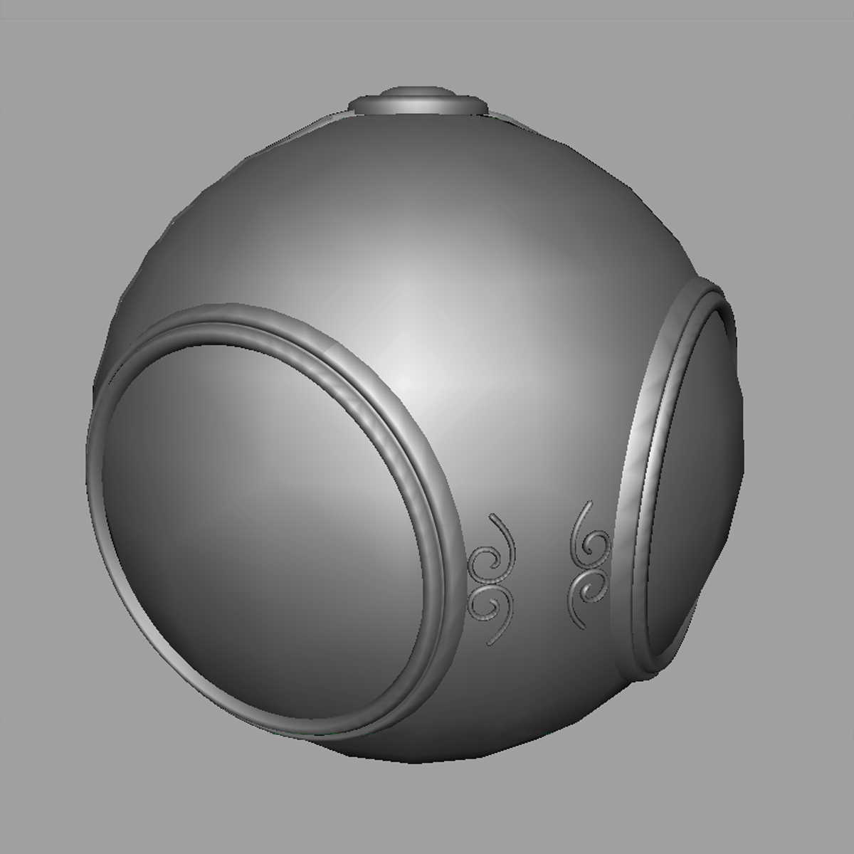

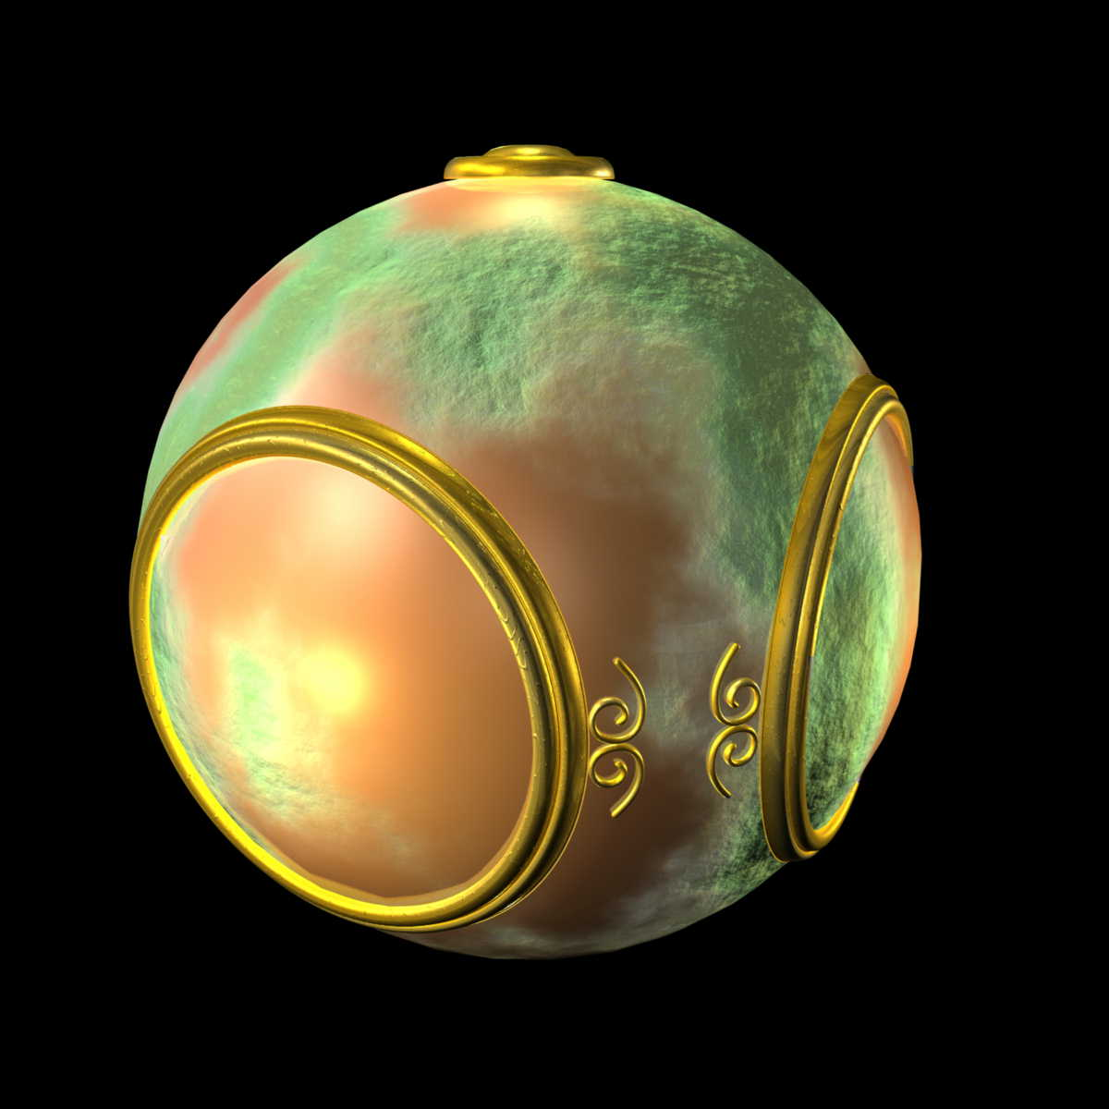
Fragment Shader Applications
Texture mapping
smooth shading
environment
mapping
bump mapping

Slide 7
Writing Shaders
First programmable shaders were programmed in an assembly-like manner
OpenGL extensions added functions for vertex and fragment shaders
Cg (C for graphics) C-like language for programming shaders
Works with both OpenGL and DirectX
Interface to OpenGL complex
OpenGL Shading Language (GLSL)

Slide 8
GLSL
OpenGL Shading Language
Part of OpenGL 2.0 and up
High level C-like language
New data types
Matrices
Vectors
Samplers
As of OpenGL 3.1, application must provide shaders

Slide 9
Simple Vertex Shader
attribute vec4 vPosition;
void main(void)
{
gl_Position = vPosition;
}
input from application
must link to variable in application
built in variable

Slide 10
Execution Model
Vertex data
Shader Program
GPU
Application
Program
Vertex
Shader
Primitive
Assembly
gl.drawArrays
Vertex

Slide 11
Simple Fragment Program
precision mediump float;
void main(void)
{
gl_FragColor = vec4(1.0, 0.0, 0.0, 1.0);
}

Slide 12
Execution Model
Application
Shader Program
Rasterizer
Fragment
Shader
Frame Buffer
Fragment
Fragment
Color

