Slide 1
Computer Graphics ECSE-4750 FALL 2015
CLASS 4

Slide 2
Class
Coordinates
What is a transform?
Transforms
How to create robot arm
Code Example

Slide 3
How to create a body
First, get a body…
The key is to generate geometric entities to represent the body parts
Body, Arms, Legs, Finger, Toes…
Then they need to move independent
But with respect to their connections.
How do we make dependent connections?
Body
head
Arm
Upper
Forearm
Wrist
Fingers
Legs
Thigh
Calf
Foot

Slide 4
Transforms are the joints
Think of it as a state diagram
Children inherit from the parents
But they get to influence their state
Color, lights, camera, position
All can be inherited and bound by the graph
Body
head
Arm
Upper
Forearm
Wrist
Fingers
Legs
Thigh
Calf
Foot
1
1
1
1
1
1
1
1
1
1
1

Slide 5
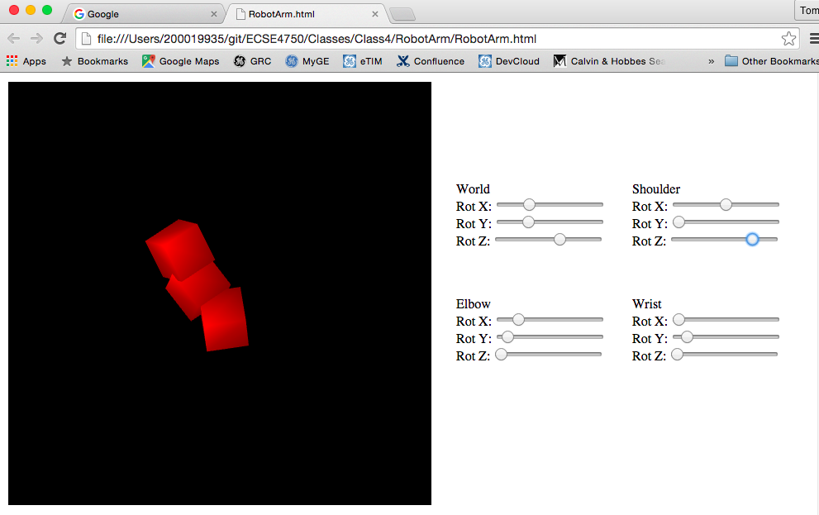
The Robot
From one start geometry
Many copies
Each independent
But hierarchical

