Slide 1
Computer Graphics ECSE-4750 FALL 2015
CLASS 5

Slide 2
Class
MidTerm
Scene Organization
Scene Graph
Object Hierarchy
New Rendering Classes
Geoemtries
Topologies
Cells
Actors
Bring it all together.

Slide 3
MidTerm
Midterm answers

Slide 4
Scene Organization
Scene Composition
Provides an abstraction layer to graphics
Consists of nodes connected by arcs
All nodes have parents except for the root node
This produces a directed acyclic graph

Slide 5
Scene Graph Traversal
Supports many operations
Transformations
Clipping and culling
Lighting
Interaction operations such as collision detection and picking
Caching
Rendering traversals occurs constantly
Interactive and animated graphics

Slide 6
Scene Graph History
#VRML V2.0 utf8
#Example VRML 2.0 file for teaching basic concepts
#of color and 3D primitive shapes.
#Created by Theresa-Marie Rhyne
# A Cylinder
Shape {
appearance Appearance {
material Material {
diffuseColor 0.75 0.5 1.0
specularColor 0.7 0.7 0.8
shininess 0.1
}
}
geometry Cylinder {
height 0.2
radius 3.
}
}
# A Sphere
Shape {
appearance Appearance {
material Material {
diffuseColor 0.2 0.5 0.75
transparency 0.0
}
}
geometry Sphere {
radius 1.0
}
}
VRML, formalized around 1995
ISO standard in 1997
Based on OpenInventor format from SGI

Slide 7
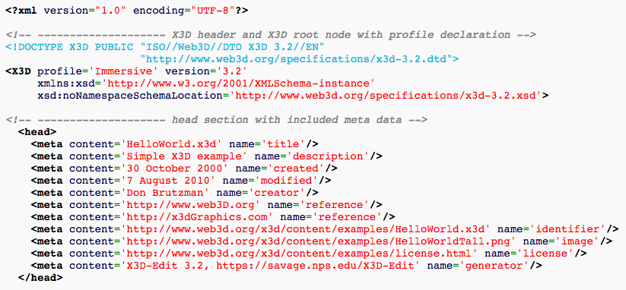
Scene Graph Syntax
X3D Format – The header

Slide 8
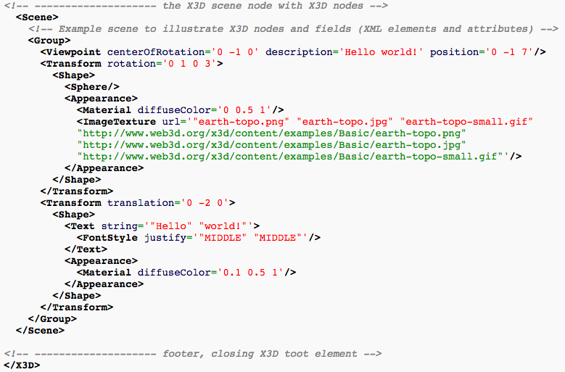
Scene Graph Syntax
X3D – The Scene

Slide 9
Scene Graphs live
http://www.openscenegraph.org/
Open source 3D graphics toolkit
C++ implementation leveraging OpenGL

Slide 10
Scene Graphs in Code
File formats are nice but how about code based scenes
Robot Arm in OpenScene Graph based library
http://osgjs.org/
Code

Slide 11
Homework 3
Using OSG.js build a robot that includes a body, head, arms (3 segments), and legs (3 segments).
Basic segments can be cubes in the OSGjs library
Ensure:
The hierarchy is correct, moving the body moves everything
Each segment is movable on its own.
Some UI to manipulate your robot. (Can be one set of sliders that switch between joints.
Extra credit:
Add hand, feet, fingers, and toes.
X-Extra credit
Animate the included Ogre

