Slide 1
Computer Graphics ECSE-4750 FALL 2015
CLASS 6

Slide 2
Class
Term Project
Homework 3
Peter Tu

Slide 3
Term Project
You will think of, implement, and document a program relating to graphics. It must demonstrate both graphics input and output; other than that it must only be legal and ethical.
This may be done by a team, and may be combined with another course's project if you get the approval of everyone involved.
You need to work in teams of 4-5 people
This is on purpose, businesses need you to work well in teams.

Slide 4
Term Project
You are all responsible for your final grade.
Part of the term project grade will be you evaluating your team members
Submission:
A graphical program of your choosing, pick a topic and code base
Must have input (Controls to change the scene)
Must be documented, how do I use it and what can it do. (A PDF is fine)
Working code so I can run it.
Evaluations of your team members, I will send out a form.
Presentation in front of class the last day, slides showing your work.

Slide 5
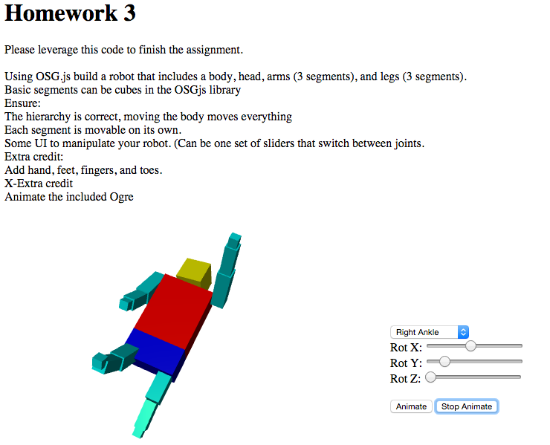
Homework 3
Simple Solution

Slide 6
Peter Tu
Peter H. Tu (GE Global Reseach, Senior Principal Scientist) Education B.S. Systems Design Engineering, 1990 University of Waterloo - Canada PhD. Engineering Science, 1995 Oxford University – England Dr. Tu is a senior principal scientist working at the General Electric Global Research (GE GR) center since 1997. He has carried out applied research in the area of Computer Vision and Image Understanding.
Topic:
Computer Vision: This talk will review a number of technical themes associated with the field of computer vision. Topics to be included are: projective geometry, the physical properties of light and materials with respect to the image formation process, object detection and machine learning, tracking and model fitting, behavior recognition and social interaction analysis.

