Slide 1
Computer Graphics ECSE-4750 FALL 2015
CLASS 7

Slide 2
Class
Term Project
Babylon library
In class challenge

Slide 3
Term Project
You will think of, implement, and document a program relating to graphics. It must demonstrate both graphics input and output; other than that it must only be legal and ethical.
This may be done by a team, and may be combined with another course's project if you get the approval of everyone involved.
You need to work in teams of 4-5 people
This is on purpose, businesses need you to work well in teams.

Slide 4
Term Project
You are all responsible for your final grade.
Part of the term project grade will be you evaluating your team members
Submission:
A graphical program of your choosing, pick a topic and code base
Must have input (Controls to change the scene)
Must be documented, how do I use it and what can it do. (A PDF is fine)
Working code so I can run it.
Evaluations of your team members, I will send out a form.
Presentation in front of class the last day, slides showing your work.

Slide 5
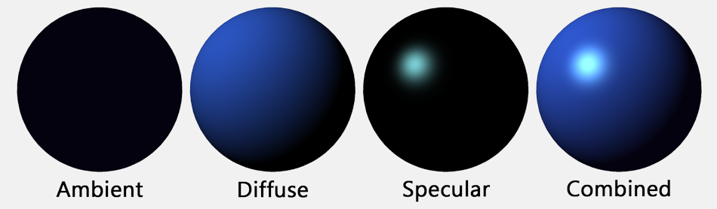
Material Properties
Ambient Reflection
Ambient reflection determines what color an object takes under ambient lighting
Diffuse Reflection
Diffuse reflection determines what color an object takes under direct lighting.
Specular Reflection
Specular reflection determines the color of an object's highlight

Slide 6
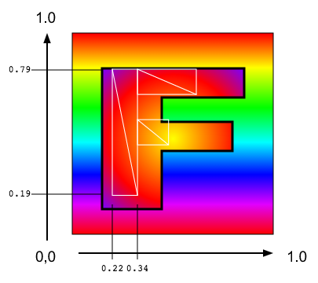
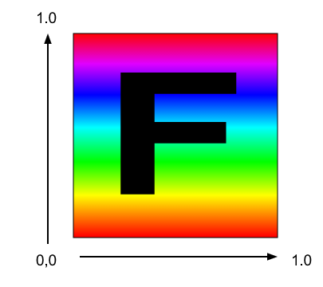
Textures

Slide 7
Scene Graph Vs Objects
Scene graphs are difficult to use
Setup and arrangement is difficult
Inserting and removing can be tricky
What is a better way

Slide 8
Babylon.js
Babylon.js is a 3D engine based on webgl and javascript
http://www.babylonjs.com/
Example code

Slide 9
In class challenge
Work in teams
Grab the code from the LMS site
Get Points:
Add texture to robot body, waist, and legs – 1 Point per body section
Make the robot walk– check out the Babylon site for animation and the Bones and Skeleton interfaces – 2 Points
Style points – Impress myself and Yu and show your demo.

