Slide 1
Computer Graphics ECSE-4750 FALL 2015
CLASS 8

Slide 2
Class
Term Project
Polygons, geometry, and should I draw them
Textures and Coordinates
Homework 4

Slide 3
Term Project
You will think of, implement, and document a program relating to graphics. It must demonstrate both graphics input and output; other than that it must only be legal and ethical.
This may be done by a team, and may be combined with another course's project if you get the approval of everyone involved.
You need to work in teams of 4-5 people
This is on purpose, businesses need you to work well in teams.

Slide 4
Polygons, geometry, and clipping

Slide 5
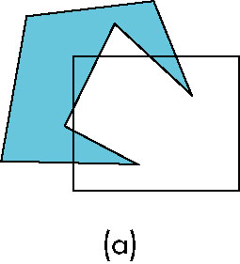
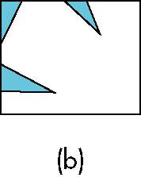
Polygon Clipping
Not as simple as line segment clipping
Clipping a line segment yields at most one line segment
Clipping a polygon can yield multiple polygons
However, clipping a convex polygon can yield at most one other polygon

Slide 6

Tessellation and Convexity
One strategy is to replace nonconvex (concave) polygons with a set of triangular polygons (a tessellation)
Also makes fill easier
Tessellation through tesselllation shaders

Slide 7
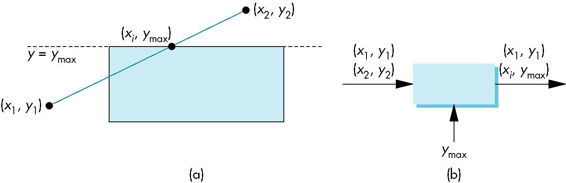
Clipping as a Black Box
Can consider line segment clipping as a process that takes in two vertices and produces either no vertices or the vertices of a clipped line segment

Slide 8
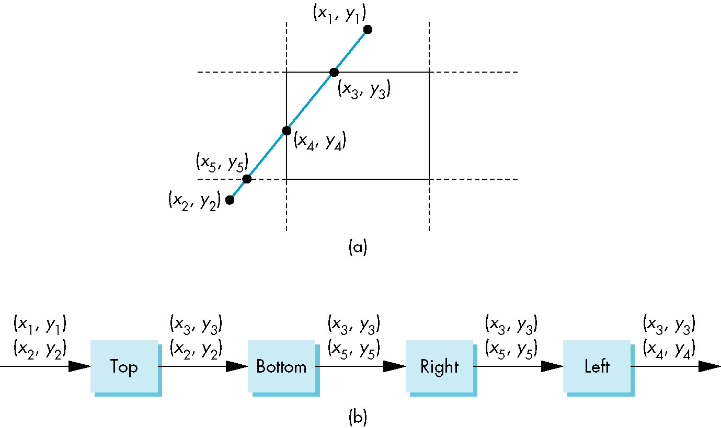
Pipeline Clipping of Line Segments
Clipping against each side of window is independent of other sides
Can use four independent clippers in a pipeline

Slide 9
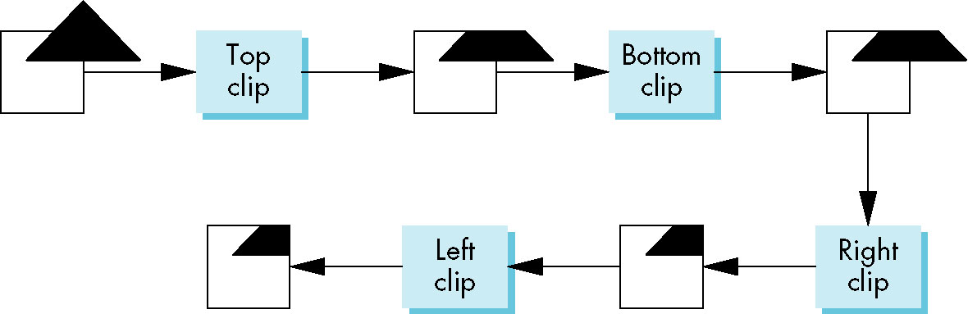
Pipeline Clipping of Polygons
Three dimensions: add front and back clippers
Strategy used in SGI Geometry Engine
Small increase in latency

Slide 10
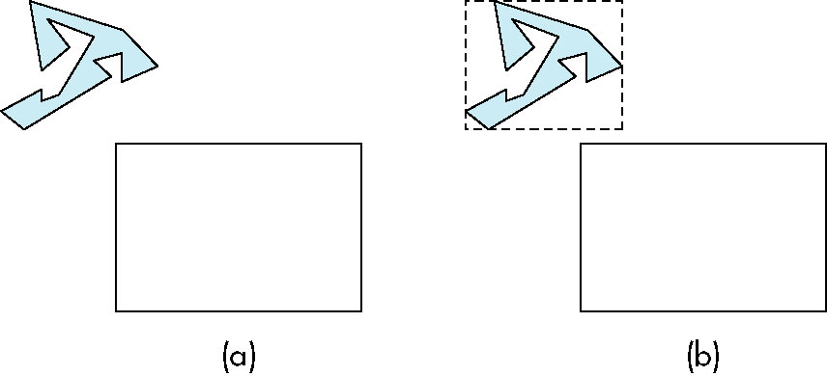
Bounding Boxes
Rather than doing clipping on a complex polygon, we can use an axis-aligned bounding box or extent
Smallest rectangle aligned with axes that encloses the polygon
Simple to compute: max and min of x and y

Slide 11
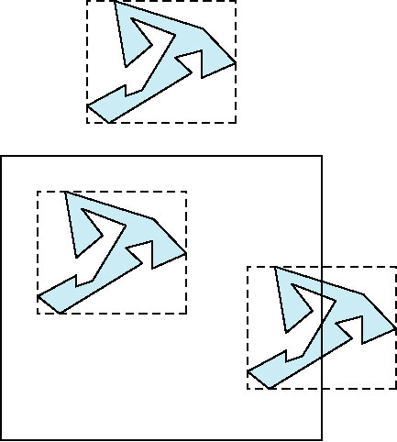
Bounding boxes
Can usually determine accept/reject based only on bounding box
reject
accept
requires detailed
clipping

Slide 12
Clipping and Visibility
Clipping has much in common with hidden-surface removal
In both cases, we are trying to remove objects that are not visible to the camera
Often we can use visibility or occlusion testing early in the process to eliminate as many polygons as possible before going through the entire pipeline

Slide 13
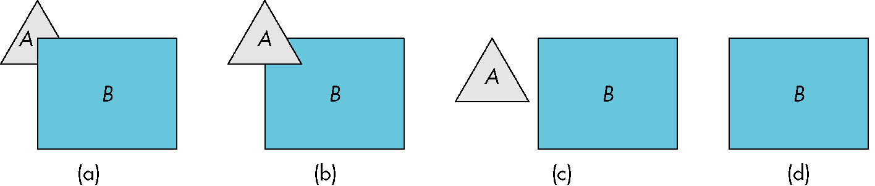
Hidden Surface Removal
Object-space approach: use pairwise testing between polygons (objects)
Worst case complexity O(n²) for n polygons
partially obscuring
can draw independently

Slide 14
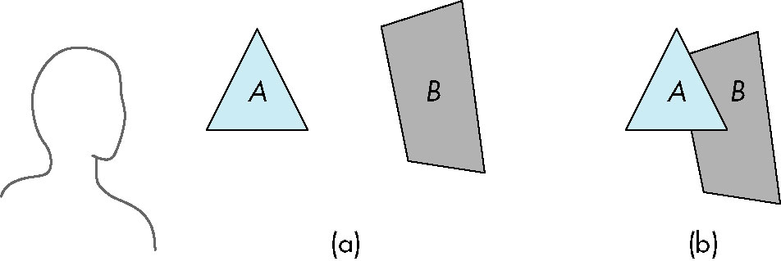
Painter’s Algorithm
Render polygons a back to front order so that polygons behind others are simply painted over
B behind A as seen by viewer
Fill B then A

Slide 15
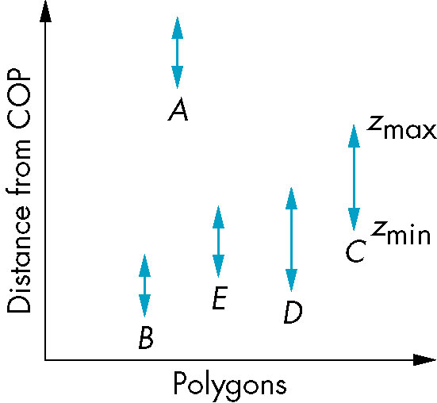
Depth Sort
Requires ordering of polygons first
O(n log n) calculation for ordering
Not every polygon is either in front or behind all other polygons
Order polygons and deal with
easy cases first, harder later
Polygons sorted by
distance from COP

Slide 16
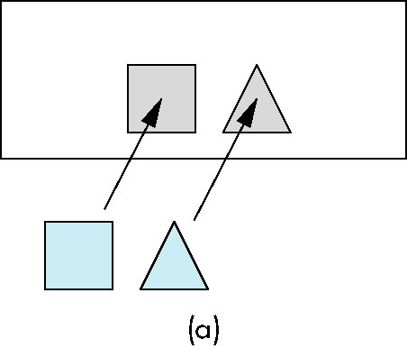
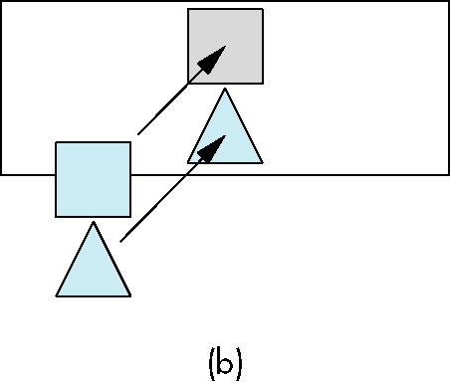
Easy Cases
A lies behind all other polygons
Can render
Polygons overlap in z but not in either x or y
Can render independently

Slide 17
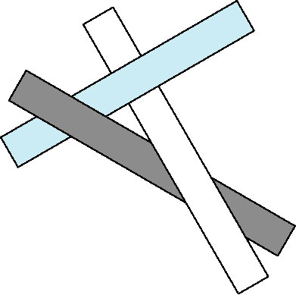
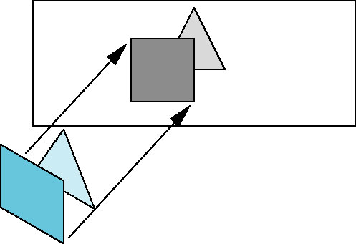
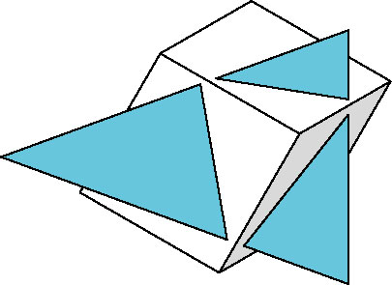
Hard Cases
cyclic overlap
Overlap in all directions
but can one is fully on
one side of the other
penetration

Slide 18
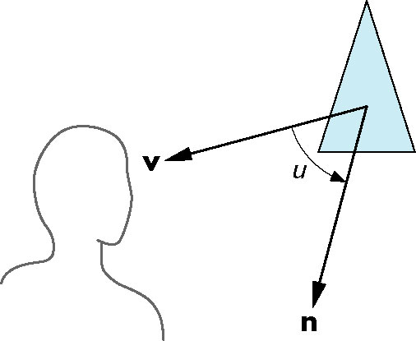
Back-Face Removal (Culling)
face is visible iff 90 ≥ θ ≥ -90
equivalently cos θ ≥ 0
or v • n ≥ 0
θ
plane of face has form ax + by +cz +d =0
but after normalization n = ( 0 0 1 0)^{T}
need only test the sign of c
In OpenGL we can simply enable culling
but may not work correctly if we have nonconvex objects

Slide 19
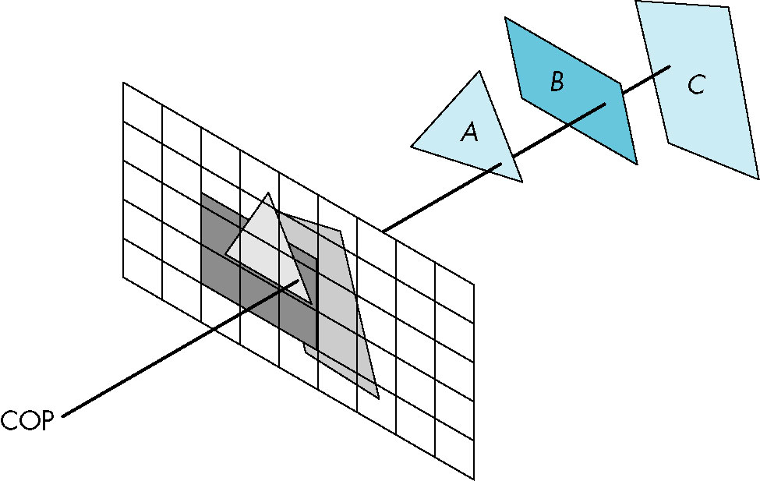
Image Space Approach
Look at each projector (nm for an n x m frame buffer) and find closest of k polygons
Complexity O(nmk)
Ray tracing
z-buffer

Slide 20
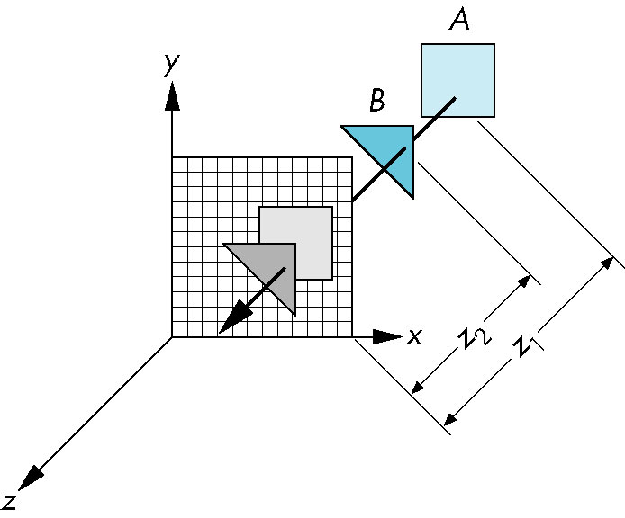
z-Buffer Algorithm
Use a buffer called the z or depth buffer to store the depth of the closest object at each pixel found so far
As we render each polygon, compare the depth of each pixel to depth in z buffer
If less, place shade of pixel in color buffer and update z buffer

Slide 21
Textures

Slide 22
Textures
Texture coordinates are specified at each vertex of a given geometry
We are drawing polygons
These need to be tessellated
Topology and geometry saves us
Only need to redefine the triangle end points
Geometry stays the same

Slide 23
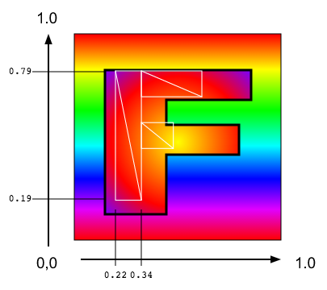
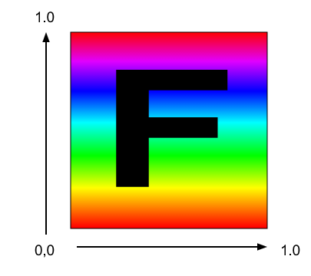
Textures

Slide 24
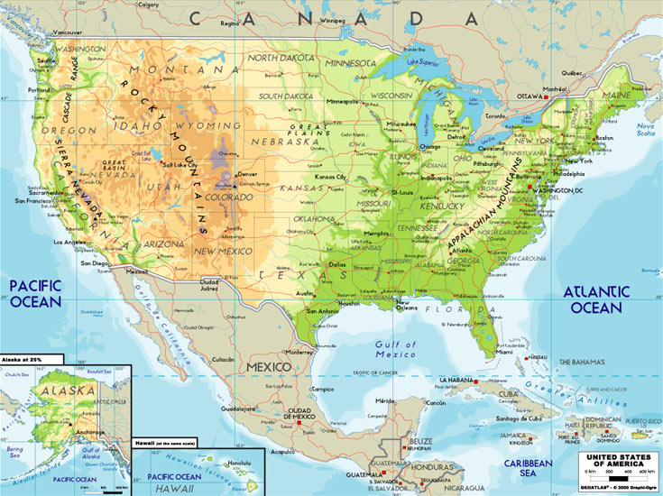
Texture coordinate generation
Interpolate on the geometries real world coordinates and find the appropriate texture coordinate
Previous example nice for simple translation
How to map to real world
Pixel: (611, 439 111)
Coord: (-75, 45)
Width: 735 Height: 550
Pixel: (84, 133 417)
Coord: (-120, 20)

Slide 25
Homework 4
Textures are very good, use your code from the in class challenge and textures to the Hw4 code.
Add code to interpolate texture coordinates for each state
Add one texture and reuse across all the geometries
Each state will “cut” themselves out of the entire image.
Try turning off some states
(Hint: To open local files you can turn off Chrome file security with the command line option: --args --disable-web-security, just remember to close the browser when finished)
(Or use Firefox ;)

