Slide 1

Problem Session 4
CS145 Autumn 2007
Project 1 Help
Yusheng Yang
Stanford University
10/22/2007

Slide 2
Outline
CS145 Autumn 2007
Announcements
Synopsis of Project 1
Parser demo
Tips
Q&A

Slide 3
Announcements
CS145 Autumn 2007
Gradiance – two due Wed 10/24
Challenge Problems #2 due Wed 10/24
Project 1 due Wed 10/31
Midterm Wed 10/31 11am-12:15pm Gates B01
  Up to and including 10/24 lecture on XPath
  Open notes/book/laptop. Closed Internet.
  Next problem session = review session

Slide 4
Synopsis of Project 1
CS145 Autumn 2007
Synopsis
Demo
Tips
Synopsis

Slide 5
3 Steps to Project 1
CS145 Autumn 2007
Plan your tables
Parse XML into tables
Prove everything worked
Synopsis

Slide 6
Plan Your Tables
CS145 Autumn 2007
<?xml version="1.0" encoding="UTF-8"?>
<!DOCTYPE Bars SYSTEM "bars.dtd">
<Bars>
<Bar><Name>Joe's Bar</Name>
<Beer Price="$2.50">
<Name>Bud</Name>
</Beer>
<Beer Price="$3.00">
<Name>Miller</Name>
</Beer>
</Bar>
</Bars>
Sells
Bar | Beer | Price
Joe’s Bar | Bud | $2.50
Joe’s Bar | Miller | $3.00
Input: XML
Output: Table
Synopsis

Slide 7
Parse XML Into Tables
CS145 Autumn 2007
<?xml version="1.0" encoding="UTF-8"?>
<!DOCTYPE Bars SYSTEM "bars.dtd">
<Bars>
<Bar><Name>Joe's Bar</Name>
<Beer Price="$2.50">
<Name>Bud</Name>
</Beer>
<Beer Price="$3.00">
<Name>Miller</Name>
</Beer>
</Bar>
</Bars>
MyParser.java
Joe's Bar<>Bud<>2.50
Joe's Bar<>Miller<>3.00
Input: XML
Output: data file for sqlldr
Synopsis

Slide 8
Prove Everything Works
CS145 Autumn 2007
Just like Project 0
  Create table
  Run sqlldr
  Query, query, query!
Synopsis

Slide 9
Parser Demo
CS145 Autumn 2007
Synopsis
Demo
Tips
Demo

Slide 10
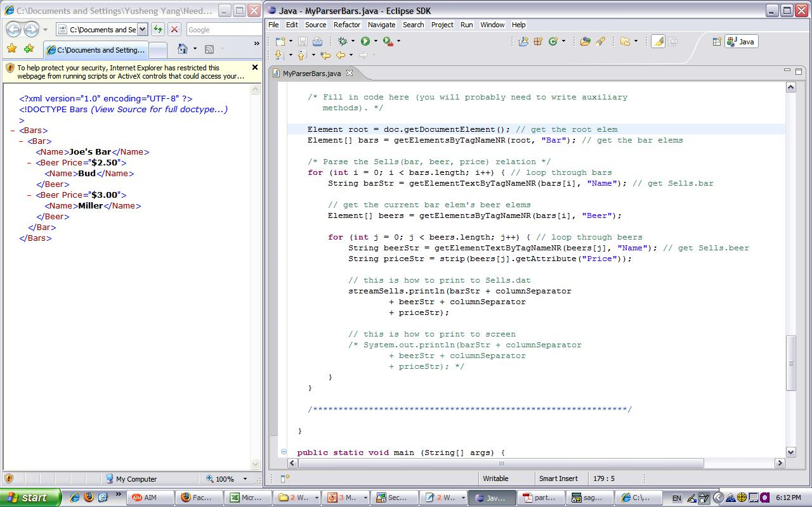
Parse XML Into Tables
CS145 Autumn 2007
Synopsis

Slide 11
Tips
CS145 Autumn 2007
Synopsis
Demo
Tips
Tips

Slide 12
Tips
CS145 Autumn 2007
http://www.w3.org/2003/01/dom2-javadoc/org/w3c/dom/package-summary.html
• No separate user data, must infer from items
(Users = Bidders + Sellers)
• “<>” is a good column separator.
• Make sure you read and understand items.txt
and items.dtd
• Use DATE ‘MON-DD-RRRR HH24:MI:SS’ for
dates in the control file
• Use NUMBER(8,2) for currency columns in
CREATE TABLE.
Tips

Slide 13
Tips
CS145 Autumn 2007
• Some of the XML elements are optional (identify them in the DTD) and make sure you handle them with care in the parser. (Hint: if no such element exists, getElementByTagNameNR returns null)
• Run your parser on items-0.xml first, verify that it’s behaving correctly, then unleash it upon the rest of the data.
• strip() currency data in the parser.
Tips

Slide 14
What to Submit
CS145 Autumn 2007
Your parser source
• Makefile for compiling your parser
• Your .ctl files
• create.sql, drop.sql, queries.sql
• runParser
• README.txt
• Create a .tar file containing the above.
• Please don’t submit any binaries or outputs.
Tips

Slide 15
Submission Rules
CS145 Autumn 2007
• runParser must ONLY have command(s) that run your parser and generate load files. It must NOT:
– Drop or create tables
– Load data into Oracle
– Run any queries
• runLoad is for your own use, no need to submit it.
Tips

Slide 16
How We Test Your Submission
CS145 Autumn 2007
• For each submission, we will:
  – Run your drop.sql & create.sql on our own test database (we won’t touch your database)
  – Run your runParser
  – Load the generated load files into our database and ensure no errors occur
  – Run queries.sql on our database
• Repeat for next submission
Tips

Slide 17
Q & A
CS145 Autumn 2007
Q: In sqlplus, how do I display all of the tables
I’ve created?
A: SELECT TABLE_NAME FROM USER_TABLES;
Questions?
First: http://www.stanford.edu/class/cs145/project1_faq.html
Second: Coursework Discussion
Last resort: cs145-aut0708-staff@lists.stanford.edu

