Slide 1
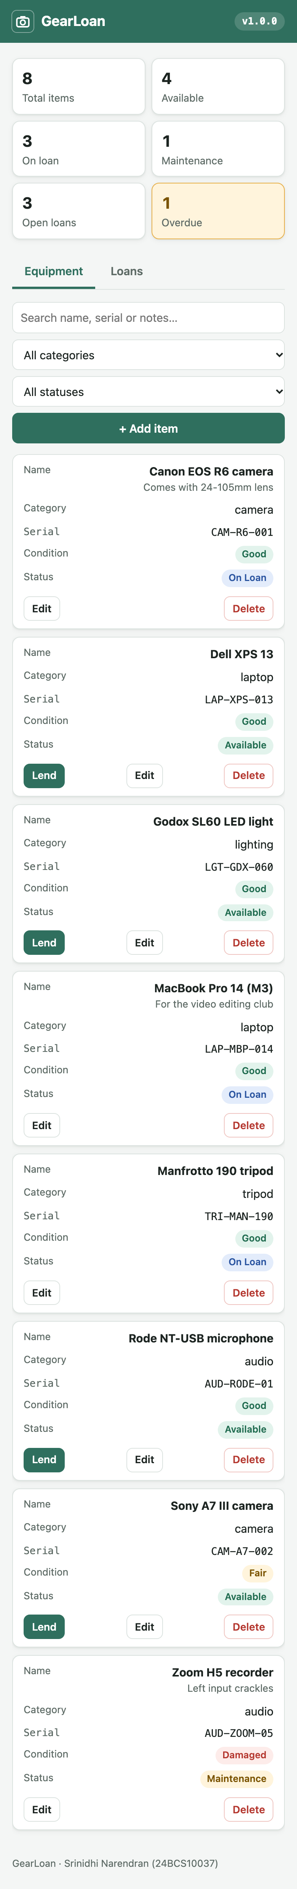
GearLoan
An equipment lending app with a full DevOps pipeline: CI/CD, security gates, Terraform on AWS, Kubernetes, GitOps and monitoring
Srinidhi Narendran
Roll No 24BCS10037 · Batch B

Slide 2
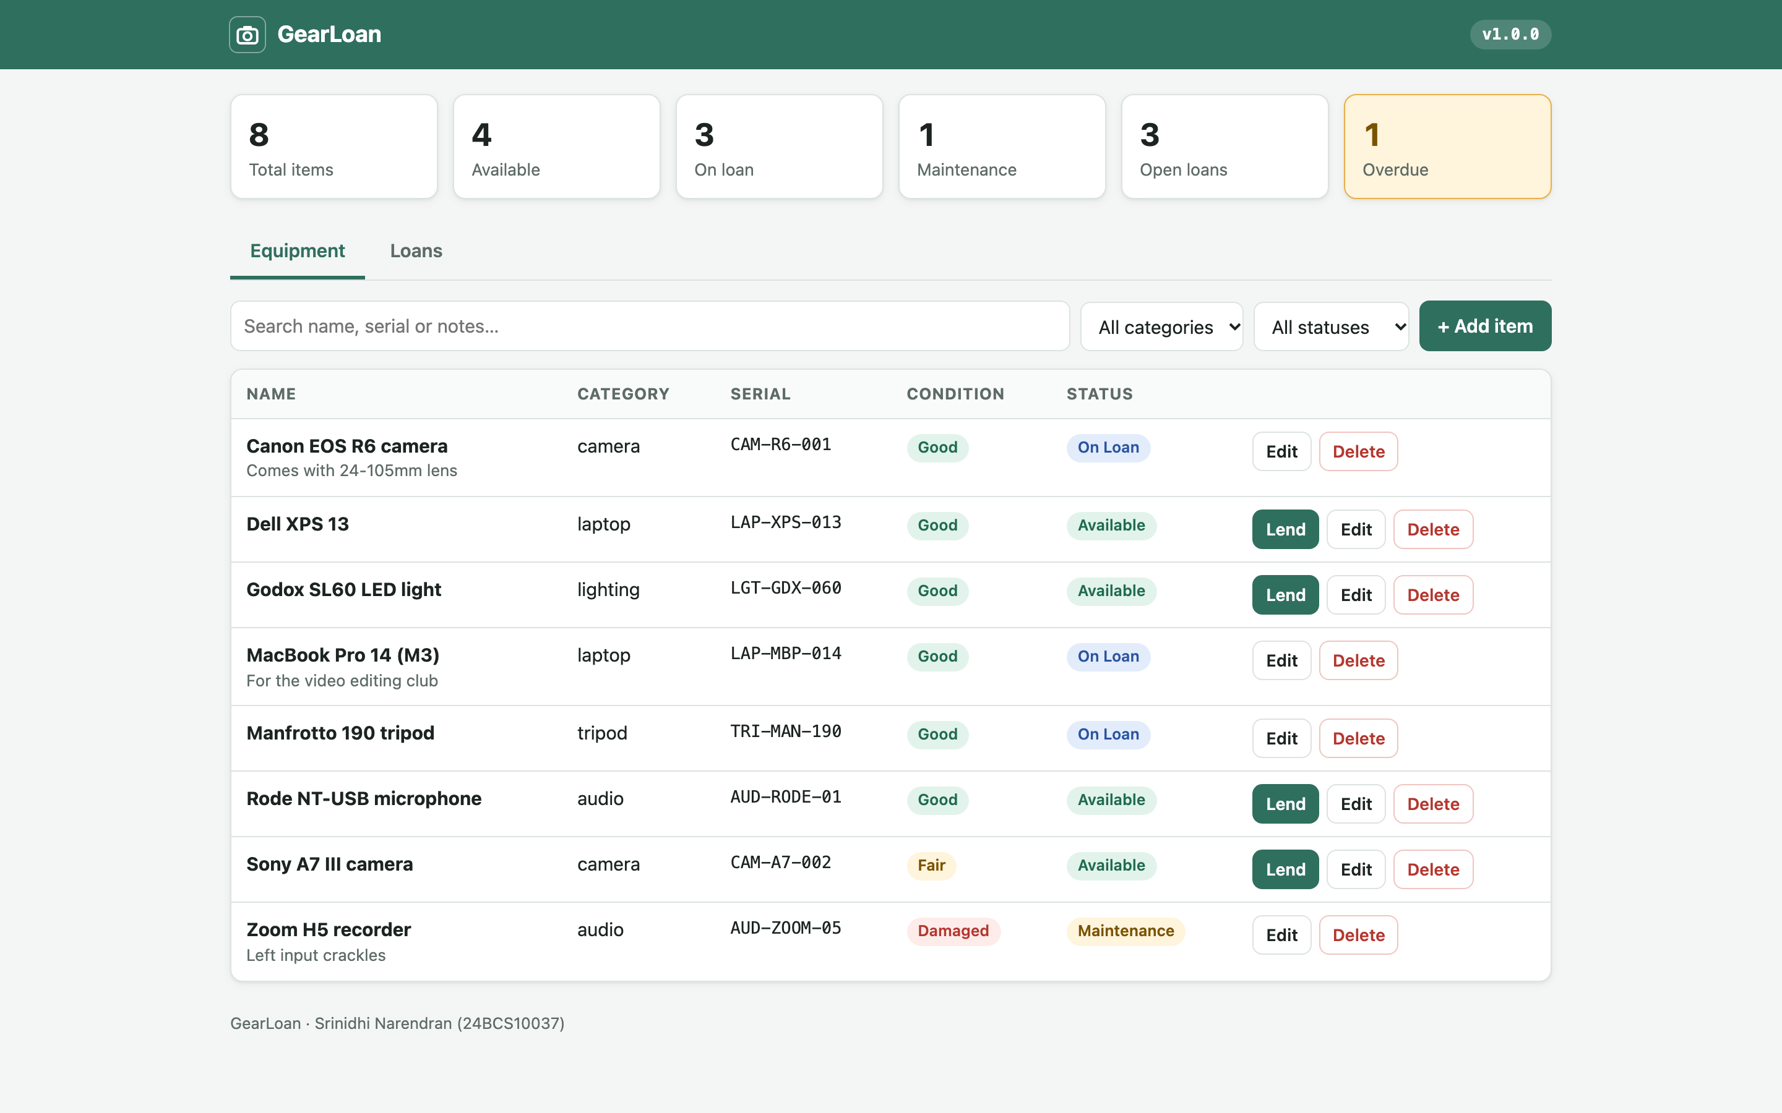
Lending club gear without a paper register
1
Items
cameras, laptops, audio, lights, tripods, with condition and serial number
2
Loans
lend with a due date, return, overdue shown automatically
3
Rules
no double lending · max 3 open loans per person · damaged → maintenance
4
API
FastAPI REST with GET, POST, PUT and DELETE, plus health, ready and metrics endpoints
PostgreSQL 17 + Alembic migration · React UI, works on phone and desktop

Slide 3
Tech stack
App
Python 3.12 · FastAPI · SQLAlchemy · Alembic · React 18 + Vite
Data
PostgreSQL 17 (StatefulSet + EBS volume)
Containers
Docker multi-stage, non-root · Docker Compose
CI/CD
GitHub Actions · GHCR · kind deploy test
Security
Bandit · pip-audit · npm audit · Gitleaks · Trivy
Cloud
Terraform · AWS VPC · EKS 1.37 · EBS CSI
Kubernetes
Helm 4 chart · ingress-nginx · HPA · Argo CD
Observability
Prometheus · Alertmanager · Grafana

Slide 4
Architecture
git push
(master)
GitHub Actions
test · scan · build
GHCR
image :<sha>
Git: values-eks.yaml
(bot commit, new tag)
AWS ap-south-1 · VPC 10.30.0.0/16 · 2 public subnets · EKS 1.37 · 2 × m7i-flex.large (all Terraform)
Internet →
AWS NLB
ingress-nginx
/ and /api
frontend ×2+
(nginx)
Argo CD pulls
& syncs the chart
backend ×2+
(FastAPI)
PostgreSQL
+ EBS gp3
HPA · probes · ConfigMap · Secret · limits · restricted Pod Security
Prometheus scrapes /metrics → Grafana dashboards + alerts

Slide 5
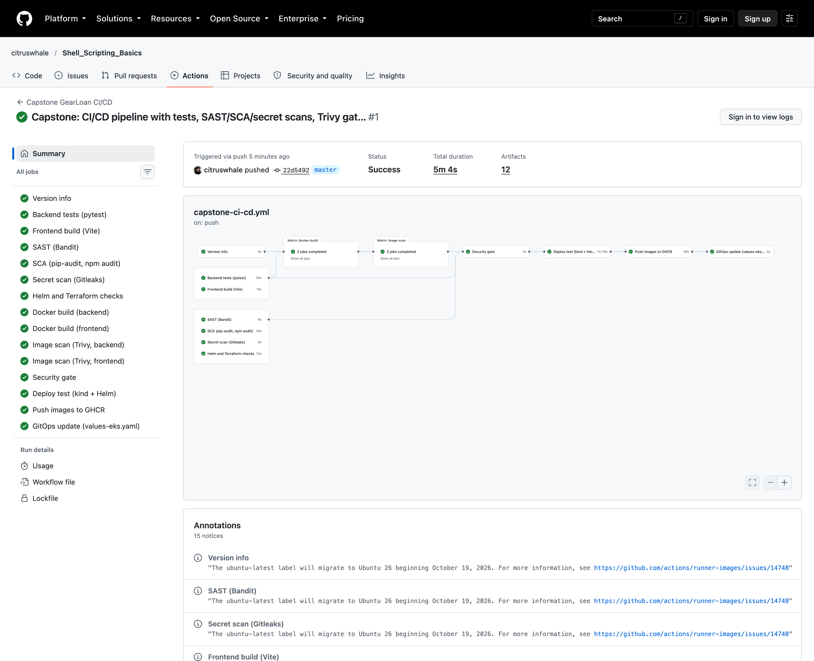
CI/CD pipeline on every push
1
Test + build
pytest on a Postgres service · frontend build
2
Scan code
Bandit · pip-audit · npm audit · Gitleaks · helm/terraform checks
3
Build once
both images, linux/amd64, saved as tarballs
4
Trivy gate
fail on HIGH / CRITICAL
5
Deploy test
kind cluster + Helm + smoke test
6
Ship
push the scanned images to GHCR :<sha> · bot updates Git
Run 38964516947: 15 jobs green in 5m 4s

Slide 6
Security gates before anything ships
0
SAST
Bandit on the backend code: no issues
SCA
pip-audit + npm audit: 0 known vulnerabilities
HIGH or CRITICAL CVEs with a fix, in both images
Secrets
Gitleaks over the whole Git history: no leaks
Trivy scanned Debian 13.7 (backend) and Alpine 3.24 (frontend) plus every Python and Node package. Clean today does not mean safe forever, so it runs on every push.
Containers
non-root users (uid 10001 / 101), read-only root filesystem
Least privilege
workflow permissions per job; no passwords in Git

Slide 7
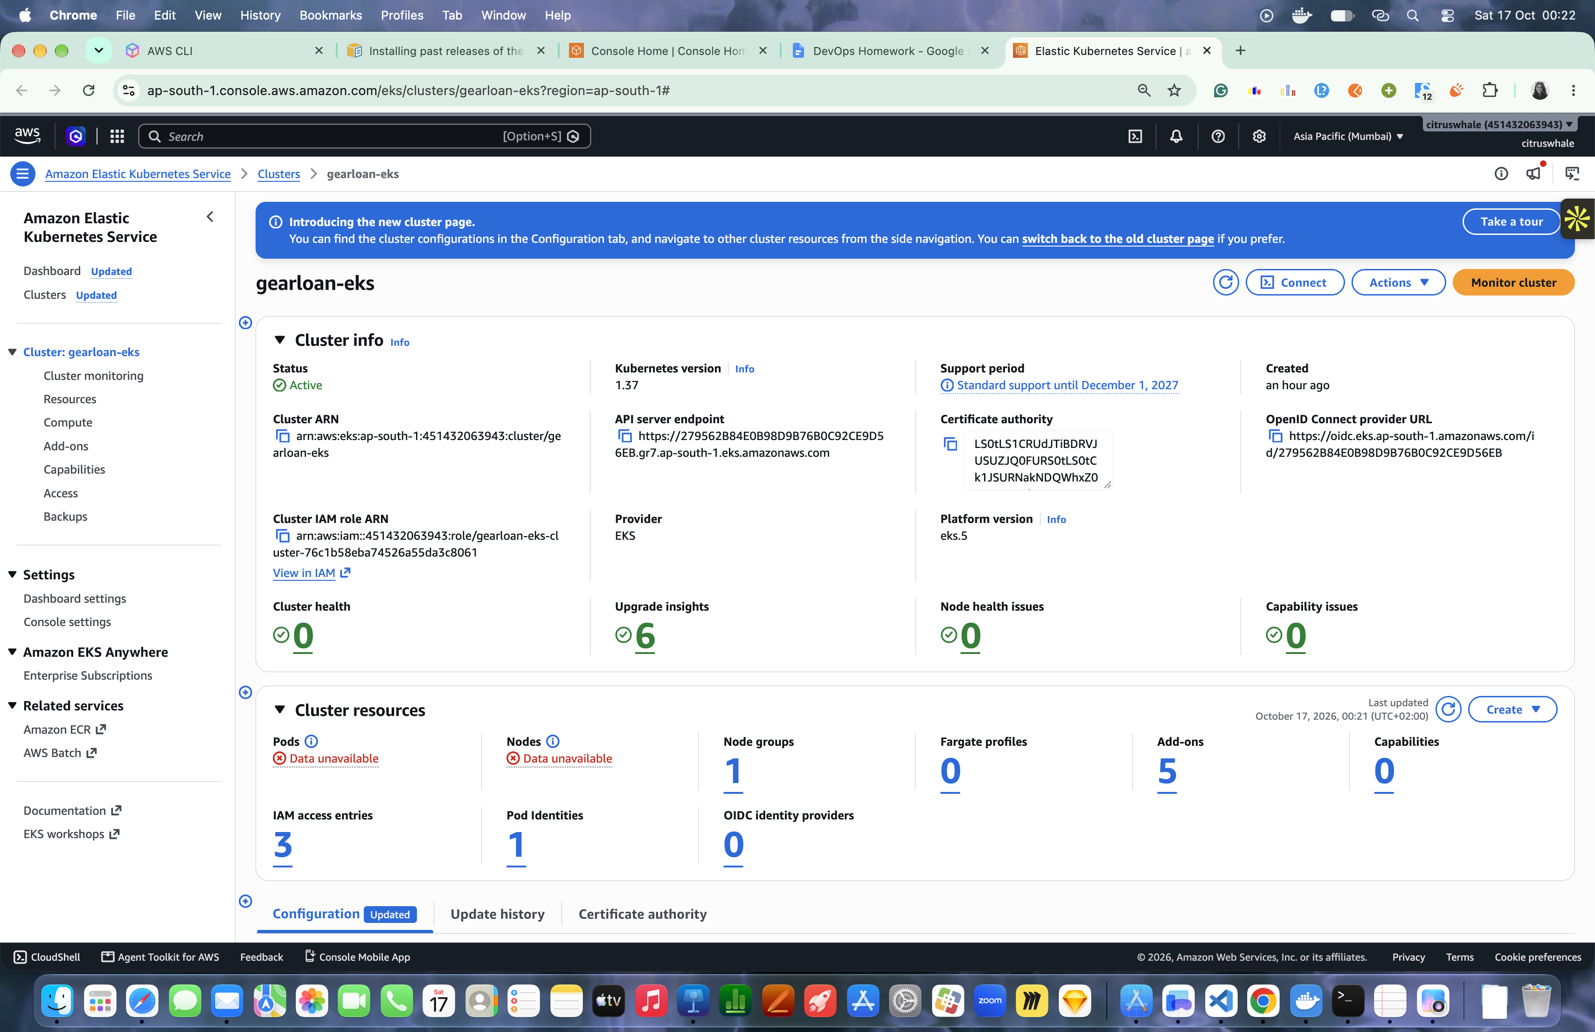
Infrastructure as code with Terraform
45
2
resources in the plan
public subnets, 2 AZs
2
$0.33
m7i-flex.large workers
per hour, then destroy
VPC 10.30.0.0/16 with an internet gateway, no NAT (keeps cost low)
EKS gearloan-eks on Kubernetes 1.37, public API endpoint
Add-ons: vpc-cni, coredns, kube-proxy, pod identity, EBS CSI driver
terraform.tfvars.example only; state and credentials never in Git

Slide 8
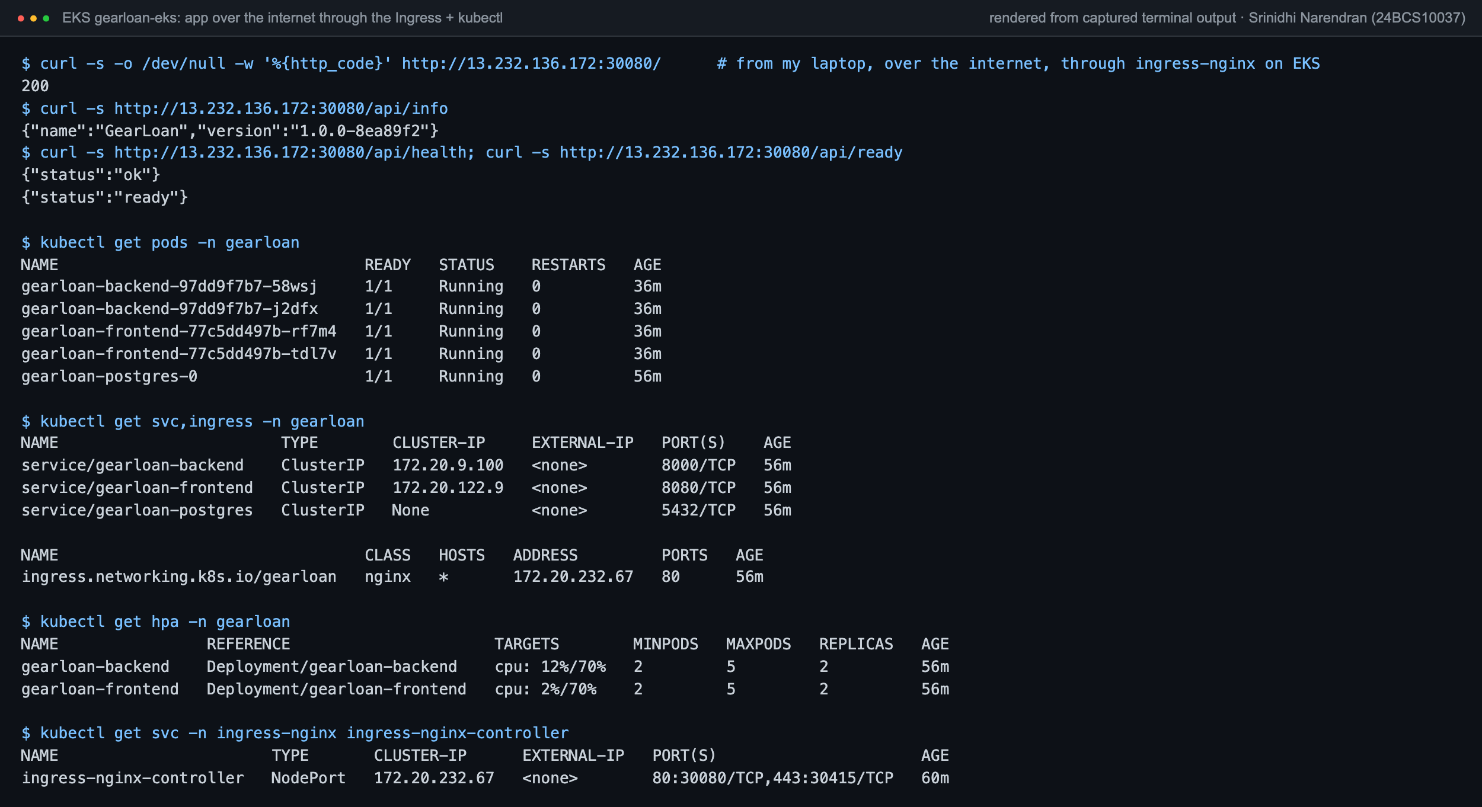
Kubernetes and Helm
Deployments
backend + frontend, 2+ replicas each
Services
ClusterIP for both; headless for Postgres
Ingress
/ → frontend · /api → backend
StatefulSet
PostgreSQL with a PVC on gp3
HPA
CPU 70%, 2–5 Pods; owns the replica count
Probes
startup · readiness /ready · liveness /health
app over the internet through the Ingress + kubectl, on EKS
Config
ConfigMap + Secret (password not in Git)

Slide 9
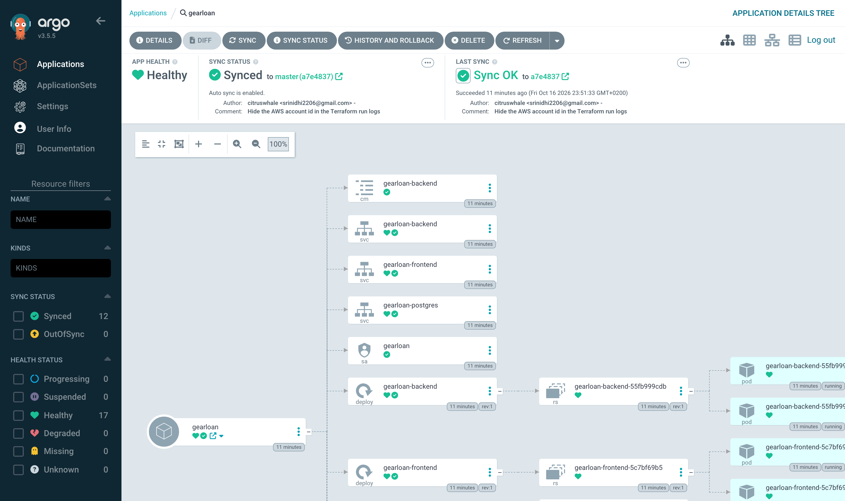
GitOps with Argo CD
Git is the source of truth: the pipeline only writes the new image tag
Argo CD pulls the Helm chart and keeps the cluster in sync
prune + self-heal: manual kubectl changes are undone
CI never needs cluster credentials
Argo CD on EKS: gearloan Synced and Healthy

Slide 10
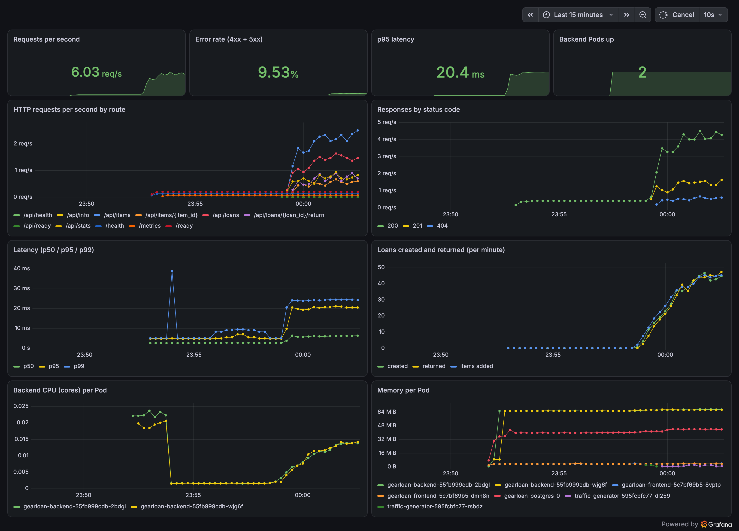
Observability: Prometheus and Grafana
/metrics
requests by route and status, latency histogram, loans created and returned
ServiceMonitor
Prometheus scrapes both backend Pods: 2/2 UP
Alerts
backend down · >20% 4xx · p95 > 500 ms. The 4xx alert fired and resolved in testing
my GearLoan dashboard, live on EKS

Slide 11
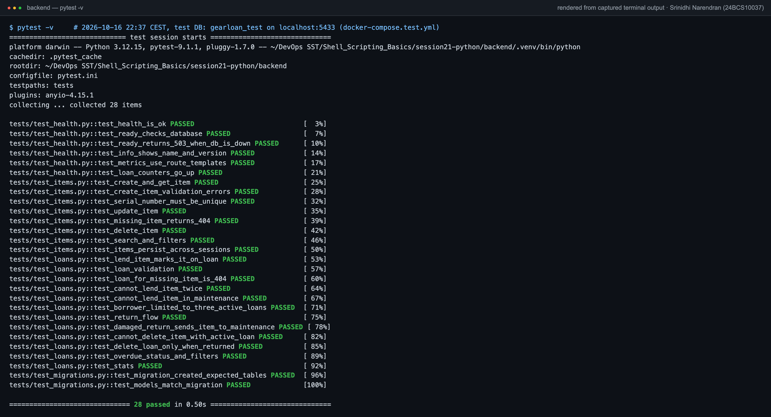
Tests and local run
28
pytest tests, all passing
4
test files: health, items, loans, migrations
3
containers in Compose
Tests use a separate gearloan_test database and refuse to run on any other

Slide 12
What I learned
1
Wait, don't guess
Services, probes and HPA metrics need a moment; use readiness and rollout status
2
Size for real use
Grafana 13 was OOMKilled until it had ~1 GiB
3
Build for the target
Mac images are arm64; EKS nodes are x86, so CI builds amd64
4
One owner per field
GitOps and the HPA must not both set replicas
5
Clean up the cloud
every lab ends with terraform destroy and a leftover check

