Slide 1
GENG5512 Presentation Integrating Time Domain in the Evaluation of Moving Target Defense
Wenxiao Zhang
22792191

Slide 2
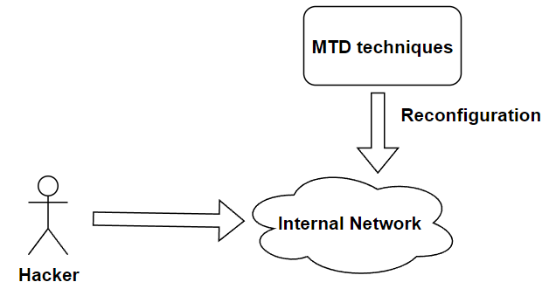
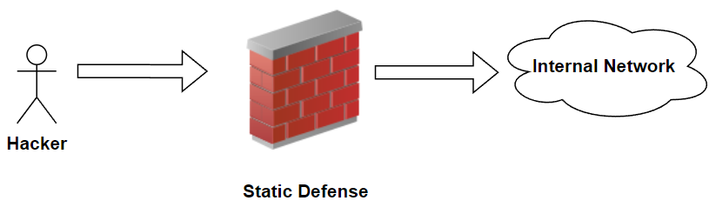
Introduction
Moving Target Defense (MTD):
A defense mechanism that can thwart adversary by dynamically moving system components in the network ^{[2]}.
Traditional defense
MTD

Slide 3
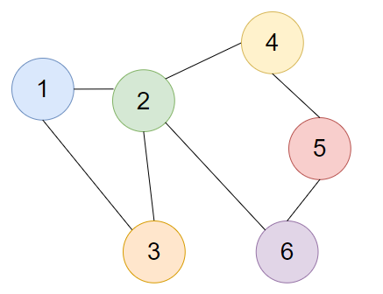
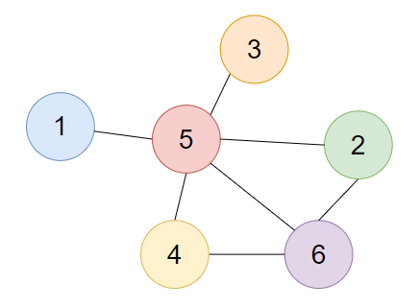
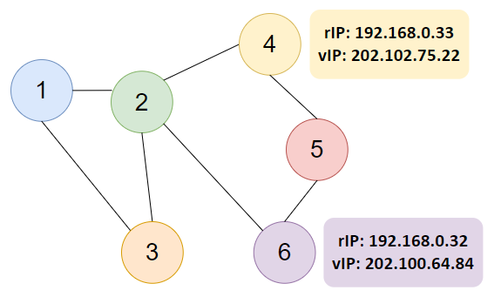
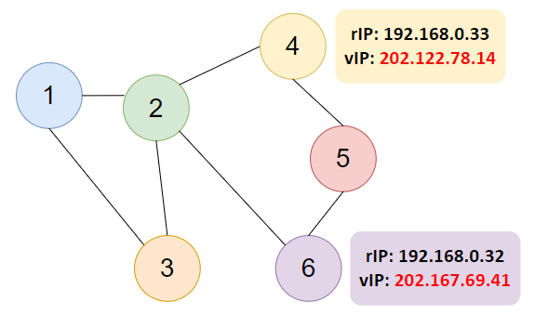
Background - Shuffle-based MTD
Network Topology Shuffle
IP Shuffle

Slide 4
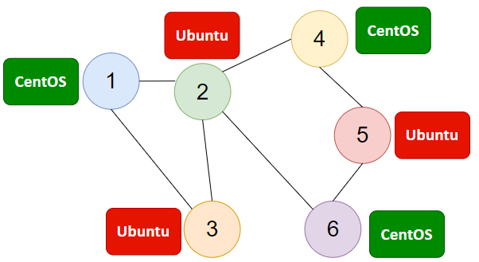
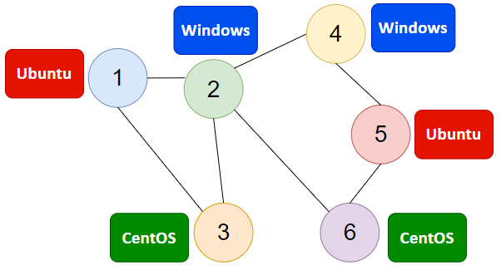
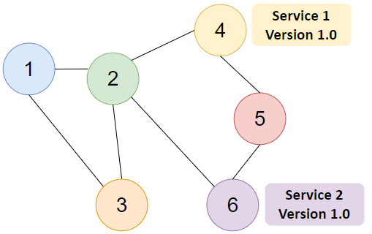
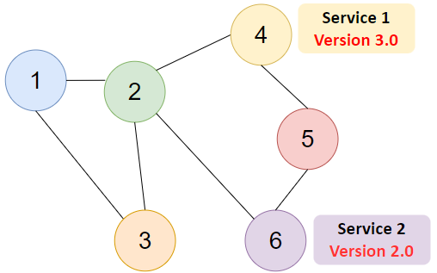
Background - Diversity-based MTD
OS Diversity
Service Diversity

Slide 5
Project Motivation
Investigating MTD Strategies that can improve the security of the system.
MTD Strategies – Strategies of combining and executing different MTD techniques.
Combination strategies:
IP Shuffle + OS Diversity
OS Diversity + Service Diversity
...
Execution schemes:
random
alternative
Simultaneous

Slide 6
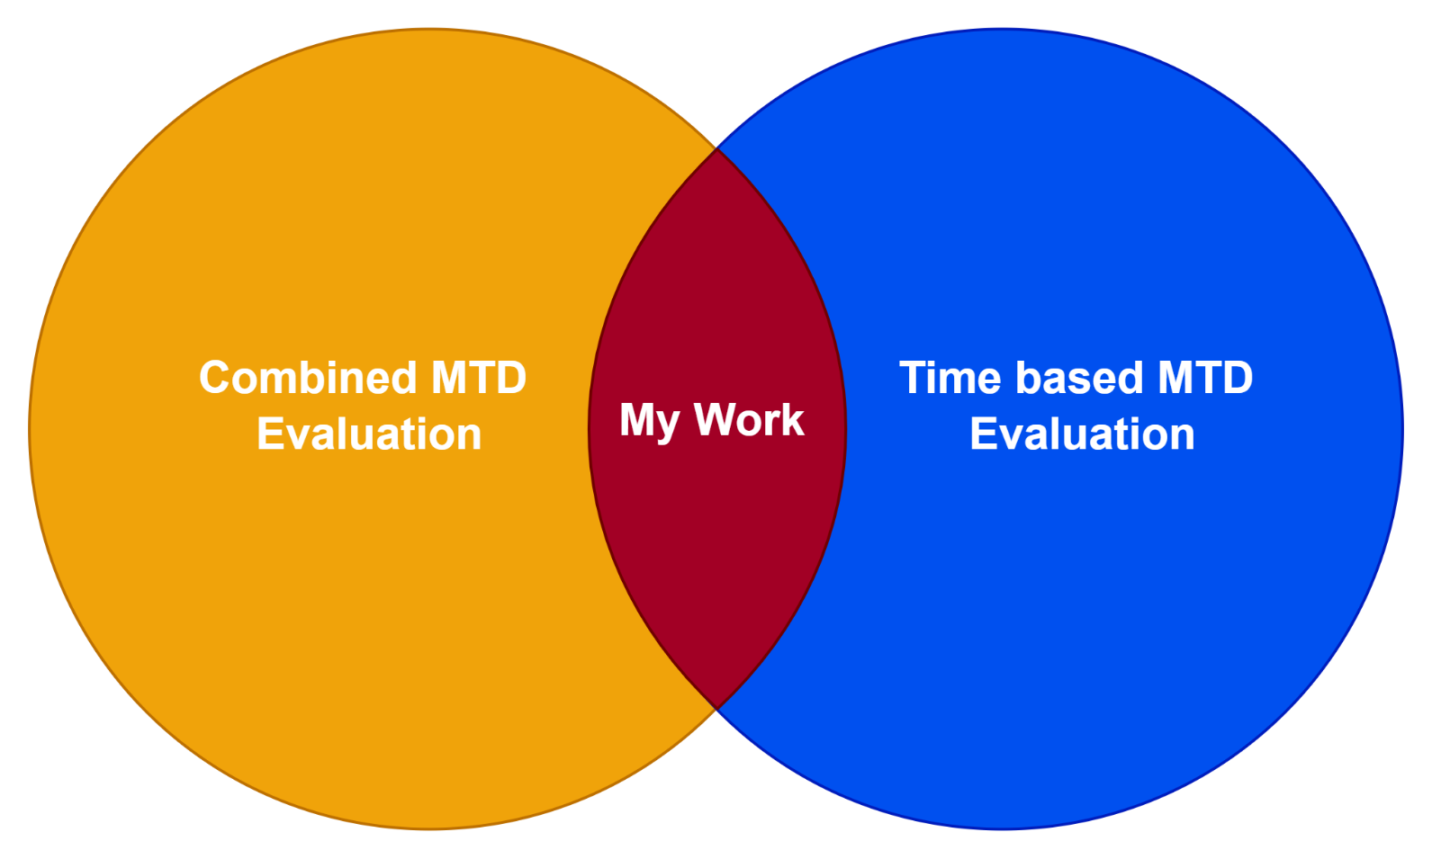
Previous Works
Alavizadeh et al. applied time-based metrics to the attacker's side, but did not fully consider the impact of time duration for specific events occurring in the network [4].
Alavizadeh et al. investigated the effectiveness of the combined MTD techniques based on HARM for the cloud environment [5].
Connell discovered that time-related issues such as resource occupation conflicts that occurred during system reconfiguration can affect the overall MTD evaluation [6].
MTDSim : An MTD simulator for evaluating the effectiveness of MTD techniques used in combinations. But only random execution scheme is implemented, and it fall short in simulating time [3].

Slide 7
Research Questions
What are the most effective strategies for combining and executing different MTD techniques?
What factors affect the effectiveness of MTDs, and how do these factors impact their performance?

Slide 8
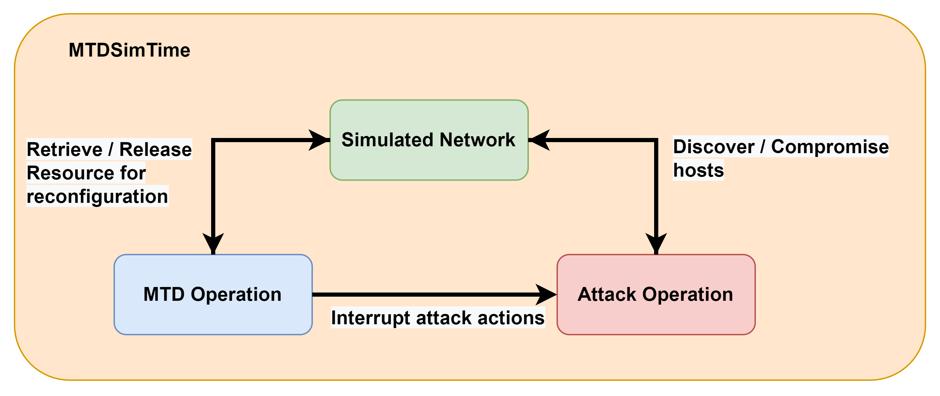
Methodology - MTDSimTime
Discrete event Simulation (DES): To identify actions that can alter the state of the network over the time period.

Slide 9
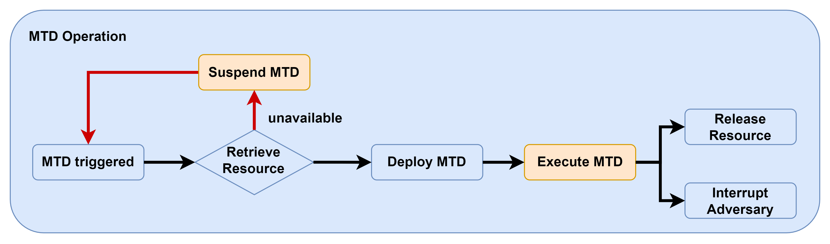
MTD Operation

Slide 10
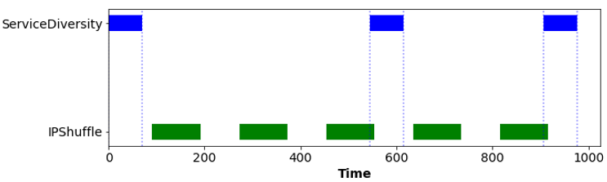
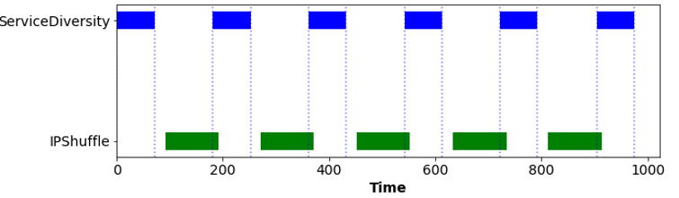
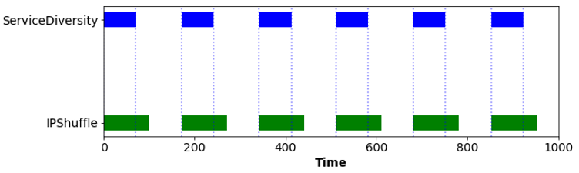
MTD Operation - Visualisation
Implement MTD Execution Scheme: To explore the optimal scheme that can maximise the effectiveness of MTD
3 MTD Execution Schemes: To explore the optimal scheme that maximise the effectiveness of MTD​.
Example:
ServiceDiversity (application layer) +
IPShuffle (network layer)
Random
Alternative
Simultaneous

Slide 11
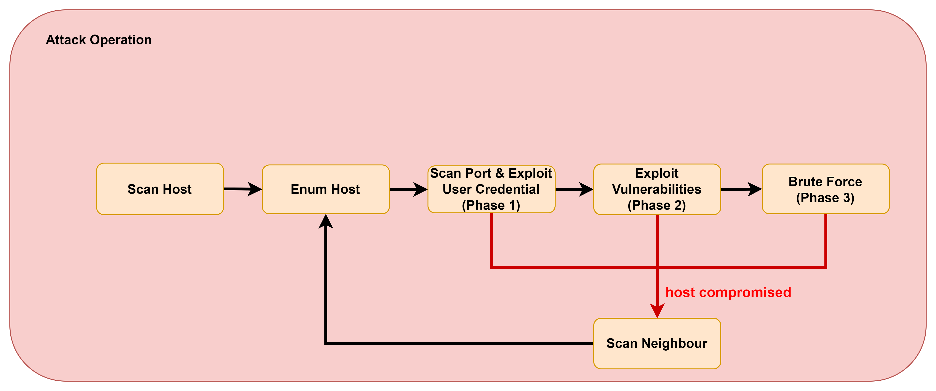
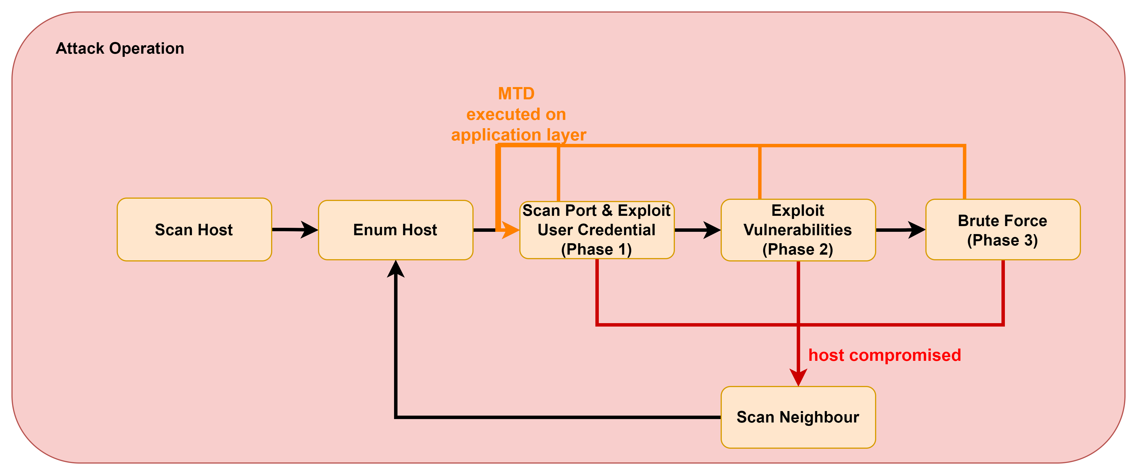
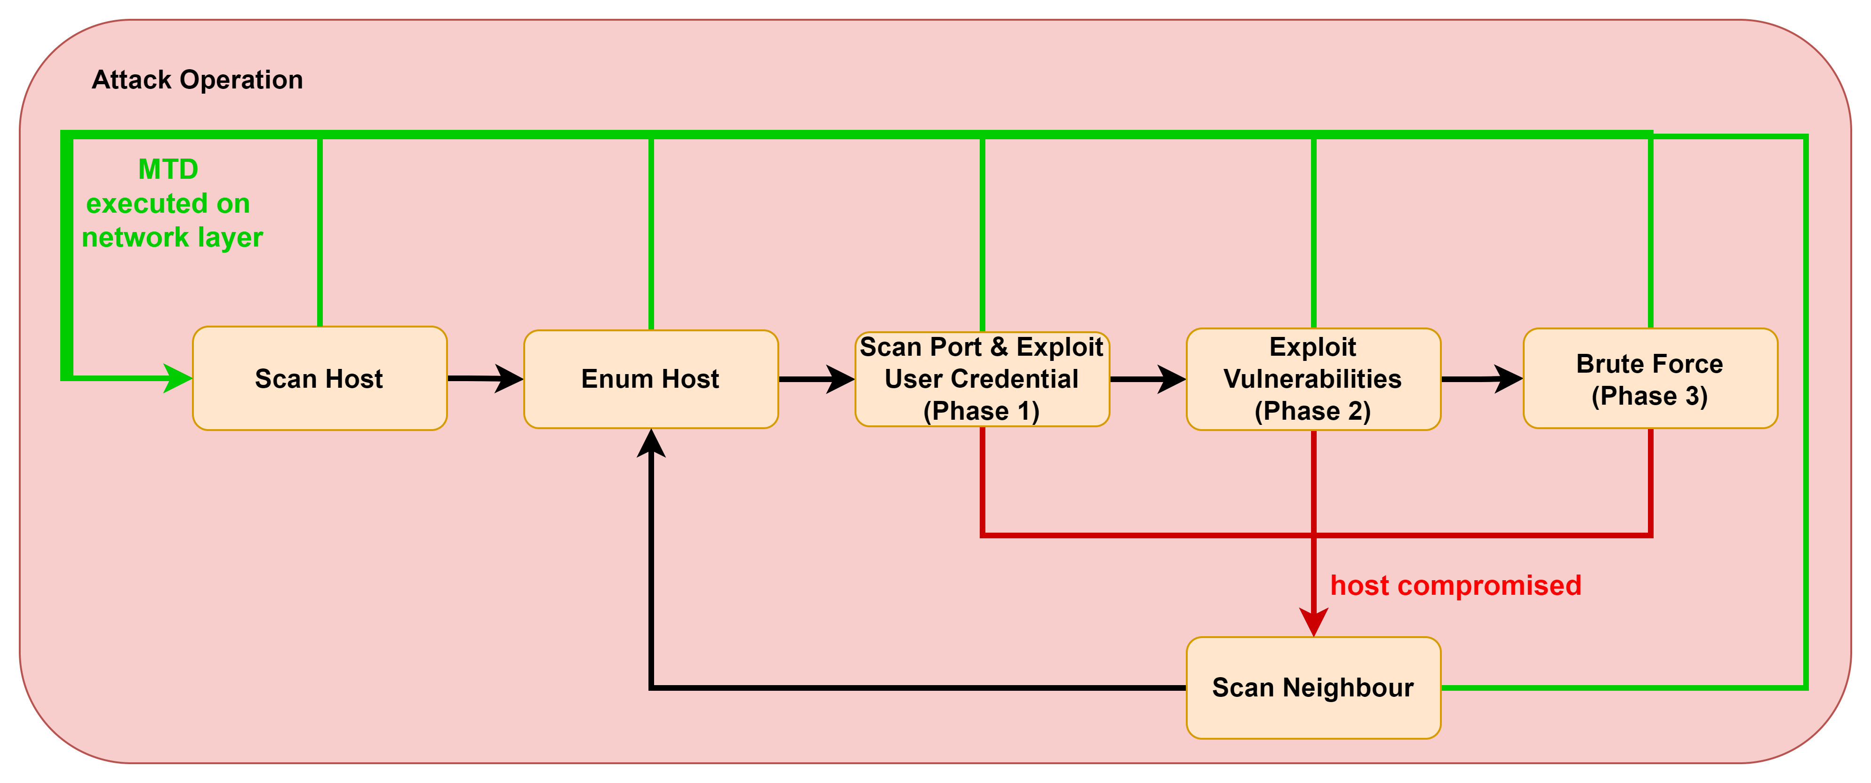
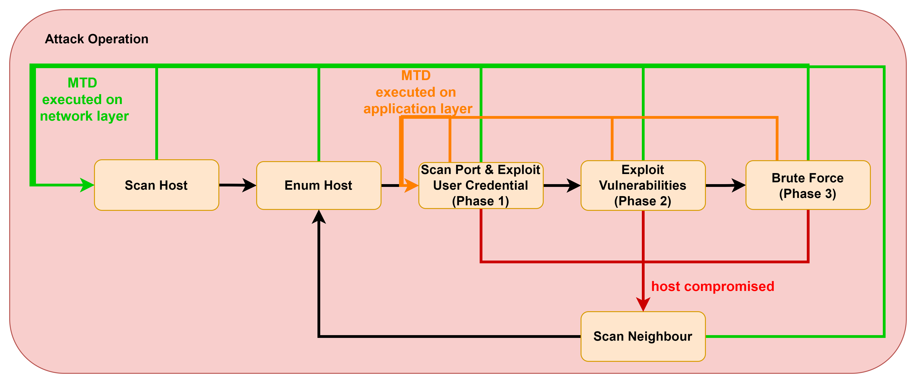
Attack Operation

Slide 12
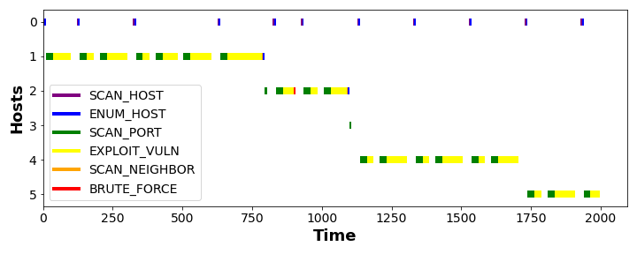
Attack Operation - Visualisation
Being interrupted by the network layer MTD
Compromise host 1
Being interrupted by the application layer MTD

Slide 13
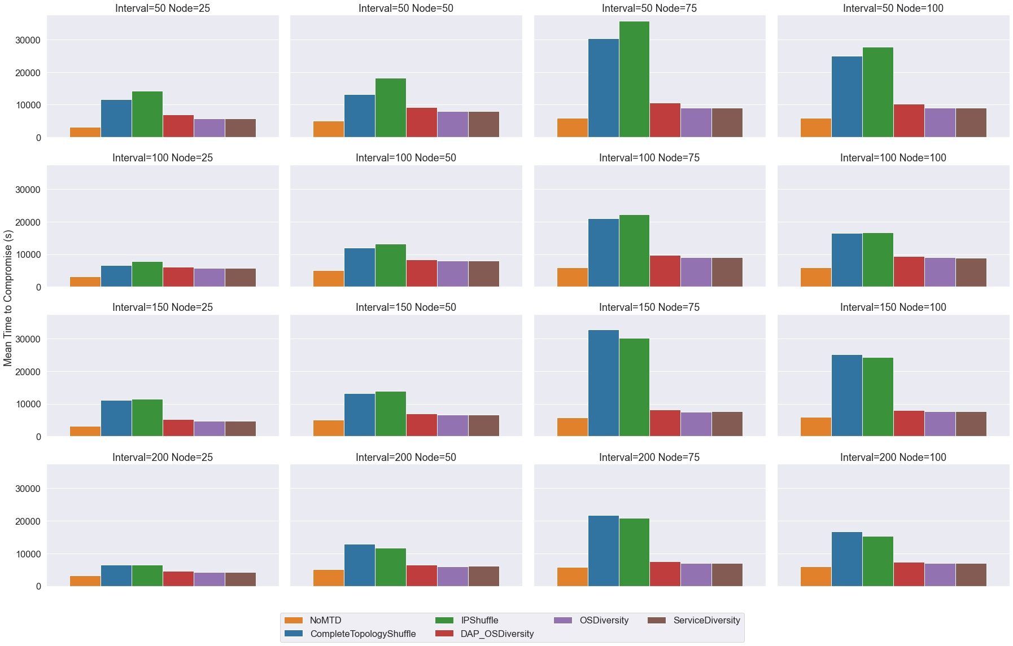
Single MTD Evaluation - MTTC
16 scenarios
Intervals: [50, 100, 150, 200]
Node: [25, 50, 75, 100]
MTTC - Mean Time to Compromise
Info:
The average time for the adversary to compromise 80% nodes in the network.
The higher the MTTC, the longer it takes for the adversary to reach their goal, the better the MTD performs.
Network Shuffle-based MTDs have dominant positions
NoMTD + 5 MTD techniques

Slide 14
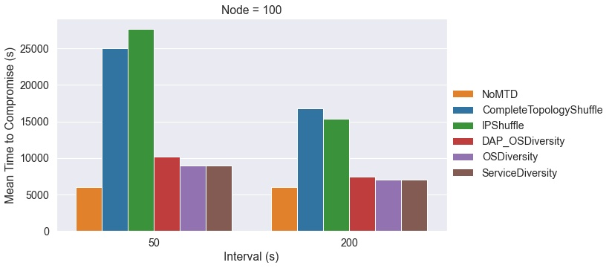
Single MTD Evaluation - Interval

Slide 15
Single MTD Evaluation - MTTC
MTTC - Mean Time to Compromise
Info:
The average time for the adversary to compromise 80% nodes in the network.
The higher the MTTC, the longer it takes for the adversary to reach their goal, the better the MTD performs.

Slide 16
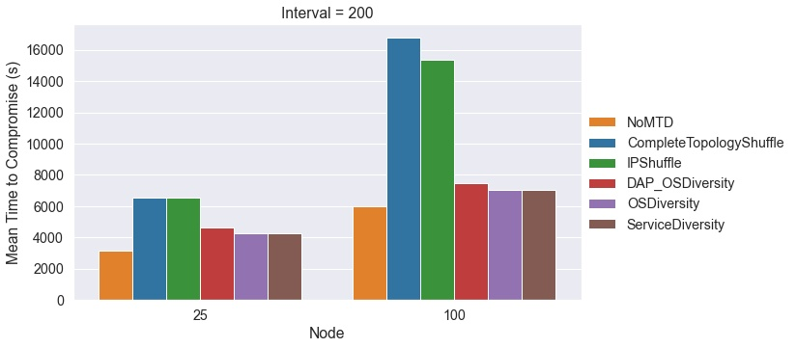
Single MTD Evaluation - Node

Slide 17
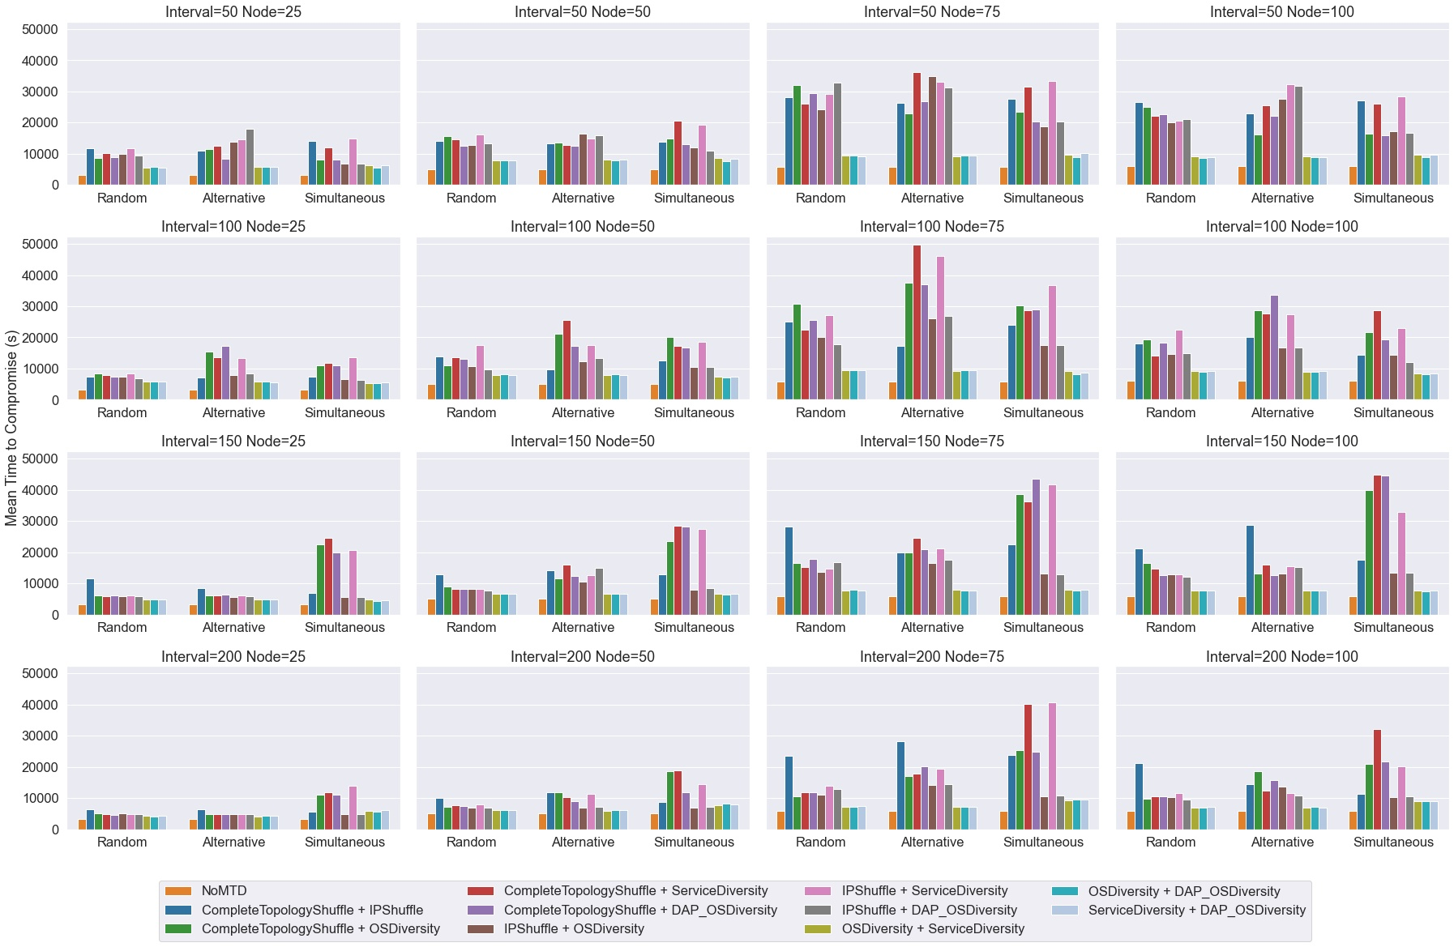
Multiple MTD Evaluation - MTTC
3 execution schemes for each scenario
NoMTD + 10 pairwise MTD combinations

Slide 18
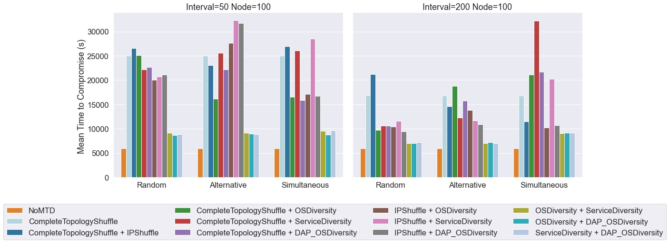
Multiple MTD Evaluation - Interval
The combination of 2 shuffle-based MTDs did not have the same dominant position as when they were used individually.
Most of the Shuffle + Diversity MTD combinations have better performance
The best single MTD may be more effective in some scenarios

Slide 19
Multiple MTD Evaluation - MTTC

Slide 20
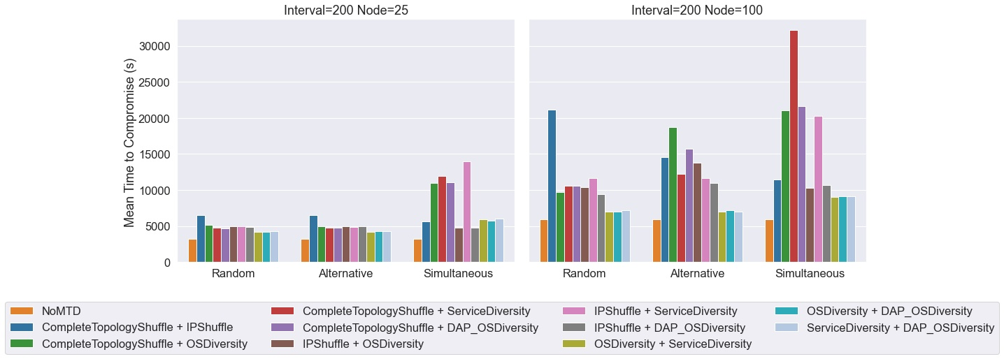
Multiple MTD Evaluation - Node

Slide 21
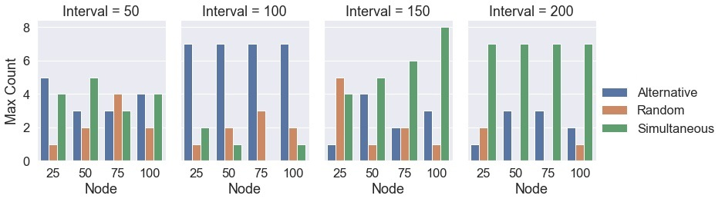
Execution Scheme Evaluation
7 combination strategies yielded the best results when using the Simultaneous scheme at scenario node 25 and interval 200.

Slide 22
Multiple MTD Evaluation - Node

Slide 23
Conclusion
In most scenarios, MTDs are more effective when
triggering with shorter Intervals;
executing in networks with more nodes;
combining multiple MTD category techniques (e.g. Shuffle + Diversity).
In most scenarios, execution schemes:
The alternative and simultaneous schemes outperform the random scheme;
The alternative scheme is particularly effective for shorter intervals (50,100);
The simultaneous scheme is more effective for longer intervals (150, 200).

Slide 24
Future works
Factors that affect MTD effectiveness;
Attack profile;
Reconfiguration limit;

Slide 25
References
[1] J. -H. Cho et al., "Toward Proactive, Adaptive Defense: A Survey on Moving Target Defense," in IEEE Communications Surveys and Tutorials, vol. 22, no. 1, pp. 709-745, Firstquarter 2020, doi: 10.1109/COMST.2019.2963791.
[2] S. Jajodia, A. K. Ghosh, V. Swarup, C. Wang, and X. S. Wang, Moving target defense: creating asymmetric uncertainty for cyber threats. Springer Science and Business Media, 2011.
[3] A. Brown "MTDSim," GitHub, 2021. [Online]. Available: https://github.com/Ccamm/MTDSim.
[4] H. Alavizadeh, J. B. Hong, D. S. Kim, and J. Jang-Jaccard, "Evaluating the effectiveness of shuffle and redundancy mtd techniques in the cloud," Computers and Security, vol. 102, p. 102091, 2021.
[5] H. Alavizadeh, J. B. Hong, J. Jang-Jaccard, and D. S. Kim, “Comprehensive security assessment of combined MTD techniques for the cloud,” in Proc. 5th ACM Workshop Moving Target Defense (MTD), 2018, pp. 11–20
[6] W. Connell, D. A. Menascé and M. Albanese, "Performance Modeling of Moving Target Defenses with Reconfiguration Limits," in IEEE Transactions on Dependable and Secure Computing, vol. 18, no. 1, pp. 205-219, 1 Jan.-Feb. 2021, doi: 10.1109/TDSC.2018.2882825.

