Slide 1
The Crime Detectives
Natasha
Jiffar
Kobe
Thierno

Slide 2
The NYPD arrested 210,000 persons in 2019
The following information is recorded with each arrest:
Type of Crime, Borough of Crime, Arresting Precinct , Age, Gender, and Race of the arrested
If the race of the person was no longer available to us, could we predict it using a model trained on past data?
Our result: No, we could not predict the race of an arrested person by much more than random guessing. (0.56 accuracy)
If these predictions cannot be improved, then it means arrests in NYC do not predict on race.

Slide 3
We created the following classification models and trained and validated them:
Logistic Regression(Label Encoded and One-Hot Encoded;with and without PCA)
KNeighbours Classifier
Support Vector Machine
Decision Tree
Random Forest
Random Forest for Feature Importance then Random Forest

Slide 4
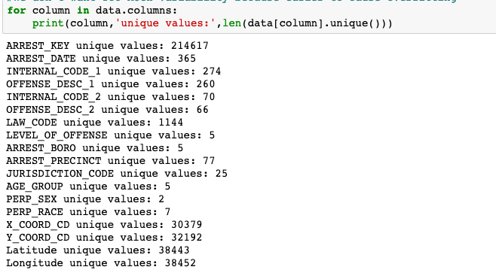
Within Column Variability (unique values)

Slide 5
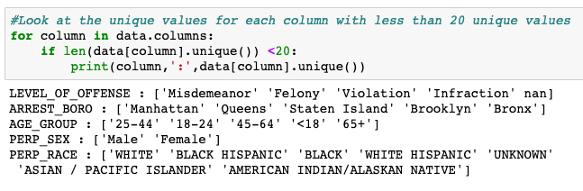
Within Column Variability (unique values) cont…

Slide 6
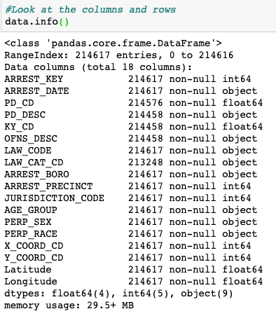
Even though we have numerical values in our dataset, our classification models will not use them as numbers, but rather will use them as categories because the numbers do not represent a measurement: they are simply IDs for internal office use.

Slide 7
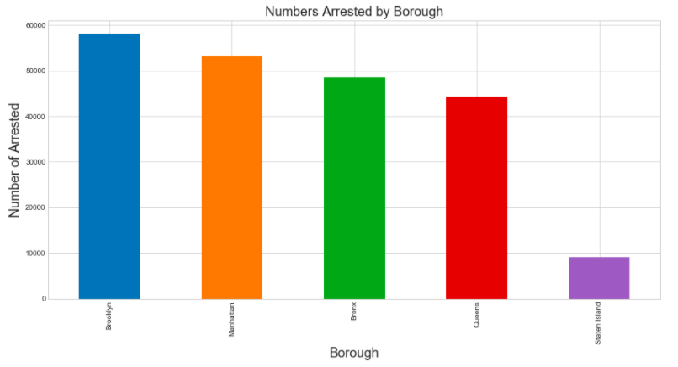
Arrests are spread out across the four Borough…

Slide 8
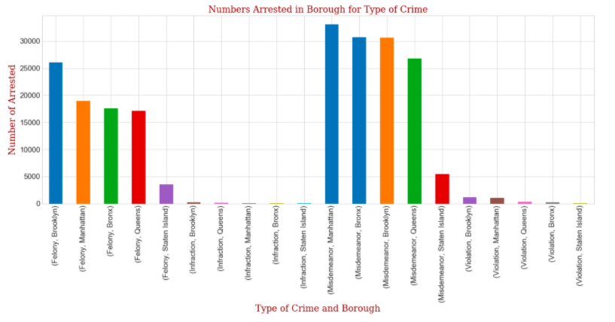
Brooklyn leads in the number of felonies

Slide 9
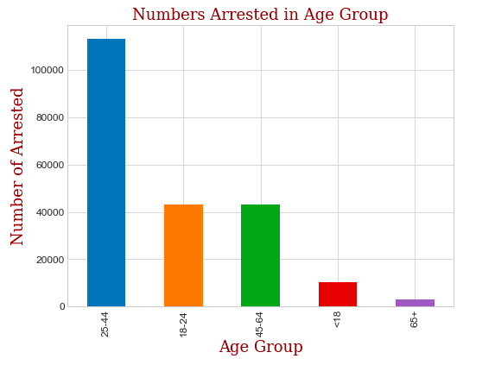
Persons between ages 25 – 44 make up a majority of arrested

Slide 10
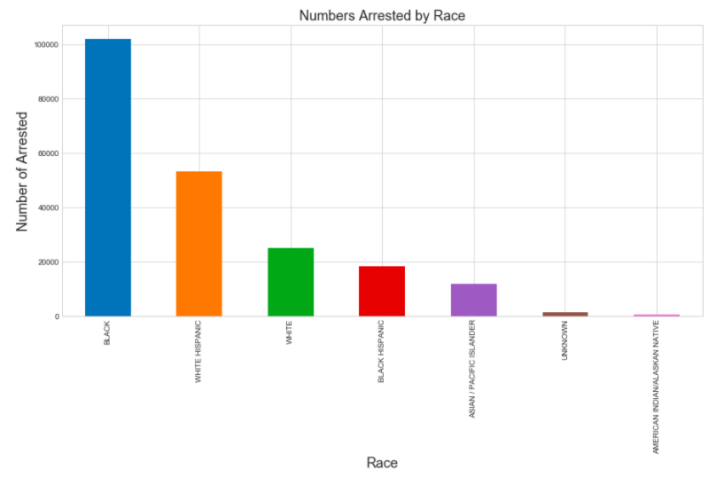
Persons who are black are more likely to be arrested

Slide 11
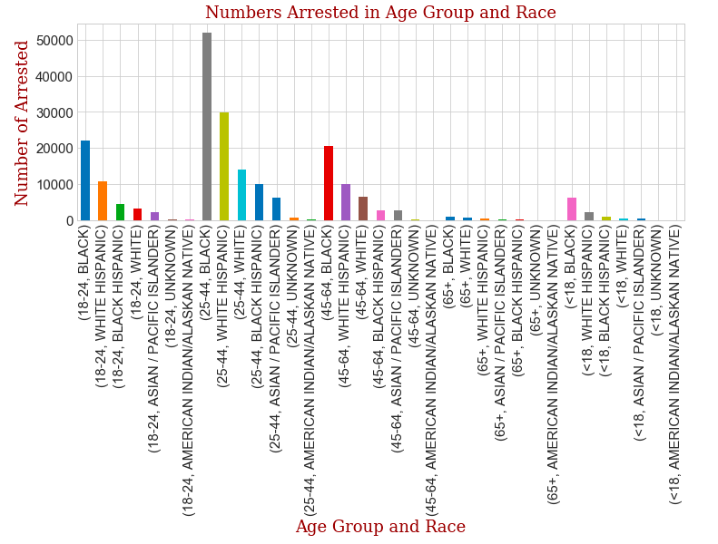
Persons who are black between 25-44 lead in the number of those arrested

Slide 12
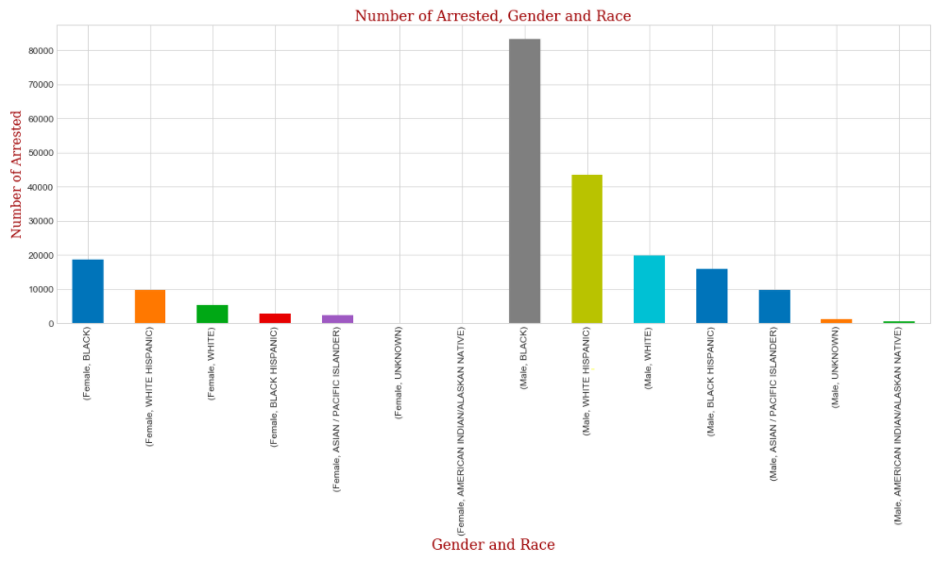
Males are arrested much more than females. Black males are arrested the most.

Slide 13
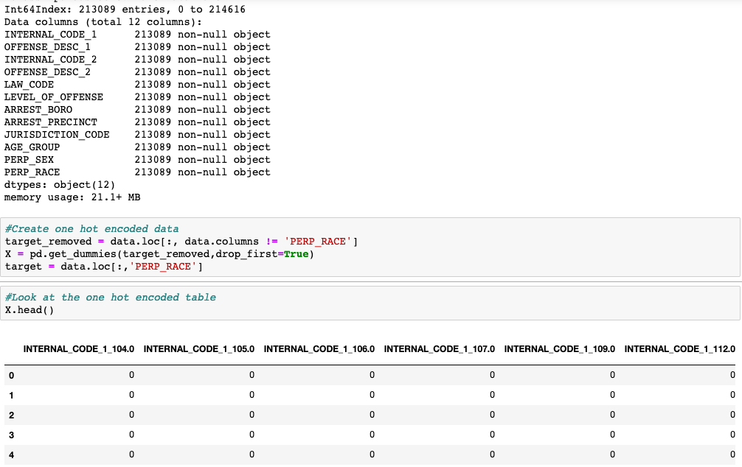
One Hot Encoding: Because the numeric columns contain internal NYPD codes and are not measurements, for our model every column is treated as nominal categorical for our classification (i.e: there is no ordering to the values)

Slide 14
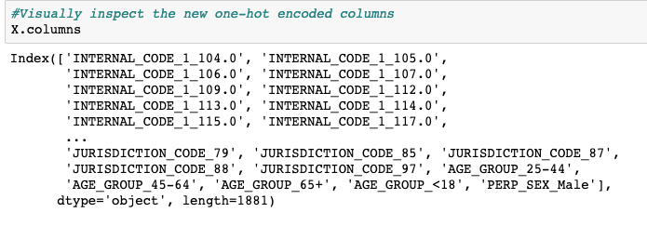
There is now 1,881 columns.
The one-hot-encoded dataframe columns

Slide 15
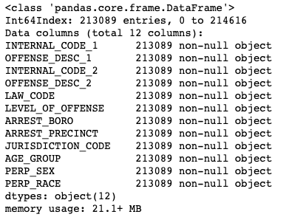
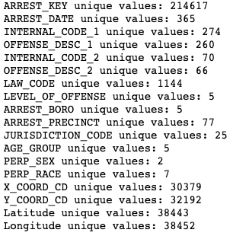
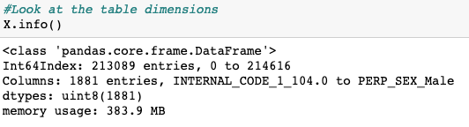
The cost of one hot encoding

Slide 16
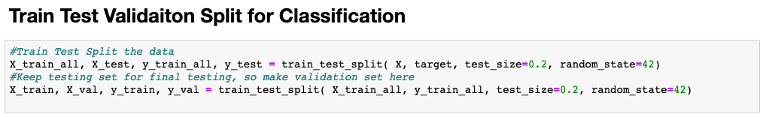
We used a validation and test split.

Slide 17
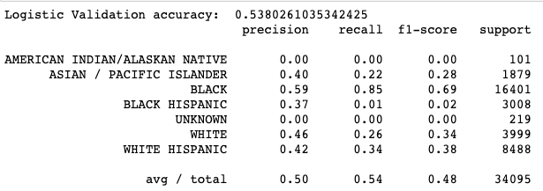
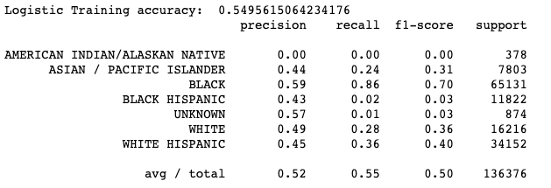
Logistic Regression without PCA

Slide 18
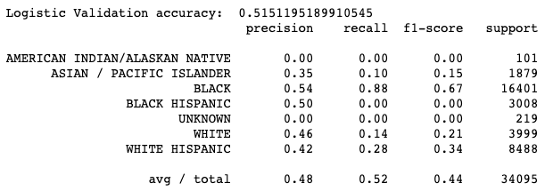
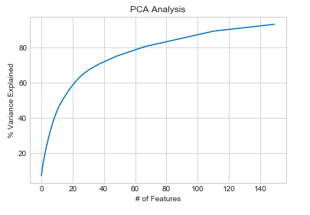
Logistic Regression with PCA

Slide 19
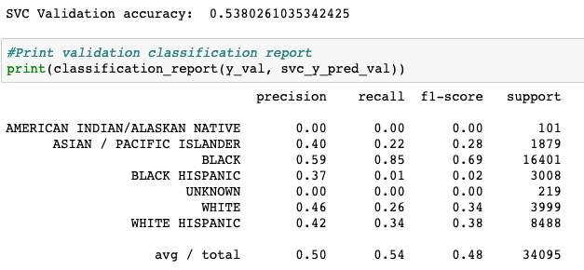
Support Vector Machine without PCA

Slide 20
KNeighbours
Took too long to train. Seems too many dimensions. Aborted

Slide 21
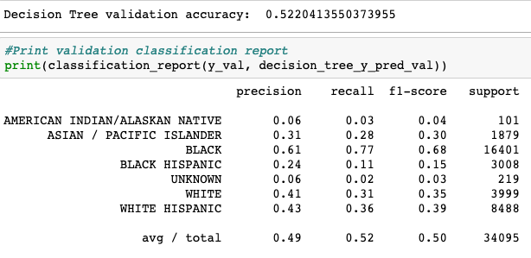
Decision Tree

Slide 22
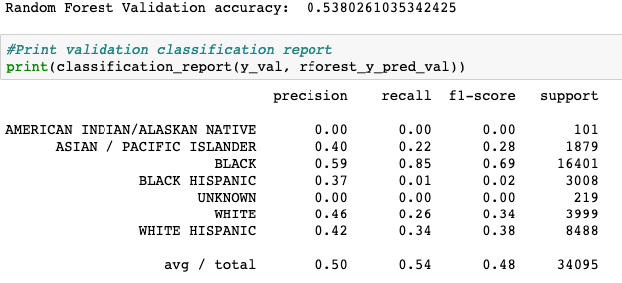
Random Forest

Slide 23
