Slide 1
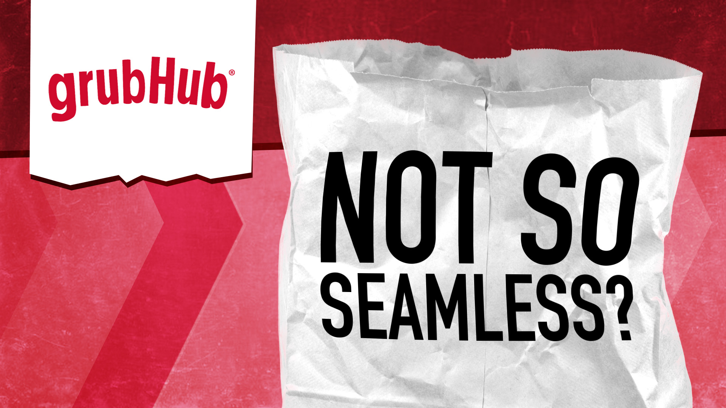
A dive into the famous globally leading ‘GrubHub’ food delivery app

Slide 2
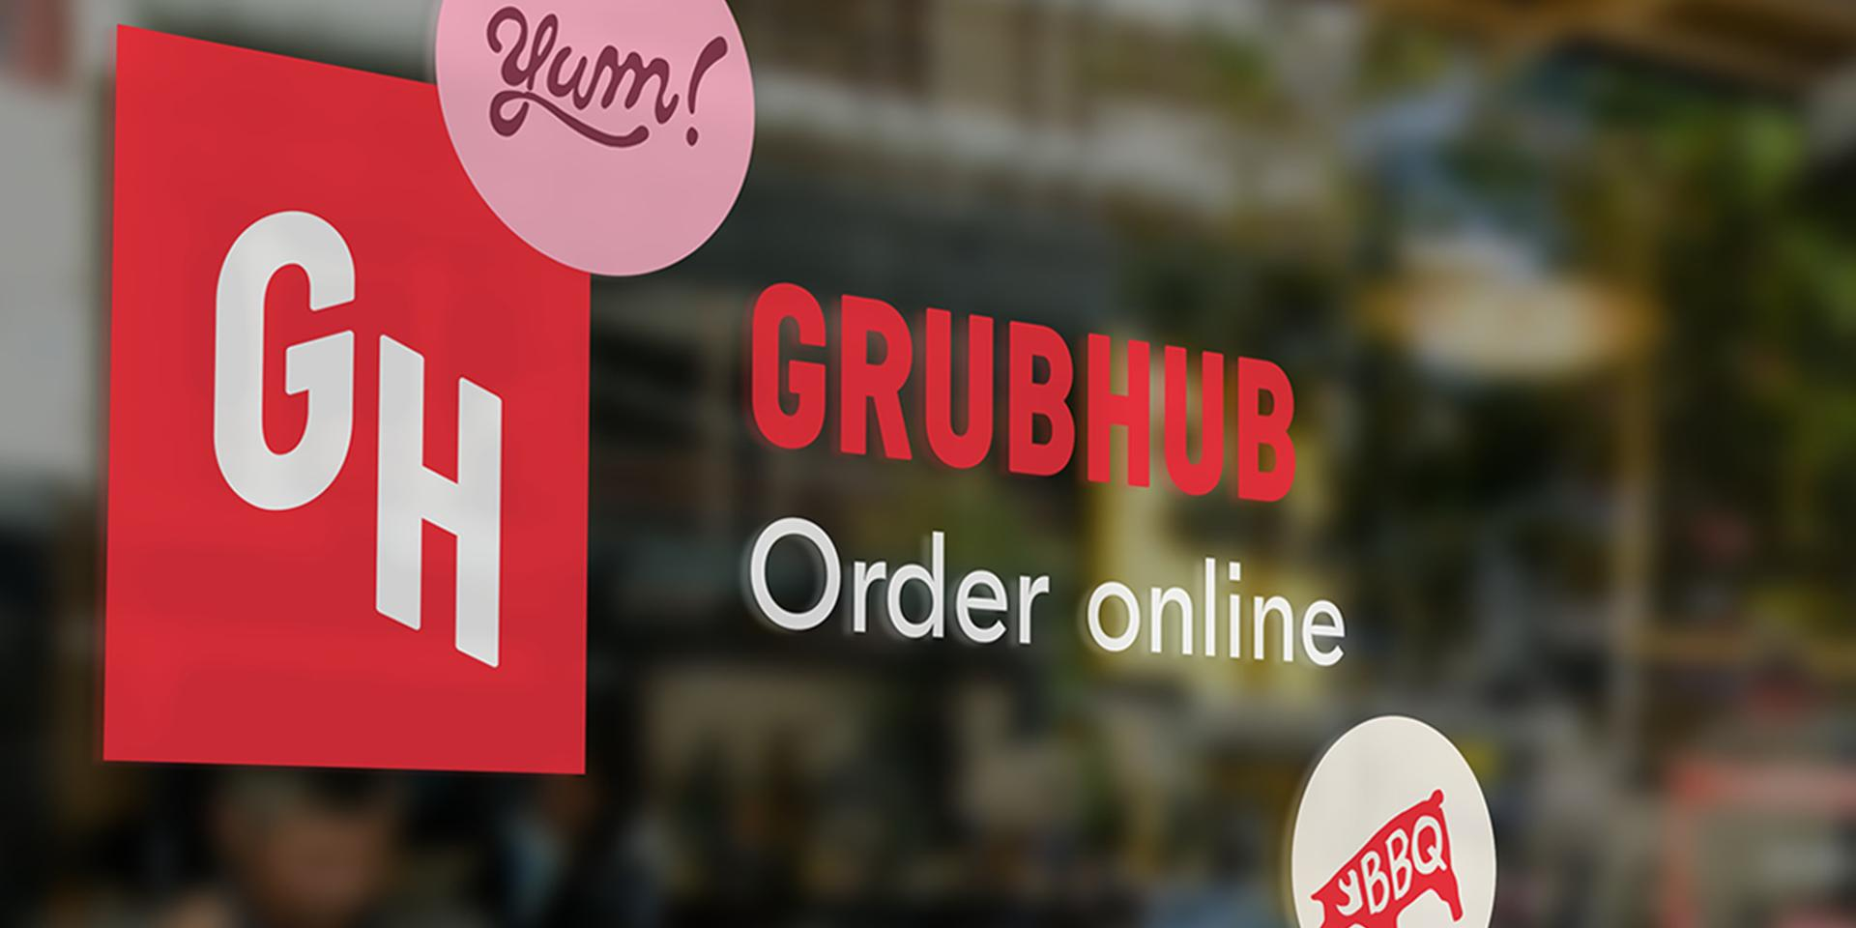
A Bit About The App
Grubhub is part of Just Eat Takeaway.com. A leading global online food delivery marketplace. Dedicated to connecting more than 33 million diners with the food they love from their favorite local restaurants, Grubhub elevates food ordering through innovative restaurant technology, easy-to-use platforms and an improved delivery experience. Grubhub features more than 300,000 restaurant partners in over 4,000 U.S. cities.
Company Statistics
Provided nearly $9 billion in gross food sales to local takeout restaurants in 2020
Processes more than 745,000 daily orders
Serves 33 million active diners
Sent more than $4 billion in total tips to drivers to date

Slide 3
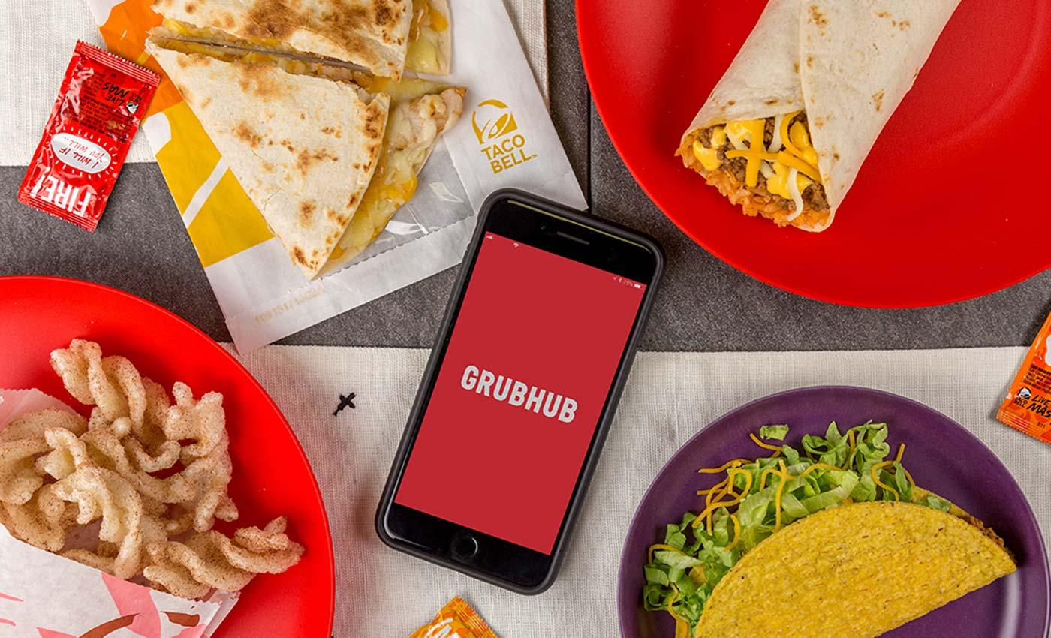
Challenges
GrubHub, in recent years, have faced challenge due to the rising competition from leading companies, such as Amazon, surprisingly enough. Te newest arrival to the on-demand delivery market may pose a serious threat to Grubhub Inc.'s success moving forward. Amazon launched its own meal delivery service Amazon Restaurants last November, and the company has been rapidly expanding the service across the US.
It is now available in 10 US cities exclusively to members of Amazon's Prime subscription program. This may seem like a miniscule base — Grubhub and Seamless are offered in over 1000 cities — but Amazon's business model has the potential to convert users. Unlike veteran delivery services, Amazon has promised not to charge a delivery fee, which will probably give it a real edge with consumers. As Amazon Restaurants arrives in new cities, it could pose a threat not only to Grubhub Inc., but to all of the players in the on-demand meal delivery space.
And within that space, quick-service restaurants (QSRs) — also known as fast-casual restaurants — such as Starbucks have been turning to mobile order-ahead apps to extract higher sales, intensify customer loyalty, and heighten foot traffic.

Slide 4
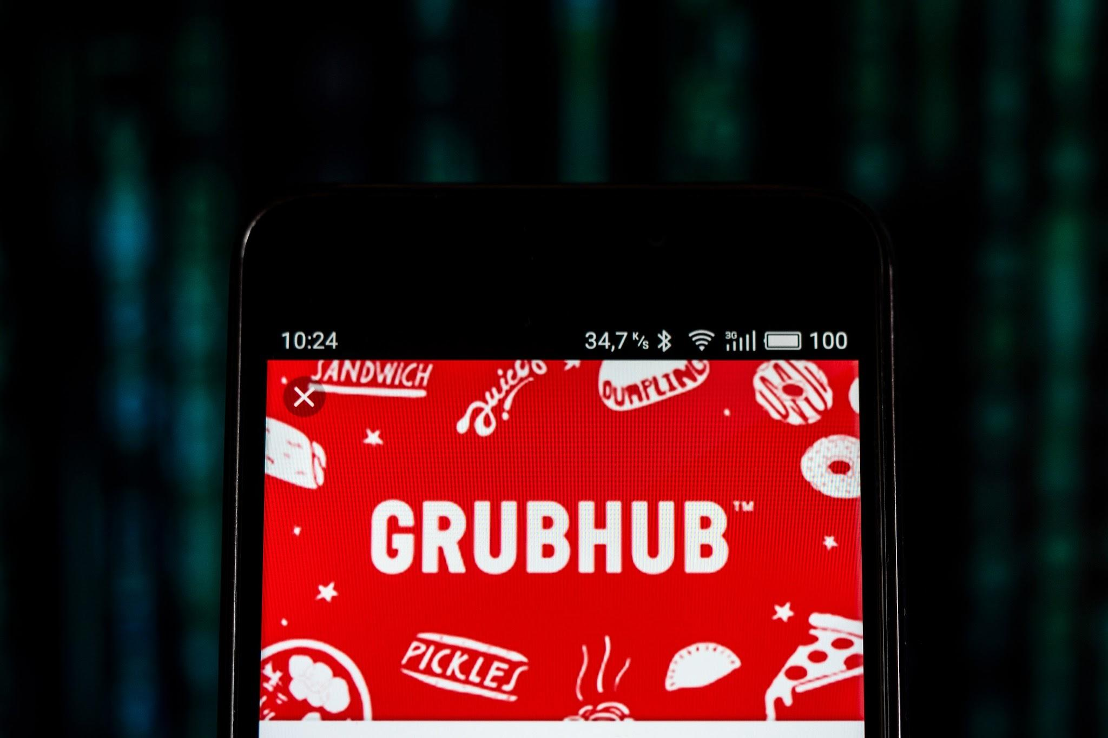
GrubHub - The Features
The original Chicago-based Grubhub was founded in 2004 by Mike Evans and Matt Maloney to create an alternative to paper menus.
The Features
Stay up to speed
Track your order and keep in the know about your delivery with push notifications.
Save your order history
Got a go-to Pad Thai that’s never let you down? You can find previous meals quickly with your order history, and reorder favorites in as little as two taps with Express Reorder.
Plan ahead with preorder
Place your order from two hours to four days in advance for food delivered right when you know you’ll need it.
Pay how you want
We accept Apple Pay, Android Pay, PayPal, eGift and credit cards, or good old-fashioned cash. What works best for you, works great for us.

Slide 5
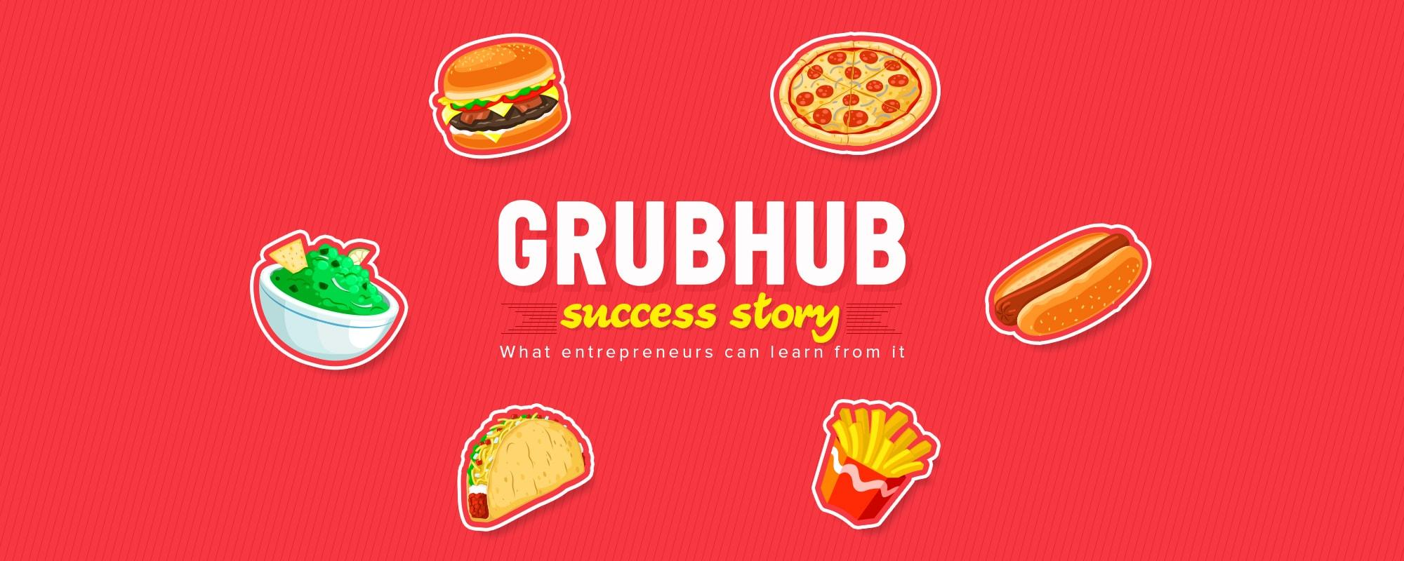
GrubHub’s Objectives - Value Propositions
For Customers:
Helps customers save time and money as they can order food online.
Customers can track the delivery after placing an order
24*7 Customer Service
Users have an option to choose a restaurant from where they want to order.
For Restaurants:
GrubHub has its own delivery persons.
GrubHub provides restaurants with an extended customer base.
GrubHub provides restaurants a software to manage their deliveries through GrubHub in an efficient way.

