Slide 1
FEDERAL UNIVERSITY OF TECHNOLOGY, MINNA SCHOOL OF INFORMATION AND COMMUNICATION TECHNOLOGY, DEPARTMENT OF COMPUTER SCIENCE COURSE TITLE: SOFTWARE ENGINEERING SEMESTER: I

Slide 2
Contents
1.0 Introduction to Software Engineering
2.0 Software processes: Software life cycle and process models; Process assessment models; Software process metrics
3.0 Software requirements and specifications: Requirements elicitation; Requirements analysis modeling techniques; Functional and nonfunctional requirements; Prototyping; Basic concepts of formal specification techniques
4.0 Software design: Fundamental design concepts and principles; Design patterns; Software architecture; Structured design; Object-oriented analysis and design; Component level design; Design for reuse
4. Software validation: Validation planning; Testing fundamentals, including test plan creation and test case generation; Black-box and white-box testing techniques; Unit, integration, validation, and system testing; Object-oriented testing Inspections
5. Software evolutions: Software maintenance; Characteristics of maintainable software; Reengineering; legacy systems; software reuse
6. Software project management: Team management; Project scheduling; Software measurement and estimation techniques; Risk analysis; software quality assurance; Software configuration management; Project management tools.

Slide 3
INTRODUCTION TO SOFTWARE ENGINEERING
1.1 What is Software Engineering?
Software:
+
Engineering:
A collection of executable programming code, associated libraries and documentations
Involves the development of products, using well-defined, scientific principles and methods.
Software Engineering is thus: the application of a systematic, disciplined, quantifiable approach to the development, operation and maintenance of software
Software engineering is a branch of computer science, which uses well-defined engineering concepts required to produce efficient, durable, scalable, in-budget and on-time software products
COMPLEX PROBLEMS
Abstraction
Decomposition

Slide 4
INTRODUCTION TO SOFTWARE ENGINEERING
1.2 THE NEED FOR SOFTWARE ENGINEERING
Large software
Scalability
Cost
Dynamic Nature
Quality Management
1.3 THE SOFTWARE CHARACTERISTIC
Operational:
Budget-Usability-Efficiency-Correctness-Functionality-Security
Transitional:
Portability- Interoperability- Reusability- Adaptability
Maintenance:
Modularity-Flexibility-Scalability

Slide 5
SOFTWARE PROCESSES
2.1 What is Software process?
It is a set of related activities that lead to the production of software product
2.2 Four Basic Activities
Software Specification
Software Design and Implementation
Software verification and Validation
Software Evolution
2.2.2 Sub-activities may Include:
Requirement validation, Architectural Design, Unit Test
2.2.3 Supporting Activities Include
Configuration and Change Management, Quality Assurance, Project Management, User Experience

Slide 6
SOFTWARE LIFE CYCLE MODEL
2.3 Type of Software Life Cycle Model
Waterfall Model
Iterative Model
Prototyping Model
Evolutionary Model
Spiral Model

Slide 7
TRANSMISSION MEDIA
A transmission medium can be broadly defined as anything that can carry information from a source to a destination
Categories of Transmission Media
Guided Media E.g Twisted pair cable, Coaxial Cable, Fiber Optic,
Unguided Media E.g RadioWaves, Microwave, Infrared

Slide 8

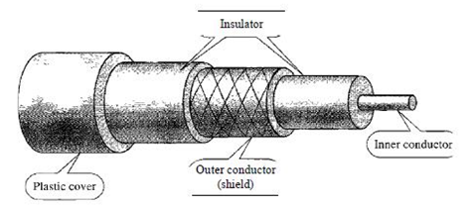
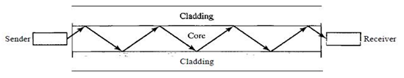
TRANSMISSION MEDIA
Figure: Twisted-pair cable
Figure: Coaxial cable

Slide 9
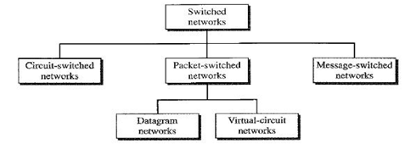
COMMUNICATION SWITCHING TECHNIQUES
A switched network consists of a series of interlinked nodes, called switches. Switches are devices capable of creating temporary connections between two or more devices linked to the switch.

Slide 10
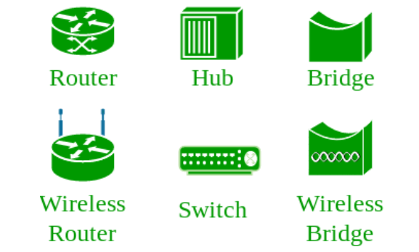
Basic Network Infrastructure
Computer Network
This is the interconnection of multiple devices, using multiple paths for the purpose of sending/receiving data or media.
Network Devices
These are devices or mediums that helps in the communication between two different devices. E.g Router, Switch, Hub, Bridge.

Slide 11
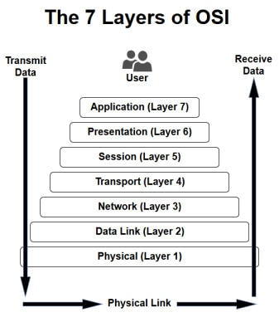
Open Systems Interconnection
The is a reference model that specifies standards for communications protocols. It is a 7 layer architecture with each layer having specific functionality to performed. All these 7 layers work collaboratively to transmit the data from one person to another across the globe.
Software Layer
Heart of OSI
Hardware Layers

Slide 12
Protocol:
Protocol is the set of rules or algorithms which define the way how two entities can communicate across the network and there exists different protocol defined at each layer of OSI model. Few of such protocols are TCP , IP , UDP , ARP , DHCP , FTP .

Slide 13
History of the WWW
WWW is an acronym for the World Wide Web
1989 | 1992/1993 | 1994
CERN (European Organization for Nuclear Research) Tim Berners-Lee(Fellow) | Dramatic growth beyond the wall of CERN Netscape(Browser) | WWW Consortium Develop and maintain standard

Slide 14
Web Basic
The success of the WorldWideWeb or Web can be attributed to two Features:
HTTP Protocol (Hypertext Transfer Protocol)
2. HTML(Hypertext Markup Language)
The HTTP allows an easy implementation of a communications system so that any type of file can be sent easily and thus simplifying the operation of the server.
The HTML feature provides an easy and straight forward mechanism for composing linked pages. The process here is highly efficient and very user-friendly.

Slide 15
Hypertext Transfer Protocol
Hypertext Transfer Protocol is one of the basic features of the Web- a communication standard whose role is to govern the request/response between a CLIENT and SERVER.
A Simple Request/Response Procedure
1. A user enters http://server.comin in browser’s address bar.
2. The browser looks up the IP address for server.com.
3. The browser issues a request for the home page at server.com.
4. The request crosses the Internet and arrives at the server.com web server.
5. The web server, having received the request, looks for the web page on its hard disk.
6. The web page is retrieved by the server and returned to the browser.
7. The browser then displays the web page websites web server.

Slide 16
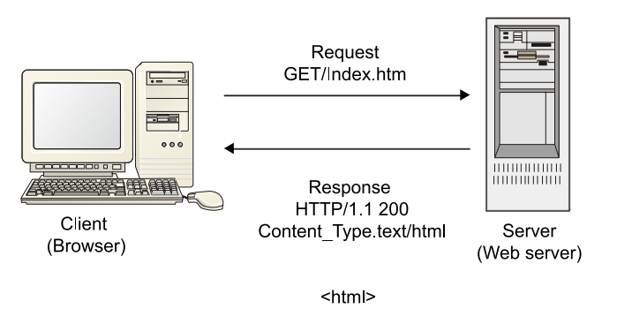
Hypertext Transfer Protocol
Following a successful connection to the server via the HTTP port, the client by its nature sends a HTTP resource request command along with some informative headers and the server responds through the same connection with the requested data and a series of informative headers.
Figurexxx Request/Response Procedure

Slide 17
HTTP REQUEST
A Client is able to make a request to a server using the following information directives:
GET- This method enables a request to be made together with some parameters to a server.
POST-In the case of POST method, a request is usually made along with some parameters as part of the request.
HEAD- Request for data on resource
PUT- Creation or sending of resource
DELETE- Deletion of resource.
TRACE- Echoes back the request just as it was received on the receiver for debugging.
OPTIONS- Used to check server capacity.
CONNECT- Reserved for use on intermediate servers that can operate as tunnels.

Slide 18
HTTP REQUEST
The most popularly used information directives are the GET and POST
The GET Request has the following format:
GET /index.html HTTP/1.1
Host: www.example.com
User-Agent: Mozilla/4.5 [en]
Accept: image/gif, image/jpeg, text/html
Accept-language: en : iso-8859-1
The above format can be split into three part depending on the type of directives tat is used
Request Line
Request Header
Request Body

Slide 19
HTTP REQUEST
Request line : contains the requested resource
Method: name of HTTP method(directive) (GET, POST, etc.).
Resource identifier: URL (Uniform Resource Locator) of the requested resource.
(index.html)
Protocol version: protocol version requested for the response.
(HTTP/1.1)
Request header: contains additional information about the client such as:
Host: name of requested server. (www.example.com)
User-Agent: name of browser or program used to access the resource. (Mozilla/4.5 [en])
Accept: some text and image formats accepted by the client.(image/gif, image/jpeg, text/html)
Accept-Language: languages supported (preferred) by the client.(en : iso-8859-1)

Slide 20
HTTP REQUEST
Request body: contains additional information
The information are either encrypted as part of the URL or they are passed as extra request data. All of these depend on the information directive (Method) deployed.
http://www.example.com/Index.jsp?name=Mr+Nobody&OK=l
GET /index.jsp?name=Mr+Nobody&OK=l HTTP/1.0
Host: www.example.com
User-Agent: Mozilla/4.5[en]
Accept: image/gif, image/jpeg, text/html
Accept-language: en
Accept-Charset: iso-8859

Slide 21
POST /index.jsp HTTP/1.0
Host: www.example.com
User-Agent: Mozilla/4.5[en]
Accept: image/gif, image/jpeg, text/html
Accept-language: en
Accept-Charset: iso-8859-1
name=Mr+Nobody&OK=l
Multipart format culled from MIME(Multipurpose Internet mail Extensions) and only exclusive for POST method
POST /index.jsp HTTP/1.0
Host: www.example.com
User-Agent: Mozilla/4.5[en]
Accept: image/gif, image/jpeg, text/html
Accept-language: en
Accept-Charset: iso-8859-1
Content-Type: multipart/form-data, delimiter="----RANDOM----"
----RANDOM---
Content-Disposition: form-data; name="name"
Mr Nobody
----RANDOM---
Content-Disposition: form-data; name="OK"
1
----RANDOM----

Slide 22
HTTP Responses
HTTP/1.1 200 OK
Date: Mon, 04 Aug 2003 15:19:10 GMT
Server: Apache/2.0.40(RedHatLinux)
Last-Modified: Tue, 25 Mar 2003 08:52:53GMT
Accept-Ranges: bytes
Content-Length: 428
Connection: close <HTML>
----
Response Line contains the HTTP version followed by the return Code and the return phrase

Slide 23
The Return Code
• 1xx Request received, still in process.
• 2xx Correct. Request processed correctly.
• 3xx Redirection. The request must be repeated or redirected.
• 4xx Client error. The request cannot be processed because it is incorrect, does not exist, etc.
• 5xx Server error. The server has failed trying to process the request, which is theoretically correct.
The return phrase only clarify the return code

Slide 24
HTML
HTML is an acronym for Hypertext Markup Language. It is one of the features that has made the WWW a success. Content that are rendered and display by the browser are usually created using HTML. Hence, it is safe to say that HTML is a static language that determines the structure and semantic meaning of a web page.
Web page
This is text based document constructed according to the specifications known as Hypertext Markup Language
Website
This is a collection of web pages

Slide 25
Simple HTML
< ! DOCTYPE html >
<html lang="en" >
<head>
<title> Page Title </title>
</head>
<body>
<h1> This is a Heading </h1>
<p>This is a paragraph.</p>
</body>
</html>

Slide 26
Basic structure of an HTML page
A DOCTYPE Section states which version of HTML the page uses
<DOCTYPE html>
An HTML Section
header <head> </head> in the HTML Section contains information about the page for the browser. This may include:
- Primary language (English, Chinese, French, and so on),
- Character set,
- Associated style sheets and script files,
- Author information,
- Keywords for search engines.
A body contains all the viewable content of the page. Those visible part of the HTML document are within <body> </body>

Slide 27
HTML 5

