Slide 1
Securing Information System
Presented by Group 2

Slide 2
Group Members
Names Matric Number
Mariam Ismail Tsiga 2015/1/55220CI
Joy H Gabako 2015/1/55918CI
Amanze Robert Chukwuemeka 2015/1/55226CI
Minkail Adamu Jibril 2015/1/55229CI
Isah Rashidah Oyiza 2016/2/64359CI
Kalu Francis Ndukwe Kalu 2015/1/56286CI
Akpa Thankgod 2015/1/55231CI
Audu Ibrahim Abdul 2015/1/56186CI

Slide 3
Objectives
Why are information systems vulnerable to destruction, error, and abuse?
What is the business value of security and control?
What are the components of an organizational framework for security and control?
What are the most important tools and technologies for safeguarding information resources.

Slide 4
SYSTEM VULNERABILITY AND ABUSE
Why are System Vulnerable?
Systems are vulnerable when large amounts of data are stored in electronic form, they are vulnerable to many more kinds of threats than when they existed in manual form. Through communications networks, information systems in different locations are interconnected. The potential for unauthorized access, abuse, or fraud is not limited to a single location but can occur at any access point in the network.

Slide 5
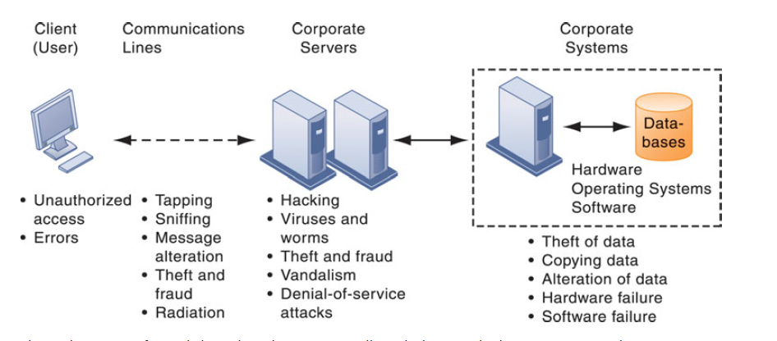
CONTEMPORARY SECURITY CHALLENGES AND VULNERABILITIES

Slide 6
Internet Vulnerabilities
Large public networks, such as the Internet, are more vulnerable than internal networks because they are virtually open to anyone. The Internet is so huge that when abuses do occur, they can have an enormously widespread impact. When the Internet becomes part of the corporate network, the organization’s information systems are even more vulnerable to actions from outsiders.

Slide 7
Wireless Security Challenges
Wi-Fi transmission technology was designed to make it easy for stations to find and hear one another. The service set identifiers (SSIDs) identifying the access points in a Wi-Fi network are broadcast multiple times and can be picked up fairly easily by intruders’ sniffer programs. Wireless networks in many locations do not have basic protections against war driving.

Slide 8
MALICIOUS SOFTWARE: VIRUSES, WORMS, TROJAN HORSES, AND SPYWARE
What is malware?
Malware is a generic name given to all malicious software that can work individually or in group to infect computer systems with malicious code written by hackers in order to disturb user experience or destroy computer resources or data stored in a system. Examples of this software includes virus, worm, trojan horse, spyware e.t.c

Slide 9
MALICIOUS SOFTWARE conti….
Computer Virus:- It is a rogue software program that attaches itself to other software programs or data files in order to be executed, usually without user knowledge
Worms:- A worm is similar to a virus by design and is considered to be a sub-class of virus. Worms spread from computer to computer, but unlike a virus, it has the capability to travel without any human action. a worm takes advantage of file or information transport features on your system, which is what allows it to travel unaided.

Slide 10
MALICIOUS SOFTWARE conti….
Trojan Horse:-They are software programs that hide their true nature and reveal their designed behavior only when activated. Trojan horses are frequently disguised as helpful, interesting, or necessary pieces of software, such as readme.exe files often included with shareware or freeware packages.

Slide 11
HACKERS AND COMPUTER CRIME
A hacker is an individual who intends to gain unauthorized access to a computer system.
Classes of Attack of a Hacker:
Denial-of-Service Attack
Stealing Passwords
Botnet and Zombies e.t.c
What is Computer Crime?
Computer crime is defined by the U.S. Department of Justice as “any violations of criminal law that involve a knowledge of computer technology for their perpetration, investigation or prosecution.”

Slide 12
Examples of Computer Crime
Breaching the confidentiality of protected computerized data
Accessing a computer system without authority
Knowingly accessing a protected computer to commit fraud
Intentionally accessing a protected computer and causing damage, negligently or deliberately
Knowingly transmitting a program, program code, or command that intentionally causes damage to a protected computer e.t.c

Slide 13
Business value of Security and Control
Many firms are reluctant to spend heavily on security because it is not directly related to sales revenue. However, protecting information systems is so critical to the operation of the business that it deserves a second look.
Recent U.S. government regulations are forcing companies to take security and control more seriously by mandating the protection of data from abuse,exposure, and unauthorized access.

Slide 14
ELECTRONIC EVIDENCE AND COMPUTER FORENSICS
Security, control, and electronic records management have become essential for responding to legal actions. Much of the evidence today for stock fraud,embezzlement, theft of company trade secrets, computer crime, and many civil cases is in digital form.
An effective electronic document retention policy ensures that electronic documents, e-mail, and other records are well organized, accessible, and neither retained too long nor discarded too soon. It also reflects an awareness of how to preserve potential evidence for computer forensics.

Slide 15
ELECTRONIC EVIDENCE AND COMPUTER FORENSICS
What is Computer Forensic:- It is the scientific collection,examination,authentication,preser-vation, and analysis of data held on or retrieved from computer storage media in such a way that the information can be used as evidence in a court of law.

Slide 16
ESTABLISHING A FRAMEWORK FOR SECURITY AND CONTROL
Information System Controls
Information systems controls are both manual and automated and consist of both general controls and application controls.
General controls :- govern the design, security, and use of computer programs and the security of data files in general throughout the organization’s information technology infrastructure.
Application controls :- they are specific controls unique to each computerized application, such as payroll or order processing.
Application controls can be classified as :-
input controls
processing controls
output controls.

Slide 17
ESTABLISHING A FRAMEWORK FOR SECURITY AND CONTROL
Risk Assessment
A risk assessment determines the level of risk to the firm if a specific activity or process is not properly controlled.
Business managers working with information systems specialists should try to determine the value of information assets, points of vulnerability, the likely frequency of a problem, and the potential for damage.
Security Policy
A security policy consists of statements ranking information risks, identifying acceptable security goals, and identifying the mechanisms for achieving these goals.

Slide 18
ESTABLISHING A FRAMEWORK FOR SECURITY AND CONTROL
DISASTER RECOVERY PLANNING AND BUSINESS CONTINUITY PLANNING
If you run a business, you need to plan for events, such as power outages, floods, earthquakes, or terrorist attacks that will prevent your information systems and your business from operating.
Disaster Recovery Planning:- they devise plans for the restoration of computing and communications services after they have been disrupted.
Business Continuity Planning:- focuses on how the company can restore business operations after a disaster strikes. The business continuity plan identifies critical business processes and determines action plans for handling mission-critical functions if systems go down.

Slide 19
ESTABLISHING A FRAMEWORK FOR SECURITY AND CONTROL
THE ROLE OF AUDITING
An MIS audit examines the firm’s overall security environment as well as controls governing individual information systems. The auditor should trace the flow of sample transactions through the system and perform tests, using, if appropriate, automated audit software.
Security audits review technologies, procedures, documentation, training and personnel.

Slide 20
TECHNOLOGIES AND TOOLS FOR PROTECTING INFORMATION RESOURCES
Businesses have an array of technologies for protecting their information Resources. They include tools for managing user identities, preventing unauthorized access to systems and data, ensuring system availability, and ensuring software quality.
Identity management and authentication
Passwords: To gain access to a system, a user must be authorized and authenticated. Authentication is often established by using passwords known only to authorized users.
Token: A token is a physical device, similar to an identification card, that is designed to prove the identity of a single user. Tokens are small gadgets that typically fit on key rings and display pass codes that change frequently.
Smart Card: A smart cardis a device about the size of a credit card that contains a chip formatted with access permission and other data. (Smart cards are also used in electronic payment systems. A reader device interprets the data on the smart card and allows or denies access.

Slide 21
TECHNOLOGIES AND TOOLS FOR PROTECTING INFORMATION RESOURCES
Biometric authentication: uses individual human traits, such as fingerprints, irises, and voices, in order to grant or deny access. It compares a person’s unique characteristics, such as the fingerprints, face, or retinal image, against a stored profile of these characteristics to determine whether there are any differences between these characteristics and the stored profile. If the two profiles match, access is granted.
Firewall: A firewall is a combination of hardware and software that controls the flow of incoming and outgoing network traffic. It is generally placed between the organization’s private internal networks and distrusted external networks, such as the Internet, although firewalls can also be used to protect one part of a company’s network from the rest of the network.
Anti-virus software: Antivirus software is designed to check computer systems and drives for the presence of computer viruses. Often the software eliminates the virus from the infected area. However, most antivirus software is effective only against viruses already known when the software was written. To remain effective, the antivirus software must be continually updated.

Slide 22
TECHNOLOGIES AND TOOLS FOR PROTECTING INFORMATION RESOURCES
Intrusion detection systems:To detect unauthorized activity within an inner network or an individual machine, organizations can implement intrusion detection and prevention systems(IDPs). IDPs feature full-time monitoring tools placed at the most vulnerable points or “hot spots” of corporate networks to detect and deter intruders continually. The system generates an alarm if it finds a suspicious or anomalous event. Scanning software looks for patterns indicative of known methods of computer attacks, such as bad passwords, checks to see if important files have been removed or modified, and sends warnings of vandalism or system administration errors.
Encryption: It is the process of transforming plain text or data into cipher text that cannot be read by anyone other than the sender and the intended receiver.
Digital certificates: are data files used to establish the identity of users and electronic assets for protection of online transaction. A digital certificate system uses a trusted third party, known as a certificate authority(CA, or certification authority), to validate a user’s identity.

Slide 23
TECHNOLOGIES AND TOOLS FOR PROTECTING INFORMATION RESOURCES
Ensuring system availability: As companies increasingly rely on digital networks for revenue and operations, they need to take additional steps to ensure that their systems and applications are always available especially by using fault-tolerant computer systems.
Fault-tolerant computer systems contain redundant hardware, software,and power supply components that create an environment that provides continuous, uninterrupted service. Fault tolerant computers use special softwareroutines or self-checking logic built into their circuitry to detect hardware failures and automatically switch to a backup device.

Slide 24
TECHNOLOGIES AND TOOLS FOR PROTECTING INFORMATION RESOURCES
ENSURING SOFTWARE QUALITY
In addition to implementing effective security and controls, organizations can improve system quality and reliability by employing software metrics and rigorous software testing. Ongoing use of metrics enables the information systems department and end users to jointly measure the performance of the system and identify problems as they occur. Examples of software metrics include the number of transactions that can be processed in a specified unit of time, online response time, the number of payroll checks printed per hour, and the number of known bugs per hundred lines of program code. For metrics to be successful, they must be carefully designed, formal, objective, and used consistently. Early, regular, and thorough testing will contribute significantly to system quality.

