Slide 1

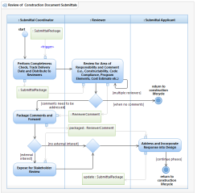
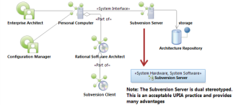
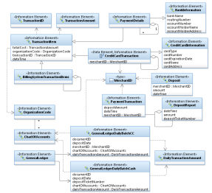
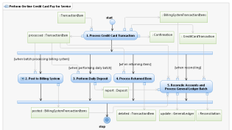
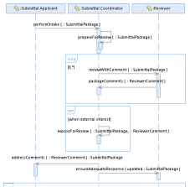
Dealing With Complexity
<<vision>>
Best Managed City
<<capability>>
Manage Infrastructure
<<capability>>
Clean Water
<<capability>>
Equal Opportunities
<<capability>>
Healthy Economy
Identify Common Capabilities
<<capability>>
Safe Public
<<capability>>
Healthy Community
<<capability>>
Reliable Energy
<<capability>>
Mobile Community
Identify Common Process
Goals Amplify Vision!
Identify Common Infrastructure
Top Down – Bottom Up
Identify Common Data
<<goal>>
Conserve Water Resources
<<goal>>
Integrate Case and Asset Management
<<goal>>
Sustain Environment
<<goal>>
Optimize Operations
Identify Common Goals
<<goal>>
Increase Revenue
<<goal>>
Respond to Customer Needs
<<goal>>
Define Mobile User Processes

Slide 2
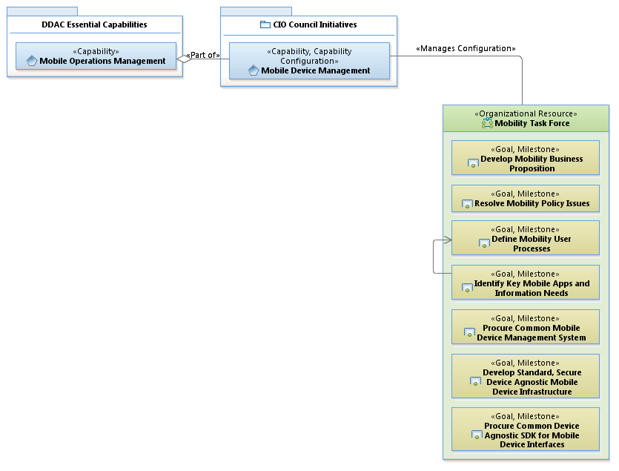
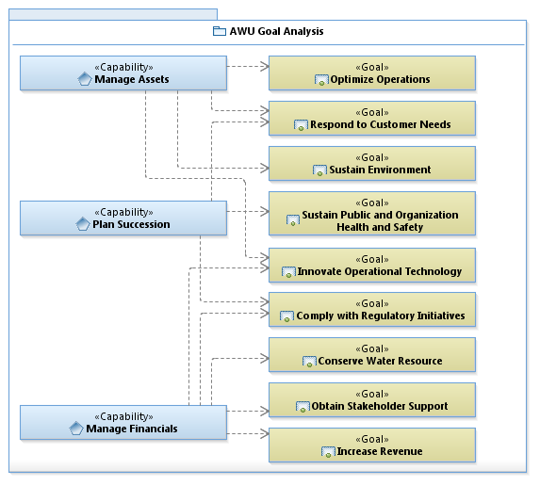
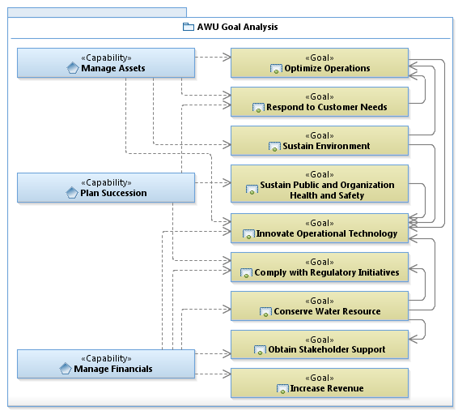
Connecting Business Needs to IT Solutions continued…

Slide 3
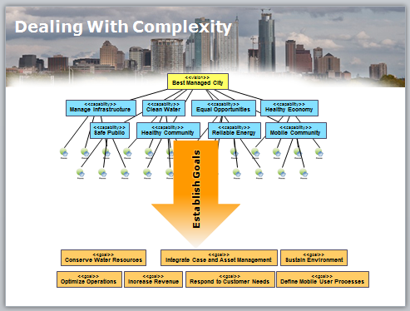
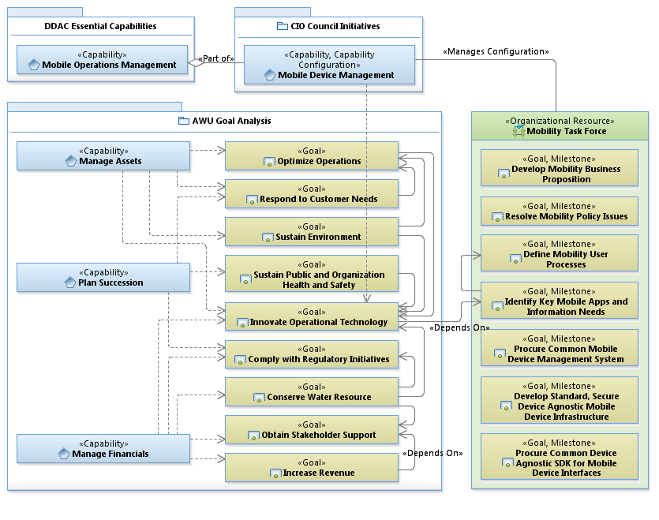
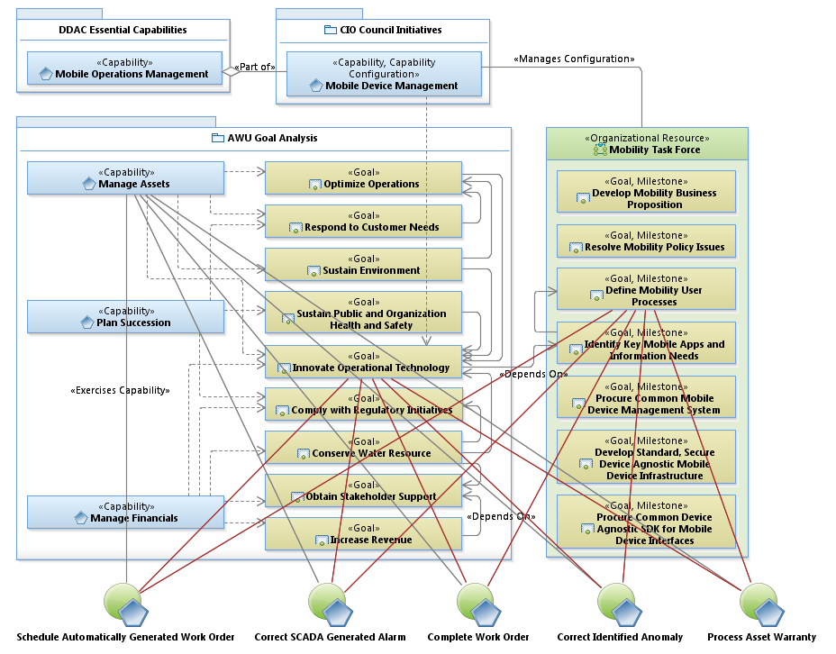
Improving Capability Using EA
Water Treatment Plant

Slide 4
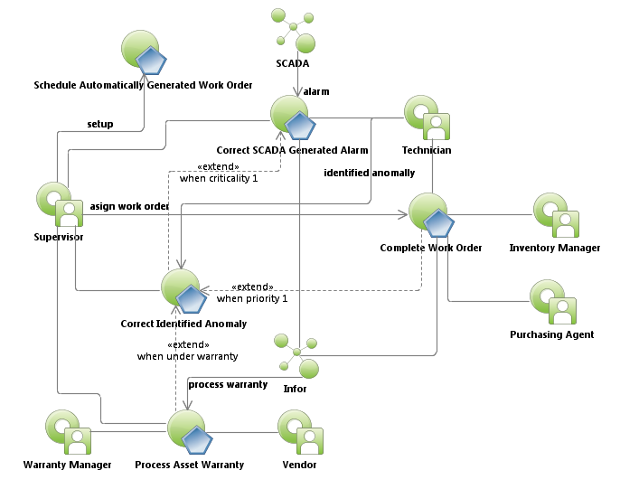
Water Treatment Plant Work Order Use Case Relationships

Slide 5
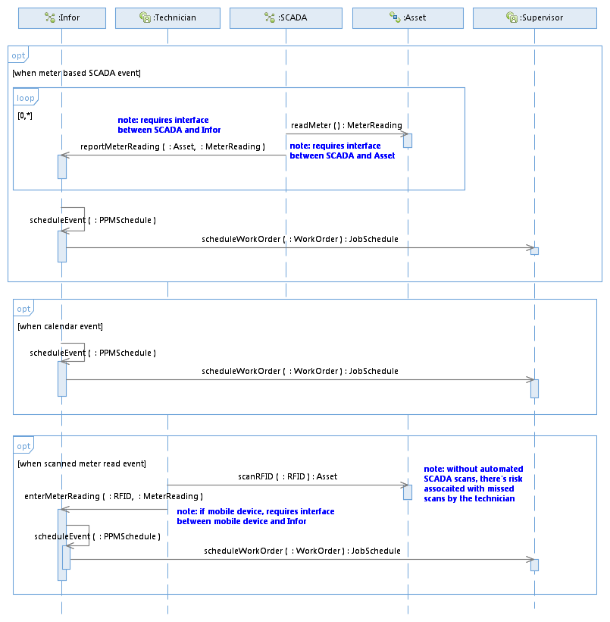
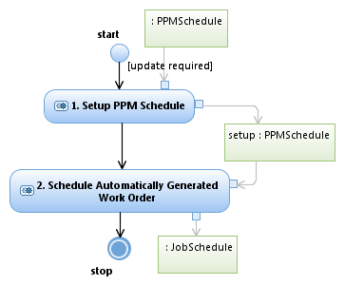
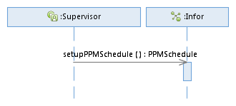
Schedule Automatically Generated Work Order

Slide 6
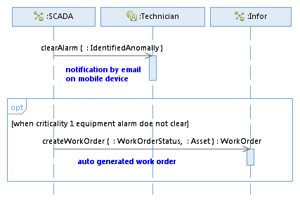
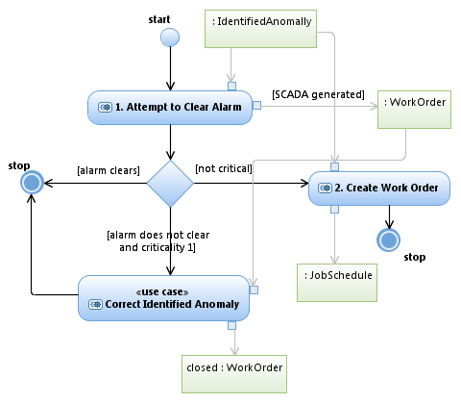
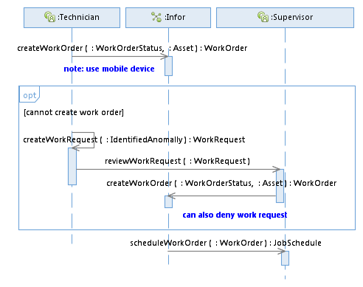

Correct SCADA Generated Alarm

Slide 7
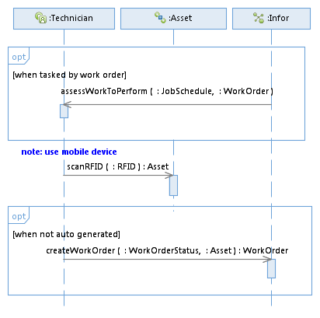
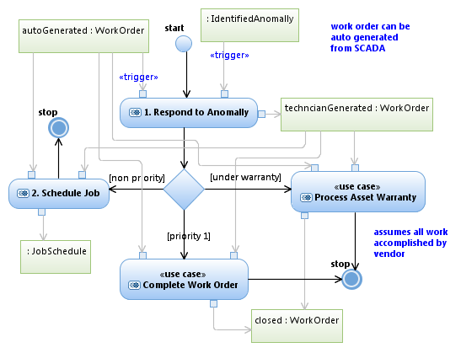
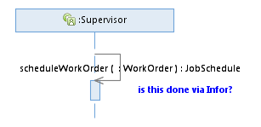


Correct Identified Anomaly

Slide 8
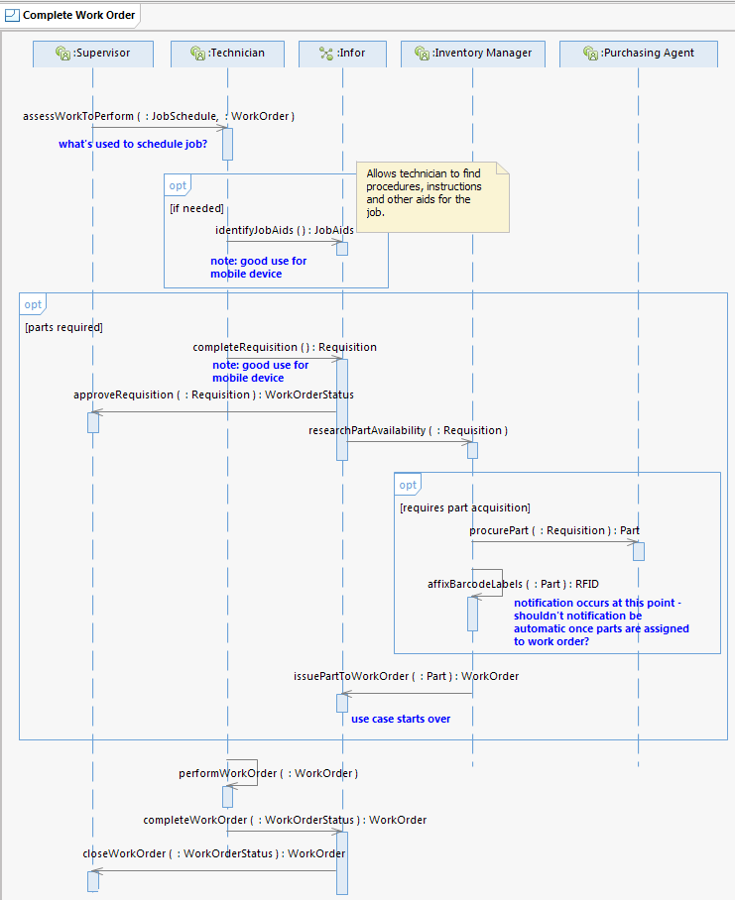
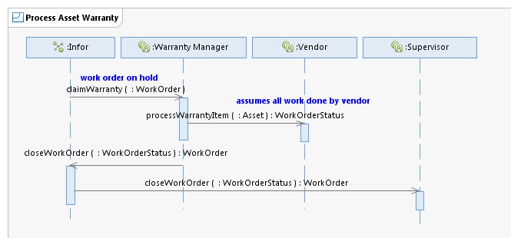
Complete Work Order Process Asset Warranty

Slide 9
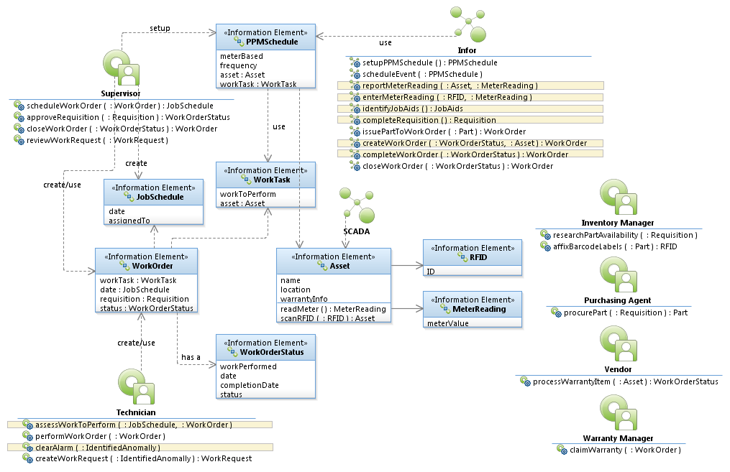
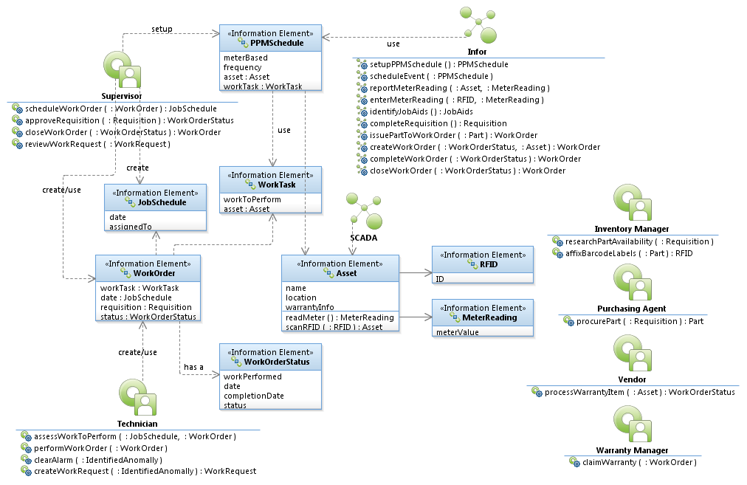

Work Order Logical Data Model

