Slide 1
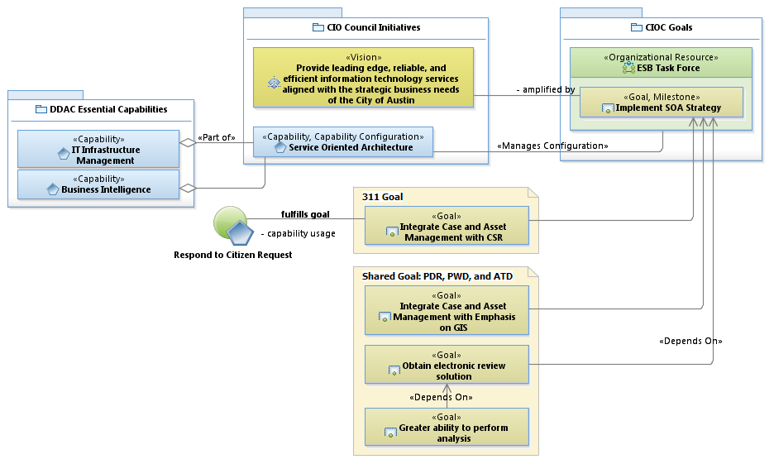
Strategic Viewpoint

Slide 2
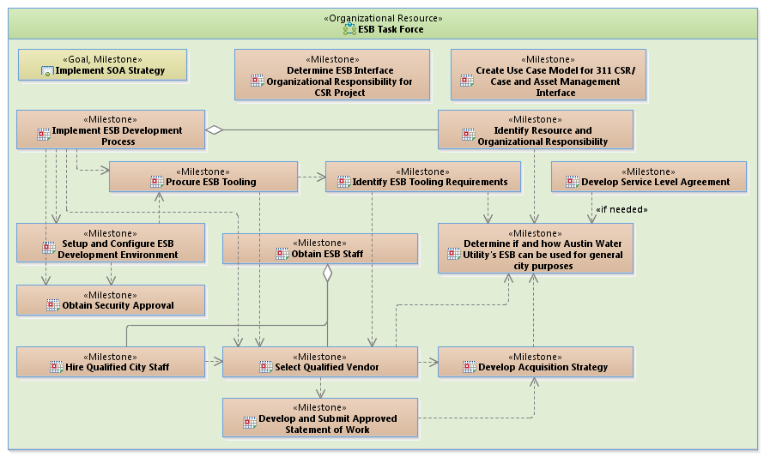
Sequencing Plan Development

Slide 3
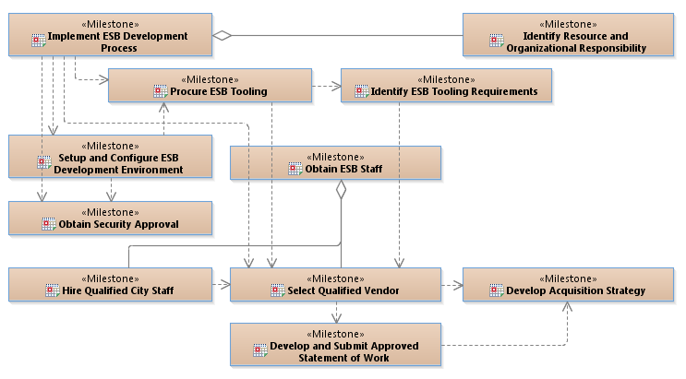
Sequencing Plan Development (cont.)

Slide 4
Sequencing Plan Development (cont.)

Slide 5
Potential Acquisition Strategy
IBM offered a significant discount for Dec procurement
Offered to setup and configure IBM Integration Bus (IIB) and develop first interface between CSR (App Hub) and Maximo (possibly Watershed)
Procure Tooling
Setup and Deploy Sample Interface
Hire Vendor
& New Hire
Dec
Jan
Feb
Mar
Apr
2013
2014
SOW on Street

