Slide 1
Enterprise Architecture Rob Byrd, Chief Enterprise Architect
Planning & Development Review (PDR) Residential Review Architecture November 04, 2013
Presented by:

Slide 2
PDR Architecture Team
Name | Title
Donald Birkner | Assistant Director
Cande Coward | Permit Program Supervisor
Gregory Hand | Business Systems Analyst Supervisor
Kathy Haught | Manager, Development Services
Tony Hernandez | Supervisor Residential Inspections
Russell Hill | Plan Review Coordinator
Julie Kirby | Technical Writer
John McDonald | Planner Principal
Dan McNabb | Building Inspections Division Manager
Julia Robbins | Business Systems Analyst Senior
Jose Roig | Supervisor Building Inspections
Christopher Summers | Business Systems Analyst
Carl Thompson | Supervisor Electrical Inspections
Daniel Word | Planner II
Stacey Wuest | EPR Project Manager
Aaron Brown | Senior Enterprise Architect

Slide 3
Architecture Principles
Vet business needs through stakeholders in context of operational use
Integrate system interface needs
Use architecture functional descriptions and artifacts as RFP requirements
Use as project tool to monitor progress toward desired state – develop Sequencing Plan

Slide 4
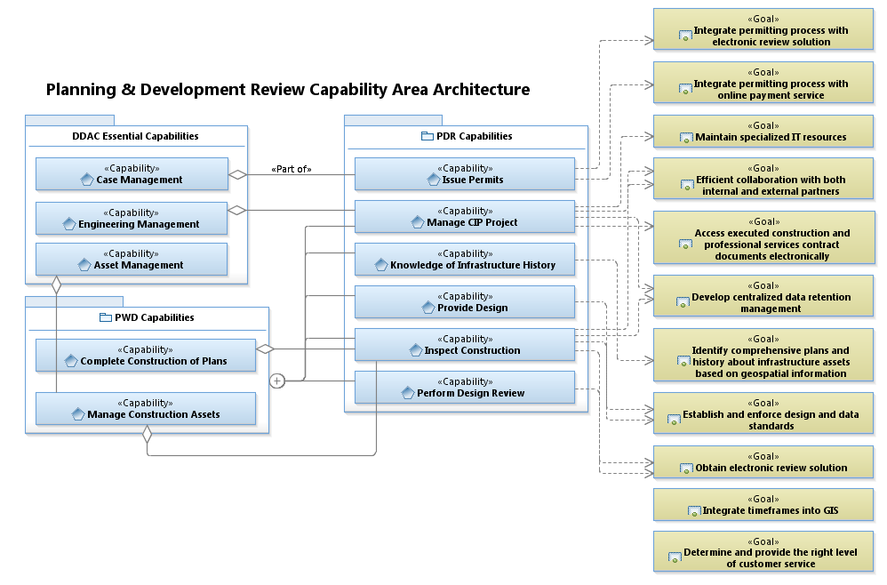
PDR Business Needs Value and Goals

Slide 5
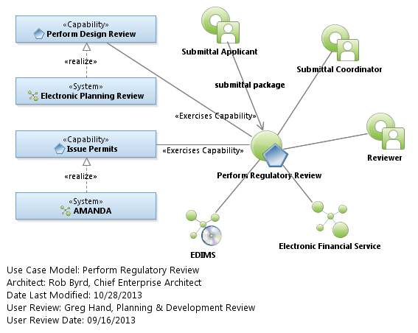
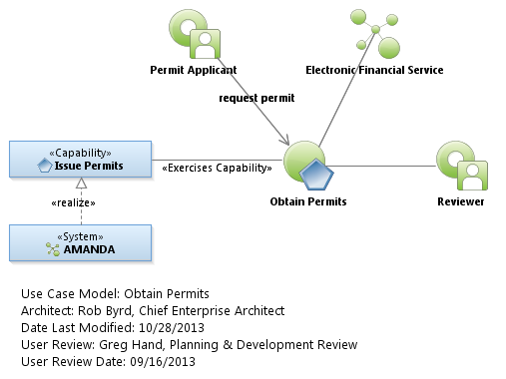
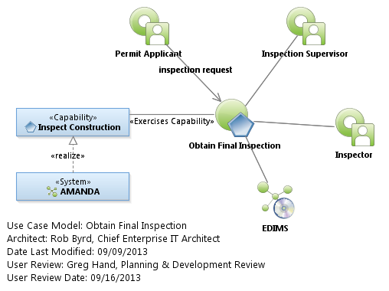
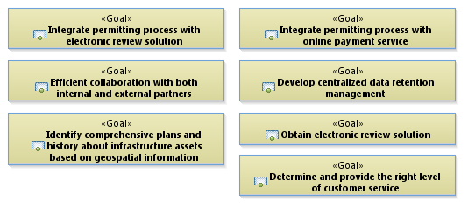
Residential Review Use Case Model

Slide 6
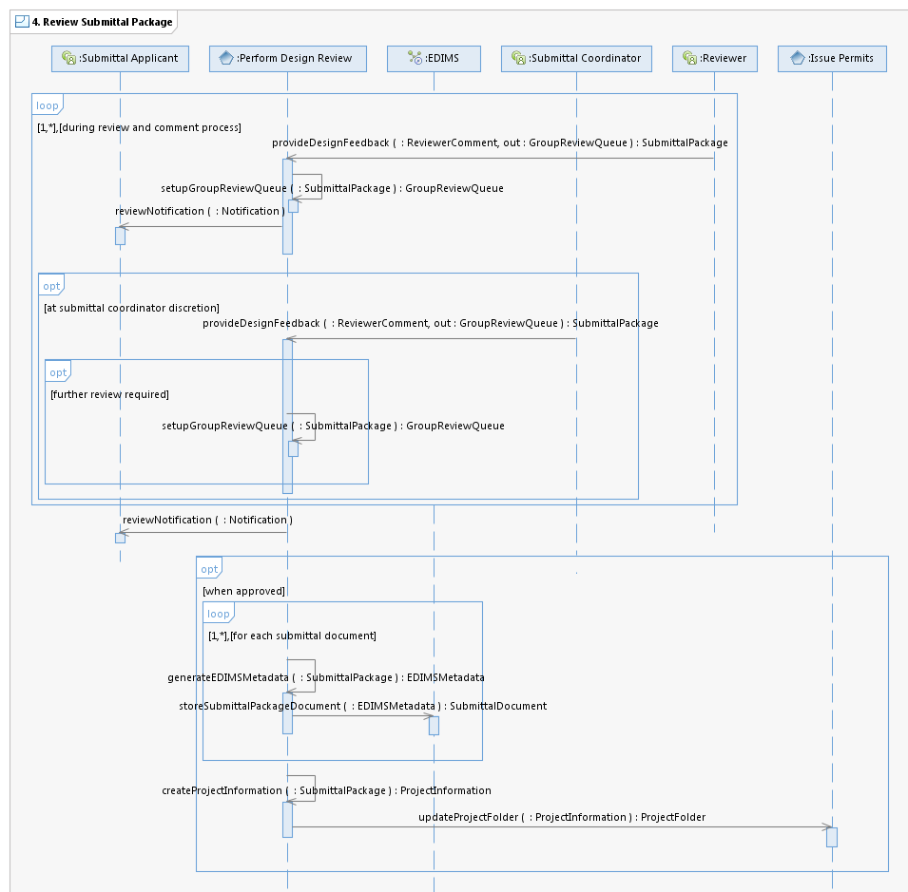
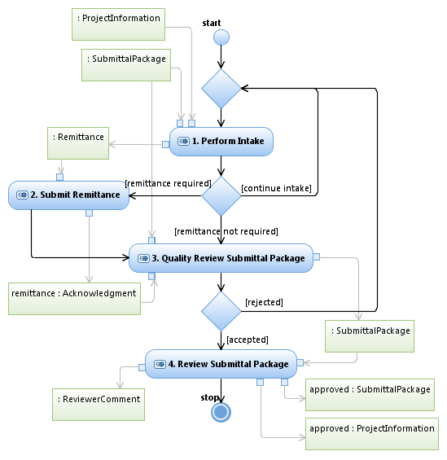
Perform Regulatory Review
provideDesignFeedback
Routinely, the Reviewer in a particular review group (by order of responsibility area setup in the Group Review Queue) checks the system Group Review Queue (listed in date/time order) for assigned reviews and submits Submittal Package Reviewer Comments. The Group Review Queue is per review group (depending on the type of review) and when under review (selected by a Reviewer), the system automatically takes the Submittal Package off the relevant Group Review Queue to prevent multiple reviews by the same area of responsibility. For some reviews, depending on certain attributes identified on the application form, the system provides a priority order of review groups because some review groups may be required to review the Submittal Package and approve or comment before other groups are provided opportunity to review. The business rules for review group order must be modifiable by selected responsible city staff. The system provides automated tools for the Reviewer to markup diagrams including comments, links to references and city codes, among other traditional markup indications to effectively communicate to the Submittal Applicant the required changes to Submittal Package items. The system must provide the ability to identify changes (deltas) for resubmitted design plans when submitted using standardized formats such as PDF and engineering CAD files. Multiple document submissions must be able to be viewed in continuous, unbroken fashion providing a seamlessly adjoined view of the design plans. The system must provide a common, frequently used comment library to include images, text, technical specifications, etc. configurable by the Reviewer. All markups indicate the particular Reviewer layer for identification by the Submittal Coordinator but not identified when submitted to the Submittal Applicant. The Submittal Coordinator may review Group Review Queue items and provide feedback to the Reviewer. If no comments, the Reviewer approves the submittal by providing a group level approval stamp indication on relevant Submittal Package items and the Submittal Coordinator approves the Reviewer Comments or the entire Submittal Package when no comments require updates by the Submittal Applicant.
updateProjectFolder
The system updates the Project Folder to include any relevant updates to the Project Information as well as the reference links to documents stored in the electronic document information management system (EDIMS).

Slide 7
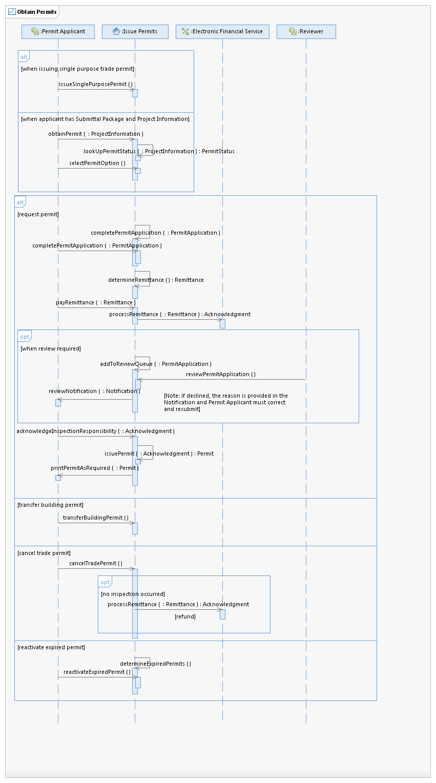
Obtain Permits

Slide 8
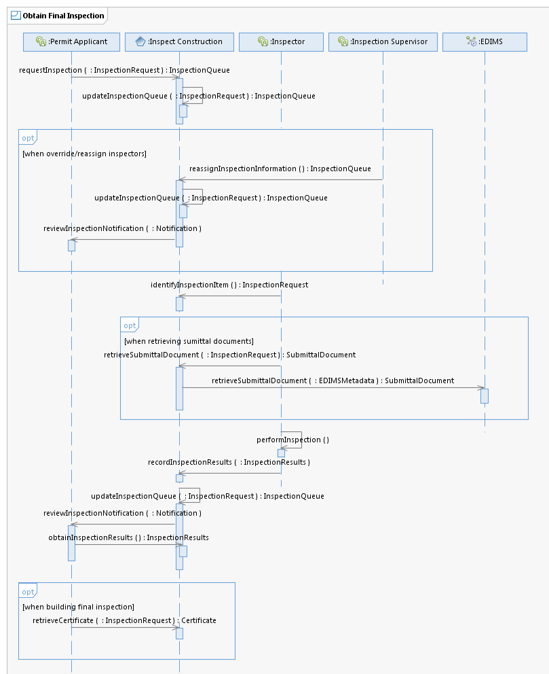
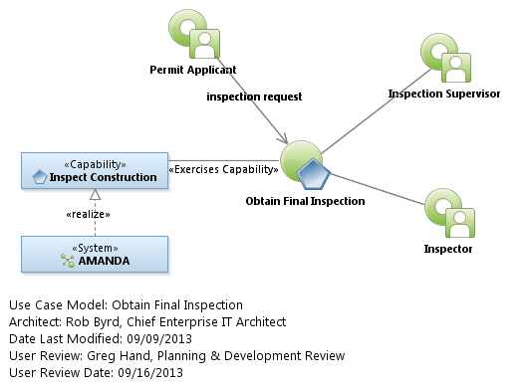
Obtain Final Inspection
requestInspection
The system provides the Permit Applicant the ability to review and/or update Project Information. In addition, the system provides a list of permits issued and the ability to select the desired issued permit for inspection. Alternately, the system provides a method to request inspection for single purpose permits for selected trade contractors performing routine day-to-day activities requiring permits. For selected permits requiring additional documentation, the system provides a method for the Permit Applicant to browse and upload additional documentation requirements associated with the issued permit - this may be a result of a previous inspection identified by the Inspector. Once an inspection request is indicated, the system assigns an Inspector and provides appropriate contact information for inspection timing and coordination (Inspection Queue). Inspections typically occur 24 - 48 hours from the request. The Permit Applicant can also see administrative hold on a permit – i.e., revision required, inspection resulted in work out of scope of the permit. etc. Finally, the system provides for special approved program inspections that provide a means for the Permit Applicant to schedule an inspection for a specific date and time.
retrieveSubmittalDocument
When the Inspector selects provided link for relevant Submittal Package Documents to review approved design submission, the system automatically retrieves the selected Submittal Document from the system.
retrieveSubmittalDocument
Using the meta-data generated link provided by system, the system retrieves the associated Submittal Document. [Enterprise Service Bus (ESB) opportunity: A single ESB interface can act as a broker to automatically retrieve documents associated with the entered meta-data.]

Slide 9
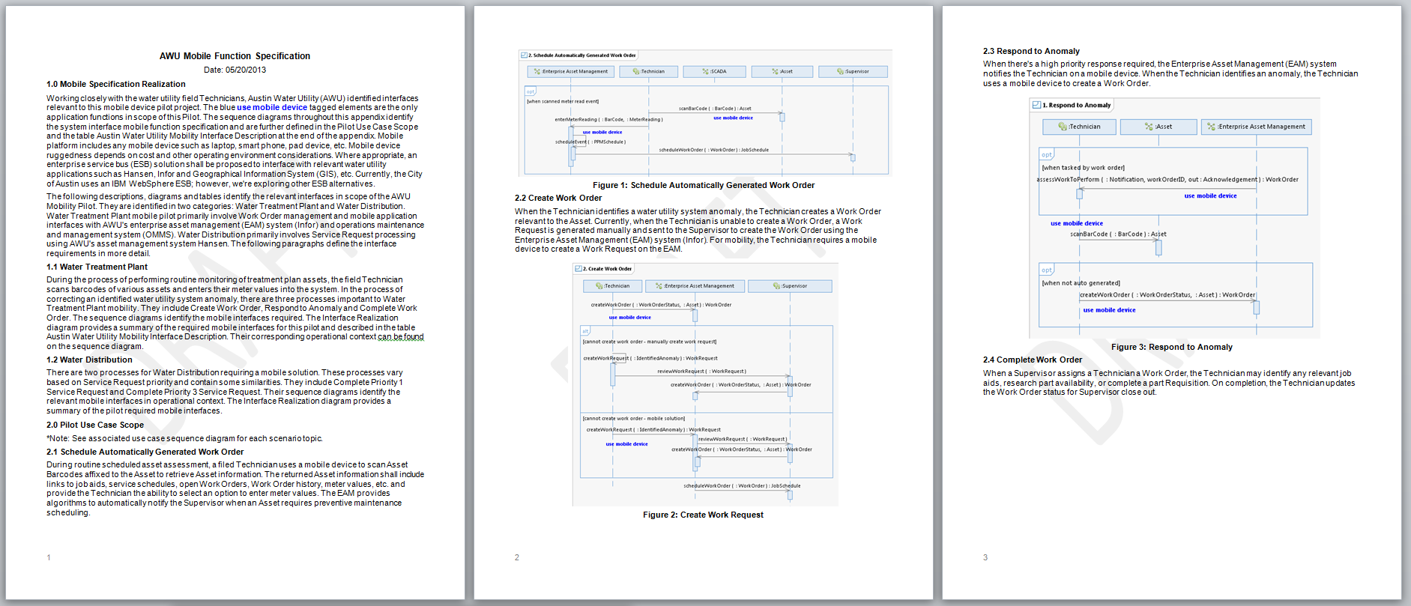
Specification for Inclusion in Statement of Work
“This is the best written SOW that we have ever seen.” Esri
Identifies clearly understood scope - provides means to scope level of effort and ensured pilot includes relevant technologies
Reduces contractor risk resulting in reduced cost
Yields additional cost savings because contractor did not perform the business analysis
Needs identified by user community – increased buy in

Slide 10
Next Steps
Vet architecture through other departments as needed
Find relevant business patterns for shared opportunity
Use modeled specifications as functional needs for RFP elicitation
Segment from supplemental specifications (general, non-functional requirements)
Use specifications to evaluate vendor selection, performance and test

