Slide 1

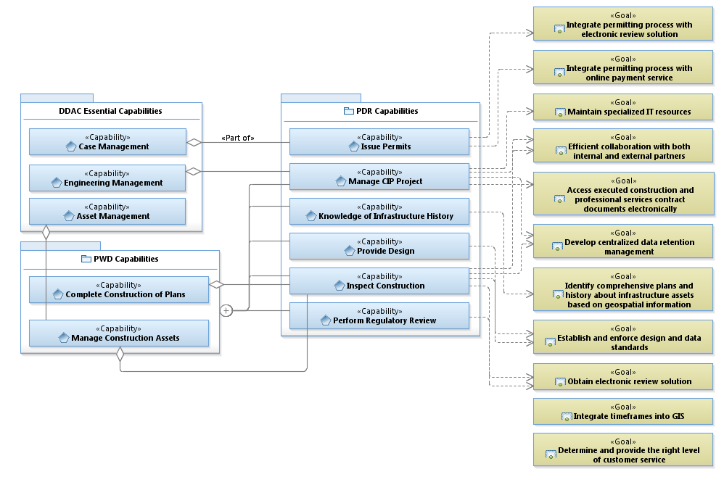
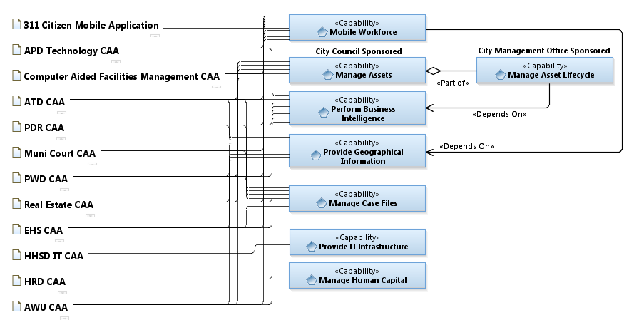
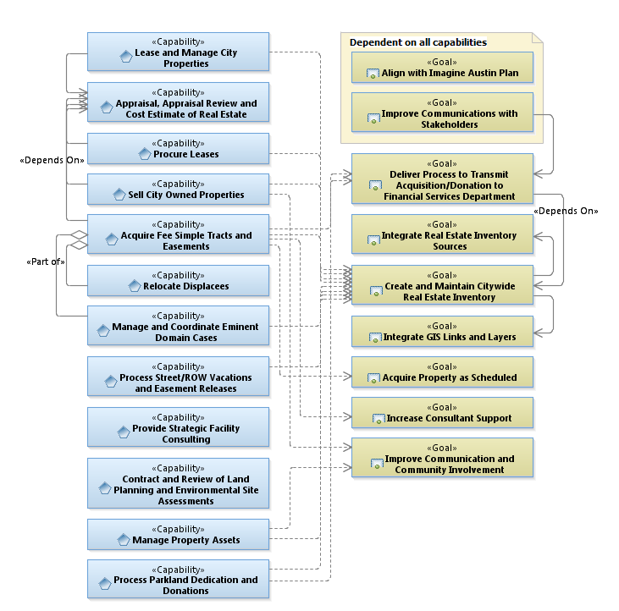
Business Derived Essential Capabilities
Business needs analysis
Leadership derived
Best accomplished through enterprise solution
Business needs analysis
Draft
Capability Area Architectures (CAAs)

Slide 2
Architecture Derived Essential Capabilities
AWU mobility pilot – asset and work order management
Explore user serviceable tools
Mobile Device Management
Exploit architecture to identify interface needs
Increase technical staff to keep pace with demand
Build user vetted architectures before implementing solutions
Integrate with Manage Case Files and Provide Geographical Information
Understand business reporting needs and establish data warehouse(s)
Exploit extract, transform, and load (ETL) technologies
Reduce impediments to accessing information
Share information with citizens
Exploit enterprise service bus (ESB) to better serve a Mobile Workforce
Increase technical staff to keep pace with demand
Explore alternative solutions
Build user vetted architectures before implementing solutions
Integrate with Manage Assets and Provide Geographical Information
Share Active Directory
Federate authentication
Move to Cloud services
Co-locate data center
Increase use of ITIL
Move toward self service
Human Resources System Assessment
Draft

Slide 3

COA IT Strategy
Vision | Recognized business partner One City IT | Imagine Austin E A20 - Improve government efficiency through technology (software and hardware) investments and by developing and retaining information technology staff
Principles | Demonstrate value as business partner Employ Enterprise Architecture in governance Integrate strategic plans Maximize use of common information system | Identify enterprise shared service opportunities Share common IT staff Identify reusable technology assets Provide business continuity
Essential Capability | IT Initiatives | Future State
Mobile Workforce Manage Assets Manage Case Files Perform Business Intelligence Provide Geographic Information Provide IT Infrastructure Manage Human Capital | Build an end-to-end service model using Enterprise Architecture processes to determine synergies and repurposing Align IT titles with required competencies Move toward a shared, citywide Active Directory and federated authentication Exercise cloud opportunities where they make sense Converge on a state of the art co-location data center Increase use of ITIL – employ CMDB Increase technical staff for key high-value enterprise tools such as Maximo and Amanda Develop mobile solutions Mature service-oriented architecture using enterprise service bus (ESB) Exploit extract, translate and load (ETL) tooling for data warehousing and business intelligence – remove impediments to information | Empowered leadership and citizens Service-oriented provider Capable and competent staff Established systems of record Cross-department integration Policies, standards and practices Conduct business online Work anywhere online Open access to information
Draft

