Slide 1
Rob Byrd Chief Enterprise Architect
Enterprise Application Services (EAS)
– A Citywide Strategy
Aligning Information Technology Services to the Business Needs of the City…

Slide 2
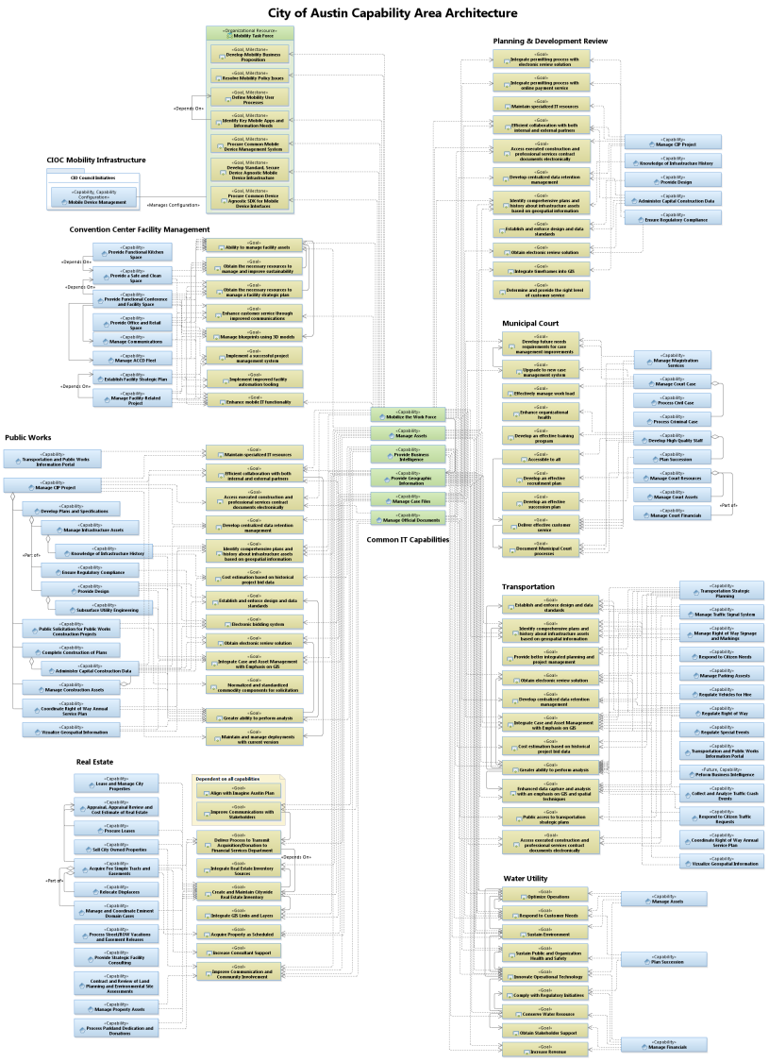
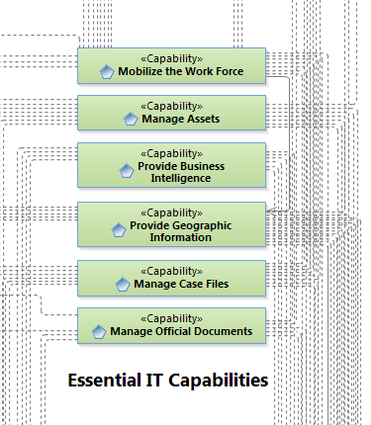
Data-Driven Evolution of Essential IT Capabilities
Data shows:
Essential IT Capability contributes to business goal
There are six Essential Capabilities – no others were identified by business

Slide 3
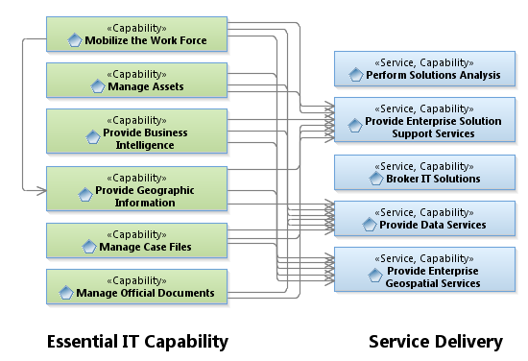
Data-Driven Evolution of Essential IT Capabilities
Where Work Performed
Capability Delivery:
Dependency relationship between Essential IT Capability and Service Delivery
Service Delivery organized by skill efficiency; therefore, Service Delivery does not align one-to-one to Essential IT Capability
Establish goals to increase Service Delivery with emphasis on Essential IT Capability

Slide 4
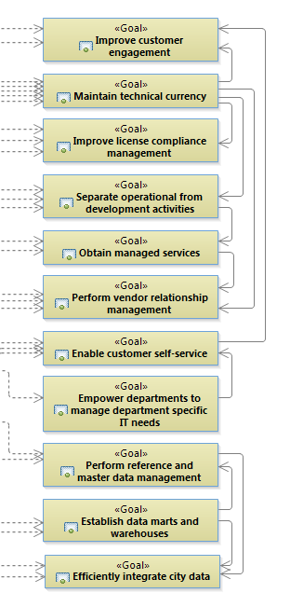
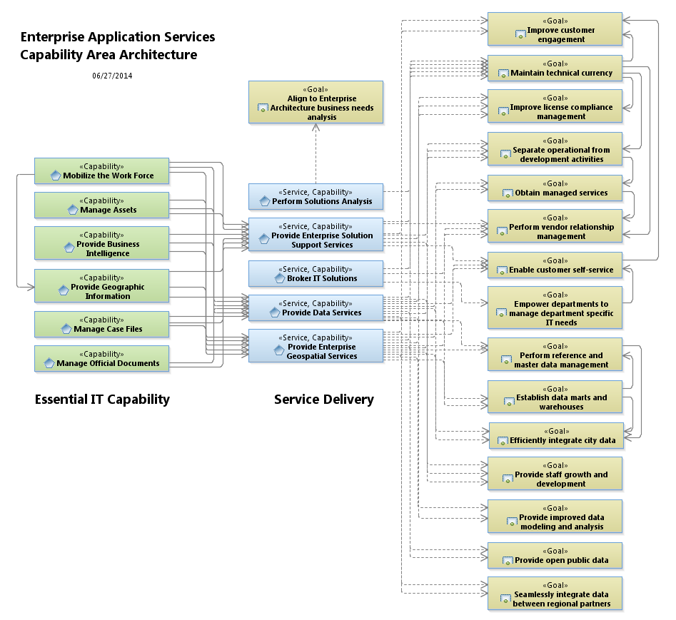
EAS Goals Enhance Essential IT Capabilities Service Delivery
In essence, IT is saying, “Here are our IT goals to accomplish the business goals…”
Establish measures of performance (objectives) to assess goal progress
Use goals and objectives to create roadmap

Slide 5
Next Steps
Establish objectives to measure goals
Create EAS Roadmap
Examine Service Delivery organizational structure using outcome focused analysis

