Slide 1
Introduction to Enterprise Architecture
Rob Byrd rob.byrd@austintexas.gov

Slide 2
Introduction to EA Overview
What is EA?
Why is EA Needed and What’s its Value?
What are the EA Challenges?
What is the Role of the Enterprise Architect?
What are the Organizational Challenges?
How do we Deal with Change?

Slide 3
Executive Summary
Twenty years ago, a new field was born that came to be known as Enterprise Architecture (EA). The field initially began to address two problems:
System complexity - Organizations were spending more and more money building IT systems
Poor business alignment - Organizations were finding it more and more difficult to keep increasingly expensive IT systems aligned with business need
The bottom line: More cost, less value
Problems have reached a crisis point
Cost and complexity of IT systems have exponentially increased, while the chances of deriving real value from those systems have decreased

Slide 4
What EA is Not…
System Architecture
Software Code or Database
Policy
IT Infrastructure
A Dictatorship…

Slide 5
What is Enterprise Architecture?
The process of translating business vision and strategy into effective enterprise change by creating, communicating and improving the key requirements, principles and models that describe the enterprise's future state and enable its evolution over time
MIT defines EA as the organizing ”logic” for business processes and IT infrastructure reflecting the integration and standardization requirements of the company's operating model. The operating model is the desired state of business process integration and business process standardization for delivering goods and services to customers
The United States Government classifies enterprise architecture as an Information Technology function, and defines the term not as the process of examining the enterprise, but rather the documented results of that examination. Specifically, US Code Title 44, Chapter 36, defines it as a 'strategic information base' that defines the mission of an agency and “describes” the technology and information needed to perform that mission, along with descriptions of how the architecture of the organization should be changed in order to respond to changes in the mission
- Reference Wikipedia
A process to deliver critical mass of understanding to the enterprise!

Slide 6
EA Provides Critical Mass of Understanding!
An instrument to provide project momentum
Facilitates identifying measureable goals and milestones useful for project planning
Develops business requirements in an understandable way
Differing opinions on how to collect good requirements – many folks reaching for the steering wheel!
Deals with complexity – develops strategy to task
Organizes capabilities aligned with a business model to achieve business results

Slide 7
Important EA Terms
Capability: People, processes and systems delivering value for a specific purpose. The quality of being capable; to have the capacity or ability to do something, achieve specific effects or declared goals and objectives
Goal: A desired result a person or a system envisions, plans and commits to achieve. A desired end-point in some sort of assumed development. Many people endeavor to reach goals within a finite time by setting deadlines (a milestone). Goals amplify the organization’s vision.
Objective: Quantifies a Goal – a performance measure.

Slide 8
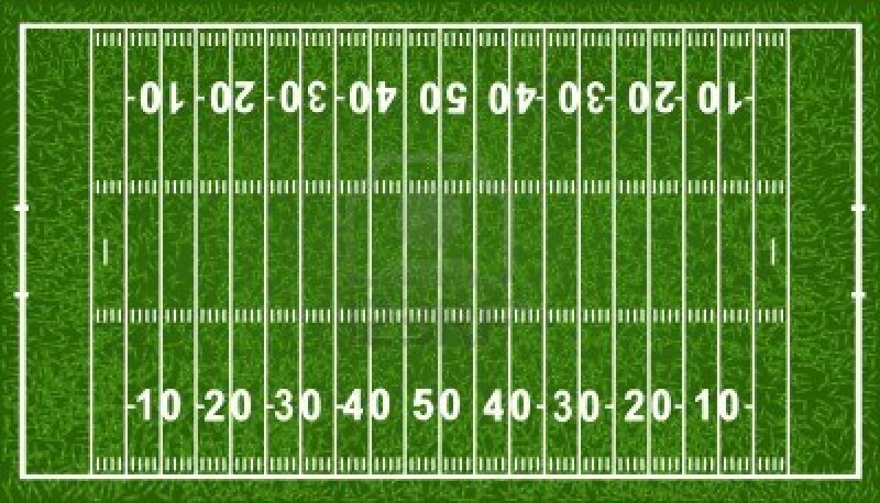
Trick to Remember Difference Between Goal and Objective
Think of a football field…
Goal
Touchdown!
Objective
10 yards every three plays

Slide 9

Connecting Business Needs to IT Solutions
The Architect’s Viewpoint
Employ innovative operational technology to support timely improvements.

Slide 10
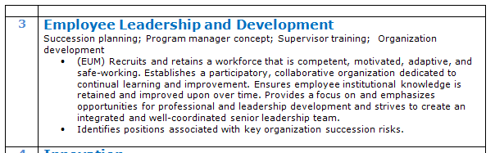

Connecting Business Needs to IT Solutions continued…
The Architect’s Viewpoint
Recruit and maintain a competent, motivated, adaptive, and safe workforce. Establish participatory, collaborative organization dedicated to learning and process improvement. Ensure institutionalization of retained knowledge. Emphasis professional and leadership development and integrate a well-coordinated leadership team.

Slide 11
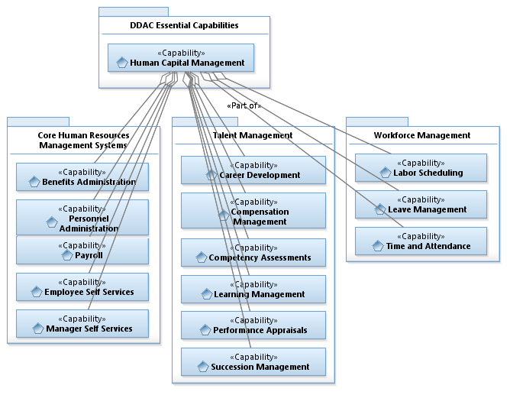
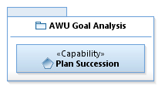
Connecting Business Needs to IT Solutions continued…
Reusable Opportunity!
<<Part of>>

Slide 12
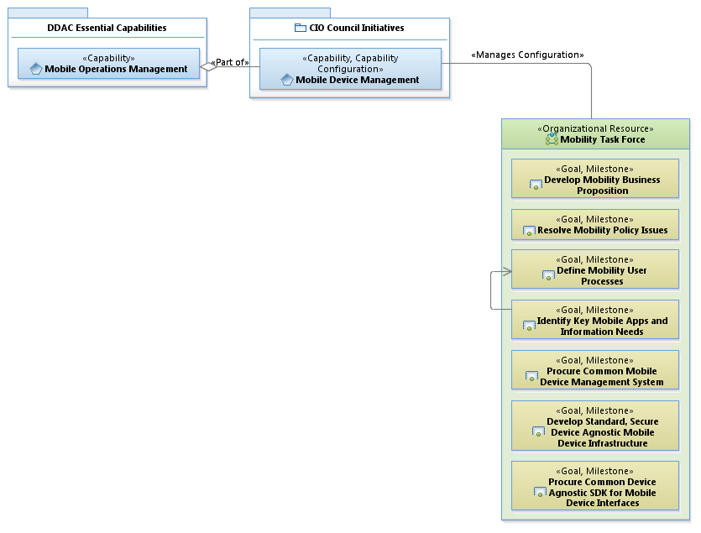
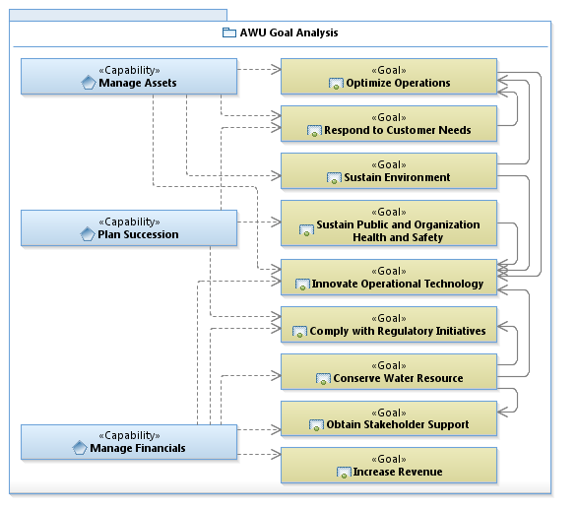
Connecting Business Needs to IT Solutions continued…

Slide 13
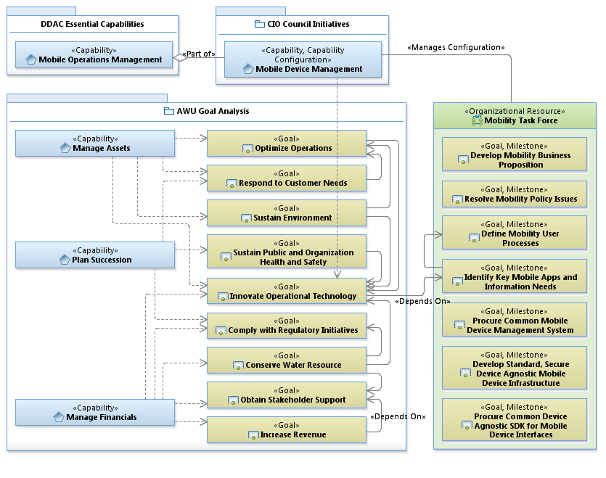
Connecting Business Needs to IT Driven Solutions continued…

Slide 14


The Power of Collaboration
Meet to determine departmental capabilities and goals
Identify common departmental goals and reusable opportunities
Identify dependency concentration
Align IT goals to business need
Architects & Business Leaders
Using common goals, begin to piece together the puzzle
Visualization develops critical mass of understanding – elicits feedback and establishes agreement – can act as contract
Becomes guiding element for governance
goal
IT solution
goal
goal
goal

Slide 15
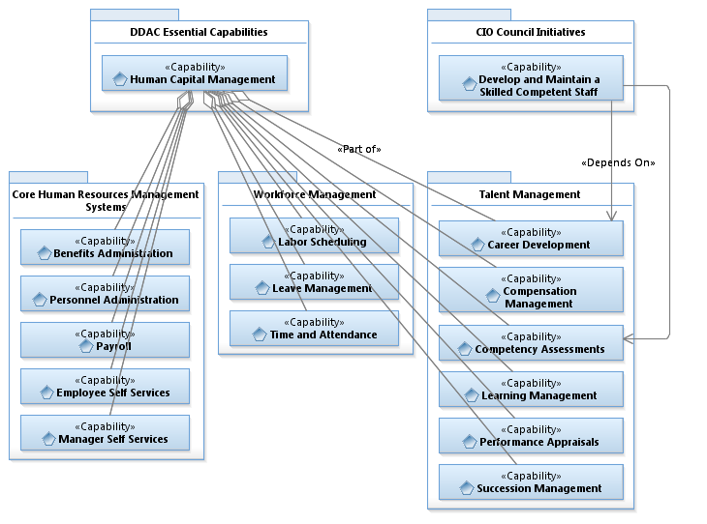
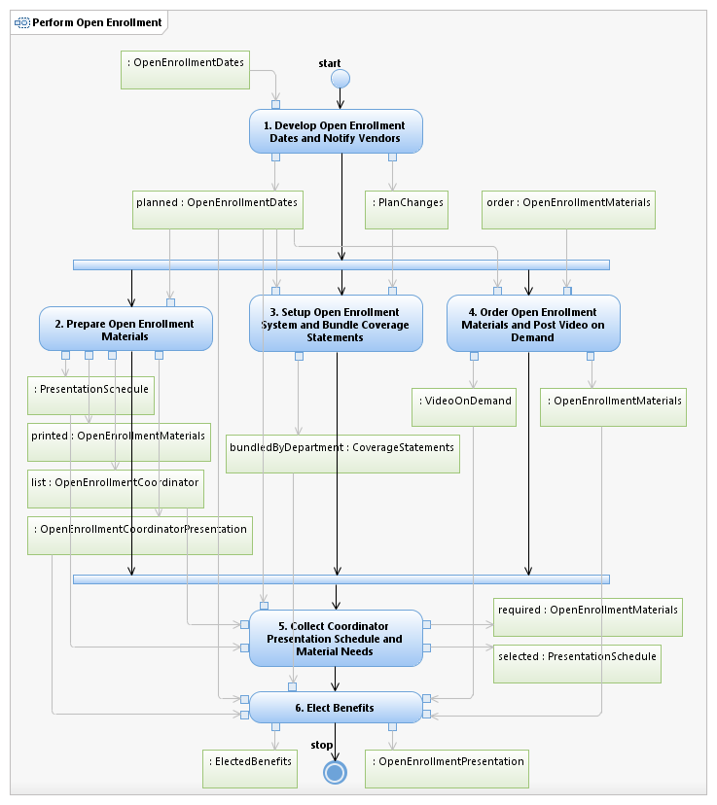
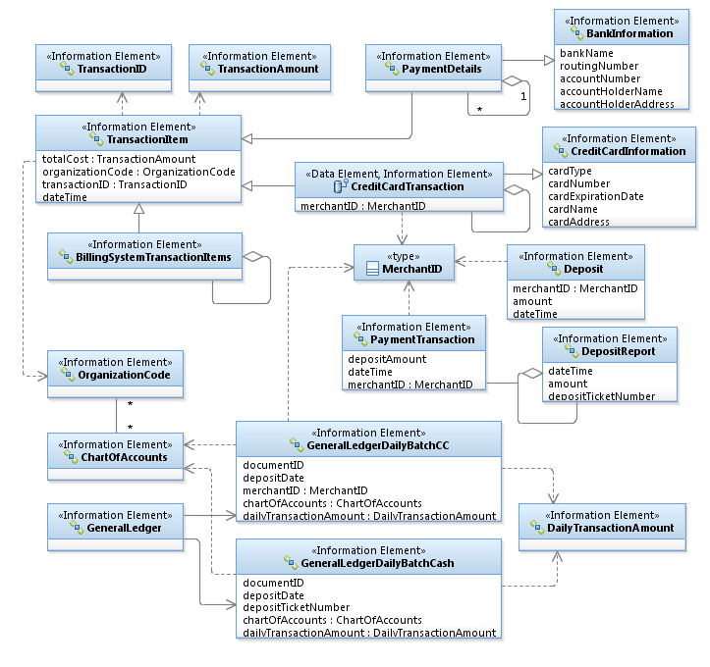
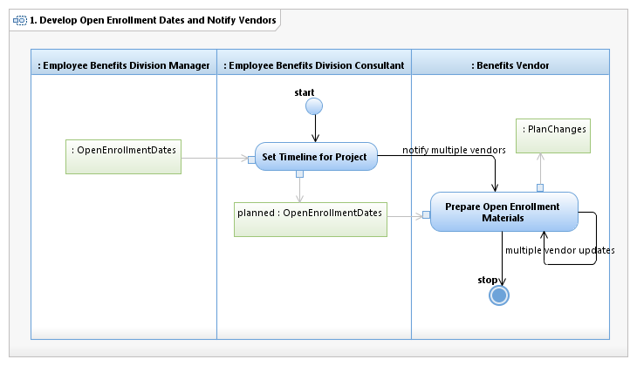
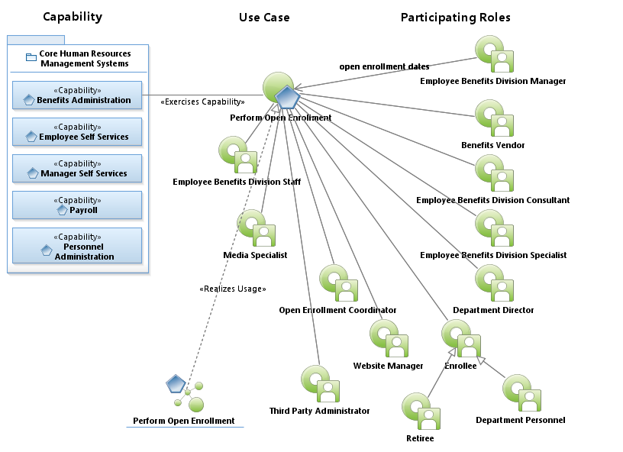
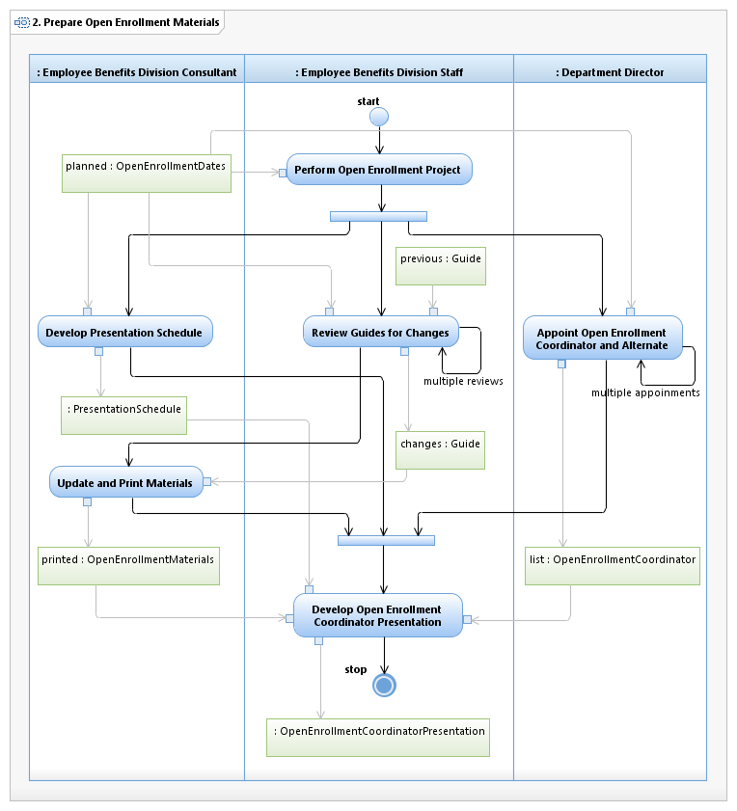
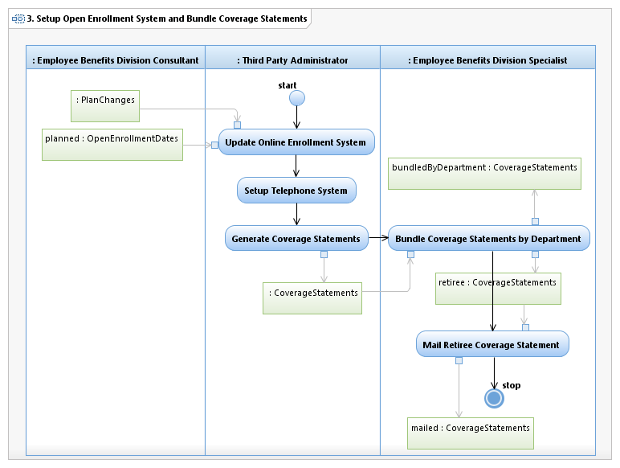
The Value of Enterprise Architecture
Communication and understanding
Common language
Knowledge management and transfer
Standardized visual and logical IT blueprints
Establish defendable business needs
Critical Mass of Understanding…
Enterprise integration
Logical and standardized relationships
Horizontal and vertical viewpoint
Better understanding and knowledge of reuse
Recognizable business patterns
Manage change
Ability to analyze impacts based on changes
Recognizable business process reengineering effects

Slide 16
Significant Challenges…
Effectively defining, modeling, and communicating enterprise complexity
Ensure required business needs drive system development – linking capabilities directly to enterprise components
Identify and manage enterprise and program boundaries – clearly define work breakdown
Recognize reusable operations and components to reduced ownership cost
Cope with change to threats, missions, operations, organizational responsibilities, technology, etc.

Slide 17
Practitioners are called Enterprise Architects
A person responsible for performing the complex analysis of business structure and processes and is often called upon to draw conclusions from the information collected. By producing this understanding, architects address the goals of enterprise architecture: effectiveness, efficiency, agility, and durability
- Reference Wikipedia

Slide 18
Enterprise Architecture in Perspective
Ask yourself this question the next time you take an elevator to the 40th floor of some very large building. If you had to take the stairs to get to your destination because an elevator didn’t exist, who would you blame?
Architecture is essential to any complex structure - be it a building or an enterprise

Slide 19
Architects Provide the Counterweight
Inspired to achieve balance between interest of business and IT stakeholders
Advises the IT environment on how to meet the key business demand
Business should not view architects as opponents, the inhibitors of new development. The business should recognize the architect as an enabler
Developers should view architects in similar light. The architect is a guide, coach, and sparing partner

Slide 20
Architects Provide the Counterweight (continued)
The architect advises and monitors the development team’s efficient, intelligent use of resources
Provides the ability to see and understand the interconnection and interdependencies between disparate systems
Times have changed… Today’s business users expect their systems to communicate with each other and share information
The architect knows how the pieces fit together and can turn that information into a cohesive strategy that spans the business stakeholders and IT infrastructure

Slide 21
Overlapping Responsibilities Create Challenges
System Development
System Design & Interfaces
Program Management
Business Systems Analysis & Requirements Management
Enterprise Architecture
A strong partnership is the key to success…

Slide 22
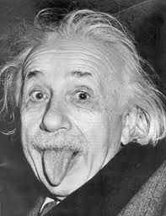
It’s Time for Change…
One definition of insanity is doing the same thing over and over again and expecting a different result
- Albert Einstein

Slide 23
Dealing with Change is Tough!
Change is coming – change is always coming…
Grant me the serenity to accept the things I cannot change, courage to change the things I can, and wisdom to know the difference
How to Cope with Change
"Control coping" is positive and proactive. You refuse to feel like a victim of change, instead you take charge and do whatever you can to be part of the solution, including managing your feelings
"Escape coping" is based on avoidance. You experience thoughts and emotions, or take specific actions, that help you avoid the difficulties of change. For instance, you might deliberately miss training classes, or show up too late to attend a meeting about the upcoming change
EA is a Major Paradigm Shift!

Slide 24


Be an Organizational Hero!
Organizational heroes use Control Coping

Slide 25
Summary
EA delivers the key requirements, principles and models that define the enterprise’s future state and evolution over time – assists in decision-making
EA provides critical mass of understanding using a industry common language (Unified Modeling Language), provides integration and understanding of reusable opportunities, and provides the ability to identify common goals
EA ensures business requirements drive system solutions
Architects are inspired to achieve balance between business and IT – they understand dependencies and are sparing partners with developers
Examine challenges of overlapping responsibilities
Be an organizational hero!

