Slide 1
Overview of Enterprise Architecture Artifacts
Rob Byrd
rob.byrd@austintexas.gov

Slide 2
Enterprise Architecture Artifacts
Strategic Viewpoints
Use Case
Use Case Specification
Use Case Diagram
Activity Model
Sequence Diagram
Logical Data Model
System Diagram
System Context and Sequence Diagram
Data Dictionary

Slide 3
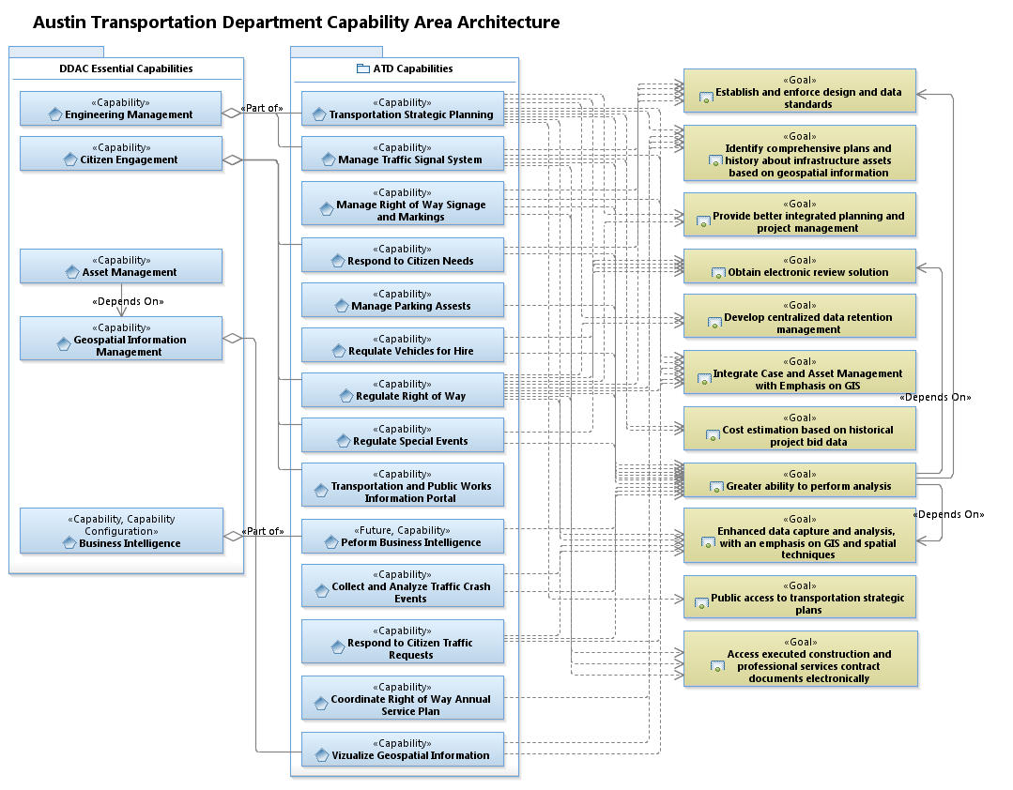
Strategic Viewpoint

Slide 4
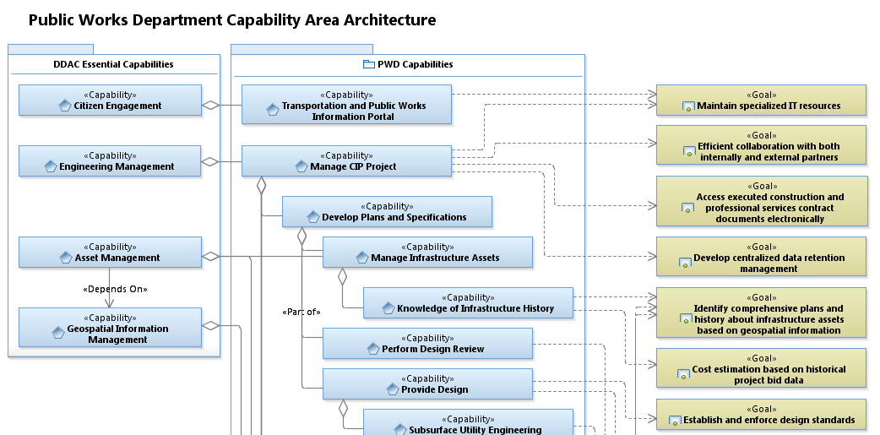
Associative Properties
Standardized Associations
<<dependency>>
<<part of>>

Slide 5
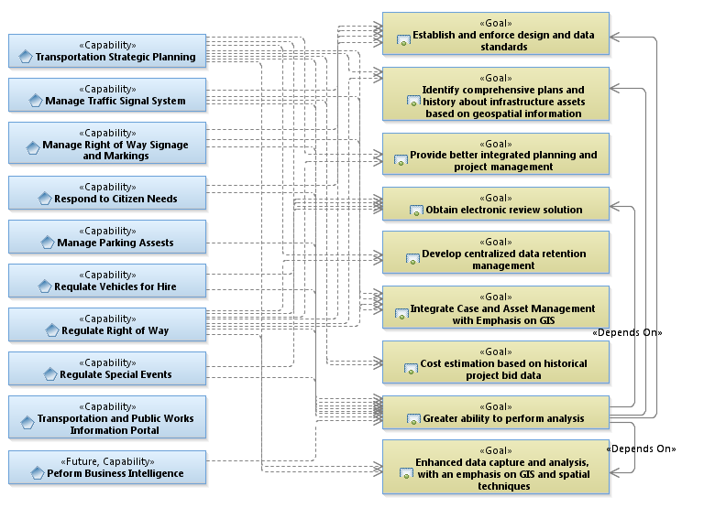
Concentration and Dependency Analysis
Has the greatest need
Provides the greatest solution
Significantly contributes to goal

Slide 6
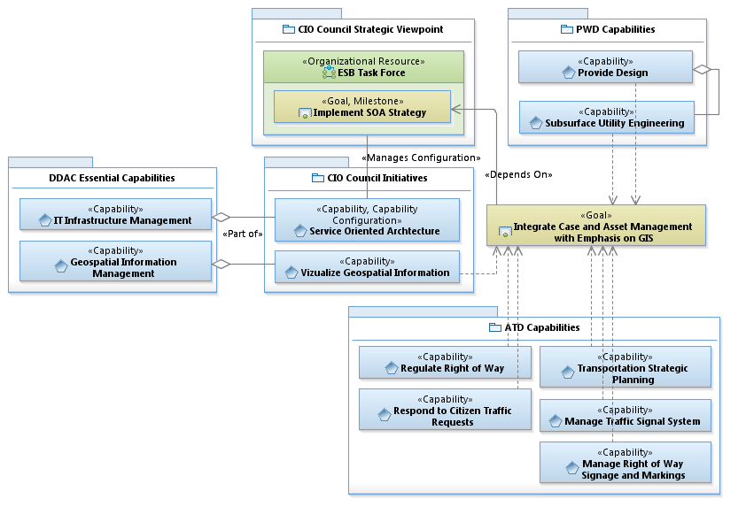
Requirements Analysis Example 1

Slide 7
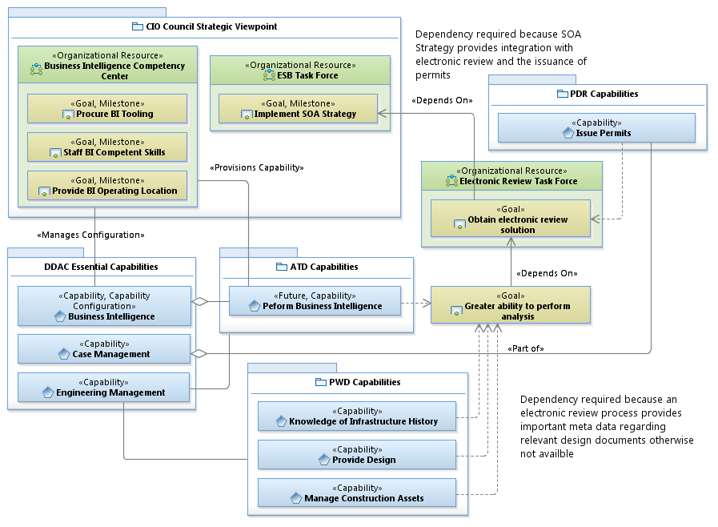
Requirements Analysis Example 2

Slide 8
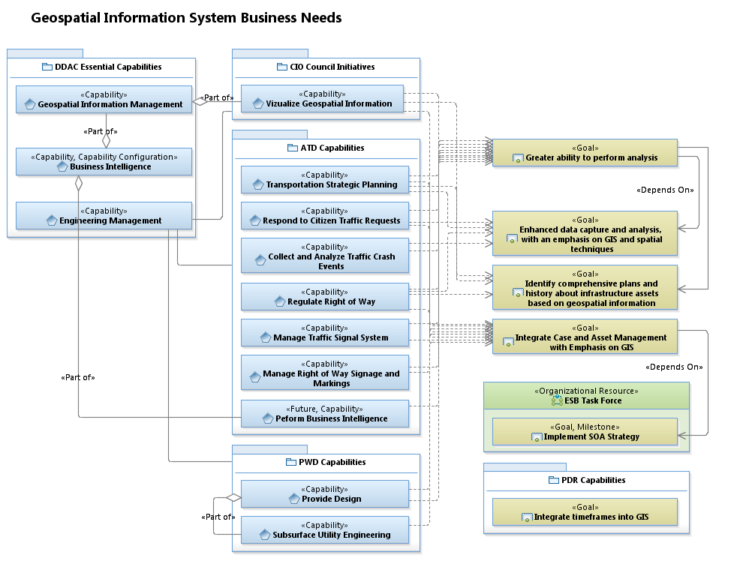
Requirements Analysis Example 3

Slide 9
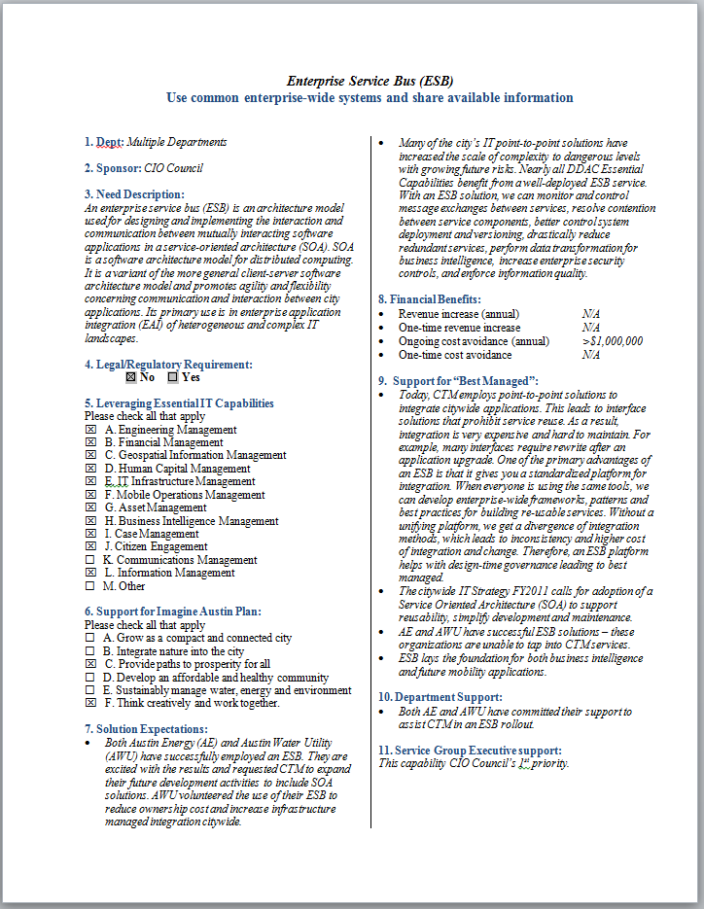
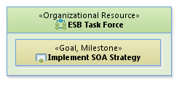
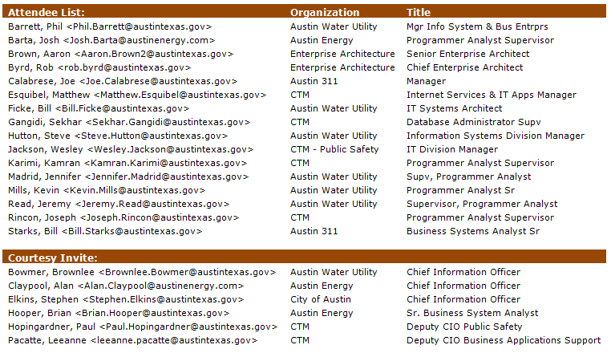
EA – Part of Governance
Business Need Statement
establishes
consists of

Slide 10
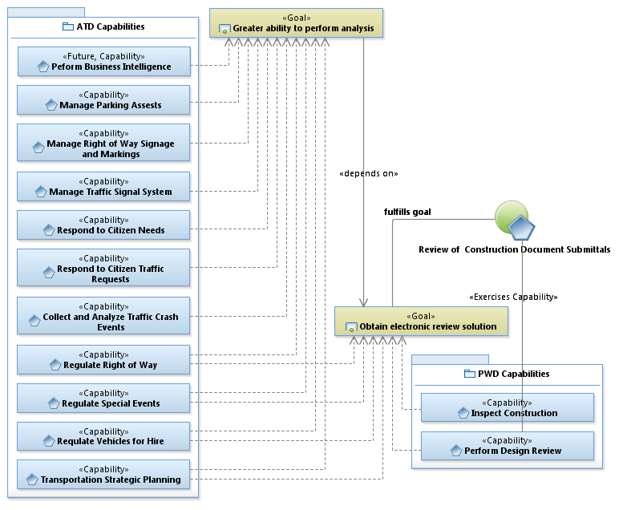
Use Case Identification
Dependency due to the need for meta-data necessary for analysis
Use Case

Slide 11
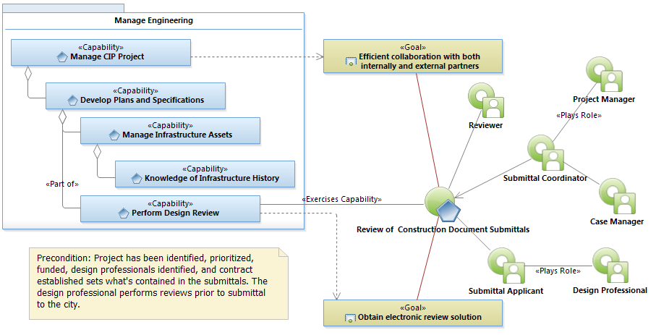
Use Case Diagram

Slide 12
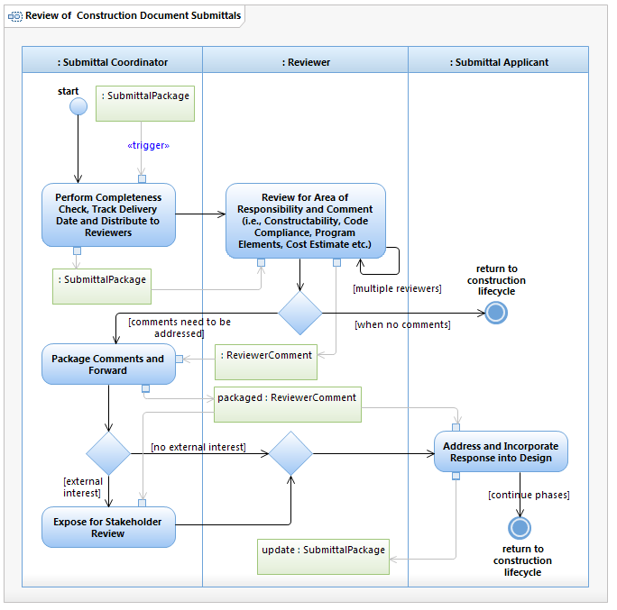
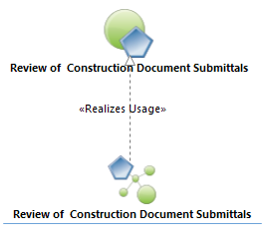
Use Case Realization

Slide 13
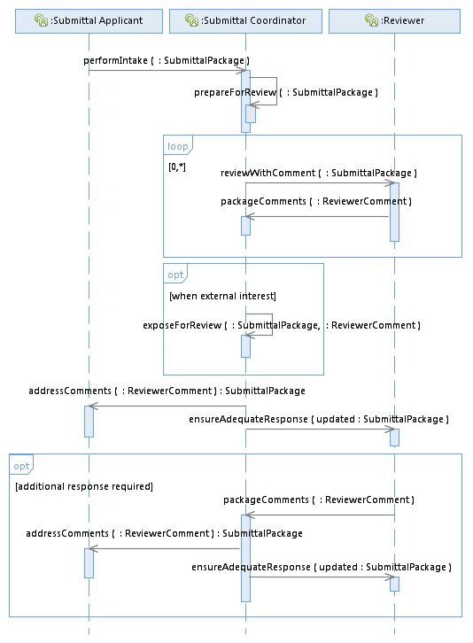
Interface Development
Arrow points to responsible entity
(not necessarily information flow)

Slide 14
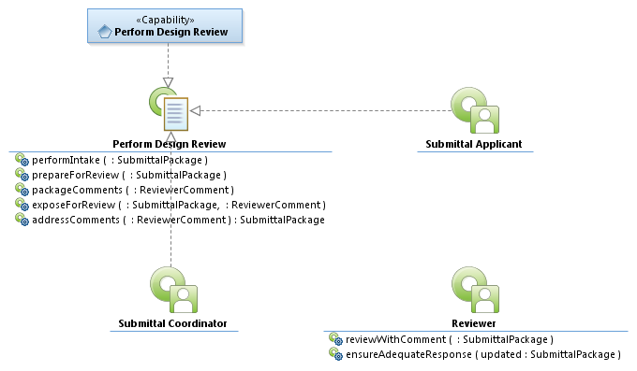
Interface Realization and Specification Development (example)
Makes service request

Slide 15
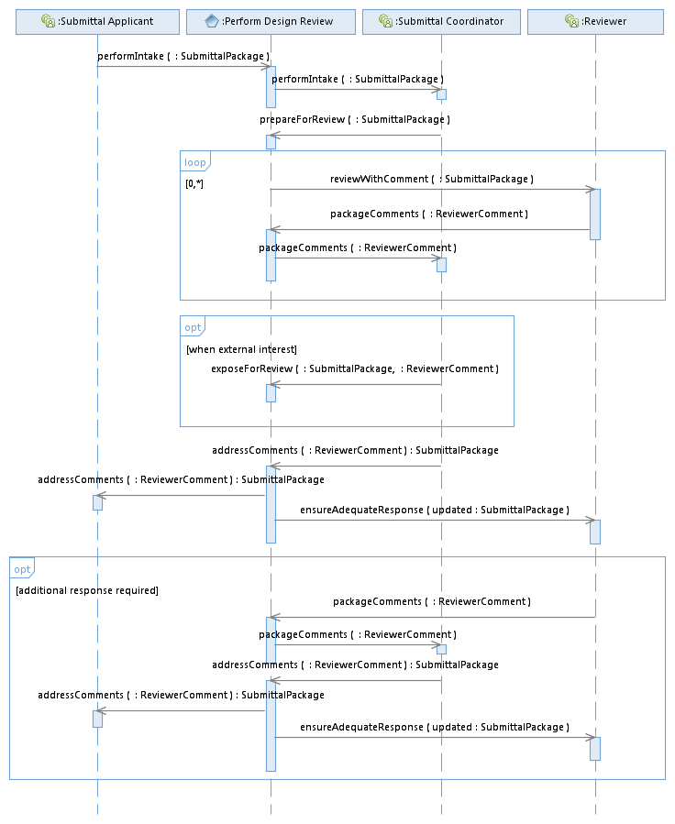
System Functional Requirements (example)
Identify Capability Interfaces

Slide 16
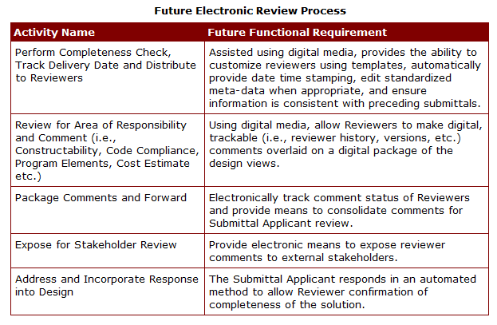
Functional Requirements

Slide 17
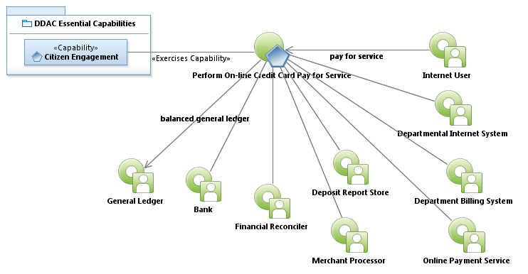
Use Case Model for Online Transactions

Slide 18

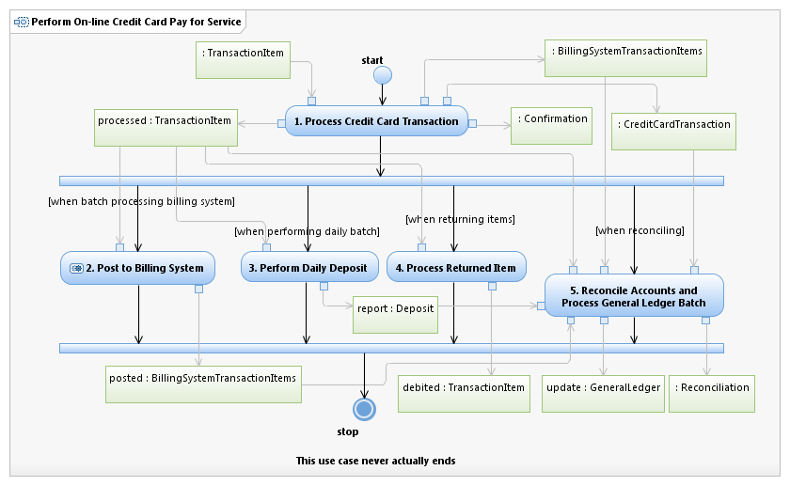
Interaction Overview Activity Model

Slide 19
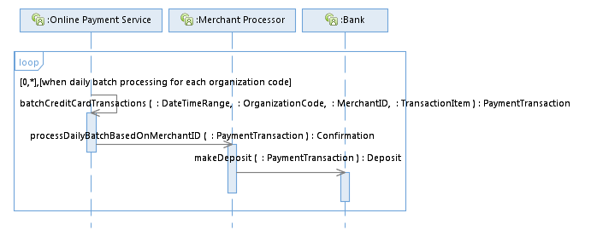
Operational Sequence Diagram
Interaction Overview

Slide 20
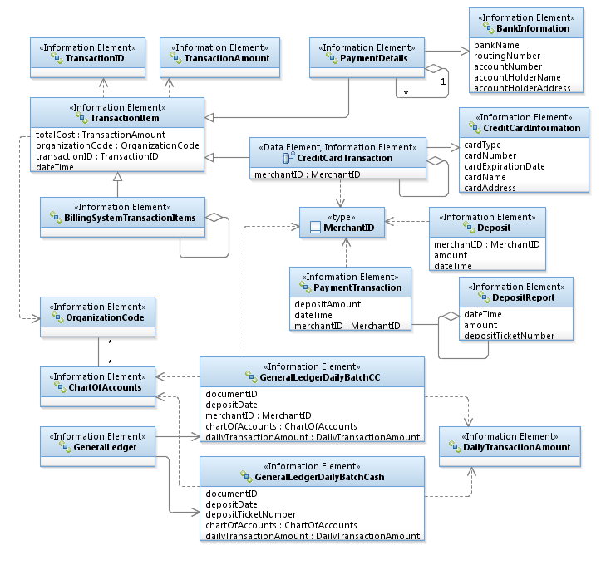
Logical Data Model
The UML expert can read this diagram like a book – associations define the relationships between the information elements
The enterprise architect makes the associations based on the use case model
Any qualified IT developer knows how to read these diagrams – hence the UML bridges the gap between the user and the developer because the user identified them in the use case

Slide 21
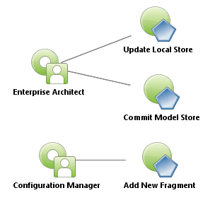
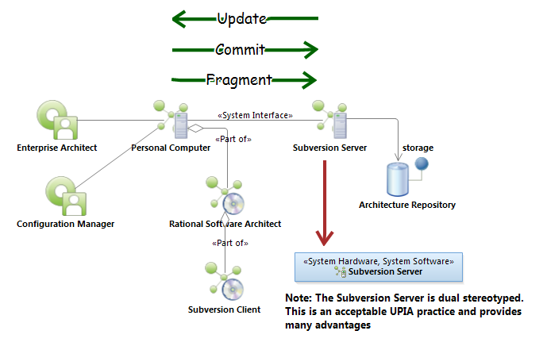
System Context Diagram
Use Case Model
Hardware
component
Software component

Slide 22
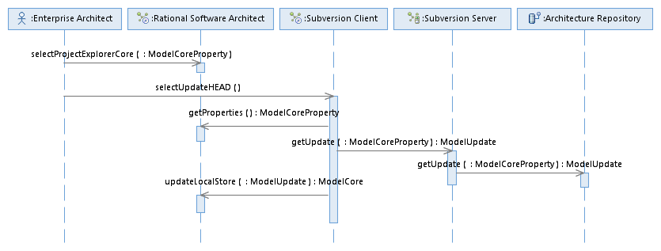
System Sequence Diagram
Object
Update Local Store
Lifeline
Message
Signature
Focus of control

Slide 23
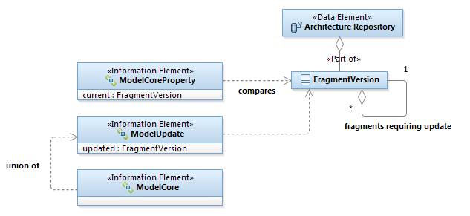
Logical Data Elements

Slide 24
Data Dictionary
Follow link to the Austin Data Dictionary

Slide 25
Summary
Strategic Viewpoints provide a means to understand complex relationships – assists in decision-making – identifies measurable goals and milestones
The Use Case provides the supporting business analysis to derive business needs and drive business solutions
EA provides a comprehensive critical mass of understanding to maintain project momentum
EA delivers understandable artifacts for development

