Slide 1
Introduction to the Unified Model Language (UML)
Rob Byrd
rob.byrd@austintexas.gov

Slide 2
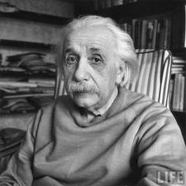
Curriculum Outline
Model Language Background
Terms and Definitions
Use Case Development Process and Tooling
We cannot solve our problems with the same thinking we used when we created them.
- Albert Einstein

Slide 3
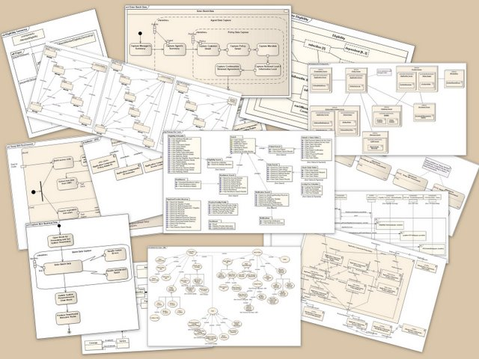
UML Background
A standardized general-purpose modeling language in the field of object-oriented software engineering
Combines best practices from: Grady Booch, Dr. James Rumbaugh, and Dr. Ivar Jacobson – Referred as the Three Amigos

Slide 4
Enterprise Architecture Method is an Abstracted use of UML
Traditional Design UML
The creation of a view that suppresses unnecessary details to focus on a specific set of details of interest
An abstraction defines a boundary relative to the perspective of the viewer
Enterprise UML

Slide 5
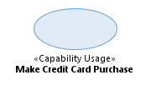
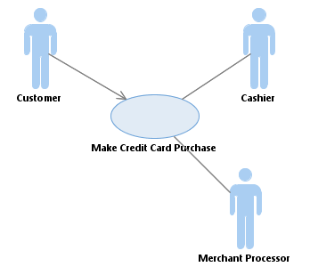
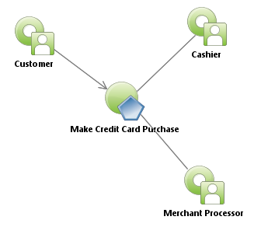

UML Profile-Based Integrated Architecture (UPIA)
Traditional UML Use Case
UML/UPIA Use Case
Standardized Stereotypes for better Business Intelligence reporting
Indicates relationship to organization
No capability or operational viewpoint
Indicates relationship to capability
Reference Wikipedia Use Case Description

Slide 6



UPIA Normalizes Defined Parts
Classes = Types of Things
Traditional UML
UML with UPIA
Stereotyped
class
Visually rendered based on stereotype
UML with UPIA
Standardized relationship stereotype
Attributes and operations turned off

Slide 7
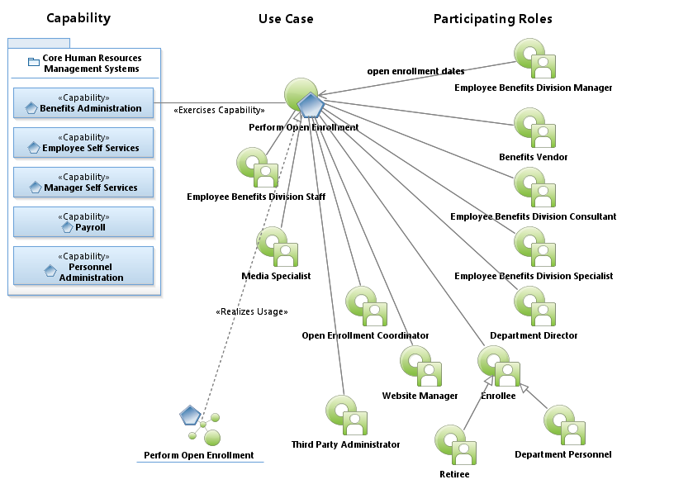
Use Case Used for Concept Development
Trace to capability
(part of strategic viewpoint)
Scope: Prepares and executes a five-week enrollment period that allows employees and retirees to make benefit changes without a qualifying event. This would include adding and dropping dependents to coverage, changing or adding medical, dental, vision, life, disability, and legal coverage.
Defines scope
Identifies reponsible roles
Ensures “results of value” ROV

Slide 8
UML Capitalizes on Human Collaboration Factors – i.e., Teams Working Together
EA should be included early!
Builds collective knowledge – individually, we’re smart – together, we’re genius
Teams should be limited to 5 - 9 people. If larger, this significantly reduces effective team knowledge
The Use Case Model establishes the audience/stakeholder on the boundary of the problem and the scope of discussion
During model development, the end state is clear preventing wondering concepts outside the discussion boundary - leads to quicker results
Provides tool for Critical Mass of Understanding!

Slide 9
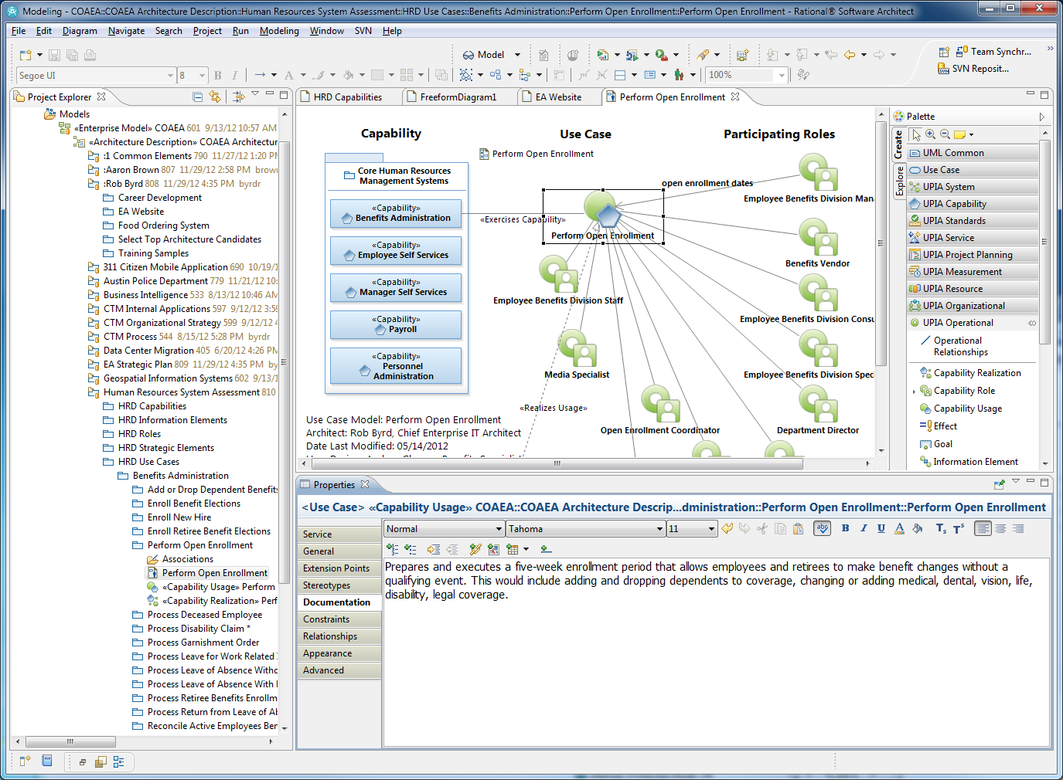
IBM Rational Software Architect Tool
UPIA Drawers
Design Space
Project Explorer
Element Properties

Slide 10
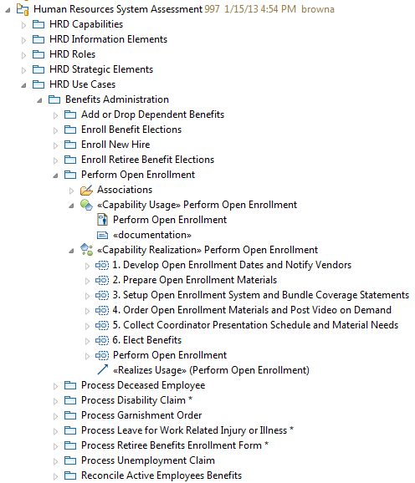

Model Structure
Project Explorer
Solely for storing parts
Design captured by diagrams
Caution: Do not design in structure!
Diagram
<<Realizes Usage>>

Slide 11
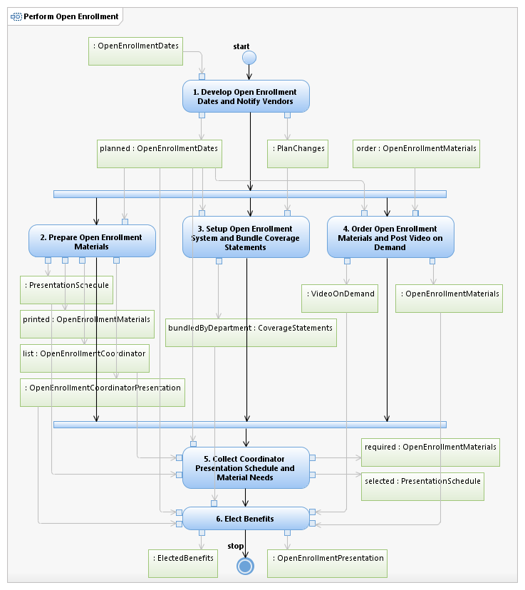
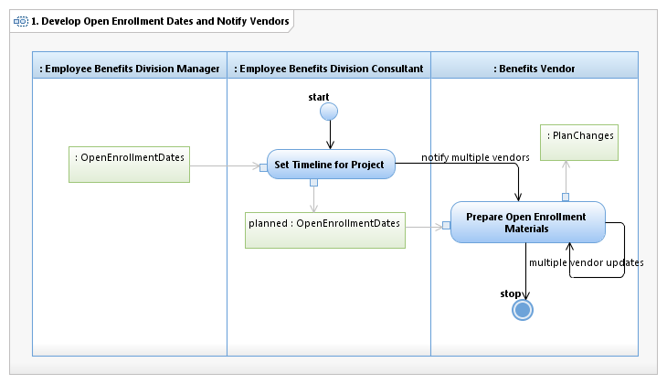
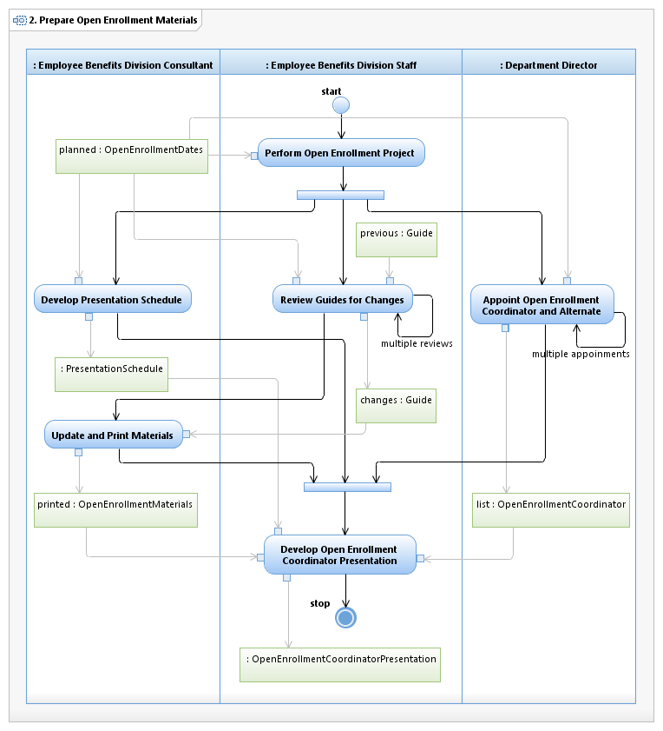
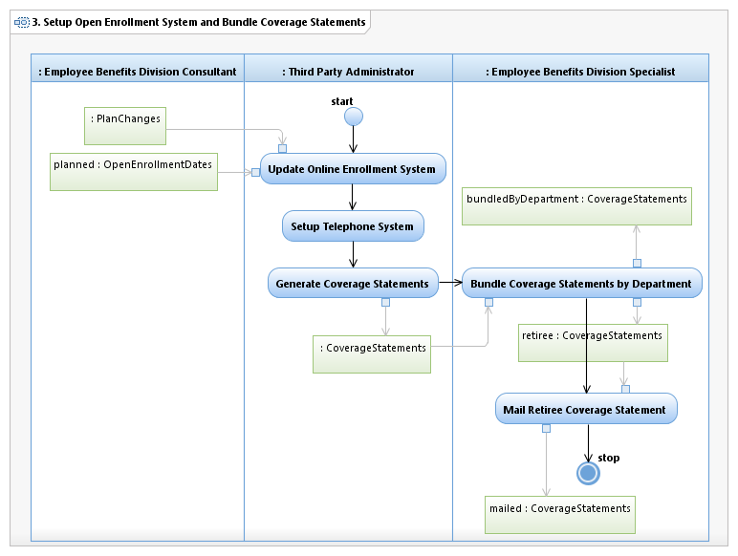
Realization Documents the Process
Realization
(employs value chain concepts)

Slide 12

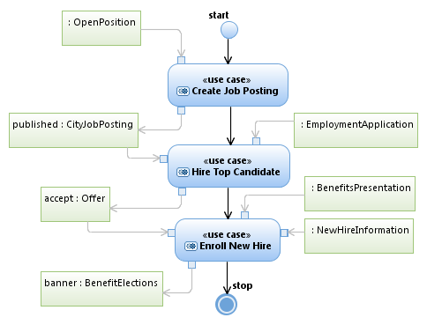
Business Component Value Chain
Use Case (business component
sometimes referred as service)
Triggering and producing object

Slide 13
Interaction Overview – Activity Model
Activity
Process Flow
(flow of control)
The value chain
Forks / Joins
(synchronizes activities)
Objects
(information elements)

Slide 14
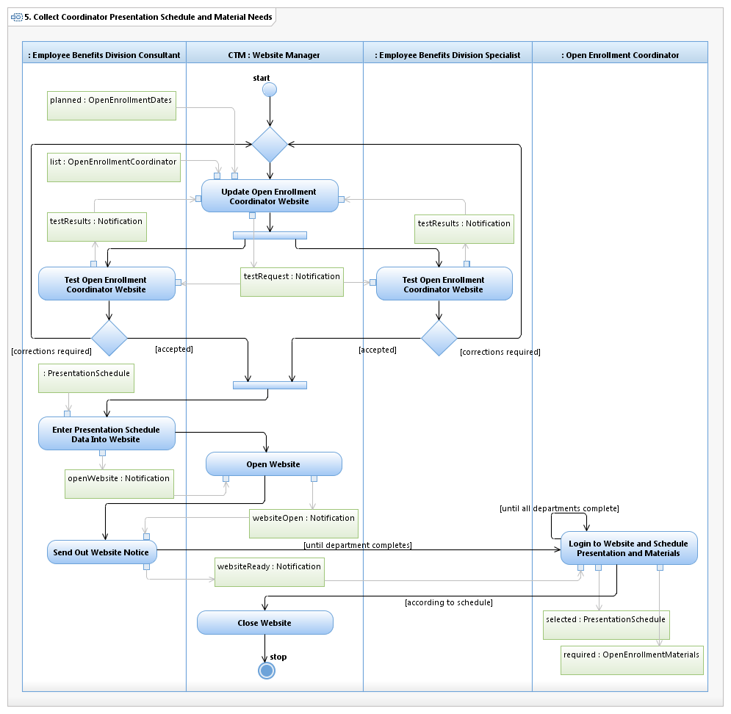

Swim-lane Activity Model
Interaction Overview
Merge Point
Decision Point
Never Yes/No!

Slide 15
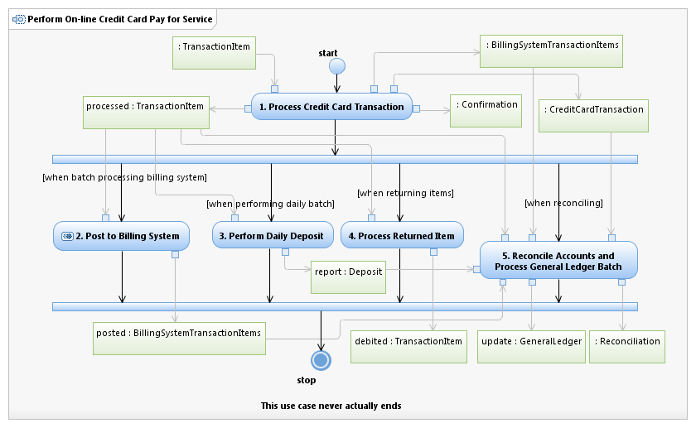

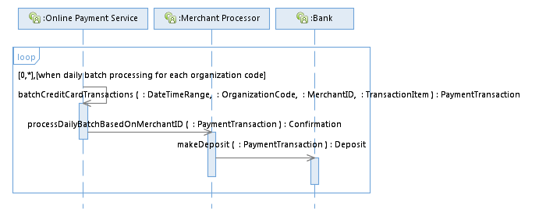
Sequence Diagram
Interaction Overview
Object
Combined fragment
Lifeline
Message
Focus of control
Signature

Slide 16
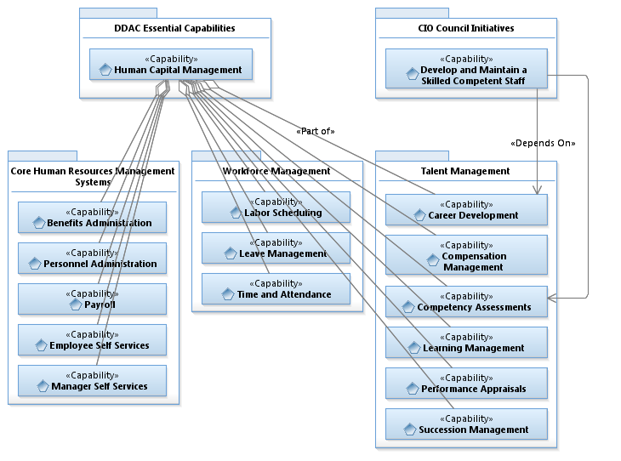
Class Relationships

Slide 17
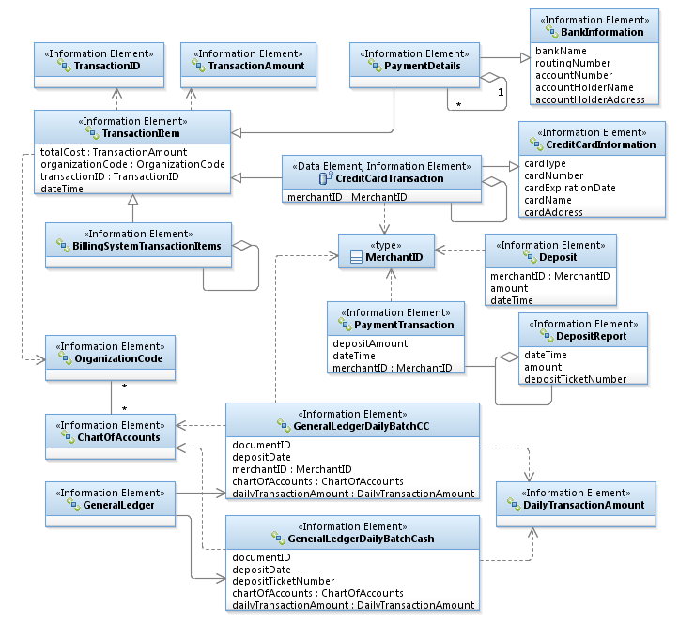
Logical Data Model
The UML expert can read this diagram like a book – associations define the relationships between the information elements
The enterprise architect makes the associations based on the use case model
Any qualified IT developer knows how to read these diagrams – hence the UML bridges the gap between the user and the developer because the user identified them in the use case

Slide 18
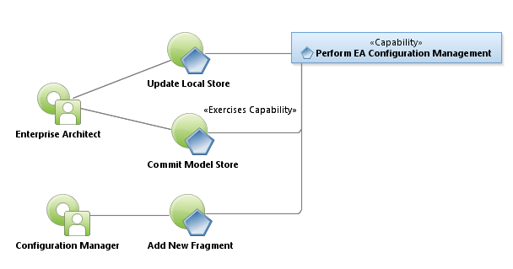
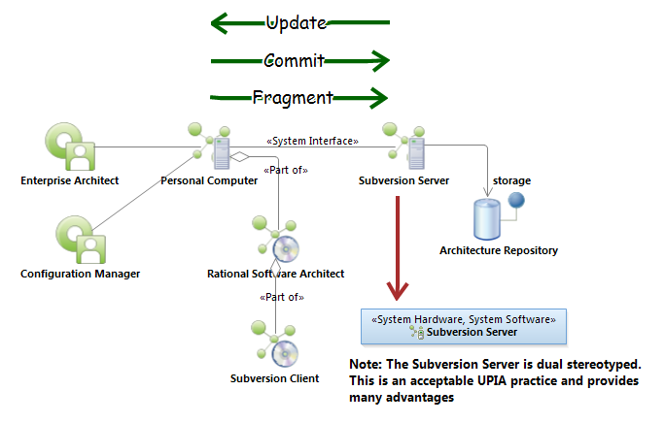
System Context Diagram
Use Case Model
Hardware
component
Software component

Slide 19
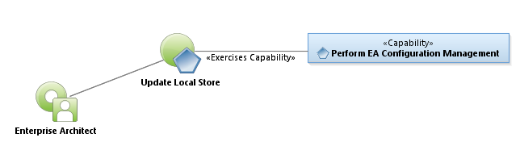
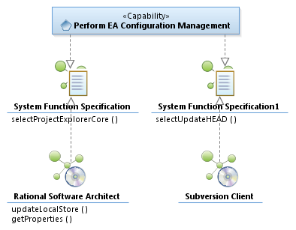
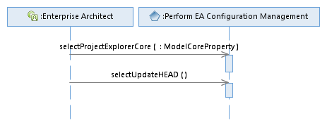
System Functional Requirements
System Functional Requirement
Interface Diagram

Slide 20
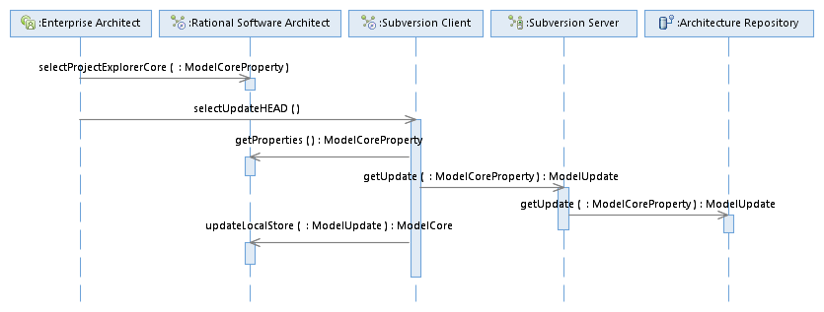
System Sequence Diagram
Black Box
White Box

Slide 21
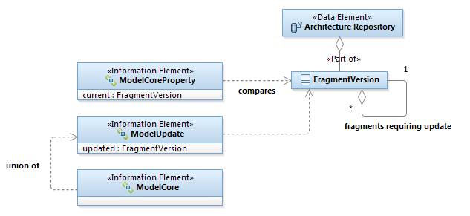
Logical Data Elements

Slide 22
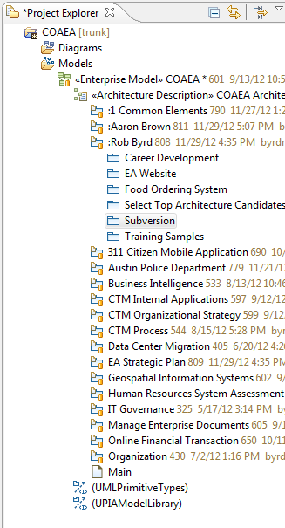
Configuration Management
UML System Context Diagram
Orange button indicates package under Subversion control

Slide 23
Summary
UML is an open standard general purpose language for object-oriented analysis and design created by the Three Amigos
UPIA extends the UML to standardize classes and their associations – it normalizes defined parts
The use case is the primary instrument for collaboration, concept development, business process analysis and value chain understanding – the use case always results in the same value
Logical data models define the data requirements used by the use case
System diagrams show systems and their interfaces
Configuration management allows teams to work collaboratively in “one” model

