Slide 1
Enterprise Architecture Status
Rob Byrd rob.byrd@austintexas.gov

Slide 2
Enterprise Architecture
The process of translating business vision and strategy into effective enterprise change by creating, communicating and improving the key requirements, principles and models that describe the enterprise's future state and enable its evolution over time
A process to deliver critical mass of understanding to the enterprise!
Critical Mass of Understanding…

Slide 3
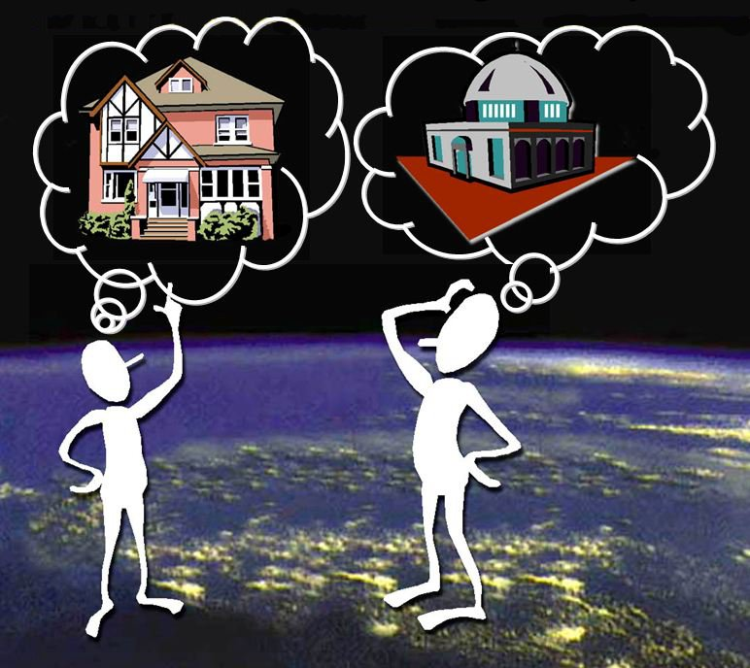
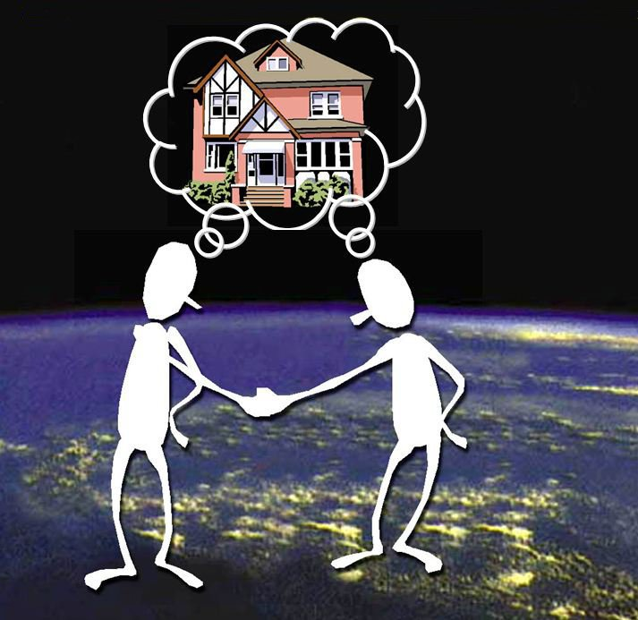
Mass of Understanding
No Blueprint = Disjointed Understanding
Blueprint = Mutual Understanding
critical understanding
momentum = mass x velocity
in a given direction

Slide 4

Enterprise Architecture Process
<<vision>>
Best Managed City
<<capability>>
Manage Infrastructure
<<capability>>
Clean Water
<<capability>>
Equal Opportunities
<<capability>>
Healthy Economy
<<capability>>
Safe Public
<<capability>>
Healthy Community
<<capability>>
Reliable Energy
<<capability>>
Mobile Community
Establish Goals
<<goal>>
Conserve Water Resources
<<goal>>
Integrate Case and Asset Management
<<goal>>
Sustain Environment
<<goal>>
Optimize Operations
<<goal>>
Increase Revenue
<<goal>>
Respond to Customer Needs
<<goal>>
Define Mobile User Processes

Slide 5
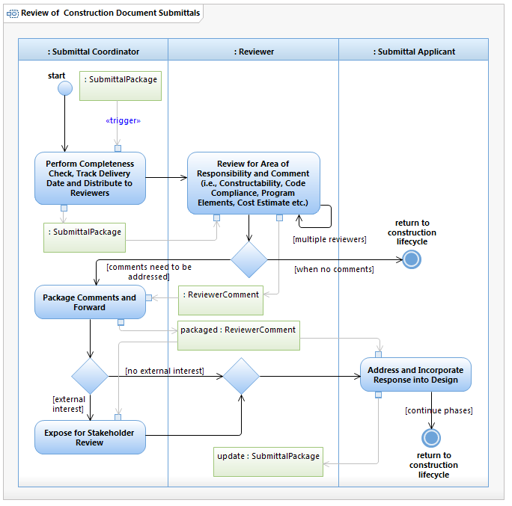
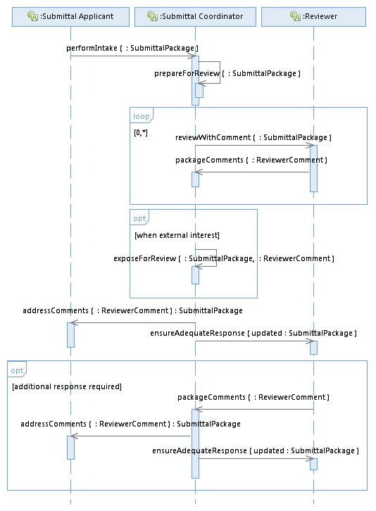

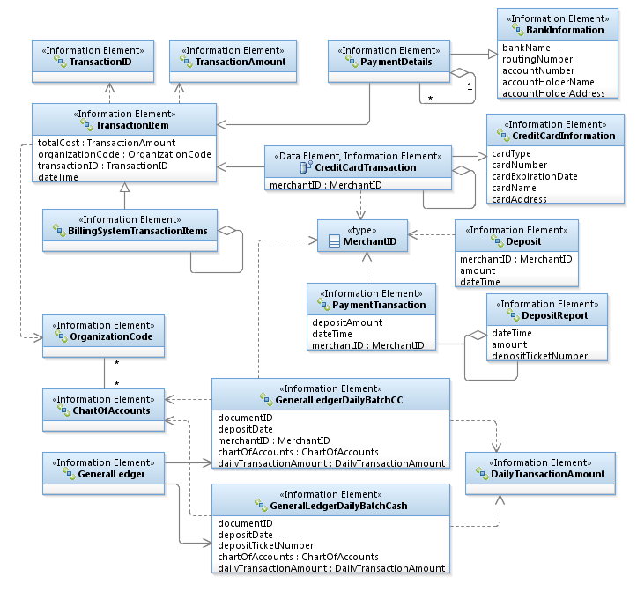
Enterprise Architecture Products
Process
Stakeholder developed!
Sample use case model

Slide 6
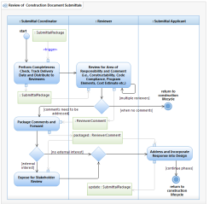
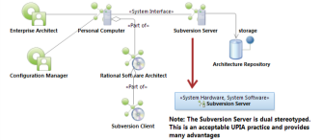
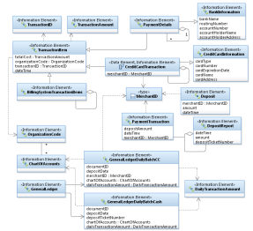
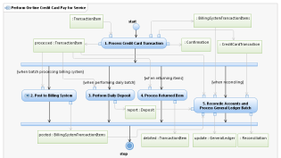
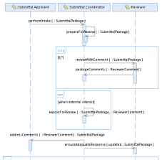
Enterprise Architecture Process
<<vision>>
Best Managed City
<<capability>>
Manage Infrastructure
<<capability>>
Clean Water
<<capability>>
Equal Opportunities
<<capability>>
Healthy Economy
Identify Common Capabilities
<<capability>>
Safe Public
<<capability>>
Healthy Community
<<capability>>
Reliable Energy
<<capability>>
Mobile Community
Identify Common Process
Goals Amplify Vision!
Identify Common Infrastructure
Top Down – Bottom Up
Identify Common Data
<<goal>>
Conserve Water Resources
<<goal>>
Integrate Case and Asset Management
<<goal>>
Sustain Environment
<<goal>>
Optimize Operations
Identify Common Goals
<<goal>>
Increase Revenue
<<goal>>
Respond to Customer Needs
<<goal>>
Define Mobile User Processes

Slide 7
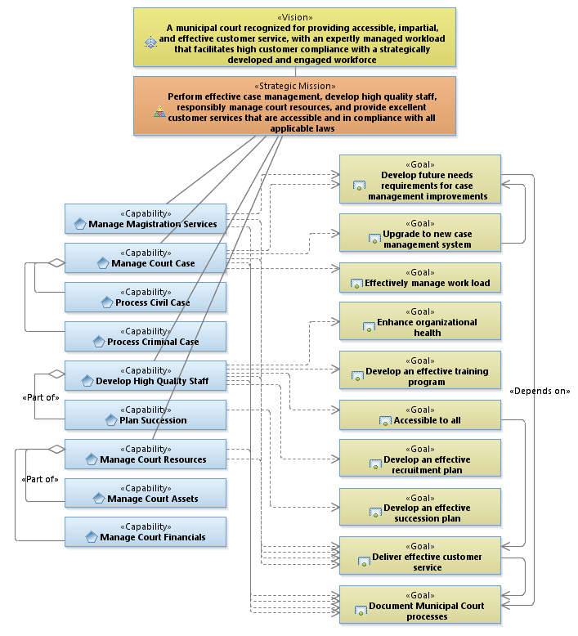
Example Capability Area Architecture

Slide 8
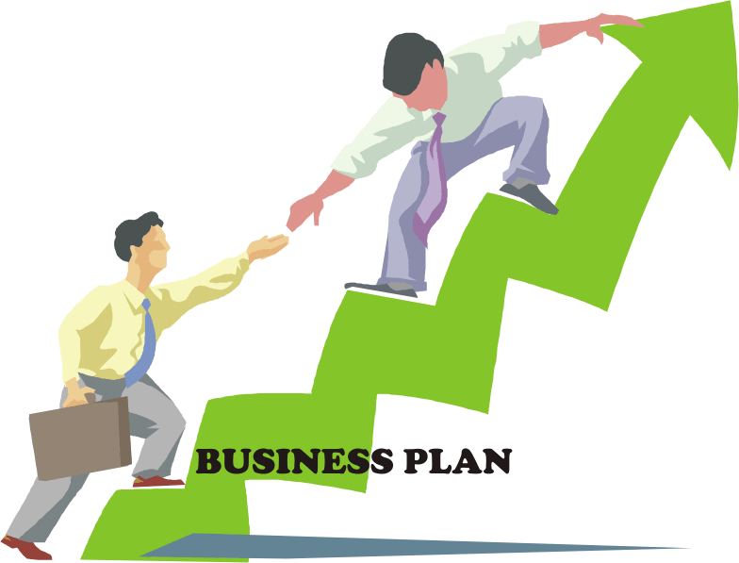
The Value of Enterprise Architecture
Ensures business outcomes drive IT solutions
Identifies important goals and their dependency
Increases team communication and understanding
Reduces implementation risk

Slide 9
EA Projects
In work
Human Resource System Assessment
Centralized Real Estate Management
Municipal Court Case Management System
Police Department Architecture
Residential Review Architecture
Coming soon – scope in work
311 Call Center
Code Compliance Mobility
Public Works Business Intelligence
Other EA activities
Enterprise Service Bus / EA Introduction
Completed Water Utility Mobility Architecture

