Slide 1
Enterprise Architecture And Project Management Office
Maneuvering through the chaos

Slide 2
What Unique Skills do Enterprise Architects bring?
Trained to know how to describe things; they understand how to build models that describe technology and solution relationships for technology, motivational and organizational considerations
Understand the “plans”, as well as the technology behind the plans
Bring the tool skills to create artifacts common throughout the technology industry
Transcribes business thinking; sort of archivists
Create the enterprise knowledge base
Diagnosis and suggest improvements - classically architecture is the first step when attempting to isolate potential issues in the environment

Slide 3
It’s a long way from Idea to 00001000100011
Precise business description required of solutions is VERY critical to successful implementations - articulations must have enough technical description to insure what’s built meets the needs of the business
Example: “The woman was hot.”
But what does this mean? It depends on who said it… maybe someone was attracted to the woman.. Maybe the woman was in a 110 degree room. Maybe the woman was having hot flashes. Maybe she was winning every hand at blackjack.
Take this analogy and imagine the description of technological solutions. It gets even more ambiguous as you add layers of complexity to what you are describing.
EA is about solving this ambiguity in a structured, repeatable approach.

Slide 4
Complex Things Need Architecture
Simple things, like a log cabin, or a “Hello World” program don’t need architecture. They are isolated, built them once, and it’s done.
Complex solutions require definition. If you can’t describe them, you can’t succeed at creating them.
Things Change. Change is complex. Without an architecture you have three options:
Change the instance of what you have and “see what happens”
Recreate (reverse engineer) from the existing implementation (takes time and costs money)
Scrap the whole thing and start over.
How many of times have you encountered this in the COA environment?

Slide 5
When should EA get involved?
Is the work complex?
Does the work cross enterprise boundaries?
Is there potential future change?
Does the work relate to technology standards?
Does the work coordinate/touch multiple systems?
Does the work relate to organizational considerations?
Is the work potentially employ new technologies?
Is there a new motivational factor?

Slide 6
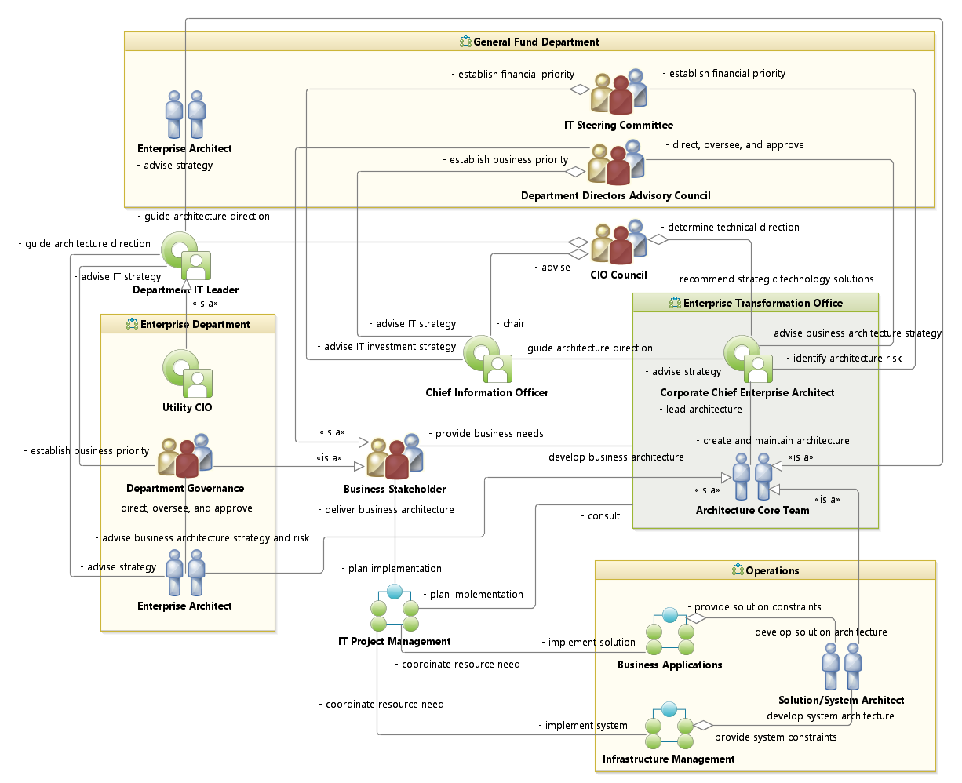
Where EA Fits in the
Organization
Note the ‘Business Stakeholder’ is a common customer for both EA and PMO
-From the EA Roadmap
( austinea.org )

Slide 7
EA’s Role Step by Step with a Project
Business Owner expresses interest in a technology and requests analysis
Business domain contacts CTM
Chief Enterprise Architect evaluates project and assigns an architecture analysis team
Chief Enterprise Architect may contact PMO to seek Project Management assistance
Note: EA performs enterprise analysis, not just approved projects analysis!
EA Evaluates the impact to the Enterprise, and creates artifacts to assist with evolving requirements
Project is presented to the DDAC and CIO council (or Department has funding of their own)
An RFI or RFP is created to support the discussion of how and what is required for the project. Included are the EA artifacts provided by EA.
EA Team participates in Demo’s and provides technical counsel for initial product selection, Alternatively, EA provides technical counsel to the internal development teams if the solution is going to be developed in-house.

Slide 8
EA’s Role Step by Step with a Project
Business Owner expresses interest in a technology and requests analysis
Conduct kickoff for business domain, outlining expectations and the process
Instructs business domain how to read EA artifacts
Works with the business domain to create a Capability Area Architecture
Collaborate with business domain to construct a proposed list of Use Cases
Business domain prioritizes Use Cases and assign SME’s for each architecture session
Meet with SME’s and conducts architecture sessions
Draft architecture to central EA repository
Business domain reviews/revises/approves architecture
Include documentation for business domain on the EA Website (austinea.org) for general consumption
EA Evaluates the impact to the Enterprise, and creates artifacts to assist with evolving requirements
Project is presented to the DDAC and CIO council (or Department has funding of their own)
An RFI or RFP is created to support the discussion of how and what is required for the project. Included are the EA artifacts provided by EA.
EA Team participates in Demo’s and provides technical counsel for initial product selection, Alternatively, EA provides technical counsel to the internal development teams if the solution is going to be developed in-house.

Slide 9
EA’s Role Step by Step with a Project
Business Owner expresses interest in a technology and requests analysis
EA Evaluates the impact to the Enterprise, and creates artifacts to assist with evolving requirements
The Business domain brings the project to the DDAC for approval
Future: Additional points added to the evaluation scorecard for a project if EA review is completed when the project is proposed!
Project is presented to the DDAC and CIO council (or Department has funding of their own)
An RFI or RFP is created to support the discussion of how and what is required for the project. Included are the EA artifacts provided by EA.
EA Team participates in Demo’s and provides technical counsel for initial product selection, Alternatively, EA provides technical counsel to the internal development teams if the solution is going to be developed in-house.

Slide 10
EA’s Role Step by Step with a Project
Business Owner expresses interest in a technology and requests analysis
The PMO Establishes a Charter for the project with the Business domain
The PMO creates a project plan
The PMO conducts their own Kick off meeting
EA provides the PMO the business domain’s Use Case artifacts, and any technical standards that might apply to the project
The PMO constructs an RFI / RFP with the Artifacts for evaluation by the Business domain
PMO consults EA for various technology considerations
The PMO coordinate the project to a successful completion.
EA Evaluates the impact to the Enterprise, and creates artifacts to assist with evolving requirements
Project is presented to the DDAC and CIO council (or Department has funding of their own)
An RFI or RFP is created to support the discussion of how and what is required for the project. Included are the EA artifacts provided by EA.
EA Team participates in Demo’s and provides technical counsel for initial product selection, Alternatively, EA provides technical counsel to the internal development teams if the solution is going to be developed in-house.

Slide 11
EA’s Role Step by Step with a Project
Business Owner expresses interest in a technology and requests analysis
EA Evaluates the impact to the Enterprise, and creates artifacts to assist with evolving requirements
EA act’s as a technical consultant for all other elements of the project:
EA sits in on product demos and acts as a technical consultant for the Business domain
If the project is an in-house development project, EA is consulted whenever there are questions or changes.
Classically, EA should be consulted each loop of an AGILE implementation, when the next set of changes is proposed.
Project is presented to the DDAC and CIO council (or Department has funding of their own)
An RFI or RFP is created to support the discussion of how and what is required for the project. Included are the EA artifacts provided by EA.
EA Team participates in Demo’s and provides technical counsel for initial product selection, Alternatively, EA provides technical counsel to the internal development teams if the solution is going to be developed in-house.

Slide 12
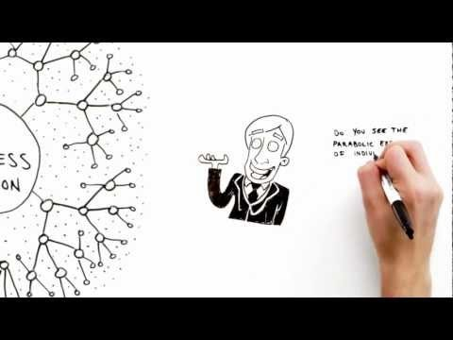

Slide 13
Analysis / Diagrams EA Create
Capability Area Architecture – This defines a Business domain by showing the Capabilities (services) provided by that Team; often this includes goals of the organization.
Logical Data Models – Provide a comprehensive list of all data needed to properly implement the requested solution. Normally one logical data model will be provided for a set of processes.
Use Case Diagrams – One is provided for each “process” indicating the name, scope of the process, roles, and systems involved. Note: The Scope from Use case diagrams are meant to be reused as test cases at implementation.
Sequence Diagrams – Define a process along a timeline, showing every role and system, the interactions between them, and the data used for each interaction.
Activity Diagrams – Define a process from a workflow perspective, broken down by role, and shows the data used at each step. Activity Diagrams ignore systems.
Interaction Overviews – Show the interactions between Processes, and includes the major data included in each step.
System Context Diagrams – Describe the physical layout of the machines, operating systems and software for a solution space. It’s the only time EA isn’t strategic!

Slide 14
Analysis / Diagrams EA Create
System Context Diagram
Capability Area Architecture
Logical Data Model
System Context Diagram
Sequence Diagram
Activity Diagram
Use Case Diagram
Interaction Overview Diagram

Slide 15
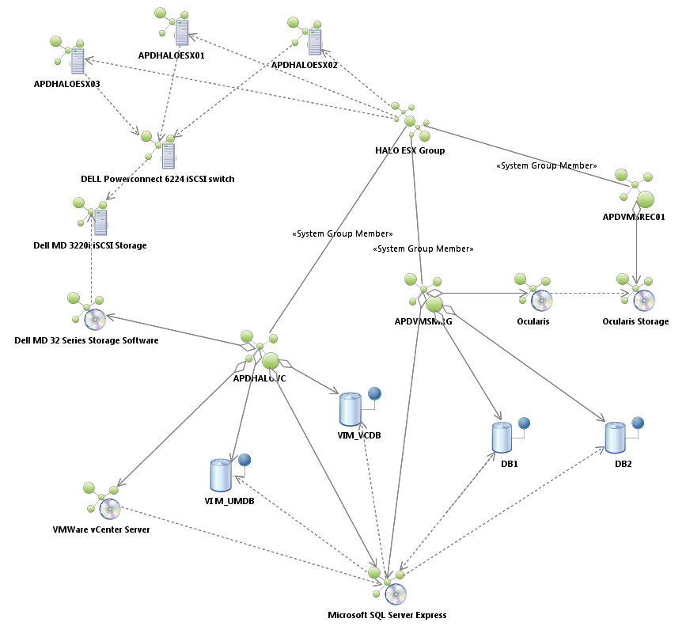
System Context Diagram
System Context diagrams show the physical layout a solution space.
This is the only time EA isn’t strategic and becomes more tactical!

Slide 16
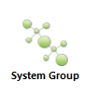
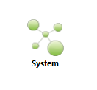
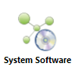


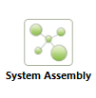


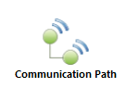
System Context Diagram
Communication paths indicate an association between two things through which they can communicate signals and messages.
Between two devices, it typically denotes a physical connection between two nodes, Like Ethernet.
Between two environments, it typically denotes a protocol (like TCP/IP)
Sometimes, when you are architecting very very large systems with multiple major systems, you want to represent pieces as a single unit. Sometimes we designate hardware like Routers, keyboards, scanners – contained hardware items with this icon. System Assembly’s are for this purpose!
If you are architecting a widely distributed system that includes communication components like microwave towers, the communication system icon is used to convey a system that manages communication!
This represents the presence of a system that is managing a network. You normally won’t see this unless the diagram is focusing on elements that provide the network managing system for a specific reason.
Data Elements indicate a data store of some kind. It might be a file, it might be a table. You can tell more about it based on with what it’s associated. You often see Oracle Servers or SQL Server software pieces associated/Dependent with data elements!
A System Group indicates a cluster of systems, like a VM farm – it’s a mechanism for providing other system spaces.
A System without the little computer next to it normally implies a VM, something without actual hardware. Normally, supplied by a System Group!
System software is any software product. It’s easy to remember – it has a little DVD built into the Icon
System Hardware is any system that has a physical box associated with it. It’s easy to remember – it has a little Computer Tower built into the Icon
An Aggregate association. The thing being pointed to is part of the thing that has the diamond
A Dependency association. The thing being pointed to is critical for the thing from which the arrow originates

Slide 17
System Context Diagram
So Let’s look at the System context diagram again

Slide 18
Capability Area Architecture

Slide 19
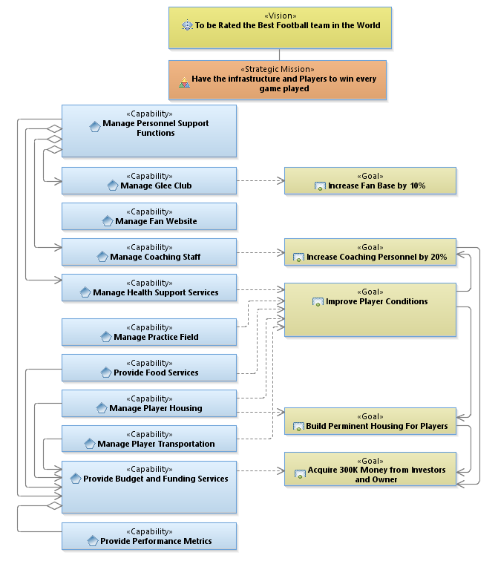
Capability Area Architecture
A Vision
A Mission
A Vision Is a State.
Some point in the future it will look like “this”.
Example: The Vision… to be rated the best Football team in the world!
A Mission is a summary of capabilities. It describes the organizations purpose.
Example: Have the Infrastructure and players to win every game played.

Slide 20
Capability Area Architecture
This indicates that one thing on our chart is part of another thing.
In this chart, the “Manage Glee Club” Capability is part of “Manage Personnel Support Functions” capability
A Capability
This indicates when capabilities are dependent on goals.
Often we see many Capabilities dependent on one or more of the same goals… this is how we decide the best places to start!
An Aggregate
A Goal
A Capability is a collection of people, processes, and technology that deliver value, achieve outcomes / effects / goals.
Example: “Manage Personnel Support Functions”
A Goal is an outcome which will aid in moving the Capability forward in its intent. Goals amplify and quantify the organization’s Vision!
Example: “Increase Fan Base by 10%”
A Dependency

Slide 21
Capability Area Architecture
This is used to indicate a relationship or to indicate a planned order based on dependencies.
A Directed Association

Slide 22
Logical Data Model
Capability Area Architecture
Logical Data Model
System Context Diagram
Sequence Diagram
Activity Diagram
Use Case Diagram
Interaction Overview Diagram

Slide 23
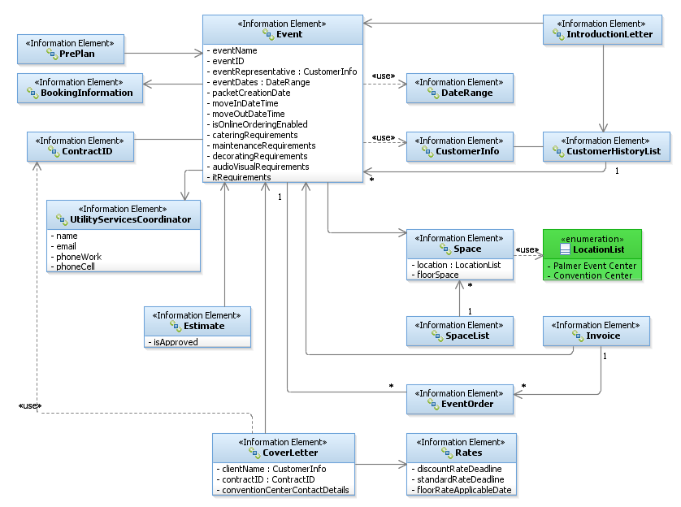
Logical Data Model
An Information
Element
An Enumeration
This describes a collection of discrete values for a kind of attribute. Think of it as an equivalent to a drop down menu of choices. The associated attribute can ONLY have the values listed.
This describes an Object used within our solution space, and its associated attributes (if there are any). It can be data at rest or data moving throughout a system.

Slide 24
Logical Data Model
Just like in Capability Area Architectures, a Directed Association tells us when one thing is part of another – literally. Think of the object being pointed to, as a subset of the thing pointing! If there’s no Arrow head and it’s a single line, that means both things contain each other.
In this example, the “Event” object contains the “BookingInformation” object
Multiplicity
This describes a dependency between one object and another. In this example, the Event depends on the DateRange object.
Multiplicity indicates a kind of referential relationship. Like a group of child records that belong to a parent. They include a range of possibilities.. 0,1…*
A Directed Association
A Dependency

Slide 25
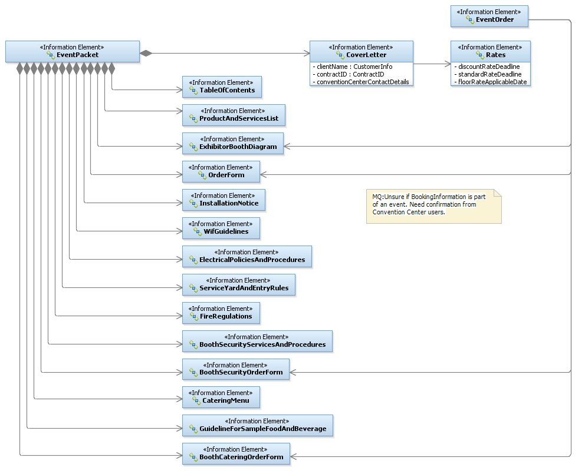
Logical Data Model
This indicates the things without the diamond are part of the thing with the diamond – as in literally a Kit…a collection of things. If you see this without the diamond filled in, it’s called “Aggregation”, implies the same kind of “kit” but implies the items are optional in the kit…if they exist they are part of the object.
A note is any important piece of information that’s related to the item to which it’s attached. They look like post-it notes!
Composition
A Note

Slide 26
Use Case Diagram
Capability Area Architecture
Logical Data Model
System Context Diagram
Sequence Diagram
Activity Diagram
Use Case Diagram
Interaction Overview Diagram

Slide 27
Use Case Diagram
In software and system engineering, a use case is a set of steps, typically defining interactions between a role (known in UML as an "actor") and a system, to achieve a goal also referred to as result of value (ROV). The actor can be a human or a system.
Think of a Use Case Diagram, as a 10,000 foot level look at your process. It shows who or what is affiliated with the Use Case being defined. It can also indicate important data to the process (things that trigger the process or that are produced from the process.) It is NOT a data flow, nor does it indicate anything other than the players in the process.

Slide 28
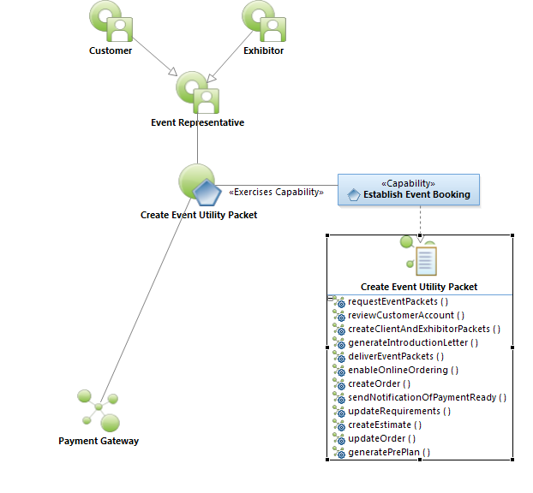
Symbols to know to read a Use Case!
Use Case Diagram
A Role
Abstraction of a Role
The Use Case Name
The Capability this Use Case Supports
A System that’s used in the Use Case
System Function Specification

Slide 29
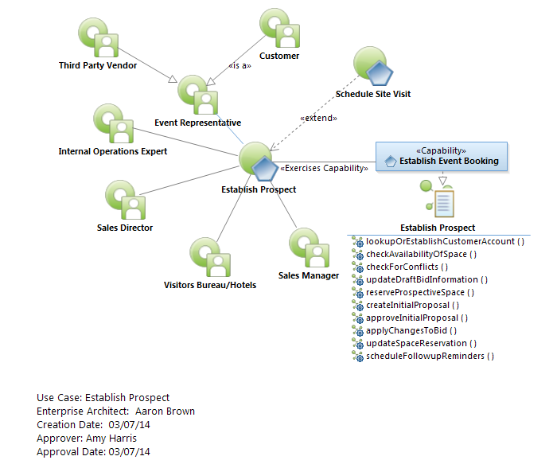
Use Case Diagram
<<Extend>>: Another use case MIGHT be called
<<Include>>: Another Use Case WILL be called
Extends / Includes
The Use Case ID Block
10000 Foot View

Slide 30
Sequence Diagram
Capability Area Architecture
Logical Data Model
System Context Diagram
Sequence Diagram
Activity Diagram
Use Case Diagram
Interaction Overview Diagram

Slide 31
Sequence Diagram
A Sequence diagram shows a process broken into a sequence of messages between objects, arranged in time sequence. It shows the sequence of messages and the objects needed to carry out the functionality of the scenario. Sequence Diagrams typically are associated with Use Case “realizations” as a logical view of a system.

Slide 32
Sequence Diagram
doMyImportantFunction( :data1, :formInfo) : rtnval
These are arguments for our function. They are values we pass to, get from, and pass in-and-out of the function. We can have as many arguments as we like.They are separated by a comma. Normally these have already been defined in our logical data model and are well known objects at this point.
Sometimes there is a “state” specified before the data object that helps the reader understand more about what’s going on.
doMyProcess(initial: data1 , completed:formInfo)
Just like in programming, a function can return a single value. It doesn’t have to. It might return information in the data objects we passed to it, but sometimes we want to return a value to insure successful execution of something. So we indicate it will pass us back a return value and then we predicate some other action on this value.
This is a function. A message. A request. Call it what you like. We often put the word “Please” in front of it to make sure it is properly formed. It’s what we are asking another role (system, database, person) to do for us.

Slide 33
Sequence Diagram
Roles (Actors)
Person 1
System 1
Database 1
verifyLoginInfo( :Credentials) : status
Time progresses
verifyLoginInfo( :Credentials) : status
The arrow head says who is doing this activity
When a role does something on its own without another actor, we call it a reflexive
displayPersonMenu( :PersonInfo)
promptForOption( :PersonInfo, :MenuX)
selectMyOption( selected:OptionChoice, :MenuX)

Slide 34
Sequence Diagram
Roles (Actors)
Person 1
System 1
Database 1
verifyLoginInfo( :Credentials) : status
Time progresses
verifyLoginInfo( :Credentials) : status
Sequence diagrams can have Option blocks that provide optional pieces of code, designated by OPT, and a Guard Condition (when it’s executed)
OPT
[status is success]
displayPersonMenu( :PersonInfo)
promptForOption( :PersonInfo, :MenuX)

Slide 35
Sequence Diagram
Roles (Actors)
Person 1
System 1
Database 1
Sequence diagrams can have Alt blocks that provide optional pieces of code, designated by ALT, and a Guard Conditions (when it’s executed). An Alt block can have as many alternate paths and Guard conditions as needed!
ALT
[status is success]
displayPersonMenu( :PersonInfo)
Time progresses
promptForOption( :PersonInfo, :MenuX)
[status is unknown]
dumpProgram( :PersonInfo)
[status is bad password]
promptForPsw( :PersonInfo)

Slide 36
Sequence Diagram
Roles (Actors)
Person 1
System 1
Database 1
Sequence diagrams can have Loop blocks that provide optional pieces of code, designated by LOOP, and a Guard Conditions (the maximum number of loops, and the conditions by which the loop ends)
lookupNextDistrict( :District, :TheQue )
Time progresses
LOOP
[0,*] [for each item in list]
displayDistrict Info( :District )
lookupNextDistrict( :District, :TheQue )

Slide 37
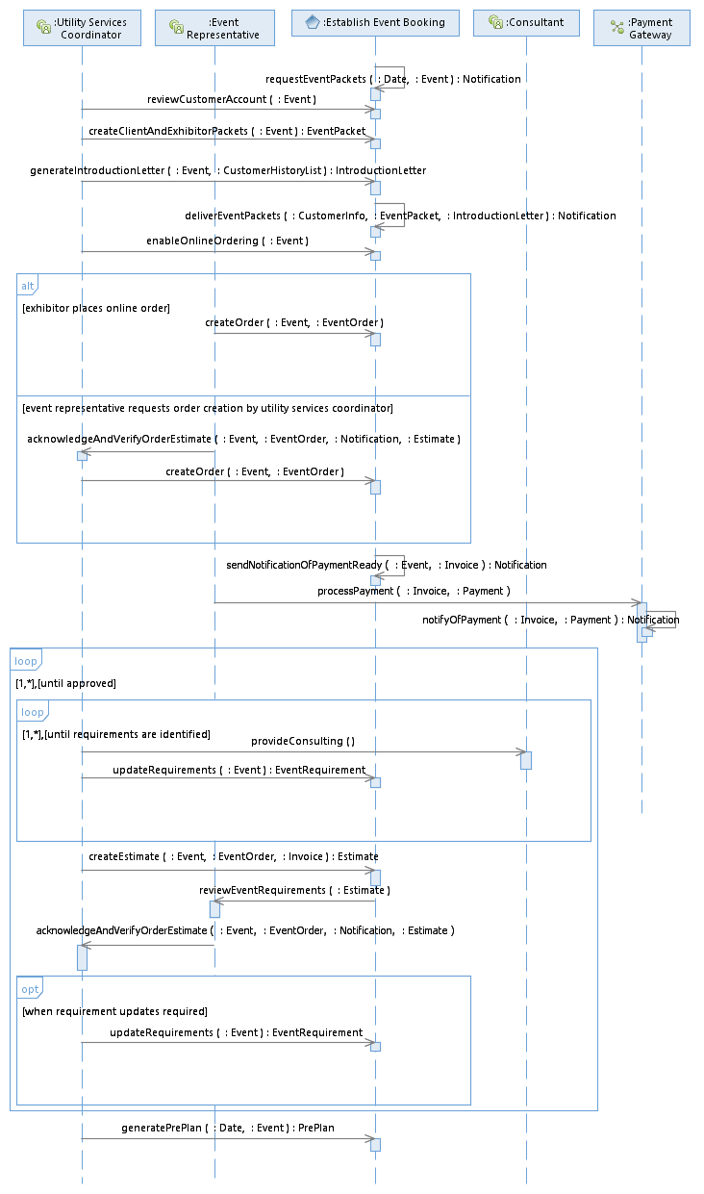
Sequence Diagram
Type/Interface | Description
Establish Event Booking/ requestEventPackets | 3-6 months prior to an Event, the system sends a Notification to the Utility Services Coordinator instructing them to create Event Packets for the Client and the Exhibitor, providing the contract ID, event name, space, notes from sales, etc. The system requests Utility Services Coordinator to verify auto-reassigned traces.
Establish Event Booking/ reviewCustomerAccount | The Utility Services Coordinator uses the system to review type of event, dates, space, booking notes, and contract clauses for accuracy. The system allows the Utility Services Coordinator to make changes as necessary, recording who made the change, the date the change was made and by whom.
Establish Event Booking/ createClientAndExhibitorPackets | The Utility Services Coordinator uses the System to create the Client and Exhibitor Packets based on templates. Event Packets include the following: (1) cover letter (client name, contract ID, event name, show dates, move in/out dates, discount rate deadlines, standard rate deadlines, floor rate applicable date, contact information for Austin Convention Center, name and contact information of utility services coordinator), (2) Table of contents, (3) List of all products…
…. | ….
Here is the associated sequence diagram for the “Create Event Utility Packet” use case done for the Convention Center.
All Sequence Diagrams have an accompanying table that describes each function in great detail. This accompanies the Sequence Diagram when it’s provided in an RFI or RFP. This is the most critical part of a sequence diagram as it indicates the detail associated with each step.

Slide 38
Activity Diagram
Capability Area Architecture
Logical Data Model
System Context Diagram
Sequence Diagram
Activity Diagram
Use Case Diagram
Interaction Overview Diagram

Slide 39
Activity Diagram
Activity Diagrams are graphical representations of workflows of stepwise activities and actions with support for choice, iteration and concurrency. They describe business and operational step-by-step workflows of components in a system.
Activity Diagrams normally designate process and people more than system. Often Activity Diagrams don’t even list the systems of concern.

Slide 40

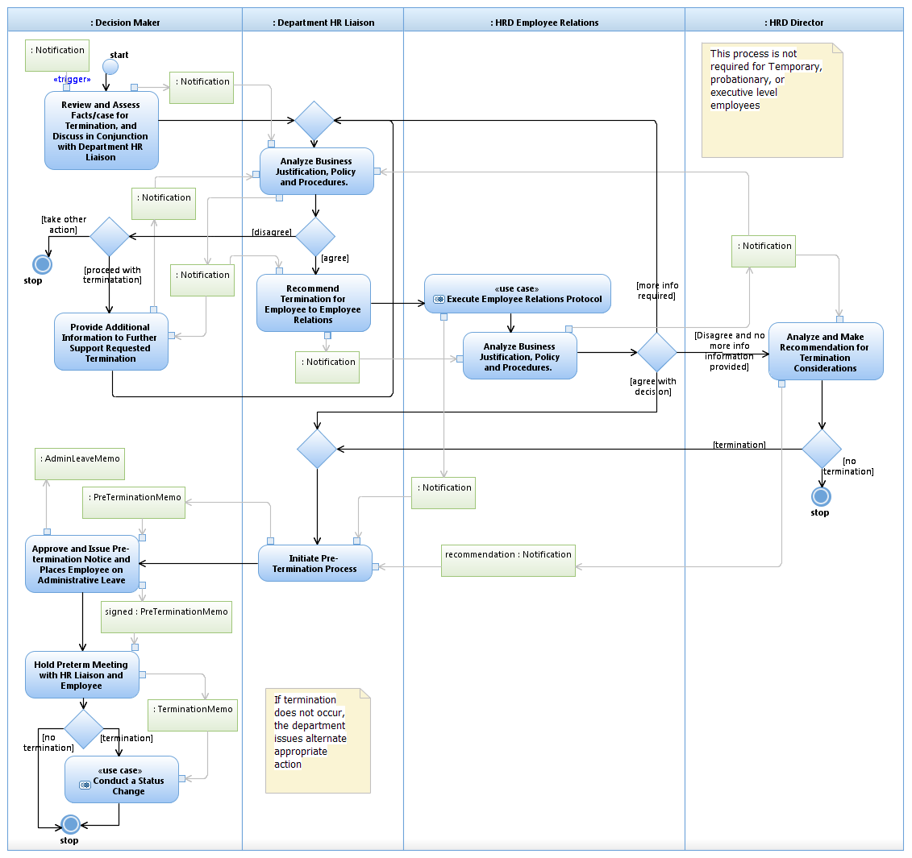
Activity Diagram
Roles (Actors)
Processes
Data
Activity Diagrams focus on Activities of specific roles and the data required for them to do tasks. This is why they are perfect for depicting workflows!
Notice there is no system represented on this diagram!
A swim lane

Slide 41




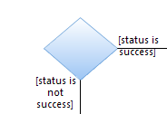

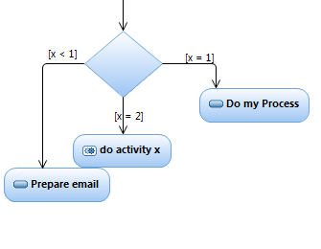
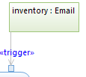


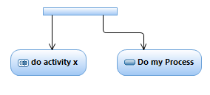
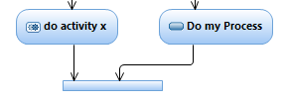
Activity Diagram
Concurrent activities are denoted by the FORK object. It can be used to denote when multiple processes execute simultaneously. Any number of process paths can be forked.
Every Process will have a control buffer as an input and as an output (at a minimum… there can be as many control buffers as desired). The first process normally includes a control buffer with the word <<trigger>> this indicates the data that triggers the beginning of the process. Control Buffers attach to processes with little arrows called “Pins” The arrows tell us if it’s an input or an output based on their direction.
Any time concurrent activities are FORKed, they terminate either with a stop, or a JOIN object. It’s used to denote a synchronization of the processes attached to it. Any number of process paths can be Joined.
This is called a Central Buffer. It holds data and is attached to process bubbles indicating the data either going into a process or coming from a process. The Data should be part of our logical data model! Note: Central buffers can be anywhere on a diagram and have no relation to the swimlane in which they exist. Sometimes they also include a state modifier like sequence diagrams.
This is a decision block. You can tell it’s a decision block because it will have guard conditions that indicate when you traverse that path. Note…there can be MANY MANY paths of a decision block, not just two.
This is a Merge block. You can tell it’s a merge block because it doesn’t have guard conditions. Since Activity Diagrams don’t have loops, these are used to provide a way to circle back logic. There is no limit to the number of paths that can be merged.
This Blue Oval with the Gear means a process that exists in another activity or sequence diagram. Remember the <<include>> and <<extend>> designations in the Use Case Diagram? There should be one of these for every one of those.
This Blue Oval means a process is being done by the Role (actor) in whose swim lane it is drawn. It always starts with an action verb. Note – processes can only have 1 in and 1 out.
Every Activity Diagram ends with a STOP element. There can be many stop objects and they can have multiple processes terminate at each. This is where the scope of the process being mapped, ends.
Every Activity Diagram begins with a START element. There will only be 1 Start object per diagram.

Slide 42
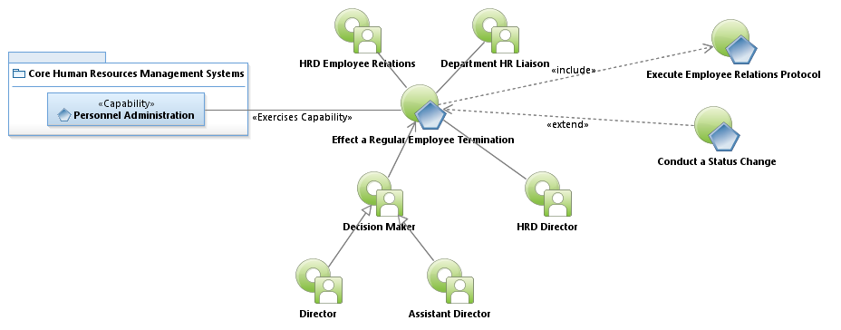
Activity Diagram
Here’s the Use Case for the Activity Diagram

Slide 43
Activity Diagram
Now let’s take another look at the Activity Diagram.

Slide 44
Interaction Overview Diagram
Capability Area Architecture
Logical Data Model
System Context Diagram
Sequence Diagram
Activity Diagram
Use Case Diagram
Interaction Overview Diagram

Slide 45
Interaction Overview Diagram
Interaction Overview Diagrams are used to step up one level and show the data and interactions of multiple use cases. They follow all the constructs of Activity Diagrams (and in truth they are another form of Activity Diagram in the COA implementation.) They have no swimlanes nor roles, and are focused on data movement throughout the model.

Slide 46
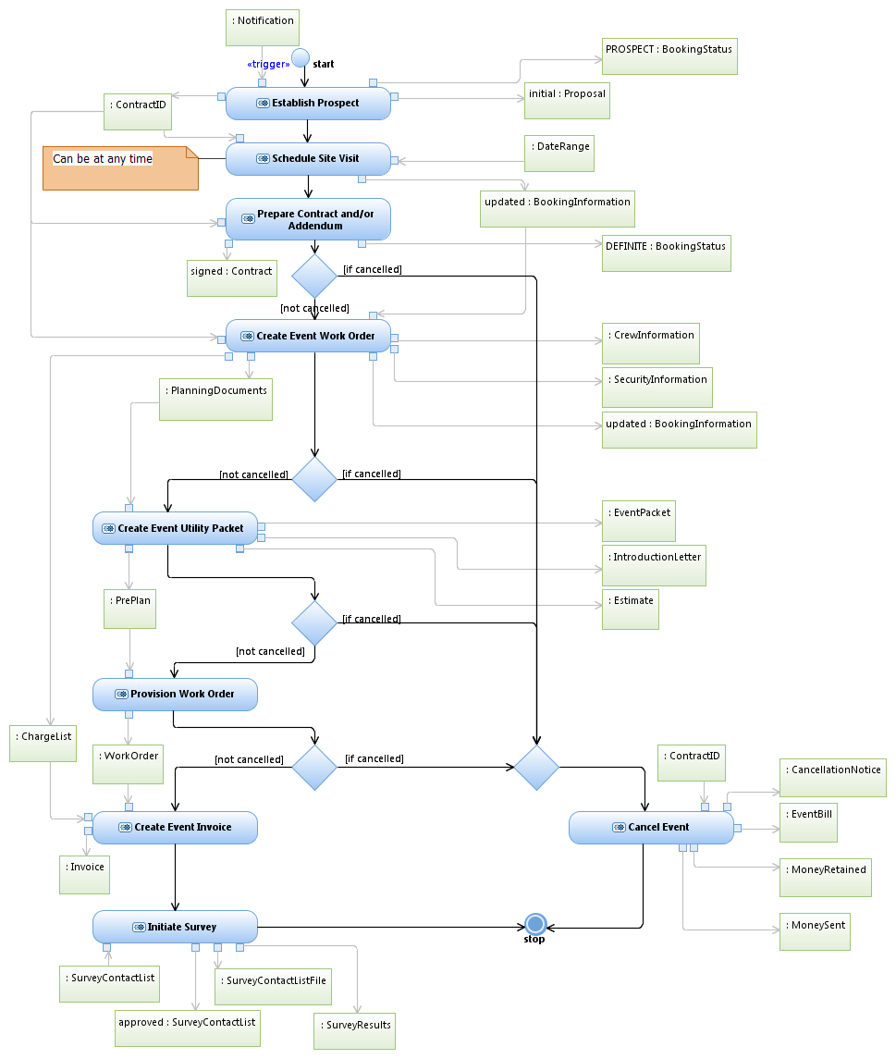
Interaction Overview Diagram
Interaction Overview Diagrams are used to step up one level and show the data and interactions between processes of a major system

Slide 47

Questions

Slide 48
Aaron Brown
Sr. IT Enterprise Architect
Aaron.brown2@austintexas.gov
512-974-2960

