Slide 1
Enterprise Architecture Strategy for Water Utility Mobility
Rob Byrd rob.byrd@austintexas.gov

Slide 2
EA Strategy Overview
Recommended SOW Items for EA Development
CIO Executive Board Recommendation
Why EA - What’s its Value?
Capability Area Architecture (CAA)
Tool for requirements development…

Slide 3
Insource EA to Reduce Cost and Risk
Use EA to deliver on the follow SOW requirements:
3.1.1.1 Prepare a detailed functional-requirement document for the Pilot Project
3.1.2.2 Integrate with the INFOR EAM system (i.e., show integration points)
3.1.2.3 Integrate with the INFOR Hansen system (i.e., show integration points)
3.1.2.4 Integrate with the Esri GIS system (i.e., show integration points)
3.1.6.1 Define and manage scope of work for the Mobile Project
3.1.6.2 Identify and communicate project risks, assumptions, and constraints
3.1.6.3 Define project completion criteria
Define important interfaces
Identifiable interface responsibility (i.e., work breakdown)

Slide 4
Good Requirements Reduce Risk and Cost
By performing an internal analysis using architecture, we dramatically reduce the risk and cost associated with the SOW and system development
Architecture can aid in developing good SOW requirements
Firm-fixed-price contracts place most of the risk on the contractor
When a potential contractor receives clearly understood requirements, they view the contract as lower-risk and provide a more accurate and lower price
We can reduce risk by developing an architecture that carefully lays out our business needs in an understandable way - reducing cost
See Enterprise Architecture as a Requirements Collection Tool

Slide 5
According to the CIO Executive Board…
Use business capabilities as building blocks for services
Recommend defining services by grouping business capabilities that are mutually important to achieve a key business outcome (in our case mobility)
Service definitions should aggregate capabilities that are closely aligned to a distinct business activity
Group capabilities needed to achieve a business outcome and use as a guiding principle to consistently and repeatedly define services

Slide 6
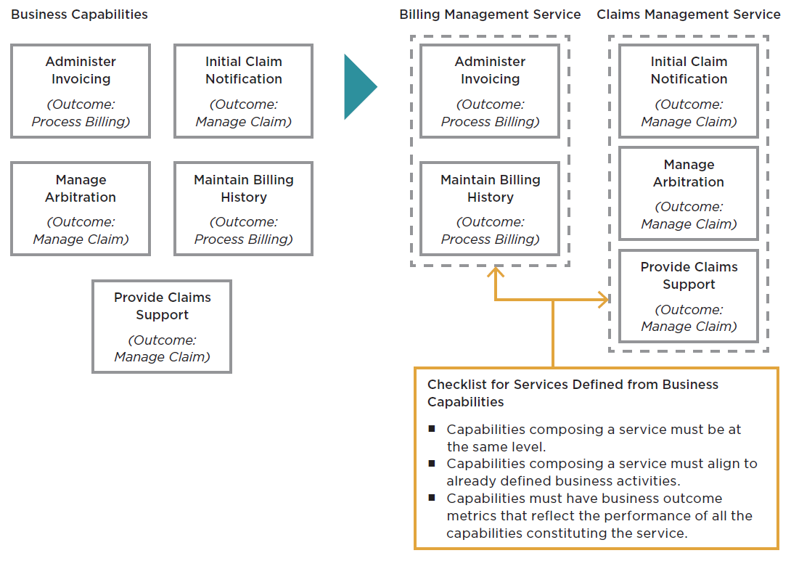
Create Outcome (Capability) Model
Service equates to a UML use case…
Note: Courtesy CIO Executive Board

Slide 7

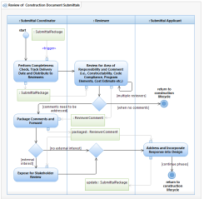
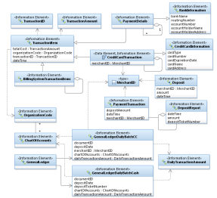
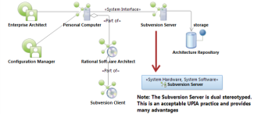
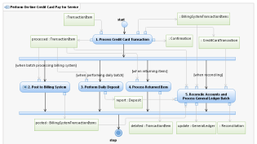
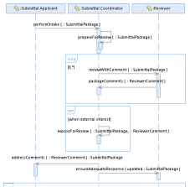
EA Identifies Common Elements
<<vision>>
Best managed city
<<capability>>
Managed Infrastructure
<<capability>>
Clean Water
<<capability>>
Equal Opportunities
<<capability>>
Healthy Economy
<<capability>>
Safe Public
Identify Common Capabilities
<<capability>>
Healthy Community
<<capability>>
Reliable Energy
<<capability>>
Mobile Community
Top Down – Bottom Up
Identify Common Goals!

Slide 8
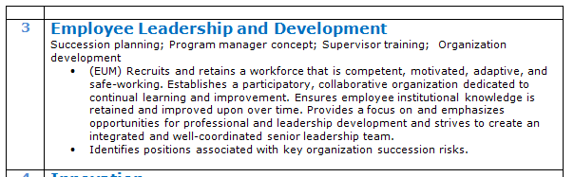

Connecting Business Needs to IT Solutions continued…
The Architect’s Viewpoint
Recruit and maintain a competent, motivated, adaptive, and safe workforce. Establish participatory, collaborative organization dedicated to learning and process improvement. Ensure institutionalization of retained knowledge. Emphasis professional and leadership development and integrate a well-coordinated leadership team.

Slide 9
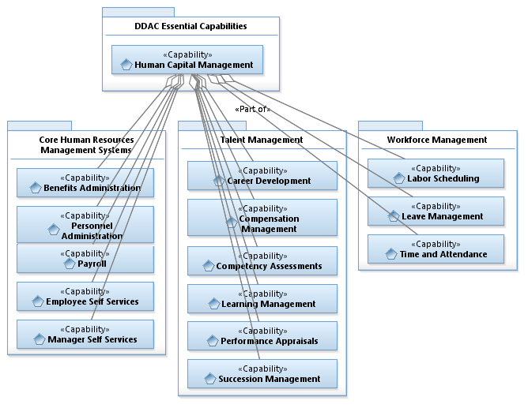
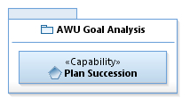
Connecting Business Needs to IT Solutions continued…
Reusable Opportunity!
<<Depends on>>

Slide 10

Connecting Business Needs to IT Solutions
The Architect’s Viewpoint
Employ innovative operational technology to support timely improvements.

Slide 11
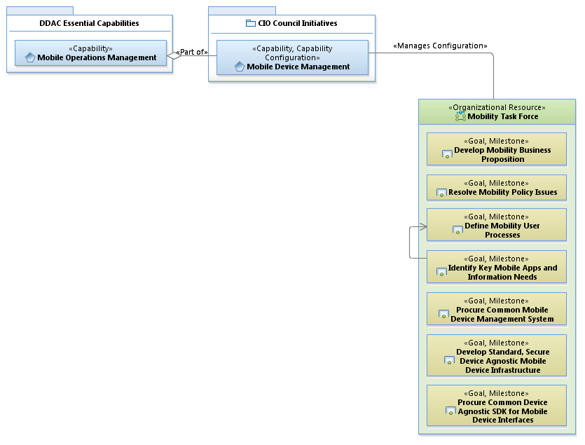
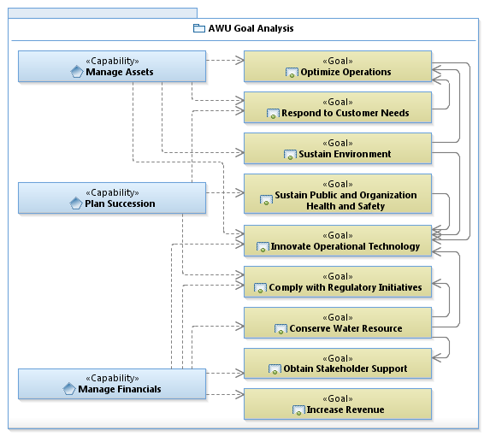
Connecting Business Needs to IT Solutions continued…

Slide 12
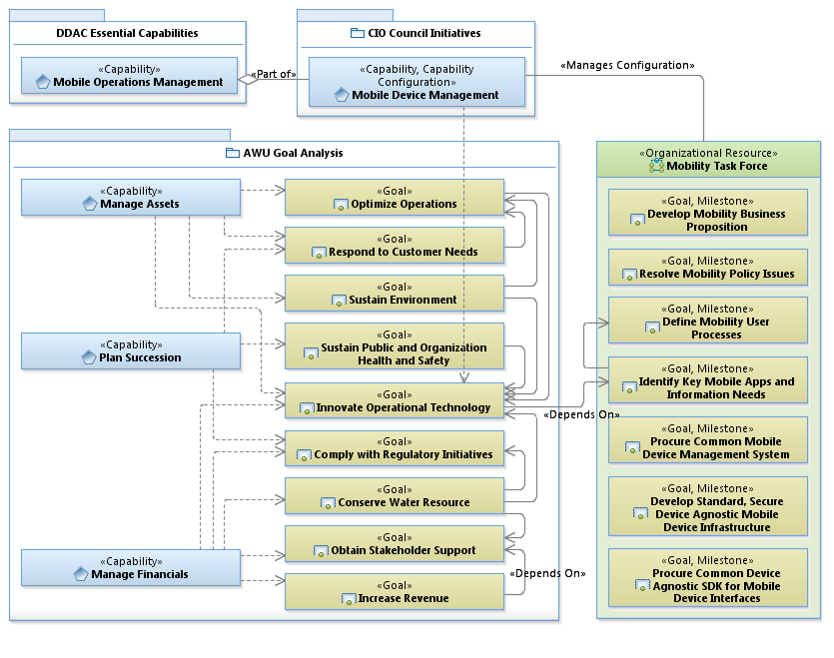
Connecting Business Needs to IT Driven Solutions continued…

Slide 13
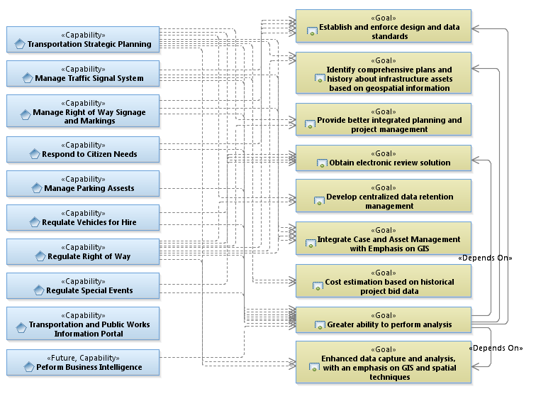
Goal setting… Concentration and Dependency Analysis
Has the greatest need
Provides the greatest solution
Significantly contributes to goal

Slide 14
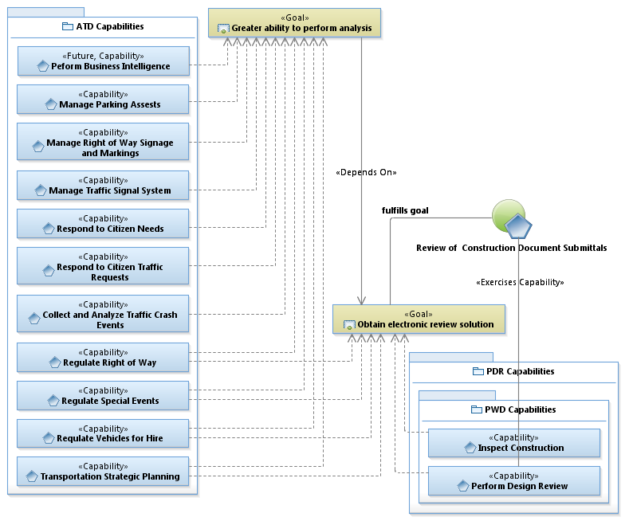
Example Engineering Management CAA
UML Use Case
(i.e., business process or service)

Slide 15
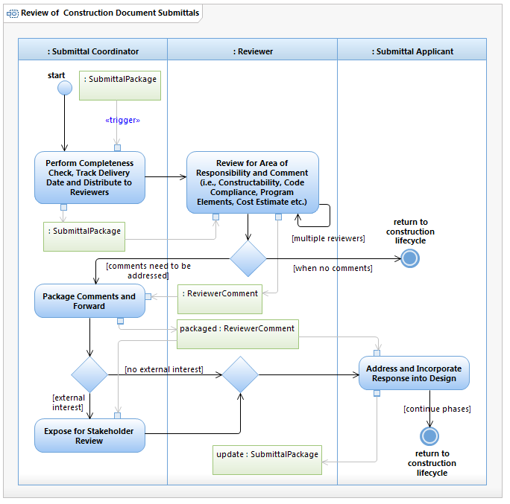
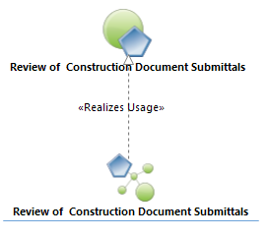
Use Case Realization
Defined Business Activity

Slide 16
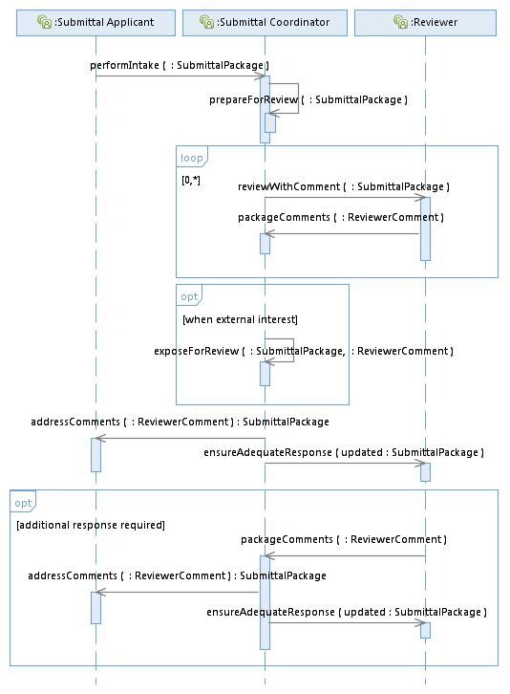
Interface Development
Arrow points to responsible entity
(not necessarily information flow)

Slide 17
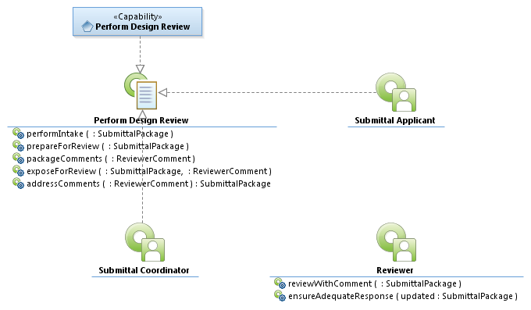
Interface Realization and Specification Development (example)
Makes service request

Slide 18
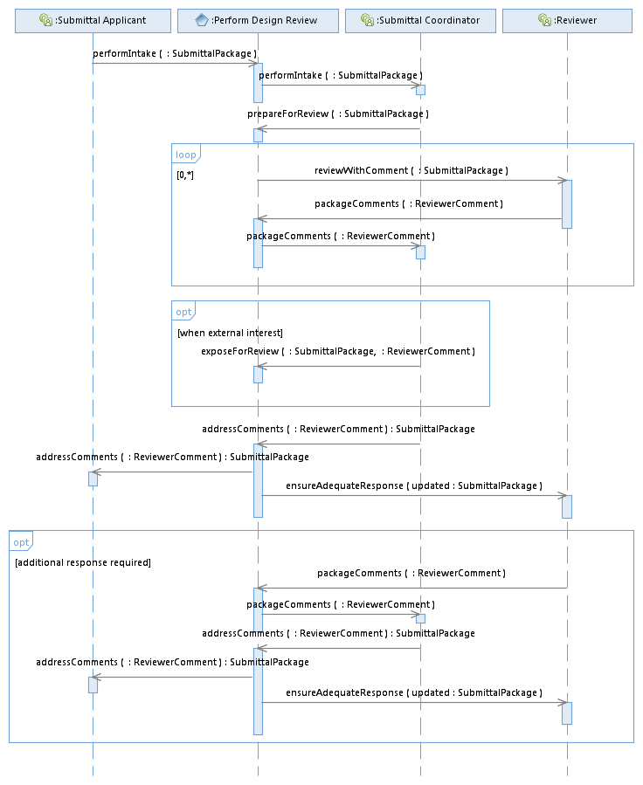
System Functional Requirements (example)
Identify Capability Interfaces

Slide 19
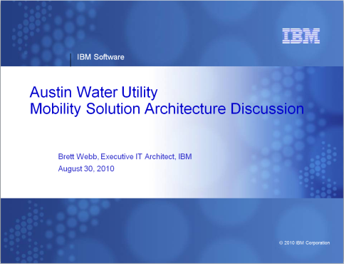
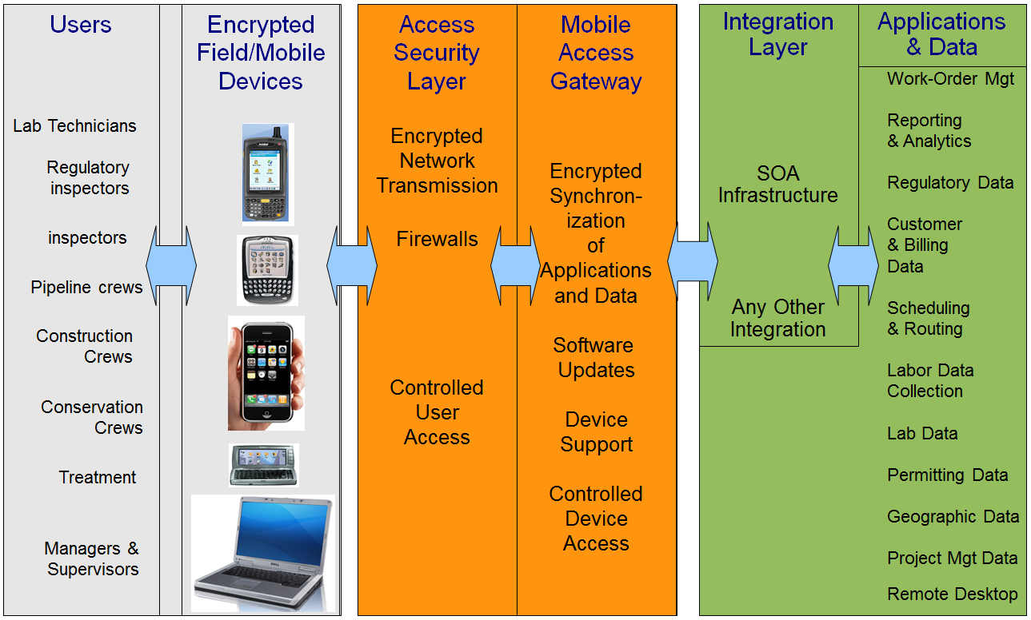
System Architecture

Slide 20
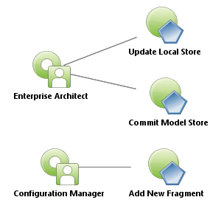
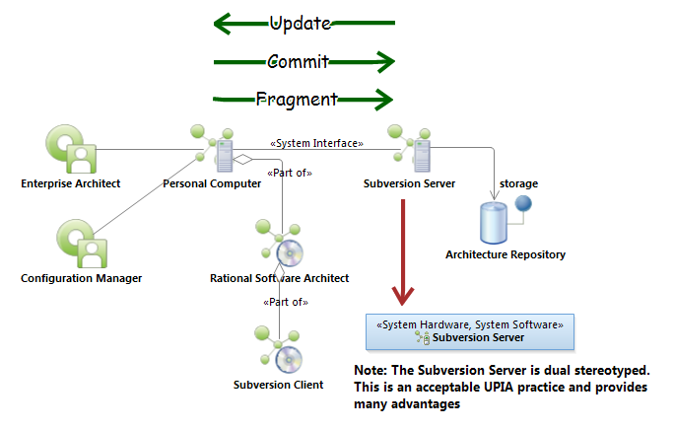
System Context Diagram (example)
<<Capability>>
Perform EA Configuration Management
Use Case Model
Hardware
component
Software component

Slide 21
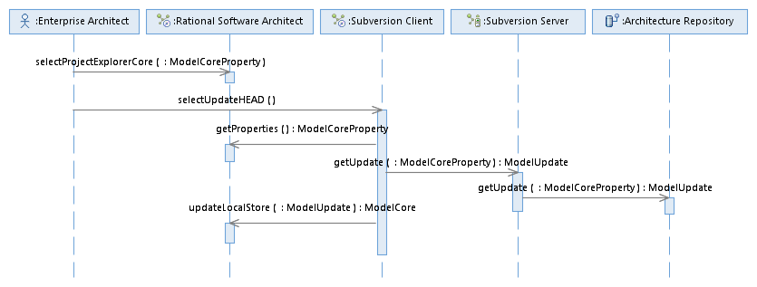
System Sequence Diagram (example)
<<Capability>>
Perform EA Configuration Management
Object
Update Local Store
Lifeline
Message
Signature
Focus of control

Slide 22
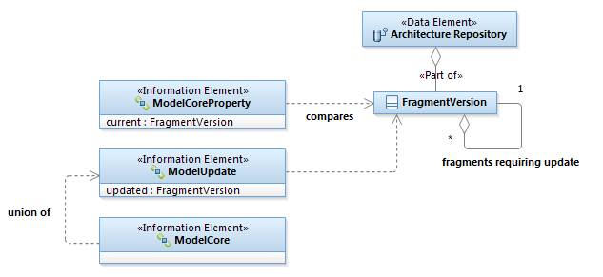
Logical Data Elements

Slide 23
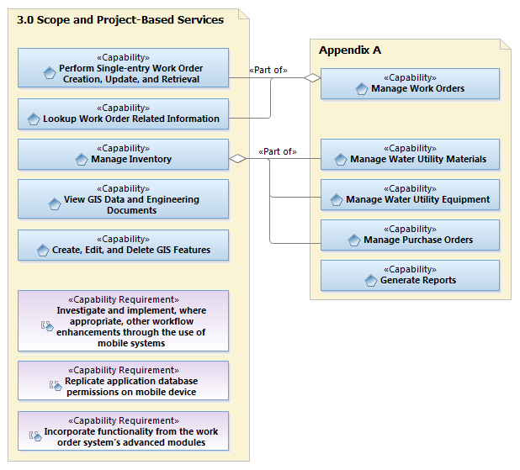
Current SOW Example
Next Steps:
Flush out capability model
Identify project goals and analyze results
Identify business use case(s) for pilot project

Slide 24
EA Provides Critical Mass of Understanding!
EA is an instrument to provide momentum
EA facilitates measureable goals and milestones useful for project planning
EA develops business requirements in an understandable way
EA deals with complexity
EA organizes information aligned with the business model to achieve business results

